Slide 1
Simulation of Indoor Millimeter-Wave Signal Received Power Using an Omnidirectional Antenna Pattern
Date: 2025-03-11
Authors:
Name | Affiliation | Address | Phone | Email
Ning Gao | OPPO |  |  | gaoning1@oppo.com
Dong Wei
Chuanfeng He
Liangxiao Xin
Chaoming Luo
Liuming Lu
Yapu Li
Ke Wang
Huixuan zhou
Yinan Qi
Weijie Xu

Slide 2
Introduction
Beamforming is essential to improving the data rate and coverage of Millimeter-Wave (mmWave) communication system, as mmWave signals experience much higher path loss compared with sub-7GHz frequencies.
However, beamforming introduces significant overhead and complexity due to multiple beamforming frames (e.g. SSW frames in 11ad/ay) and dedicated beamforming procedure.
It is suggested that IMMW should have less signaling overhead, less complexity, lower data rate, and shorter range compared with 11ad/11ay. ^{[1-4]}
An omni-directional antenna pattern mode without beamforming seems to be a new choice for IMMW, which is suitable for short-range communication like P2P sharing and small devices such as mobile phones.
In this contribution, we share some ray tracing simulation results of the Rx power of mmWave signals that are transmitted and received with omni-directional antenna pattern.

Slide 3
Simulation Parameters
Default Simulation Settings
Frequency: 60 GHz
Tx Power: 30 dBm
Tx Antenna: isotropic (an ideal omni-directional antenna that radiates uniformly in all directions)
Rx Antenna: isotropic
Location of the Tx Device: center of room ceiling
Surface Material: wood
Path Type: reflection path
Max Number of Reflections: 2
Simulation Target
Rx power of the signal

Slide 4
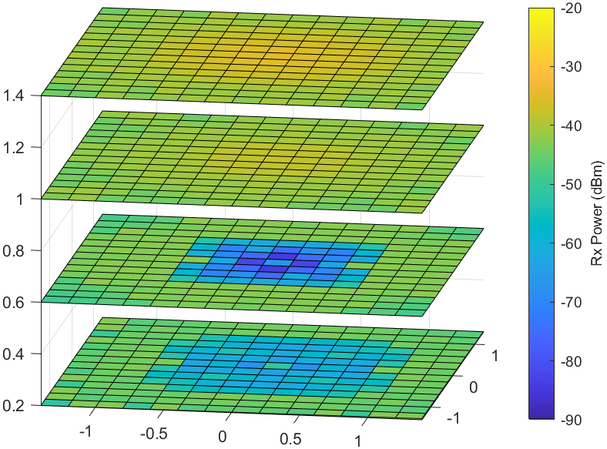
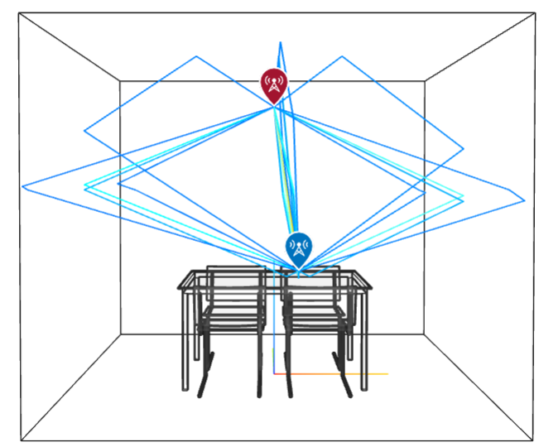
Rx Power in a Small Room
Small Room
Size: 3m×3m×2.5m
Examples: bedroom, small conference room
Rx Power Heatmap

Slide 5
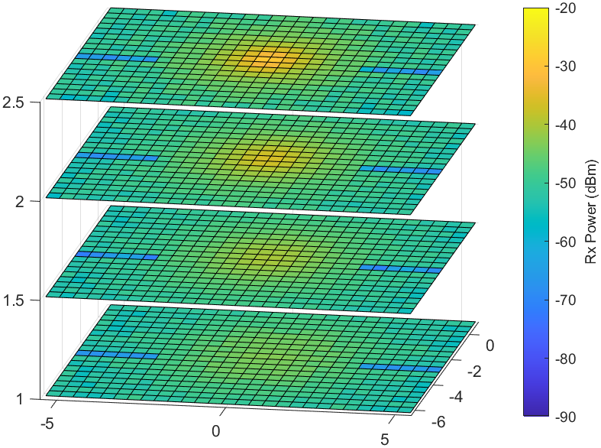
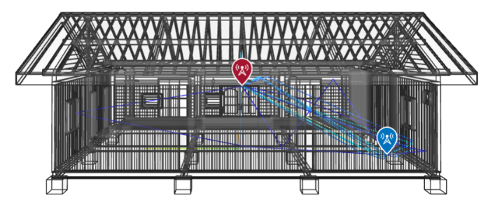
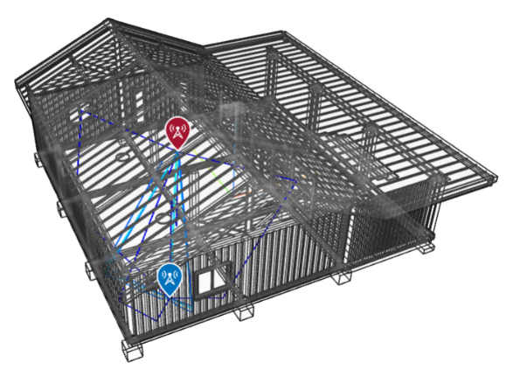
Rx Power in a Medium Room
Medium Room
Size: 12m×7m×2.5m
Examples: living room, class room
Rx Power Heatmap
pillars

Slide 6
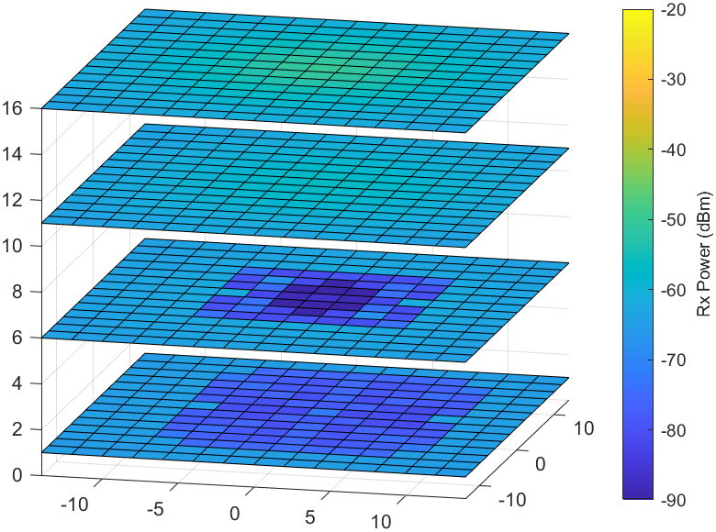
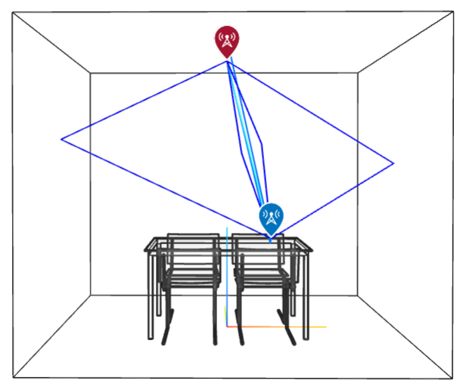
Rx Power in a Large Room
Large Room
Size: 30m×30m×25m
Examples: theater, music hall
Rx Power Heatmap
Note: this is a small room magnified 10 times

Slide 7
Comparison of Different Rooms
Small Room: 3m×3m×2.5m
Medium Room: 12m×7m×2.5m
Large Room: 30m×30m×25m
Distance | 1.6 m
LOS | Rx: -41.2 dBm
NLOS | Rx: -61.5 dBm
Distance | 5.5 m
LOS | Rx: -53.9 dBm
NLOS | Rx: -75.5 dBm
Distance | 18.4 m
LOS | Rx: -62.0 dBm
NLOS | Rx: -80.8 dBm
Observation:
In small rooms, Rx power is good in most locations, regardless of LOS or NLOS;
In medium and large rooms, Rx power is good for LOS, but poor for NLOS;

Slide 8
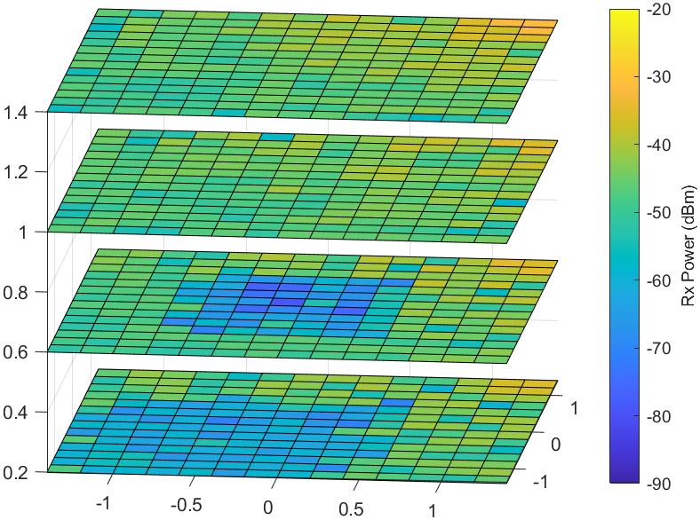
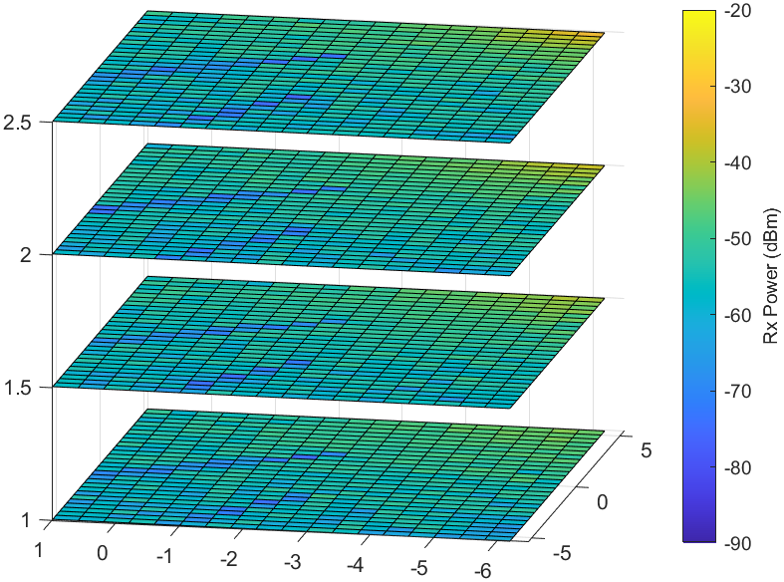
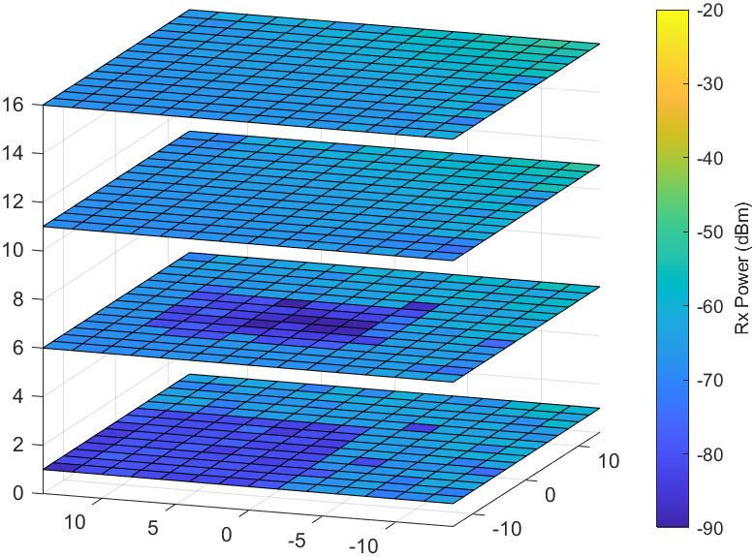
Comparison of different Location of the Tx Device
Small Room: 3m×3m×2.5m
Medium Room: 12m×7m×2.5m
Large Room: 30m×30m×25m
Center of
Room Ceiling
Corner of
Room Ceiling
Observation:
Ceiling center deployment is better than ceiling corner deployment

Slide 9
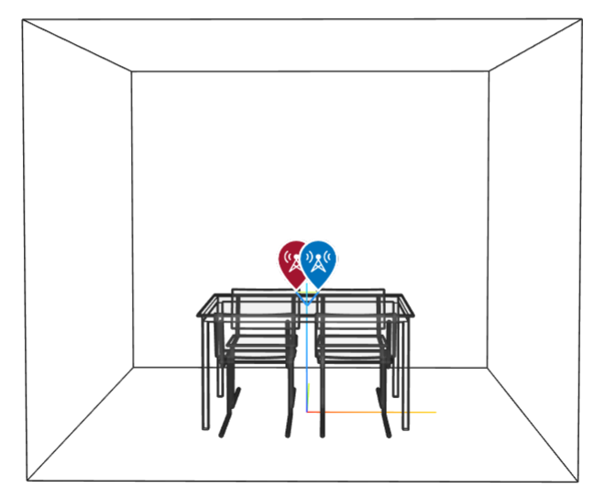
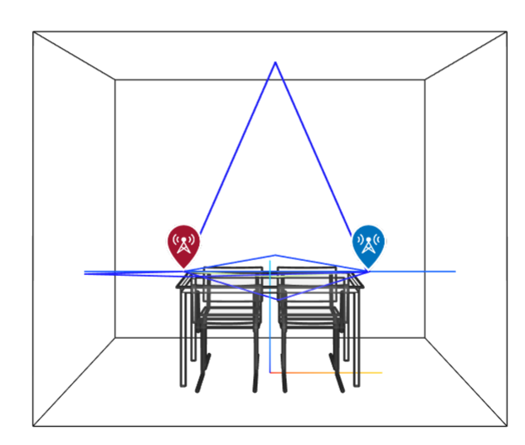
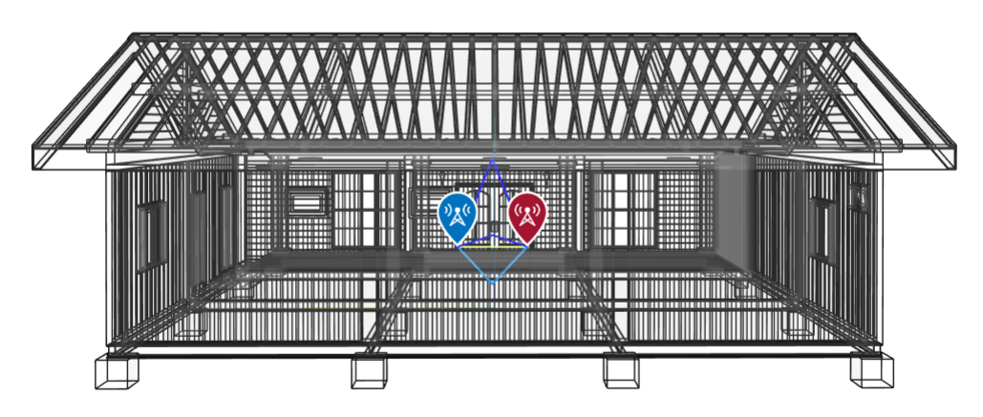
Close Distance between Tx and Rx in Different Rooms
Small Room: 3m×3m×2.5m
Medium Room: 12m×7m×2.5m
Large Room: 30m×30m×25m
Distance | 1.5 m
LOS | Rx: -41.1 dBm
NLOS | Rx: -53.6 dBm
Distance | 1.5 m
LOS | Rx: -42.2 dBm
NLOS | Rx: -68.0 dBm
Distance | 1.5 m
LOS | Rx: -41.5 dBm
NLOS | Rx: -74.2 dBm
-12.5
-25.8
-32.7
Observation:
When the Tx device and Rx device are close:
for LOS channel, the Rx power is good regardless of the size of the room
for NLOS channel, the larger the room, the worse the Rx power

Slide 10
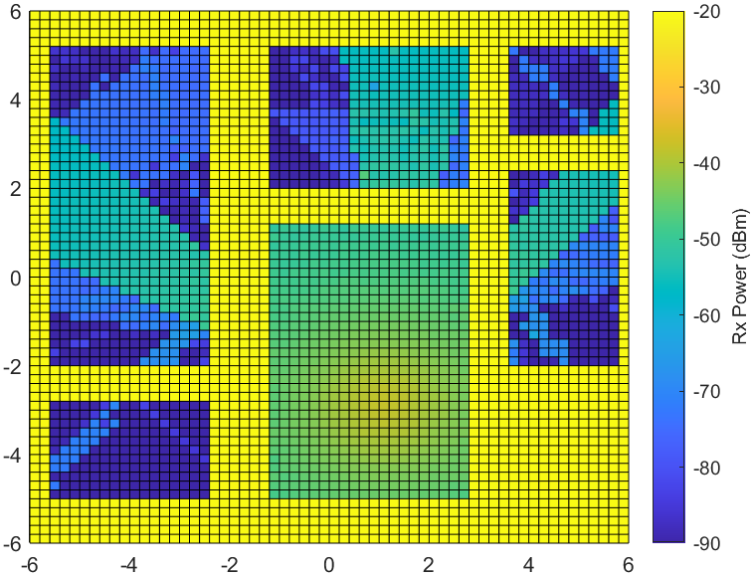
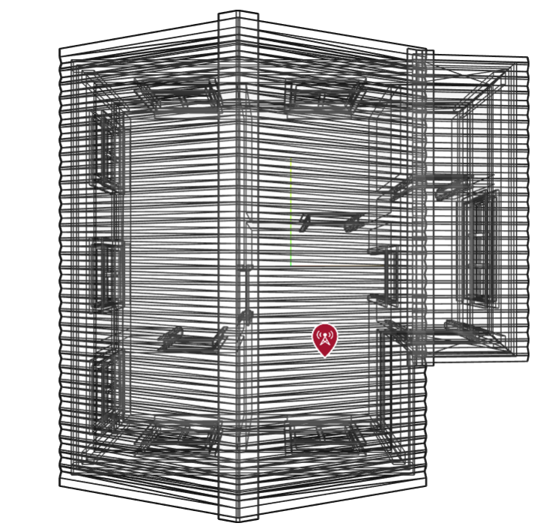
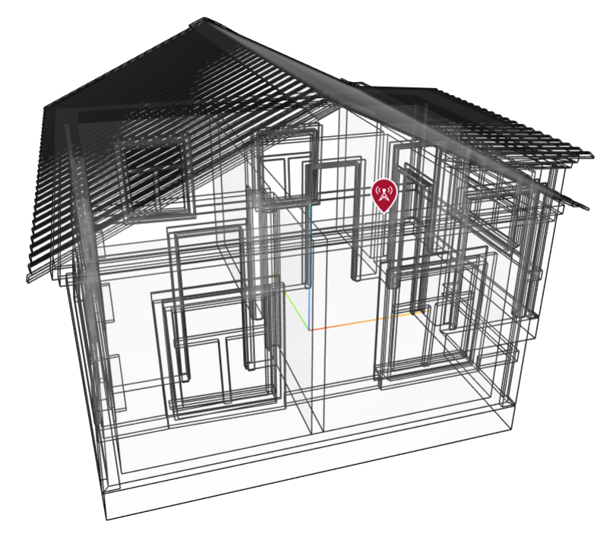
Rx Power in Adjacent Rooms
A House with 6 Rooms
Size: 12m×12m×5m
Max Num Reflection: 10
Rx Power Heatmap
Non-simulation Area
Observation:
If the door is open, the Rx power in some parts of adjacent rooms is good, while the Rx power in other parts is very poor.

Slide 11
Comparison of Different Surface Materials
Room Size | Surface Material | LOS | NLOS
Small Room 3m×3m×2.5m | Wood | Rx: -45.3 dBm | Rx: -61.1 dBm
 | Plasterboard | Rx: -44.2 dBm | Rx: -57.0 dBm
 | Concrete | Rx: -42.3 dBm | Rx: -52.6 dBm
Medium Room 12m×7m×3.5m | Wood | Rx: -57.6 dBm | Rx: -77.5 dBm
 | Plasterboard | Rx: -56.8 dBm | Rx: -73.6 dBm
 | Concrete | Rx: -55.2 dBm | Rx: -69.3 dBm
Large Room 30m×30m×25m | Wood | Rx: -63.4 dBm | Rx: -81.7 dBm
 | Plasterboard | Rx: -63.0 dBm | Rx: -77.7 dBm
 | Concrete | Rx: -62.5 dBm | Rx: -73.8 dBm
+1.1
+4.1
+3.0
+8.5
+0.8
+3.9
+2.4
+8.2
+0.4
+4.0
+0.9
+7.9
Observation:
The surface material has a significant impact on Rx power in NLOS channels, but has little impact in LOS channels.

Slide 12
Summary
Simulation results demonstrate that under an omni-directional antenna pattern and a 30 dBm Tx power configuration :
The Rx power is good in a small room for both LOS and NLOS, and good in a medium or a large room only for LOS;
The Rx power is also good in a LOS channel where the Tx device and Rx device are close to each other, regardless of the size of the room;
The Rx power can be affected by deployment location and surface materials.
However, the Rx power is just a basic requirement for mmWave communication, we also need to take SNR, Phase Noise, EVM, and PER into consideration before reaching a conclusion.
If feasible, with the help of MLO, the omni-directional antenna pattern could be an option for IMMW apart from the quasi-omnidirectional and the directional antenna patterns defined in 11ad/ay.

Slide 13
Reference
[1] 11-23-1905-00-immw-high-level-thoughts-on-immw
[2] 11-23-1819-01-immw-integrated-mmwave-design-considerations
[3] 11-23-1968-00-immw-discussion-on-general-direction-of-integrated-mmwave
[4] 11-23-2004-00-immw-technical-scope-proposal

