Slide 1
Multi-Purpose AID for Different Feedback Information in Multi-STA BlockAck
Date: 2025-01-11
Authors:

Slide 2
Abstract
There are proposals in TGbn to use special AID values for different UHR features, e.g.,
  Multi-STA BlockAck for unavailability report, link adaptation feedback, BSR
  Common Info/User Info of Trigger frame for I-FCS, MIC, DPS, DUO, ELR
Proposal: a multi-purpose AID value to indicate multiple features
  Allow including multiple features in a single field/frame with a single AID value
Example:
  A Multi-STA BlockAck frame contains multiple Per AID TID Info fields
  Each Per AID TID Info field contains the same AID11 value and different TID values (or other Control Info/Feedback Type fields) to indicate different feedback information

Slide 3
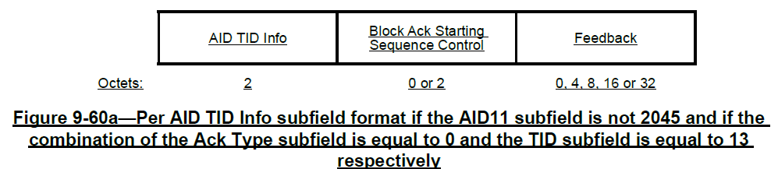
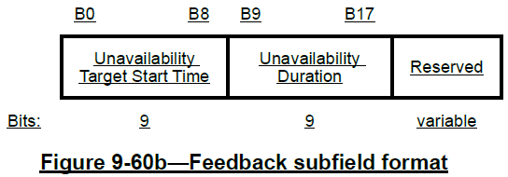
Background: Feedback Context of Multi-STA BlockAck
“A value of 2008 in the AID11 subfield is used to identify a Per AID TID Info field that carries feedback (see 37.11.2 (Dynamic Unavailability Operation (DUO) mode)) that applies to all receiving UHR STAs.” [1]
“If the AID11 subfield of the AID TID Info subfield is not 2045, and if the Ack Type subfield is equal to 0 and the TID subfield is equal to 13 then the Per AID TID Info subfield has the format shown in Figure 9-60a” [1]
Ack Type subfield equal to 0 and the TID subfield equal to 13

Slide 4
Different Feedback Information in Multi-STA BlockAck
There proposals to include different information in multi-STA BlockAck, e.g.,
  DUO
  BSR
  Link adaptation
  …
Benefits for different feedback information in the same Multi-STA BlockAck:
  More accurate information about the current status of the AP/STA
  More efficient signaling of different feedback information in a single frame
  Supports multiple features at the same time

Slide 5
Different Feedback Information in Multi-STA BlockAck: Options
Option 1: different AID values, in separate Per AID TID Info fields or in separate multi-STA BlockAck frames
Option 2: same AID value, in separate Per AID TID Info fields
  AID11: the AID of a UHR STA for unicast, or a special value, e.g., 2008, for broadcast.
  Different feedback information indicated by different TID field values.
  Preferred option, with good balance of low complexity/overhead and high flexibility
Option 3: same AID value, in the same Per AID TID Info field
  Differentiate by different TID field values and/or different Fragment Number field values
Per AID TID Info
AID TID Info |  |  | Feedback
AID11 | Ack Type | TID | Block Ack Starting Sequence Control | DUO Info
Per AID TID Info
AID TID Info |  |  | Feedback
AID11 | Ack Type | TID | Block Ack Starting Sequence Control | BSR
Per AID TID Info
AID TID Info |  |  | Feedback
AID11 | Ack Type | TID | Block Ack Starting Sequence Control | Link Adaptation Info
…

Slide 6
Different Feedback Information in Multi-STA BlockAck: More Details on Option 2
Option 2: same AID value, in separate Per AID TID Info fields
  AID11: the AID of a UHR STA for unicast, or a special value, e.g., 2008, for broadcast.
  Different feedback information indicated by different TID values, or by other fields, e.g.,
    Fragment Number field
    or new defined Control Info/Feedback Type field.
Per AID TID Info
AID TID Info |  |  | Feedback
AID11 | Ack Type | TID | Block Ack Starting Sequence Control | DUO Info
Per AID TID Info
AID TID Info |  |  | Feedback
AID11 | Ack Type | TID | Block Ack Starting Sequence Control | BSR
Per AID TID Info
AID TID Info |  |  | Feedback
AID11 | Ack Type | TID | Block Ack Starting Sequence Control | Link Adaptation Info
…
Control Info/Feedback Type
Control Info/Feedback Type
Control Info/Feedback Type

Slide 7
Conclusion
This contribution presents multi-purpose AID to indicate the information of multiple features in the same frame/field.
It can be used to include different feedback information in the same Multi-STA BlockAck frame.
  The Multi-STA BlockAck frame contains multiple Per AID TID Info fields
  Each Per AID TID Info field contains the same AID11 value and different TID values to indicate different feedback information
  Optionally may reuse existing fields (e.g., Fragment Number field) or define new Control Info/Feedback Type field to indicate different feature combinations

Slide 8
References
[1] IEEE P802.11bn/D0.1, January 2025

