Slide 1
Channelization in IMMW
Date: 2025-3-9
Authors:

Slide 2
Introduction
The IMMW PHY is proposed to leverage sub-7GHz PHY design[1].
In [2], high level design for IMMW channelization is proposed
  Align or not align with 11ay.
  Overlapping or non-overlapping channels.
In this presentation, we will share more details on IMMW channelization and BW design.

Slide 3
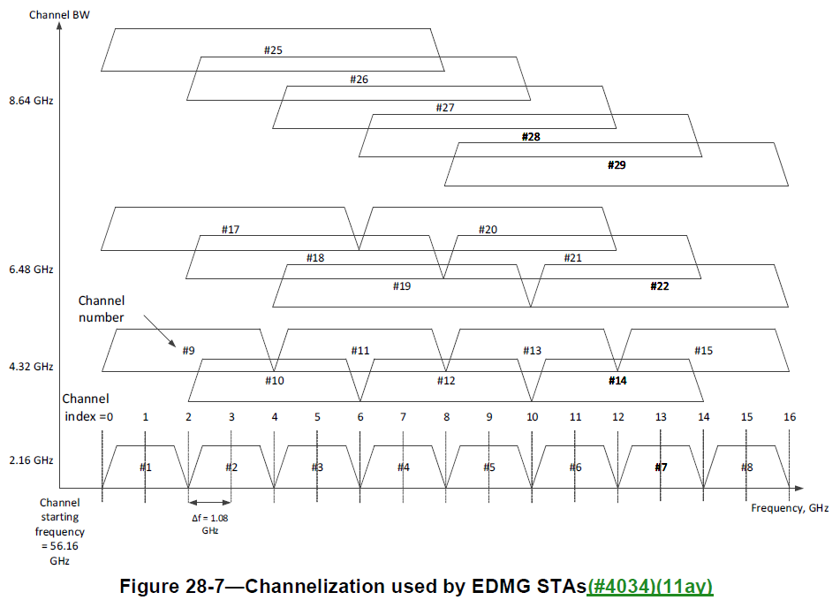
Recap: 11ay
There are totally 8 channels with BW=2.16GHz.
  Larger BWs consists of 2, 3 or 4 consecutive 2.16GHz channels.
We can use 8*2.16GHz=17.28GHz BW to do channelization for IMMW.

Slide 4
IMMW Channelization proposal
Channels are non-overlapped
  Based on the available mmW frequency band of 11ay, we can define enough channels
  Avoid complex signaling design
No channel aggregation, such as 320+320 MHz
  Similar design has been abandoned since EHT

Slide 5
IMMW Channelization Example
An example with minimum BW_{min}=320MHz.
The channel center frequency is defined as an integer multiple of BW_{min}/2=160MHz.
  320MHz channel number is 1, 3, 5,…, 105, 107.
  640MHz channel number is 2, 6, 10,…, 102, 106.
  1280MHz (if any) channel number is 4, 12, 20, 28,…, 84, 92, 100.
Channel center frequency = Channel starting frequency + 0.16*n_{ch} (GHz)
Where n_{ch} is channel number, and equals to 1, 2, 3,…, 108.

Slide 6
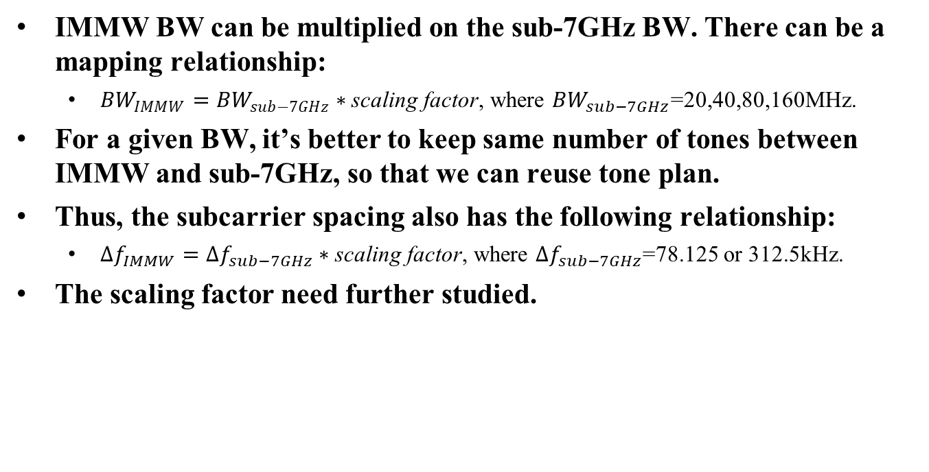
Bandwidth Proposal
IMMW BW can be multiplied on the sub-7GHz BW. There can be a mapping relationship:
  ${BW}_{IMMW}={BW}_{sub−7GHz}∗\text{scaling} \text{factor}$, where ${BW}_{sub−7GHz}$=20,40,80,160MHz.
For a given BW, it’s better to keep same number of tones between IMMW and sub-7GHz, so that we can reuse tone plan.
Thus, the subcarrier spacing also has the following relationship:
  $∆f_{IMMW}=∆f_{sub−7GHz}∗\text{scaling} \text{factor}$, where $∆f_{sub−7GHz}$=78.125 or 312.5kHz.
The scaling factor need further studied.

Slide 7
Summary
We propose IMMW channels are non-overlapped and non- aggregation.
  Low complexity for signaling and implementation.
The channel center frequency is defined as an integer multiple of BW_{min}/2.
  This definition provides a unique numbering system for all channels.
  It’s flexible to define channelization sets for next generation IMMW.
Based on sub-7GHz, we can use same scaling factor to design IMMW BW and IMMW subcarrier spacing.

Slide 8
SP 1
Do you agree to add the following into 11bq SFD?
  IMMW channels are non-overlapped and non-aggregation.
    Y
    N
    A

Slide 9
SP 2
Do you agree to add the following into 11bq SFD?
  The IMMW channel center frequency is defined as an integer multiple of BW_{min}/2.
  Note: The BW_{min} is TBD
    Y
    N
    A

Slide 10
References
[1] P802.11bq_PAR
[2] 11-23-1878-01-immw-high-level-design-considerations-of-immw

