Slide 1
Issue on ELR PPDU Length Indication
Date: 2025-3-7
Authors:

Slide 2
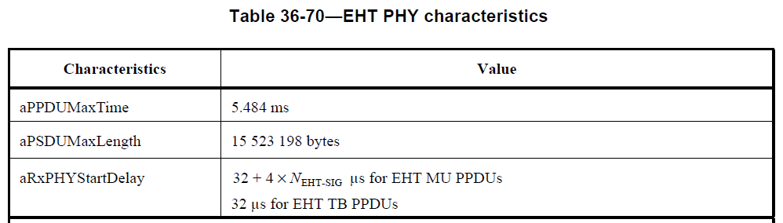
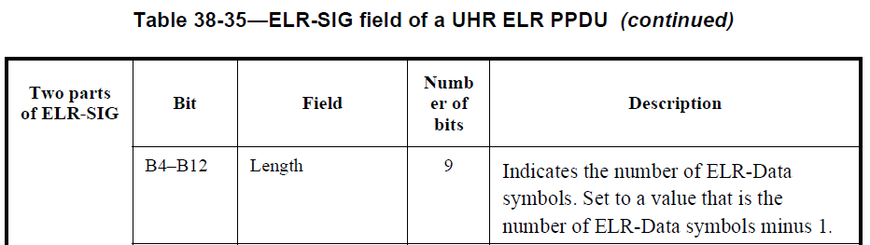
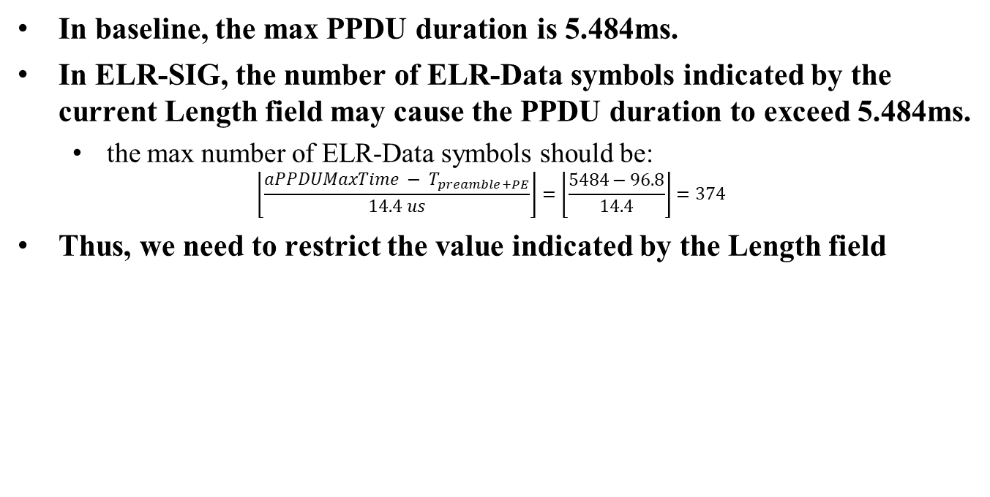
Problem
In baseline, the max PPDU duration is 5.484ms.
In ELR-SIG, the number of ELR-Data symbols indicated by the current Length field may cause the PPDU duration to exceed 5.484ms.
  the max number of ELR-Data symbols should be:
$$\left\lfloor \frac{aPPDUMaxTime − T_{preamble+PE}}{14.4 us}\right\rfloor =\left\lfloor \frac{5484−96.8}{14.4}\right\rfloor =374$$
Thus, we need to restrict the value indicated by the Length field

Slide 3
Proposal
We can add the following note in the description of Length field in ELR-SIG-1.
Two parts of ELR-SIG | Bit | Field | Number of bits | Description
ELR-SIG-1 | B4-B12 | Length | 9 | Indicates the number of ELR-Data symbols. Set to a value that is the number of ELR-Data symbols minus 1. Note: Any Length selection that results in a number of ELR-Data symbols that is larger than 374 symbols is not allowed.

Slide 4
SP
Do you support the following text add in ELR-SIG Length field in 802.11bn?
  Any Length selection that results in a number of ELR-Data symbols that is larger than 374 symbols is not allowed.

Slide 5
References
[1] Draft P802.11be_D7.0
[2] Draft P802.11bn_D0.1

