Slide 1
Open Topics for DRU on 60MHz
Date: 2025-03-08
Authors:
Name | Affiliations | Address | Phone | Email
Shengquan Hu | Mediatek | 2840 Junction Ave. San Jose, CA, 95134 |  | Shengquan.hu@mediatek.com
Jianhan Liu |  |  |  | Jianhan.liu@mediatek.com
Thomas Pare

Slide 2
Introduction
The following SPs & motions have been passed for DRU on DBW60:
  Tone plan
  Pilot tone index
  Signaling
In this contribution, we will discuss the following open topics:
  DRU UHR-STF transmission for DBW60
  Global CSD start index assignment for DBW60
  Constant shift value for 60MHz DRU on frequency subblock of wide BW
  RU Allocation subfield design for DBW60

Slide 3
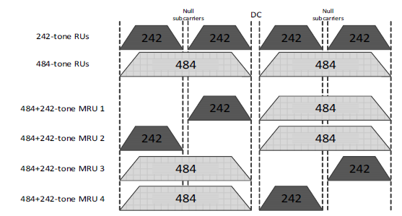
DRU UHR-STF Transmission for DBW60
RECAP: DRU UHR-STF transmission for DBW20/40/80 in [1]:
  The same UHR-STF sequences are used in UHR TB PPDUs for both UHR DRU and UHR RRU.
  The PPDU BW determines which UHR-STF sequence is used
  For a DRU with a given DBW, the occupied STFs tones are the same as that of the largest RRU corresponding to the distribution BW within the PPDU BW
Propose: DRU UHR-STF transmission for DBW60:
  Follow the same methodology as for DBW20/40/80
  For DBW60, the occupied STFs tones are the same as that of the largest RRU/MRU (i.e. 484+242) corresponding to the distribution BW 60MHz within the PPDU BW
DBW60

Slide 4
Performance of Power Measurement for DBW60
3 DRU242 on DBW60, 1ss, D-NLOS
Random phase and random delay [-0.4,+0.4]us from each STA
Comparing to use all the STF tones within DBW60, using the range of MRU(484+242) has two STF tones less, however, it achieves almost same power measurement accuracy as using all the STF tones in range of [-500:253]

Slide 5
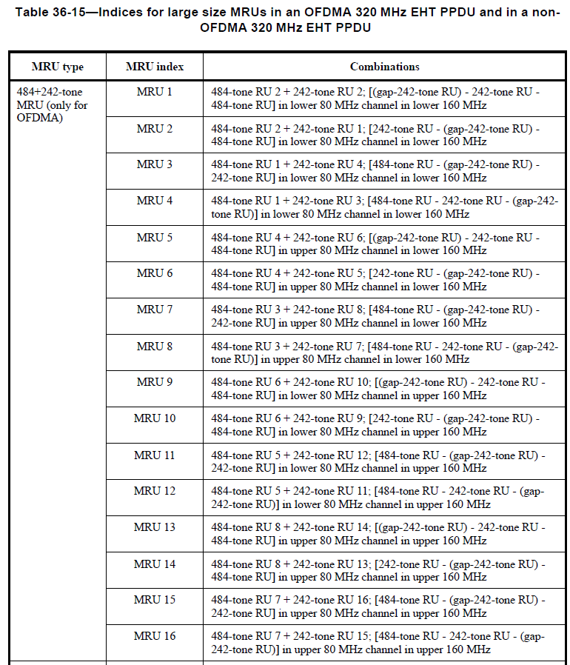
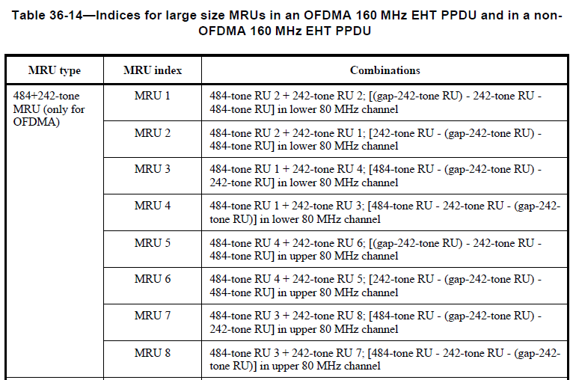
60MHz DRU UHR-STF for 160/320 PPDU BW
160/320MHz UHR-STF sequence is used for 60MHz DRU in frequency subblock of BW160/320, respectively
The occupied STF tones are the same as that of MRU(484+242) corresponding to the DBW60 within 160/320MHz
60MHz DRU in freq. subblock of 320MHz PPDU
60MHz DRU in freq. subblock of 160MHz PPDU

Slide 6
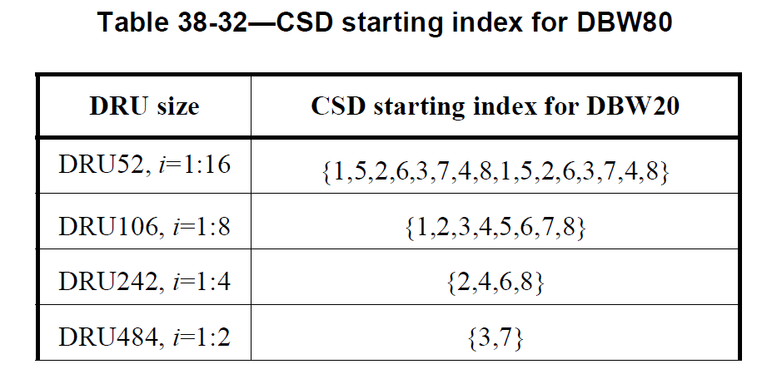
Recap: CSD Starting Index Assignment for DRU on 80MHz
DRU index based CSD start index assignment is defined for DBW20/40/80 in [1]
CSD starting index assignment for DBW80 is defined as below
DRU52
1 | 5 | 2 | 6 | 3 | 7 | 4 | 8 | 1 | 5 | 2 | 6 | 3 | 7 | 4 | 8
1 |  | 2 |  | 3 |  | 4 |  | 5 |  | 6 |  | 7 |  | 8
2 |  |  |  | 4 |  |  |  | 6 |  |  |  | 8
3 |  |  |  |  |  |  |  | 7
DRU106
DRU242
DRU484

Slide 7
Proposal of CSD Starting Index Assignment for DRU on 60MHz
Reuse the DBW80 CSD start index assignment without change
CSD start index for DRU52/106/242 on DBW60 corresponds to the first 60MHz portion of 80MHz
Simpler, implementation friendly and achieve similar power measurement performance as Ref [2]
Share the same table as DBW80, no need extra memory for DBW60 CSD table in implementation
For 80MHz
Corresponding to 1st 60MHz portion for DBW60
DRU52
1 | 5 | 2 | 6 | 3 | 7 | 4 | 8 | 1 | 5 | 2 | 6 | 3 | 7 | 4 | 8
1 |  | 2 |  | 3 |  | 4 |  | 5 |  | 6 |  | 7 |  | 8
2 |  |  |  | 4 |  |  |  | 6 |  |  |  | 8
3 |  |  |  |  |  |  |  | 7
DRU106
DRU242
DRU size | CSD starting index for DBW60
DRU52, i=1:12 | {1,5,2,6,3,7,4,8,1,5,2,6}
DRU106, i=1:6 | {1,2,3,4,5,6}
DRU242, i=1:3 | {2,4,6}

Slide 8
Comparison of DRU CSD Start Index Assignment Design Options
Contribution [2] proposed to modify the DBW80 CSD starting index table for DRU52 to reduce some CSD collisions:
DRU size | CSD starting index for DBW60
DRU52, i=1:12 | {1,5,2,6,3,7,4,8,1,5,2,6}
DRU106, i=1:6 | { 1, 2, 3, 4, 5, 6}
DRU242, i=1:3 | { 2, 4, 6}
DRU size | CSD starting index for DBW60
DRU52, i=1:12 | {1,5,2,6,3,7,4,8,7,5,8,6}
DRU106, i=1:6 | { 1, 2, 3, 4, 5, 6}
DRU242, i=1:3 | { 2, 4, 6}
Reused
Modified
However, our simulations show that both reused CSD index assignment and modified CSD index assignment achieve almost same power measurement accuracy
Following is an example of DRU allocation for power measurement accuracy comparison in the simulations:
DRU CSD Start Index Assignment
DRU Allocation (logically) for 4xDRU106+4xDRU52
DRU52 | 1 | 5 | 2 | 6 | 3 | 7 | 4 | 8 | 1 | 5 | 2 | 6
DRU106 | 1 |  | 2 |  | 3 |  | 4 |  | 5 |  | 6
DRU242 | 2 |  |  |  | 4 |  |  |  | 6
Reused assignment
52 | 52 | 52 | 52 | 52 | 52 | 52 | 52 | 52 | 52 | 52 | 52 | 52 | 52 | 52 | 52
106 |  | 106 |  | 106 |  | 106 |  | 106 |  | 106 |  | 106 |  | 106
242 |  |  |  | 242 |  |  |  | 242 |  |  |  | 242
(with CSD collision for 1ss & 2ss)
modified [2]
DRU52 | 1 | 5 | 2 | 6 | 3 | 7 | 4 | 8 | 7 | 5 | 8 | 6
DRU106 | 1 |  | 2 |  | 3 |  | 4 |  | 5 |  | 6
DRU242 | 2 |  |  |  | 4 |  |  |  | 6
In 1st 60MHz
(no CSD collision for 1ss, with collision for 2ss)

Slide 9
Performance Comparison of Power Measurement Accuracy
DBW60, D-NLOS
4 DRU106 and 4 DRU52
1ss & 2ss
Random phase and random delay [-0.4,+0.4]us from each STA
Observation:
  Reused & modified CSD start index assignments achieve similar power measurement accuracy
  Both achieves compatible power measurement accuracy as MU-MIMO on RRU
1ss
2ss

Slide 10
Performance Comparison of Power Measurement Accuracy
DBW60, D-NLOS
12xDRU52, 2ss (could be considered as worst case)
Random phase and random delay [-0.4,+0.4]us from each STA
Observation:
  Reused & modified CSD start index assignments achieve similar power measurement accuracy, couldn’t see the notable benefit of modified CSD start index assignment

Slide 11
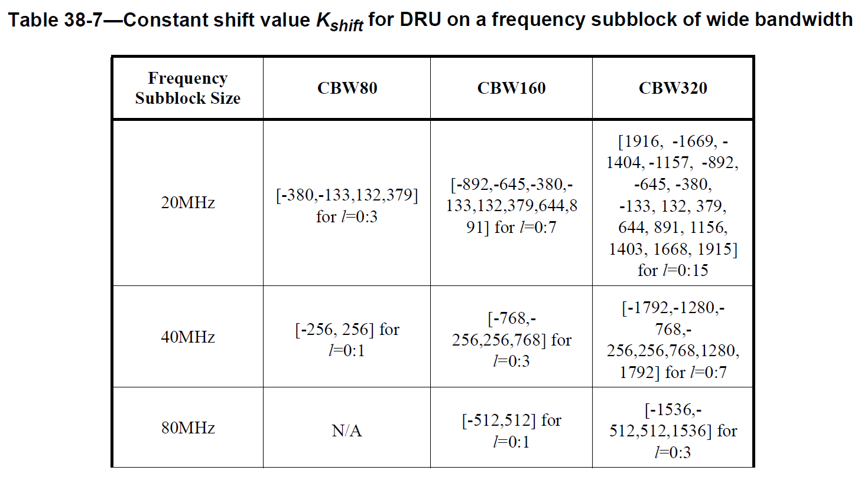
Constant Shift Value for 60MHz DRU on a Frequency Subblock of Wide BW
RECAP: For DBW20/40/80, when a DRU is distributed over a frequency subblock of wider BW PPDU, the DRU subcarrier indices are defined as below [1]:
K_{shift}(l) is the constant shift value for the l-th frequency subblock of 20/40/80 MHz within CBW80/160/320
Propose for DBW60: reuse the DBW80 constant shift values
Example Illustration of 60MHz DRU in CBW160
-1012
12
1st 80MHz
2nd 80MHz
60MHz,
-500
DBW60
500
80MHz RRU996 range
Since DBW60 can be considered as 60MHz subblock within 80MHz with the highest 20MHz unallocated, thus, we propose to reuse the DBW80 constant shift values

Slide 12
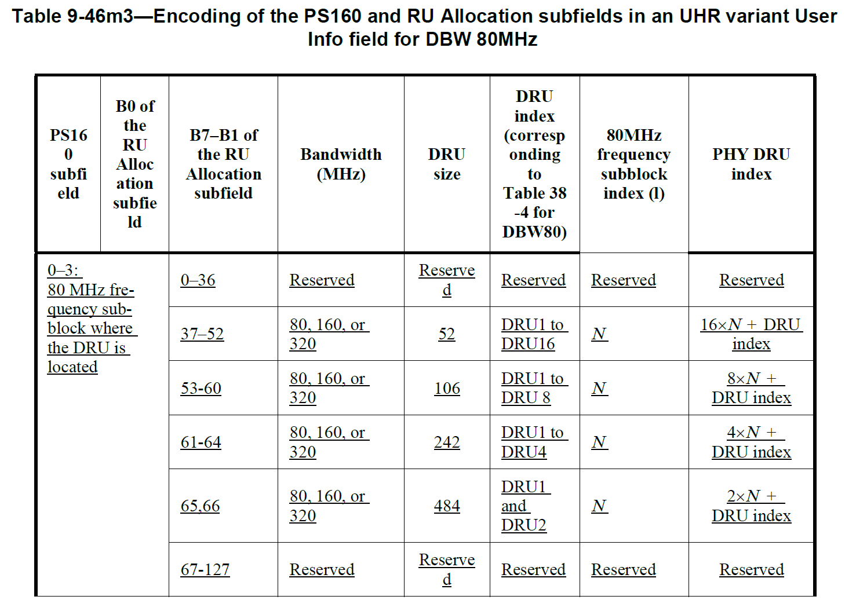
Recap: RU Allocation Subfield for DBW80
The mapping of DRU index (correspond to DRU tone plan table for DBW20/40/80) to PHY DRU index is defined in [1] for DBW20/40/80
The RU Allocation subfield for DBW80 is defined as below [1]:

Slide 13
Proposal of RU Allocation Subfield for DBW60
DBW60 DRU RU Allocation preserves the same hierarchical structure as DBW80 except that the DRUs corresponding to the highest 20MHz (logically) are not used. The following illustrates an example of PHY DRU index for DBW60 in CBW160:
(1st 80MHz, N=0)
(2nd 80MHz, N=1)
DRU52 | 1 | 2 | 3 | 4 | 5 | 6 | 7 | 8 | 9 | 10 | 11 | 12 | 13 | 14 | 15 | 16 | 17 | 18 | 19 | 20 | 21 | 22 | 23 | 24 | 25 | 26 | 27 | 28 | 29 | 30 | 31 | 32
DRU106 | 1 |  | 2 |  | 3 |  | 4 |  | 5 |  | 6 |  | 7 |  | 8 |  | 9 |  | 10 |  | 11 |  | 12 |  | 13 |  | 14 |  | 15 |  | 16
DRU242 | 1 |  |  |  | 2 |  |  |  | 3 |  |  |  | 4 |  |  |  | 5 |  |  |  | 6 |  |  |  | 7 |  |  |  | 8
DRU index
PHY DRU index
DBW60 RU Allocation Subfield can be defined as below with minor modifications from DBW80 in [1]:
Encoding of the PS160 and RU Allocation subfields in an UHR variant User Info field for DBW 60MHz
PS160 subfield | B0 of the RU Allocation subfield | B7-B1 of the RU Allocation subfield | Bandwidth (MHz) | DRU Size | DRU index (corresponding to DBW60 tone plan Table) | 80MHz frequency subblock index (l) | PHY DRU index
0-3: 80 MHz frequency subblock where the DRU is located |  | 0-36 | Reserved | Reserved | Reserved | Reserved | Reserved
 |  | 37-48 | 80, 160, or 320 | 52 | DRU1 to DRU12 | N | 16xN + DRU index
 |  | 49-52 |  |  | Reserved | Reserved | Reserved
 |  | 53-58 | 80, 160, or 320 | 106 | DRU1 to DRU6 | N | 8xN + DRU index
 |  | 59, 60 |  |  | Reserved | Reserved | Reserved
 |  | 61-63 | 80, 160, or 320 | 242 | DRU1 to DRU3 | N | 4xN + DRU index
 |  | 64 |  |  | Reserved | Reserved | Reserved
 |  | 65-127 | Reserved | Reserved | Reserved | Reserved | Reserved

Slide 14
Summary
Four remaining topics for DBW60 DRU are discussed & addressed in this contribution:
  Occupied STF tones for 60MHz DRU are the same as that of MRU(484+242) corresponding to DBW60 within the PPDU BW
  Reusing DBW80 CSD start index assignment without changes for DBW60, simpler & implementation friendly
  Reusing the same constant shift values for DRU on 80MHz frequency subblock of wide BW for DRU on 60MHz frequency subblock
  RU Allocation subfield for DBW60 is based on RU Allocation subfield for DBW80 with minor modifications

Slide 15
Reference
[1]. Draft IEEE P802.11bn D0.1
[2]. 11-25-0359-00-00bn-open-issues-for-dbw60, LGE

Slide 16
SP#1
Do you agree to include the following text to the 11bn SFD?
  the occupied STFs tones of UHR-STF for DRU on DBW60 are the same as that of the largest MRU (i.e. 484+242) corresponding to the distribution BW 60MHz within the PPDU BW

Slide 17
SP#2
Do you agree to include the following text to the 11bn SFD?
  DRU CSD start index assignment for DBW60 is defined as below?
DRU size | CSD starting index for DBW60
DRU52, i=1:12 | {1, 5, 2, 6, 3, 7, 4, 8, 1, 5, 2, 6}
DRU106, i=1:6 | { 1, 2, 3, 4, 5, 6}
DRU242, i=1:3 | { 2, 4, 6}

