Slide 1
Transmit Constellation Error for Additional MCSs
Date: 2025-03-08
Authors:
Name | Affiliations | Address | Phone | email
Genadiy Tsodik | Huawei |  |  | Genadiy.tsodik@huawei.com
Shimi Shilo
Oded Redlich
Rani Keren

Slide 2
Introduction
802.11bn defined four new MCS values to improve the throughput of single stream transmissions
We need to define all the relevant specification parameters for the new MCSs
In this contribution we present an analysis of the corresponding transmit constellation error and propose new values to be added to the 802.11bn spec

Slide 3
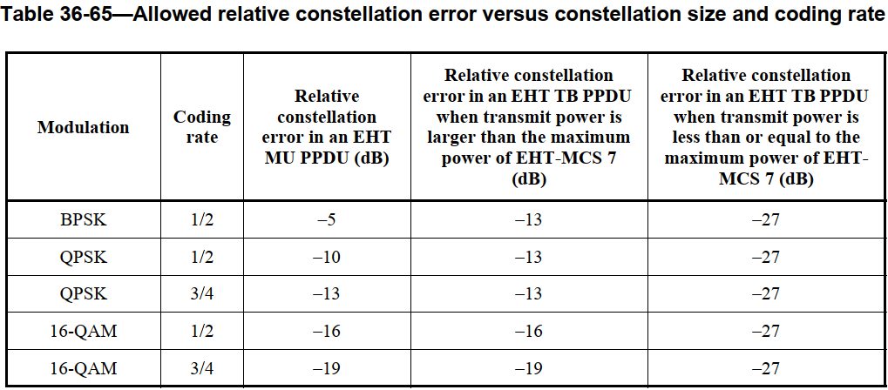
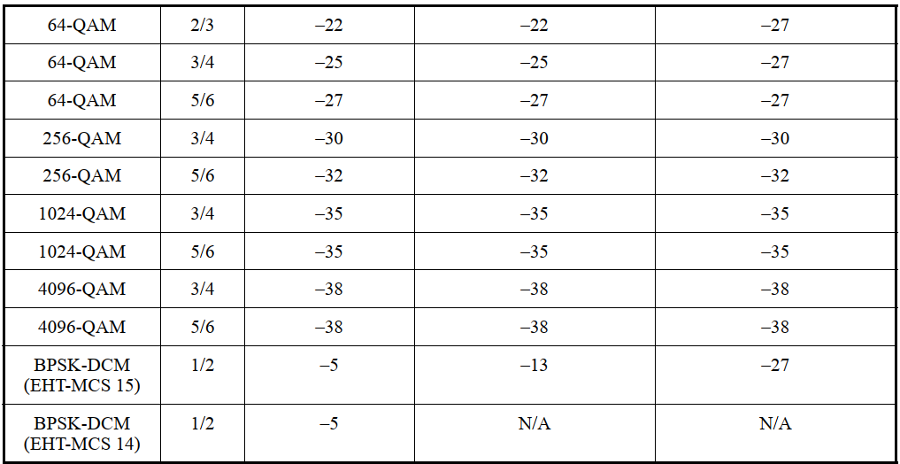
Candidate Transmit Constellation Error
Transmit Constellation Error is defined in 802.11be in “Table 36-65—Allowed relative constellation error versus constellation size and coding rate”
We assume that the allowed constellation error of each new MCS is expected to be within the range of the constellation errors of MCSs corresponding to two closest PHY bit rates (next higher and lower)

Slide 4
Analysis Principle and Criteria
We checked the sensitivity level degradation caused by the transmit constellation error at the existing MCS
We can see that both for QPSK ½ and
16QAM ¾ Tx EVM defined by spec
leads to ~1dB degradation @10% PER
Thus in order to define the requirements
for new MCSs we performed the next
steps:
  Check sensitivity level of SISO transmission of the new
  MCS in TGnD channel with no impairments
  Check sensitivity degradation with transmit constellation
  error within the range [TxEVM₀, TxEVM₁], where TxEVM₀
  and TxEVM₁ are the requirements for MCSs corresponding to
  lower and higher bit rate compared to tested MCS, respectively (Tx EVM is created using the Rapp PA model)
  Select transmit constellation error that leads to sensitivity degradation lower than or equal to 1dB
In the next slides we present simulation results and propose transmit constellation error requirements for all new MCSs
1.1dB
1dB

Slide 5
QPSK 2/3
Current Transmit Constellation Error for QPSK ½ and QPSK ¾ are -10dB and -13dB, respectively
Transmit Constellation Error of -11dB and -12dB imply similar degradation of ~0.9dB @10% PER

Slide 6
16QAM 2/3
Current Transmit Constellation Error for 16QAM ½ and 16QAM ¾ are
-16dB and -19dB respectively
Transmit Constellation Error of -18dB and -19dB imply degradation of
~0.9-1dB @10% PER, while worse Tx EVM leads to degradation of more than 1dB

Slide 7
16QAM 5/6
Current Constellation Error for 16QAM ¾ and 64QAM 2/3 are -19dB and -22dB respectively
Transmit Constellation Error of -21dB and -22dB imply degradation of ~0.5dB @10% PER, while Tx EVM of -20dB leads to degradation of ~0.7dB

Slide 8
256QAM 2/3
Current Transmit Constellation Error for 64QAM 5/6 and 256QAM ¾ are
-27dB and -30dB respectively
Transmit Constellation Error of -29dB and -30dB imply degradation of
~0.9-1.1dB @10% PER, while worse Tx EVM leads to degradation of ~1.4dB

Slide 9
Performance in AWGN channel
We checked the performance of new MCSs with Tx EVM values within the range of two closest PHY bit rates
The tested scenario was AWGN channel and 4096B payload size as defined in the spec
In case of QPSK 2/3 Tx EVM of
-12dB provides slightly better
performance compared to Tx EVM
of -11dB

Slide 10
Performance in AWGN channel
In case of 16QAM 2/3 Tx EVM of -18dB provides a gain of 0.3dB compared to Tx EVM of -17dB

Slide 11
Performance in AWGN channel
In case of 16QAM 5/6 and 256QAM 2/3 better Tx EVM provides a very small performance gain of ~0.1dB

Slide 12
Phase Noise Impact
We added a transmit phase noise as defined in WLAN performance criteria document to check the impact on the performance
As we see on the figure below, phase noise cause negligible degradation compared to Tx EVM caused by PA nonlinearity

Slide 13
Summary
We studied the transmit constellation error requirements for the new MCSs incorporated in 802.11bn
Based on the simulation results (with AWGN and TGnD channels) we propose to define the next transmit constellation error values for the UHR MU PPDU (will be added to the “Allowed relative constellation error versus constellation size and coding rate” table in 802.11bn)
Same results are shown in [1]
MCS | Transmit Constellation Error
QPSK 2/3 | -12dB
16QAM 2/3 | -18dB
16QAM 5/6 | -20dB
256QAM 2/3 | -29dB

Slide 14
References
[1] 11-25/392r0 Transmit and Receive Specifications for New MCS in 11bn, Alice Chen, et. Al (Qualcomm)

Slide 15
Straw Poll #1
Do you support the following:
  Transmit Constellation Error required values for the new MCSs 17, 19, 20 and 23 (QPSK 2/3, 16QAM 2/3, 16QAM 5/6 and 256QAM 2/3) for the UHR MU PPDU will be:
  Supporting docs: 11-25/354r0, 11-25/392r0
MCS | Transmit Constellation Error
QPSK 2/3 | -12dB
16QAM 2/3 | -18dB
16QAM 5/6 | -20dB
256QAM 2/3 | -29dB

