Slide 1
802.15.4ab NB Status Update
Date: 2025-03-10
Authors:

Slide 2
Background: Europe 6 GHz NB vs 802.11 VLP spectrum
NB with 14 dBm EIRP is 15/18/21 dB stronger than 802.11 VLP with 80/160/320 MHz
10 dBm/MHz
NB
-5 dBm/MHz
80 MHz 802.11
-8 dBm/MHz
160 MHz
802.11
-11 dBm/MHz
320 MHz 802.11
Note that skirts associated with NB spectrum are not shown and affect many 802.11 sub-carriers
Carlos Aldana, Meta Platforms

Slide 3
Channel Plan for 802.15.4ab using 2.5 MHz wide channels
Channels 0 to 49 span UNII-3 and channels 50 to 249 span UNII-5

Slide 4
Status
LB #207 on Draft 1.0 began on 6/12/24 and results available 7/20/24
1471 comments received
There were 31 comments rejected due to “lack of consensus”
Group decided to reject all NB channel access comments due to “lack of consensus”. Main concern in comments is lack of a mandatory mechanism.
802.19 voted 11 Y, 10 N on Coex Assessment document from 802.15.4ab (15-23-452r7)
47 comments received
LB #213 (Recirculation) on Draft 2.0 began on 3/4/25 and ends 3/24/25
NB Channel Access text in Draft 1.0 and Draft 2.0 is almost identical.

Slide 5
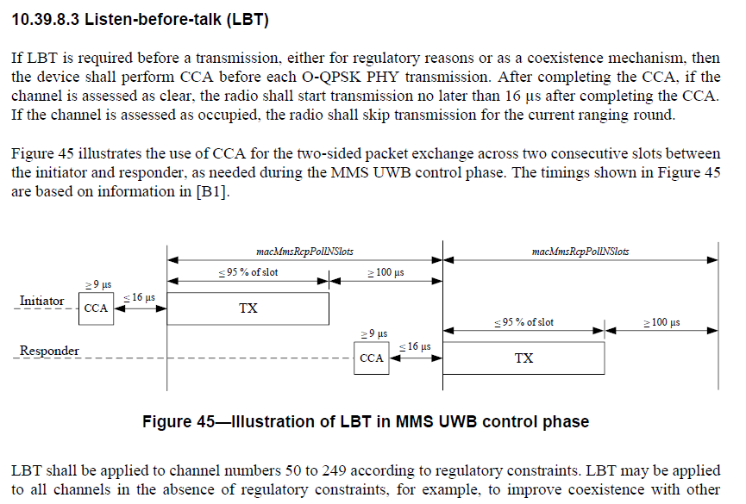
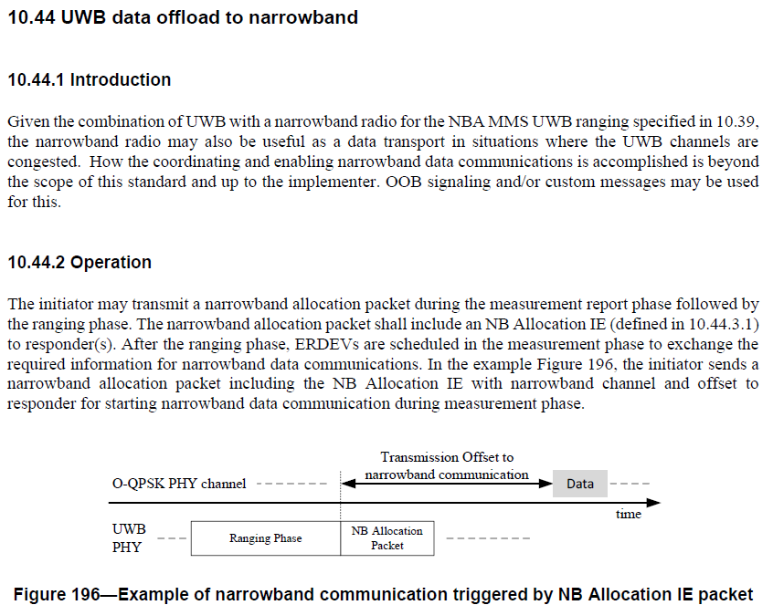
802.15.4ab Draft 2.0 Update
Draft 2.0 published, but coexistence concerns remain in Sections 10.39.8.3 and 10.44.

Slide 6
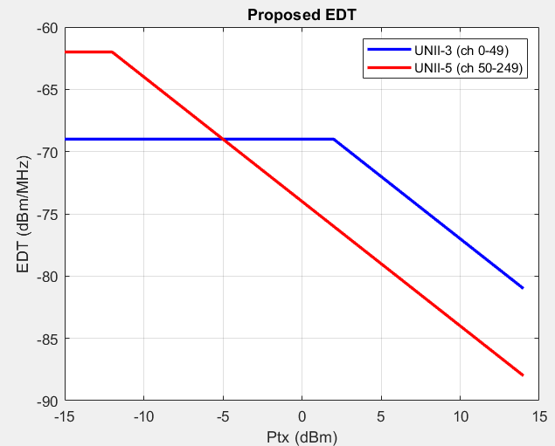
Summary of NB Proposal 1: 15-24-407
Perform CCA
Yes
Success
No
Failure
CCA idle?
EDT can be made dynamic

Slide 7
Summary of NB Proposal 2: 15-25-99
Hop and wait M us
Perform CCA
Success
No
No
Yes
CCA idle?
Max CCAs reached?
Yes
Failure

Slide 8
Next Steps
Discussions are ongoing
Resolving NB channel access in this recirc prevents recurring NB channel access related comments at later SA ballot(s) and recirc ballots
A fragmented approach will create interoperability challenges

Slide 9
References
IEEE 802.11-25/99r0 (Multiple CCA for NB)
IEEE 802.11-25/73r6 (Possible Next Steps on NB Channel Access (CID 988))
IEEE 802.11-25/407r7 (Proposed Resolution for CID 988)
IEEE 802.11-24/130r0 (Effect of no-LBT NB on 802.11 devices: Part 2)
IEEE 802.11-24/148r0 (NB Simulation Results Comparison)
IEEE 802.11-23/1279r0 (NB with LBT)
IEEE 802.11-23/1259r1 (Effect of no-LBT NB on 802.11 devices)
IEEE 802.15-23/243r2 (NB Assisted Data Communications)
IEEE 802.15-22/486r5 (Spectrum Sensing Based Deferral (SSBD))
IEEE 802.15-22/381r5 (NBA-UWB MMS Ranging Text Proposal for 15.4ab)
IEEE 802.15-21/593r2 (More on NBA-MMS)
IEEE 802.15-21/292r0 (Opportunities for improved UWB/NB coordination)
Carlos Aldana, Meta Platforms

