Slide 1
Consideration on Multi-AP framework for Co-SR
Date: 2025-3-7
Authors:

Slide 2
Introduction
Co-SR DL MU PPDU and Trigger frame initiating the Co-SR data has been agreed as an SFD[1]
In addition, ICF (Initial Control frame) and ICRF (Initial Control Response frame) for exchanging control information between APs for the Multi-AP coordination of Co-SR has also been discussed[2][3]
In this contribution, we propose a Multi-AP framework for the Co-SR types

Slide 3
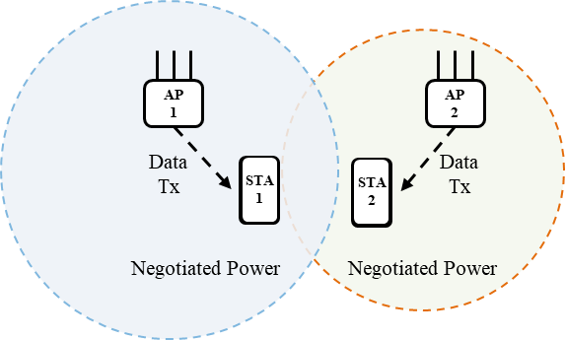
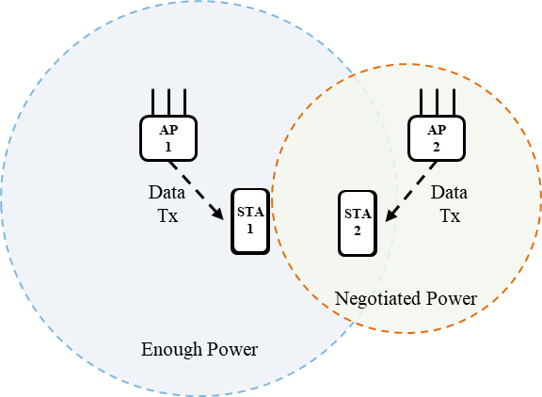
Recap: Co-SR Types
We proposed following Co-SR types
Co-SR type is different from Co-SR mode
Two-way Co-SR coordination[4][5]
Sharing AP determines Tx power of Co-SR data so that the Sharing AP and Shared AP suppress interference to the destination non-AP STAs
To calculate each Tx power of APs, the Sharing AP needs to obtain information of non-AP STAs associated with Candidate APs
It is also called Optimal Co-SR coordination
One-way Co-SR coordination[6][7]
Shared AP controls Tx power of Co-SR data to suppress interference to a non-AP STA of Sharing AP
Sharing AP doesn’t control its own Tx power for the Co-SR data transmission, so it doesn’t need information of non-AP STAs associated with Candidate APs
Shared AP determines its own Tx power based on the recommended Tx power requested by Sharing AP
Two-way Co-SR coordination
One-way Co-SR coordination

Slide 4
Clarification of differences with 11ax SR
11ax OBSS-PD based SR
OBSS-PD based SR allows simultaneous transmission by decreasing Tx power as OBSS_PD level increases
It doesn't need to exchange control information with OBSS
The AP performing SR does not identify specific STA to suppress interference, and transmits a PPDU with Tx power that does not interfere with entire OBSS
11ax PSR-based SR
PSR-based SR allows simultaneous transmission in OBSS while transmitting TB PPDU in BSS
It can indicate the timing of simultaneous transmissions and the PSR that suppresses interference to the BSS AP receiving the TB PPDU, allowing for more accurate interference suppression than OBSS PD-based SR
Potentially higher interference level than expected might be received due to multiple APs transmitting based on PSR-based SR.
One-way Co-SR
One-way Co-SR allows simultaneous transmission of DL PPDU in BSS and DL PPDU in OBSS
AP notified as a Shared AP in Trigger frame can perform simultaneous transmission which suppress interference to destination non-AP STA of Sharing AP by using the recommended Tx power notified by the Trigger frame at the timing of Co-SR data transmission specified in the Trigger frame
It specifies a Shared AP with Trigger frame, so it can prevent non-Shared APs from participating in the Co-SR

Slide 5
Multi-AP framework for Co-SR (1/2)
RSSI of interference between each AP and non-AP STA is measured in interference measurement
Each non-AP STA can measure RSSI of interference by using beacon signals
AP requests non-AP STAs in its BSS to transmit measurement report including RSSI of interference from OBSS AP

Slide 6
Multi-AP framework for Co-SR (2/2)
Sharing AP that has acquired TXOP notifies MAPC (Multi-AP Coordination) scheme with ICF and requests ICRF from Candidate APs
Candidate APs respond to Sharing AP with ICRF that contains participation Indicator for the MAPC scheme (Co-SR in this case) and control information required for the MAPC scheme
Sharing AP starts Co-SR data transmission by transmitting a Trigger frame containing the AP ID of at least one Shared AP selected from the Candidate APs that have requested to participate in coordination in ICRF
Whether to define Co-SR with more than one Shared AP is TBD
It is TBD for one-way Co-SR that the ICF/ICRF exchange is mandatory or optional

Slide 7
Expected Frame Contents for Co-SR Types
 | Two-way Co-SR | One-way Co-SR
Initial Control Frame | MAPC scheme Co-SR type | MAPC scheme Co-SR type
Initial Control Response Frame | Participation Indicator Destination non-AP STA Info for Candidate AP (AID, RSSI of interference received from Sharing AP, ARIL) Traffic Priority Info | Participation Indicator Traffic Priority Info
Trigger frame | MAPC scheme Co-SR mode Co-SR type Tx power of Sharing AP AID of destination non-AP STA for Shared AP Recommended Tx power of Shared AP | MAPC scheme Co-SR mode Co-SR type Tx power of Sharing AP Recommended Tx power of Shared AP
One-way Co-SR has lower overhead than Two-way Co-SR because Sharing AP doesn’t need the destination non-AP STA info for Candidate APs
In One-way Co-SR, ICF/ICRF exchange can be optional, so if ICF/ICRF exchange can be skipped, overhead can be reduced even further

Slide 8
Summary
In this contribution, we shared our views on the Multi-AP framework for Co-SR transmission
We discussed frame contents of the ICF, ICRF and Trigger frame for Co-SR
We showed that One-way Co-SR coordination can reduce overhead compared to Two-way Co-SR coordination because it doesn’t require destination non-AP STA information of Candidate APs

Slide 9
References
[1] 25/14, “TGbn Motions List - Part 2”
[2] 24/1514r1, “Multi-AP framework for C-SR”
[3] 24/2059r0, “Discussion on Initial Frame Exchange in CSR/COBF”
[4]23/1037r0, “Performance of Coordinated Spatial Reuse”
[5]23/1972r1, “Evaluation of Coordinated Spatial Reuse - Follow Up”
[6]20/590r5, “Coordinated Spatial Reuse: Focus on Downlink”
[7]24/640r0, “Consideration on C-SR Types”

Slide 10
Straw poll #1
Do you agree to add the following text to the TGbn SFD?
11bn defines two-way Co-SR coordination as a Co-SR type
Two-way Co-SR coordination is a Co-SR type that determines the Tx power of each AP based on the destination non-Ap STA information for Candidate APs in pre-negotiation
Detailed signaling is TBD

Slide 11
Straw poll #2
Do you agree to add the following text to the TGbn SFD?
11bn defines one-way Co-SR coordination as a Co-SR type
One-way Co-SR coordination is a Co-SR type without pre-negotiation using information of the destination non-AP STAs for Candidate APs
Detailed signaling is TBD

Slide 12
Straw poll #3
Do you agree to add the following text to the TGbn SFD?
In One-way Co-SR coordination, exchanging ICF and ICRF between APs before Trigger frame that initiate the start of Co-SR data transmission is optional

