Slide 1
Details of Duty-cycle operation for AMP
Mar 2025
Doc.: IEEE 802.11-25/0341r0
Date: 2025-03-06
Authors:
Name | Affiliation | Address | Phone | Email
Chuanfeng He | OPPO |  |  | hechuanfeng@oppo.com
Weijie Xu |  |  |  | xuweijie@oppo.com
Yinan Qi |  |  |  | v-qiyinan@oppo.com

Slide 2
Mar 2025
Doc.: IEEE 802.11-25/0341r0
Background
For AMP communication, power storage is necessary for AMP STA to supply the operation power when simultaneously harvested power only is not enough to cover the consumed power[1].
Power saving from duty cycle
It is challenging for AMP STA to perform consistent monitoring for potential AMP trigger for uplink transmission due to limited power storage.
Duty-cycle operation can reduce the time duration of AMP STAs Rx, which are the main contributors of power consumption during awake time.
The motions related to duty cycle operation were agreed [2].
MM-1: If AMP device is able to support AMP TSF, the maximum timing offset is ±10⁴ ppm.
MM-2: 11bp defines a mechanism to allow an AP to solicit AMP uplink PPDU(s) from one or more 802.11bp clients.
MM-4: If an AMP device is able to support TSF, it can monitor AMP DL Frame in a duty-cycle manner.
Slide 2
Chuanfeng He (OPPO)

Slide 3
Mar 2025
Doc.: IEEE 802.11-25/0341r0
Definition of initial service period
Initial service period (ISP)of AMP STA
AMP STA performs energy harvesting, and wakes up upon enough energy storage. Before waking up, AMP STA does not maintain synchronization.
AMP STA blindly searches AMP trigger (trigger sensing) within initial service period.
A fully charged capacitor of 24µF can support 1.8 seconds (1.5V and 10µA are assumed) length of ISP, which is the maximum length of ISP.
Minimum length of ISP should be longer than AMP trigger interval to facilitate initial AMP trigger detection.
Slide 3
Chuanfeng He (OPPO)

Slide 4
Mar 2025
Doc.: IEEE 802.11-25/0341r0
Definition of normal service period
Normal service period (NSP)of AMP STA
Once AMP STA detects a AMP trigger during ISP, it can monitor further AMP trigger in a duty-cycle manner through normal service period.
The minimum length of NSP for AMP trigger monitoring should at least cover the length of AMP trigger.
Slide 4
Chuanfeng He (OPPO)

Slide 5
Mar 2025
Doc.: IEEE 802.11-25/0341r0
Duty-cycle operation at AP side
Operation at AP side[3]
AP sends AMP trigger frames following trigger interval[4]
Information carried in AMP trigger frame[4]
Timestamp to align the local TSF timer of AMP STAs
Duty cycle configuration
Duty cycle parameters, e.g. Trigger interval, NSP length
Information for AMP STA to determine Duty-cycle period and the target trigger transmission time for monitoring
Slide 5
Chuanfeng He (OPPO)

Slide 6
Mar 2025
Doc.: IEEE 802.11-25/0341r0
Duty-cycle operation at AMP STA side
Operation at AMP STA side[3]
AMP STA monitors AMP trigger to obtain
Timestamp
Duty cycle configuration
AMP STA derives its specific Duty-cycle period and target AMP trigger transmission time
AMP STA or STA group specific Duty-cycle operation, including specific Duty-cycle period, target AMP trigger transmission time
Reduce power consumption through less trigger monitoring
Spread AMP STAs to trigger sets to reduce collision
AMP STA grouping randomly or based on predefined rules
AMP STA matches its NSP to the target AMP trigger transmission time, based on its Duty-cycle configuration and local TSF timer.
Slide 6
Chuanfeng He (OPPO)

Slide 7
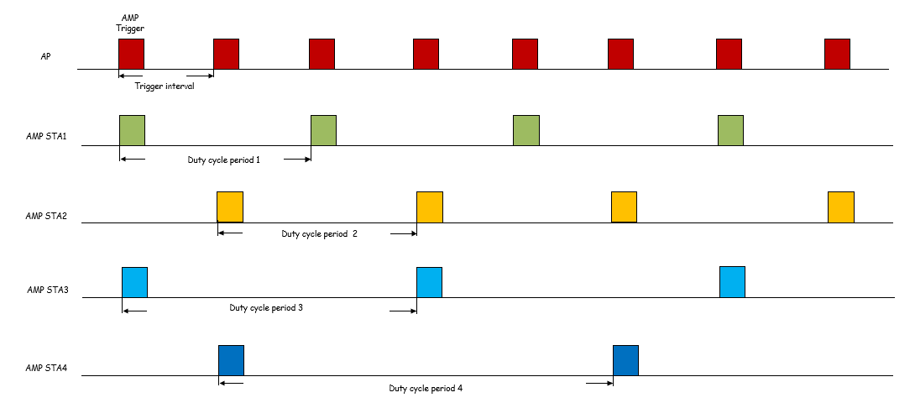
Mar 2025
Doc.: IEEE 802.11-25/0341r0
Duty-cycle operation at AMP STA side
Specific Duty-cycle operation
Specific service periods for AMP trigger
Specific duty cycle periods for AMP STA 1-4
Specific offset to determine position of service periods for AMP STA 1-4
Slide 7
Chuanfeng He (OPPO)

Slide 8
Mar 2025
Doc.: IEEE 802.11-25/0341r0
Summary and proposals
In this submission, the details of Duty-cycle operation for AMP are discussed and proposed.
Duty cycle configuration is indicated through AMP trigger frame
AMP STA or STA group specific Duty-cycle operation.
Slide 8
Chuanfeng He (OPPO)

Slide 9
Mar 2025
Doc.: IEEE 802.11-25/0341r0
Straw Poll #1
Do you agree with the following text:
Duty-cycle configuration is carried in AMP trigger.
Yes
No
Abstain
Slide 9
Chuanfeng He (OPPO)

Slide 10
Mar 2025
Doc.: IEEE 802.11-25/0341r0
Straw Poll #2
Do you agree with the following text:
AMP STA or STA group specific Duty-cycle operation is supported.
Yes
No
Abstain
Slide 10
Chuanfeng He (OPPO)

Slide 11
Reference
Mar 2025
Doc.: IEEE 802.11-25/0341r0
IEEE 11-24/1500r0, Duty-cycle-amp-operation, OPPO
IEEE 11-24/1613r4, Specification framework for tgbp
IEEE 11-25/0032r0, Duty cycle AMP operation, OPPO
IEEE 811-25/0031r0, Trigger based multiple access for AMP, OPPO

