Slide 1
Trigger based TDM multiple access
Mar 2025
Doc.: IEEE 802.11-25/0340r0
Date: 2025-03-06
Authors:
Name | Affiliation | Address | Phone | Email
Chuanfeng He | OPPO |  |  | hechuanfeng@oppo.com
Weijie Xu |  |  |  | xuweijie@oppo.com
Yinan Qi |  |  |  | v-qiyinan@oppo.com

Slide 2
Mar 2025
Doc.: IEEE 802.11-25/0340r0
Background
  Some motions about trigger based AMP uplink communication were agreed[1].
  PM-2: 11bp defines at least one mode of MAC/PHY that allows an AMP-only device with active uplink communication in 2.4GHz subject to the following requirements:
    clock accuracy requirement is relaxed compared to legacy 802.11 devices;
    the active uplink communication can only be sent in response to being polled by the AP.
  MM-2: 11bp defines a mechanism to allow an AP to solicit AMP uplink PPDU(s) from one or more 802.11bp clients.
  Several contributions were raised to discuss trigger based TDM multiple access mechanism.[2][3][4][5][6]
Slide 2
Chuanfeng He (OPPO)

Slide 3
Mar 2025
Doc.: IEEE 802.11-25/0340r0
Recap: Multiple access mechanisms
  Burst uplink traffic from large number of AMP device is typical for AMP communication, e.g. in logistics and warehouse scenarios.
  Sequential polling/trigger is inefficient for the access of large number of AMP device.
    Large overhead of polling/triggering signaling
    Large average latency of uplink AMP data collection
    Large power consumption of AMP device due to long “waiting” time for target polling/triggering identification.
  Multiple access mechanism can address the burst type uplink traffic from large number of AMP device, including TDM, FDM and CDM.[4]
Slide 3
Chuanfeng He (OPPO)

Slide 4
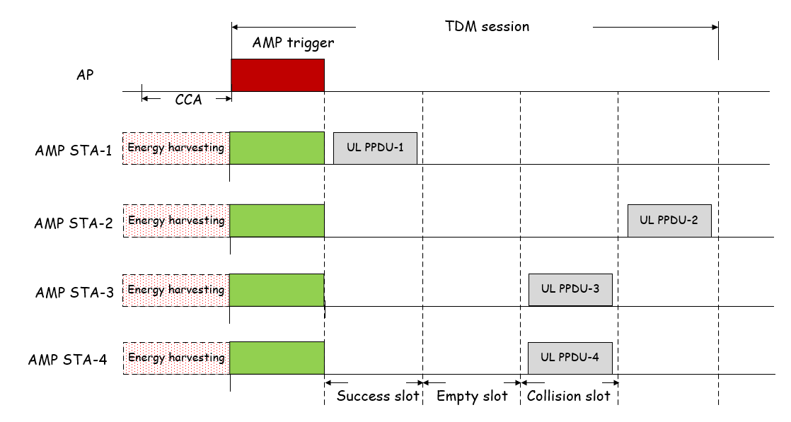
Mar 2025
Doc.: IEEE 802.11-25/0340r0
Recap: Trigger based TDM multiple access
  One AMP trigger grants multiple slots for multiple AMP STAs to access. There will be three types of TDM slots.[2]
    Success slot: AMP transmission from one AMP STA on the slot.
    Collision slot: Concurrent AMP transmission on the slot, which may lead to transmission failure.
    Empty slot: no AMP transmission on the slot, which may lead to slot waste and idle channel assessed by other devices.
  The first slot is success slot since only one AMP STA selects this slot for AMP transmission.
  The second slot is empty slot since no AMP STAs select this slot for AMP transmission.
  The third slot is collision slot because AMP STA 3 and 4 both select this slot for AMP transmission.
Slide 4
Chuanfeng He (OPPO)

Slide 5
Mar 2025
Doc.: IEEE 802.11-25/0340r0
Basic components of trigger based TDM
  Slotted TDM resource
  Slotted TDM resource to support slotted based random access
  A number of slots are scheduled through AMP trigger
  TDM resource information in AMP trigger
  Number of slots
  Slot duration: indicated or predefined
  Timestamp for synchronization
  Synchronization is necessary to align the slots among AMP STAs.
  Timestamp is used to align the TSF time of AMP STAs.
  Short timestamp is defined for AMP TSF.
    To address short awake and operating duration of AMP STA, especially for inventory and warehouse use cases.
    To reduce overhead of timestamp.
    Indicated in AMP trigger.
Slide 5
Chuanfeng He (OPPO)

Slide 6
Mar 2025
Doc.: IEEE 802.11-25/0340r0
Slot based random access
  AMP trigger based TDM multiple access mechanism should avoid collision slots as much as possible.[3]
      Slot based random access to spread AMP STAs among slots
      “Random-slotted collision arbitration” for EPC query of RFID
        A Tag loads a random number(in the range [0- 2^{Q}-1]) into a counter based on the parameter Q in a Query command(Query or QueryAdjust).
        Decrement this counter based on Reader commands(QueryRep).
        Reply to the Reader when its counter reaches zero.
      “Random-slotted collision arbitration” for AMP trigger
        AMP STAs load a random number in the range [0- 2^{Q}-1] into a counter, where Q is carried in the detected AMP trigger.
        Decrement this counter based on further detected AMP trigger.
        Join a trigger session and select a slot for PPDU transmission when the counter reaches zero after decrement based on the trigger.
Slide 6
Chuanfeng He (OPPO)

Slide 7
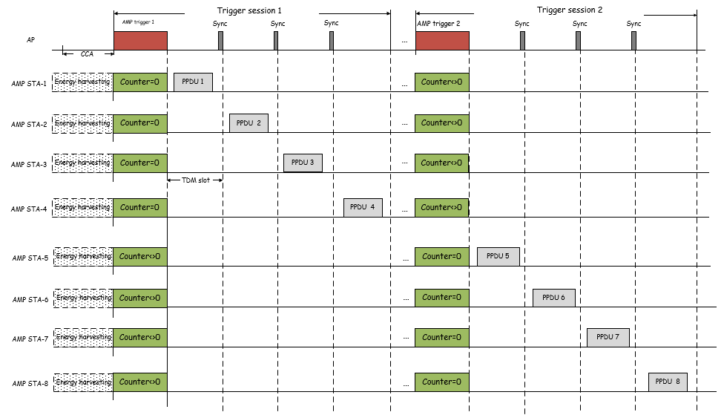
Mar 2025
Doc.: IEEE 802.11-25/0340r0
Slot based random access
  AMP STA 1-8 decrements their counter when AMP trigger 1 is detected.
  The counters of AMP STA 1-4 reach zero based on AMP trigger 1. AMP STA 1-4 join the trigger session 1, and select one slot for PPDU transmission.
  The counters of AMP STA 5-8 do not reach zero based on AMP trigger 1, but reach zero based on AMP trigger 2. AMP STA 5-8 join the trigger session 2, and select one slot for PPDU transmission.
Slide 7
Chuanfeng He (OPPO)

Slide 8
Mar 2025
Doc.: IEEE 802.11-25/0340r0
Empty slots avoidance
  Empty slots avoidance[3]
    Empty slots can be avoided to improve resource utilization efficiency.
    Slot based random access for collision arbitration also helps to reduce empty slots through spreading AMP STAs among slots.
    Empty slots should be avoided for active transmitter case, which may lead to idle channel assessed by other devices.
      It can be realized by the assist of AP.
  Empty slots avoidance procedure
    AP switches to RX at the start of each slot.
    AP searches AMP preamble of UL PPDU in the slot.
      If AP detects AMP preamble within a short period, it continues the reception of UL PPDU.
      If AP does not detect AMP preamble within a short period, it switches to TX to send padding signal.
Slide 8
Chuanfeng He (OPPO)

Slide 9
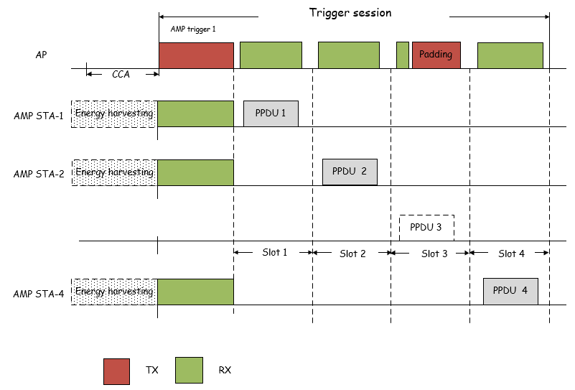
Mar 2025
Doc.: IEEE 802.11-25/0340r0
Empty slots avoidance
  AP switches to RX at the start of each slot.
  AP detects AMP preamble of UL PPDU during slot 1,2 and 4, which are success slots.
  AP does not detect AMP preamble of UL PPDU during slot 3, which is empty slot.
  AP switches to TX to send padding signal in slot 3.
Slide 9
Chuanfeng He (OPPO)

Slide 10
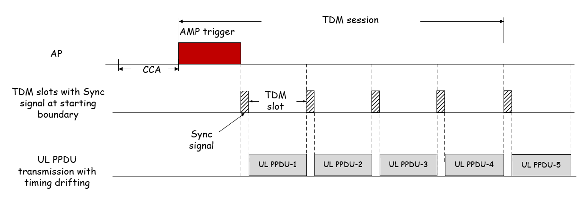
Mar 2025
Doc.: IEEE 802.11-25/0340r0
Time synchronization during TDM operation
  AMP STA is able to support AMP TSF, which means it can support TDM multiple access based on its local TSF time.[3]
  To address the timing drifting during TDM operation
    Option 1: Guard intervals are introduced between adjacent slots to minimize the potential collision due to timing drifting. It is applicable to active transmitter, since its maximum clock offset is ± 10³ ppm.
    Option 2: Sync signal at the TDM slot boundaries to align the AMP transmission on the TDM slots. The Sync signal is used to eliminate timing misalignment due to timing drifting. AMP STAs monitors sync signal of the target TDM slot before UL PPDU transmission. It is applicable to backscatter, since its maximum clock offset is ± 10⁴ ppm.
Slide 10
Chuanfeng He (OPPO)

Slide 11
Mar 2025
Doc.: IEEE 802.11-25/0340r0
Summary and proposals
  In this submission, some details of trigger based TDM multiple access for AMP were discussed.
    Slotted TDM resource indicated in AMP trigger
    Timestamp definition and indication for AMP TSF
    Slot based random access
    Empty slots avoidance
    Time synchronization during TDM operation
  The following are proposed.
    Slotted TDM resource are triggered for the random access of AMP STAs.
    TDM resource and timestamp information are indicated in AMP trigger.
Slide 11
Chuanfeng He (OPPO)

Slide 12
Mar 2025
Doc.: IEEE 802.11-25/0340r0
Straw Poll #1
Do you agree with the following text:
  Slotted TDM resource can be triggered for multiple access of AMP STAs.
Yes
No
Abstain
Slide 12
Chuanfeng He (OPPO)

Slide 13
Mar 2025
Doc.: IEEE 802.11-25/0340r0
Straw Poll #2
Do you agree with the following text:
  AMP STAs apply slot based random access for UL PPDUs transmission.
Yes
No
Abstain
Slide 13
Chuanfeng He (OPPO)

Slide 14
Mar 2025
Doc.: IEEE 802.11-25/0340r0
Straw Poll #3
Do you agree with the following text:
  AMP trigger indicates TDM resource and timestamp information to AMP STAs.
Yes
No
Abstain
Slide 14
Chuanfeng He (OPPO)

Slide 15
Reference
Mar 2025
Doc.: IEEE 802.11-25/0340r0
IEEE 11-24/1613r4, Specification framework for tgbp
IEEE 11-24/1776r1, multiple access mechanisms for amp, OPPO
IEEE 11-25/0031r0, Trigger based multiple access for AMP
IEEE 11-25/0046r0, Channel access for Active Tx non-AP AMP STAs, Huawei
IEEE 11-22/0252r0, Slotted vs Pure Aloha for Active Transmitter AMP Use Cases, Wiliot
IEEE 11-24/2113r0, UL Access for AMP, Qualcomm

