Slide 1
AMP DL OOK Generation
Date: 2025-03-10
Authors:
Name | Affiliation | Address | Email
Panpan Li | Huawei | Singapore | lipanpan25@huawei.com
Bin Qian |  | Shenzhen, China
Lumin Liu |  | Singapore
Lei Huang |  | Singapore

Slide 2
Abstract
This contribution intend to discuss some remaining issues related to backscattering operation
Encoding and modulation
DL OOK generation

Slide 3
Remaining issues related to encoding and modulation
Issues
Encoding of AMP Downlink PPDU AMP-Data field for backscattering operation is TBD
Modulation of AMP Uplink PPDU AMP-Sync field and AMP-Data field for backscattering operation is TBD
Proposal
Propose to use Manchester encoding for the AMP Downlink PPDU AMP-Data field for backscattering operation.
Keeping consistent with non-backscattering operation as mentioned in [1]
The AMP Uplink PPDU AMP-Sync field and the AMP-Data field will use On-Off Keying (OOK) modulation for backscattering operation.
Keep consistent with non-backscatter UL
OOK modulation is easy to implement for STA side

Slide 4
Remaining issues related to AMP DL OOK
Motion #30 [2]:
The (3dB) bandwidth of the AMP DL PPDU in 2.4 GHz is at least 10 MHz for backscattering communication. The transmit spectrum mask is TBD.
OOK generation：
[3] pointed out DSSS based OOK has advantages including better performance, no new hardware requirement and flexibility to support different data rates. Another spreading code with less randomization was proposed to replace Barker code to generate a narrow bandwidth DSSS signal.
[4] proposed wideband DSSS-OOK for backscattering operation and new spreading sequences to achieve specific bandwidths.
[5] proposed wideband MC-OOK generation to achieve 12-15MHz BW.
Problems to be solved:
Generation of wideband OOK is TBD
This contribution will compare the performance of DSSS-OOK and MC-OOK for backscattering operation.

Slide 5
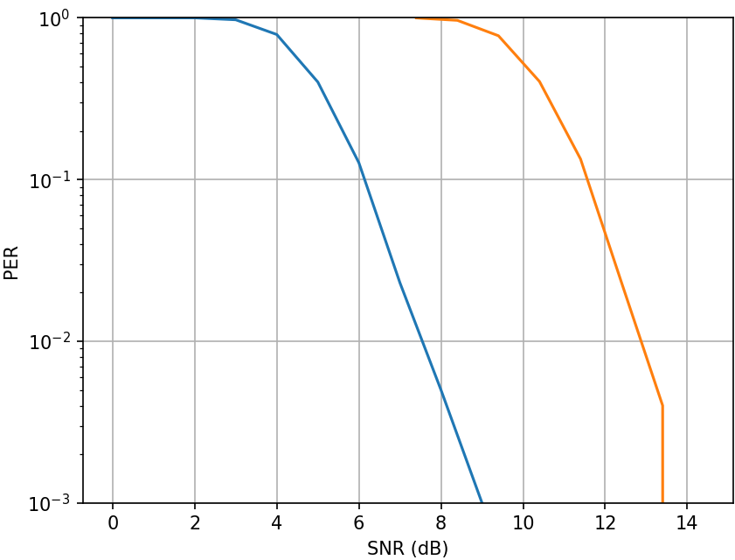
Simulation results: DL
DL PPDU AMP-data field PER comparison between DSSS-OOK (11b) and MC-OOK (WUR)
SNR is defined on 22MHz BW
Simulation setting:
Data rate: 250kbps
AWGN channel
Tx side:
Packet size = 160 bits
Manchester encoding
no filter
Rx side:
Fs_Rx=2 MHz
no LPF
Clock accuracy: 0ppm
MC-OOK
DSSS
DSSS based waveform achieve better performance than MC-OOK!

Slide 6
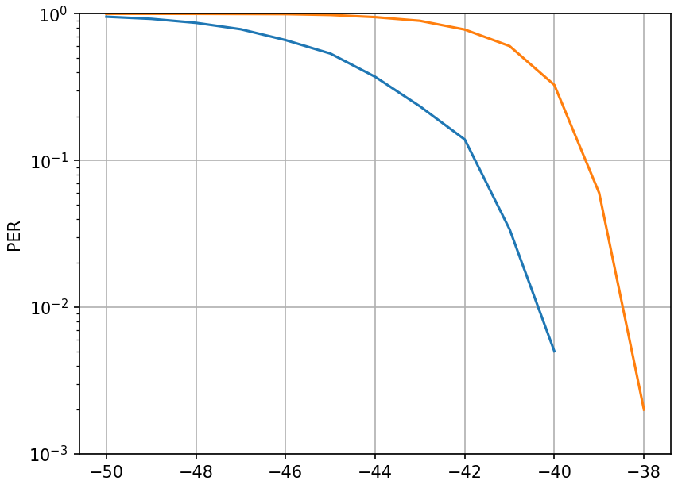
Simulation results: UL for Mono-static backscatter
UL PPDU AMP-data field PER comparison between DSSS-OOK (11b) and MC-OOK (WUR)
Simulation setting:
Data rate: 250kbps
AWGN channel
AP side:
Packet size = 160 bits
Manchester encoding
Antenna isolation: 20dB
Leakage: 0dBr
Rx noise: -45dBr
No Tx filter
with Rx filter
Non-coherent detector
STA side:
Modulation noise: -20dBr
Backscatter loss: 5dB
No Tx filter
Clock accuracy: 0ppm
Note: Signal attenuation is defined as Friis channel path loss of DL+UL
MC-OOK
DSSS
Signal attenuation (dB)
0.177 | 0.158 | 0.141 | 0.125 | 0.112 | 0.099 | 0.089 | Distance (m)
Notes:
5%

Slide 7
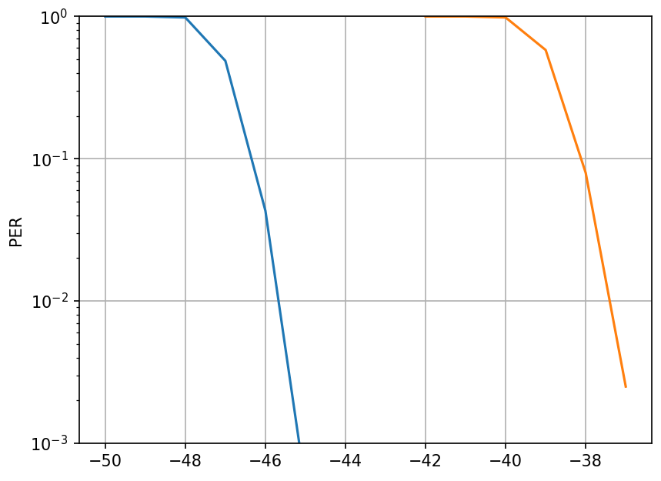
Simulation results: UL for Bi-static backscatter
Leakage
AP
STA
Energizer
d
1m
Simulation setting:
Data rate: 250kbps
Energizer side:
EIRP: 20dBm
Leakage: with path loss of distance (d+1) meter
No Tx filter
AP side:
Rx noise: -70dBm
with Rx filter
Non-coherent detector
STA side:
Packet size = 160 bits
Manchester encoding
Modulation noise: -20dBr
Backscatter loss: 5dB
No Tx filter
Clock accuracy: 0ppm
Note: Signal attenuation is defined as Friis channel path loss of distance d
MC-OOK
DSSS
Signal attenuation (dB)
3.146 | 2.499 | 1.985 | 1.577 | 1.252 | 0.995 | 0.79 | Distance (m)
Notes:
10%

Slide 8
Summary
This contribution discussed the AMP DL OOK generation
DSSS OOK achieves better performance than MC-OOK.

Slide 9
Reference
[1] 11-24-1797-00-00bp-design-considerations-of-dl-data-rate-and-sync
[2] 11-24-1322-06-00bp-tgbp-motion-dock
[3] 11-24-1802-00-00bp-ook-generation-for-amp-dl
[4] 11-25-0050-01-00bp-amp-dl-wideband-ook-generation
[5] 11-25-0051-01-00bp-signal-design-for-ook

Slide 10
SP 1
Do you agree to add the following text to TG bp SFD?
The AMP Downlink PPDU AMP-Data field will use Manchester encoding for backscattering operation.
Yes
No
Abstain

Slide 11
SP 2
Do you agree to add the following text to TG bp SFD?
The AMP Uplink PPDU AMP-Sync field and the AMP-Data field will use On-Off Keying (OOK) modulation for backscattering operation.
Yes
No
Abstain

Slide 12
SP 3
Do you agree to add the following text to TG bp SFD?
DSSS based OOK is supported for AMP DL backscattering operation.
Yes
No
Abstain

