Slide 1
AMP Data Communication in sub-1 GHz
Date: 2025-03-10
Authors:
Name | Affiliation | Address | Email
Panpan Li | Huawei | Singapore | lipanpan25@huawei.com
Bin Qian |  | Shenzhen, China
Lumin Liu |  | Singapore
Lei Huang |  | Singapore

Slide 2
Abstract
This contribution intends to start the discussion of AMP data communication in sub-1 GHz
  Operating bands, bandwidth, channelization
  DL data rates

Slide 3
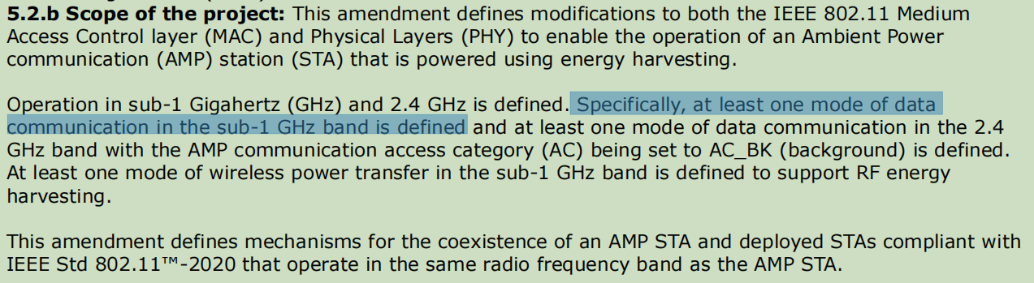
Background
TG BP PAR [1]:
  At least one mode of data communication in sub-1 GHz is defined
There are some contributions touching WPT PHY/MAC topics.
AMP data communication in sub-1 GHz has not been discussed.

Slide 4
Motivation
Motivation of data communication in sub-1 GHz
  AMP Data communication in sub-1 GHz may achieve larger coverage.
  Sub-1 GHz is less crowded than 2.4 GHz. 11ah is the only IEEE 802.11 product operating in sub-1 GHz.
  AMP have different use cases than 11ah
    AMP data communication focus on short-medium distance in sensor use cases: 10cm - 50m, AMP doesn’t support data offloading
    11ah target long distance in data offloading/sensing use cases: up to 1km
  AMP have different device capabilities than 11ah
    AMP STA is typically battery-free, while S1G STA typically is battery powered
    AMP STA usually possesses lower capability than S1G STA
  AMP may need to seek different regulations from 11ah
    Unlike 2.4 GHz bands regulations, different areas possess various sub-1 GHz bands regulations
    There are some countries/areas without 11ah because of lacking/strict regional regulations, e.g., China. Even for countries with 11ah, AMP may need to meet different requirements from 11ah for same sub-1 GHz spectrum.

Slide 5
PHY design general principle in sub-1 GHz
Different use cases and device capabilities compared with 11ah bring different requirements on PHY design for AMP
  AMP PHY design sub-1 GHz should be consistent with 2.4 GHz as much as possible
    Device type
      Mono-static backscatter, bi-static backscatter, active transmission
      Device capability remain same with 2.4G
    PPDU format
      Overall formats (e.g., DL: preamble + Sync + (SIG) + Data + Excitation) remain same with 2.4G
  Focus on difference of AMP PHY operating on sub-1 GHz and 2.4G
    Operating class, bandwidth, channelization
    DL data rates
    Waveform generation

Slide 6
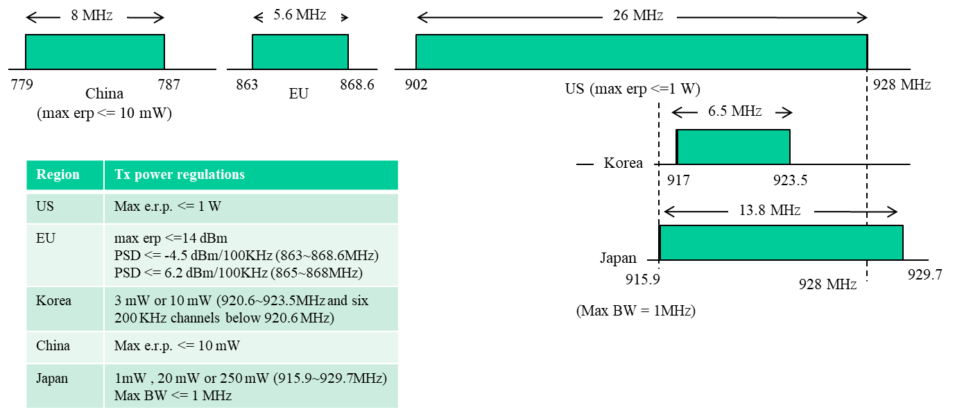
Operating bands, bandwidth, channelization
There are various sub-1 GHz operating bands and regulation requirements in US, China, EU, Japan, Korea [2-4].
  Sub-1 GHz spectrum available in the US (26MHz) is much larger than other countries (and allows higher transmission power)
  Other areas’ sub-1 GHz bands
    either have higher max Tx power (W), narrower max bandwidth (>100kHz),
    or have lower max Tx power (mw), wider max bandwidth (MHz)
    Cannot achieve high max Tx power and wider max bandwidth at same time
Channelization in 11ah propose BW [5-6]:
  1 MHz (Mandatory)
  2 MHz (Mandatory)
  4, 8 and 16 MHz (Optional)

Slide 7
Operating bands, bandwidth, channelization for AMP
AMP has very different use cases, device types/capabilities compared with 11ah, which may lead to different channelization.
The most important feature of AMP is power insufficiency, thus AMP may seek operating bands with higher max Tx power.
Possible AMP operating bands in sub-1GHz:
  For US, comply with FCC
  For China, RFID bands
  For EU: maybe RFID bands
  For other areas, choose operating bands with higher Tx power limitation
Possible AMP BW in sub-1GHz:
  200 kHz , 400 kHz, 250 kHz, 500 kHz,...

Slide 8
DL data rates in sub-1 GHz
Data rates are limited by BW.
  Narrow BWs (x*100 kHz) lead to lower data rates for AMP in sub-1 GHz than 11ah.
  Take Manchester encoding as example, the theoretical maximum data rate will be 62.5 kbps for bandwidth being 250 kHz, and 125 kbps for 500 kHz
  Choose another lower data rate (<62.5 kbps) for ease of implementation
Proposed data rates
  31.25 kbps (Mandatory)
  62.5 kbps (Optional)
  125 kbps (Optional)
  …

Slide 9
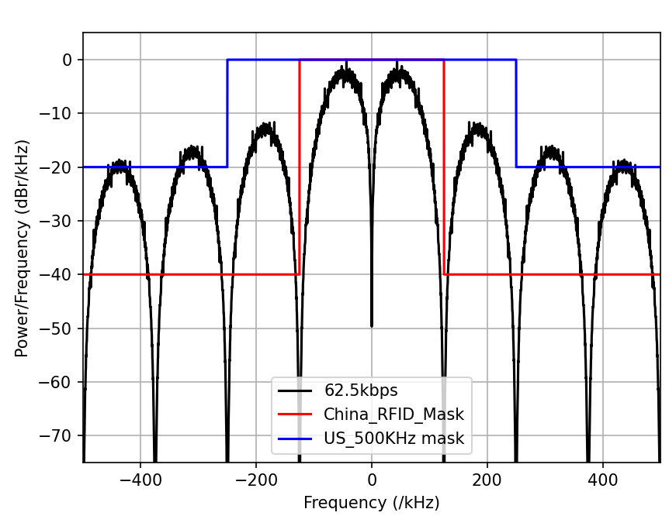
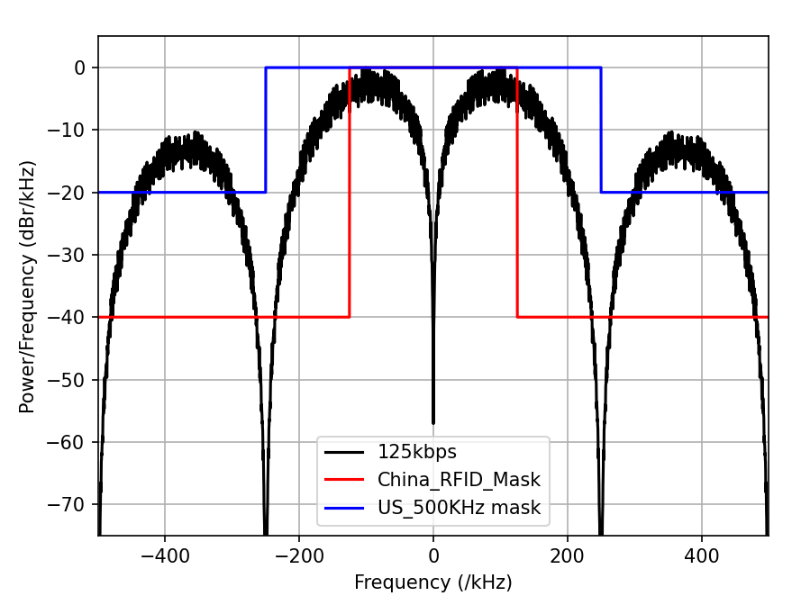
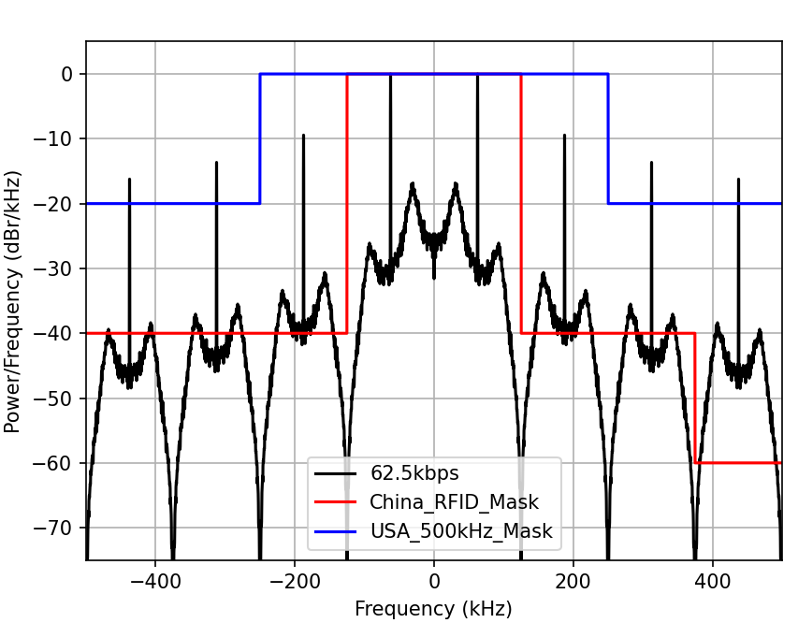
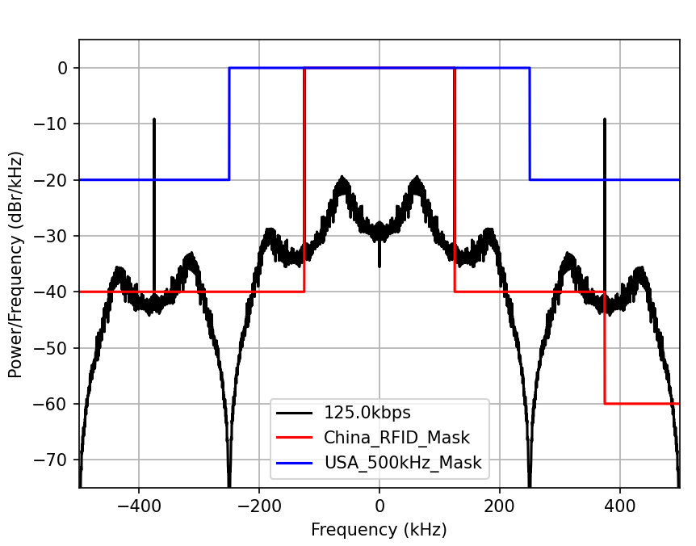
DL data rates in sub-1 GHz
Simulation setting
Encoding: take Manchester, PIE as examples (open to other choices)
Modulation: OOK (suggest to keep consistent with 2.4G)
Waveform: CW (narrow BWs make DSSS/OFDM/MC-OOK not suitable)
No Tx filter
Manchester
PIE

Slide 10
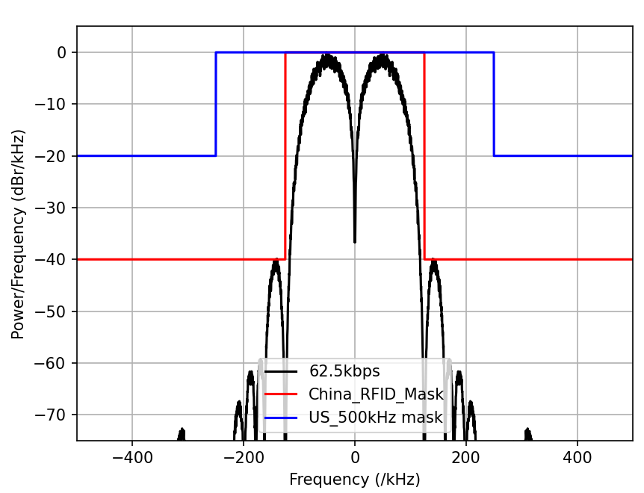
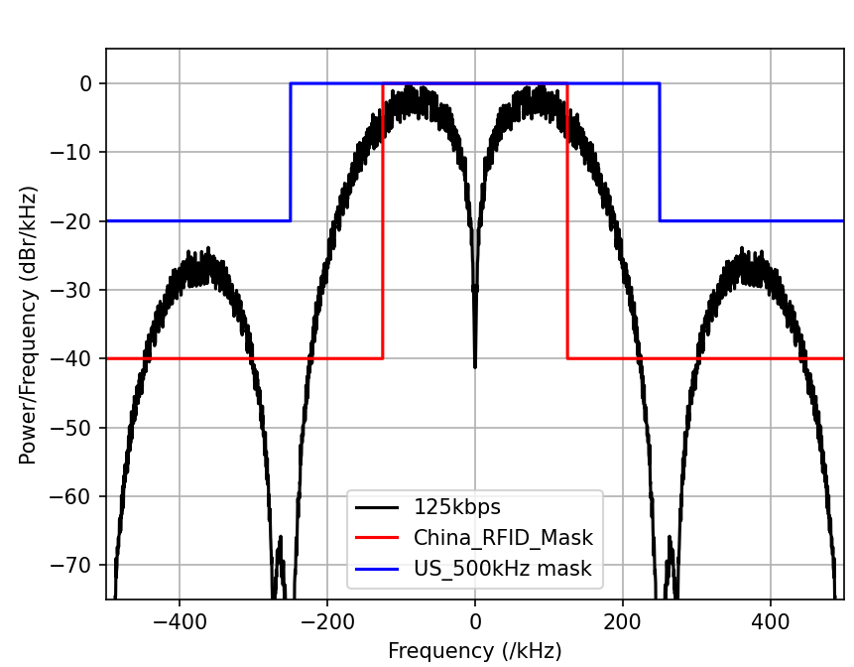
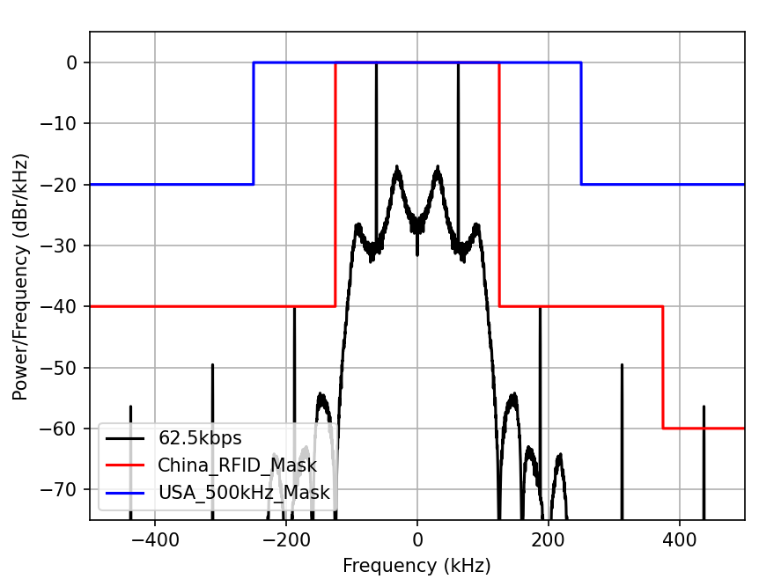
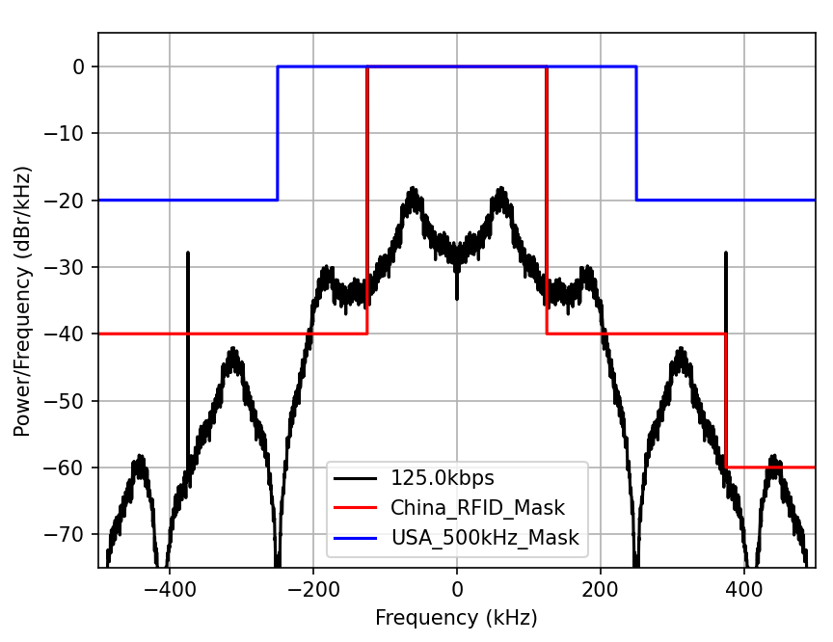
DL data rates in sub-1 GHz
Satisfying Tx mask is implementation specific, may apply filter to lower sidelobe. Here are some examples, but the choice of filters should take complexity into consideration.
Manchester
PIE
Notes:
70,45; 250,20;62.5,26.5; 250,15

Slide 11
Summary
This contribution discussed the AMP data communication in sub-1 GHz
  Supports mono-static backscattering communication, bi-static backscattering communication and active transmission
  Operating bands, Bandwidth, channelization
    Consider different bands/regulations from 11ah: which with higher max Tx power
    Consider narrower BW: 200 kHz , 400 kHz, 250 kHz, 500 kHz, …
  DL data rates
    Consider lower data rates: 31.25kbps, 62.5 kbps, 125 kbps

Slide 12
Reference
[1] 11-24-0575-01-0amp-p802-11bp-par
[2] 11-10-1217-00-00ah-fcc-part-15-and-channel-widths
[3] 11-11-0685-00-00ah-s1g-spectrum-regulations
[4] 11-11-0957-02-00ah-s1g-spectrum-regulations-in-china
[5] 11-11-1238-00-00ah-channelization-and-bandwidth-modes-for-11ah
[6] 11-11-1296-03-00ah-potential-channelization-for-11ah

Slide 13
SP 1
Do you agree to add the following text to TG bp SFD?
  11bp defines at least one mode of MAC/PHY that supports mono-static and bi-static backscattering communication in sub-1 GHz.
  Yes
  No
  Abstain

Slide 14
SP 2
Do you agree to add the following text to TG bp SFD?
  11bp shall specify an AMP uplink PPDU for AMP STA supporting active transmission that contains an AMP-Sync field and AMP-Data field in sub-1 GHz. Inclusion of an AMP-SIG field in the AMP uplink PPDU is TBD.
  Yes
  No
  Abstain

Slide 15
SP 3
Do you agree to add the following text to TG bp SFD?
  11bp shall allow transmission in sub-1 GHz with the following bandwidths restricted by regional regulations: 200 kHz , 400 kHz, 250 kHz, 500 kHz.
  Yes
  No
  Abstain

Slide 16
SP 4
Do you agree to add the following text to TG bp SFD?
  The AMP Downlink PPDU in sub-1 GHz shall support at least the following data rates:
    31.25 kbps
    62.5 kb/s
    125 kb/s
  Yes
  No
  Abstain

