Slide 1
WPT Protocol and Signaling
Date: 10 Mar 2025
Name | Affiliation | Address | Phone | Email
Ian Bajaj | Huawei | Singapore |  | ian.bajaj@huawei.com
Lei Huang
Rojan Chitrakar
Notes:
Jul 12, 2010
Page 1

Slide 2
Introduction
IEEE TGbp PAR [1] defines at least one mode of wireless power transfer in the sub-1 GHz band to support RF energy harvesting.
Motion AM-3 and Motion WM-1 were added to the SFD in Jan F2F which covers the definition of the AMP Energizer, its function in transmitting WPT/excitation waveform, and how it receives control information from an AMP AP.
Motion WM-2 was added to the SFD in Jan F2F which allows an AMP non-AP STA to report its energy harvesting and power related information to the AMP AP.
In this contribution, we wish to clarify the WPT Protocol introduced in [2], and provide details on the WPT signaling between the AMP AP and AMP Energizer for control, and between the AMP non-AP STA and AMP AP for feedback.

Slide 3
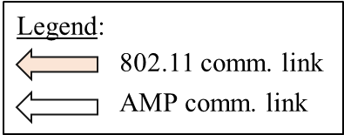
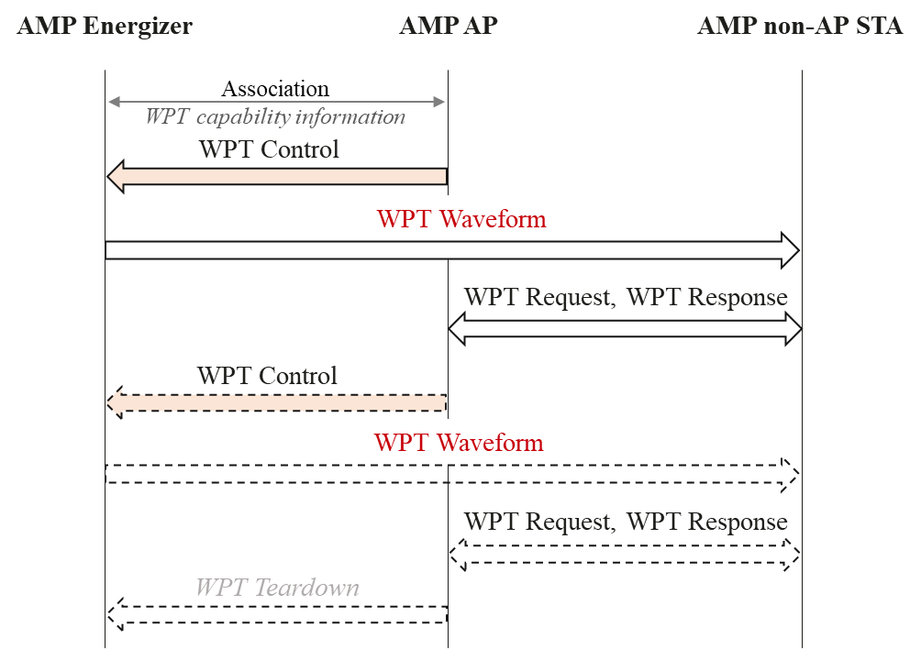
WPT Protocol
The WPT Protocol may comprise of the following steps:
AP carries out the association procedure with AMP Energizer (exchange capability information pertaining to WPT – AMP Energizer’s function, operational bands, etc. [3])
AMP AP sends a control signal to the AMP Energizer
AMP Energizer sends the WPT waveform to AMP non-AP STA
AMP AP sends a WPT Request to trigger a WPT Response (WPT report/feedback) from AMP non-AP STA
Repeat steps 2-3 with same or different configuration. Step 4 maybe repeated for ongoing WPT reporting.
AMP AP may optionally send an WPT teardown frame or utilize MAC parameters in the WPT initialization frame to stop WPT waveform transmission at the AMP Energizer.
For an integrated AP-Energizer architecture, the WPT initialization is not be required, and the AMP AP sends the WPT waveform to the AMP non-AP STA.
1
2
3
4
2
3
4

Slide 4
WPT Signaling Details
WPT Control frame can carry the following fields:
  Start Time (12 bits) – indicates the time to transmit the WPT waveform in us. Start Time field can be expressed as the LSB of the AP’s TSF.
  Duration (4 bits) – indicates the transmission duration of the WPT waveform in ms.
  Interval (11 bits) – indicates the time period between subsequent WPT waveform transmissions in ms. This eliminates the need for future control signaling for the same configuration.
  Transmit power (6 bits) – indicates the transmit power of the WPT waveform, expressed in dBm.
The AMP AP can request for WPT feedback through the Response Type field in the Payload of an AMP Poll/AMP Request Frame [4]. The WPT related responses that can be solicited maybe one or more of the fields indicated by previous contributions [5].
The WPT feedback can be reported through an AMP Response Frame with the solicited fields optionally present in the Payload, based on the presence bit in the Type Dependent control field.
The WPT feedback maybe reported as triggered by the AMP AP, or optionally self-reported by the AMP non-AP STA by piggybacking few bits with the UL data [6].

Slide 5
Summary
The steps involved in the WPT Protocol were discussed.
The WPT related fields that are carried in the control signaling from the AMP AP to the AMP Energizer were discussed, namely, the Start Time, Duration, Interval and Transmit Power with their recommended field size.
The means to enable WPT reporting between the AMP non-AP STA and AMP AP were discussed.

Slide 6
SP
Do you agree to add the following text to TGbp SFD?
Control information that is sent from the AMP AP to the AMP Energizer relating to the WPT waveform includes one or more of the following: Start Time, Duration, Interval, and Transmit Power.
[Reference: 11-24/1208r1, 11-24/1524r2, 11-24/1769r0, 11-25/0037r0, 11-25/0336r0]

Slide 7
References
[1] 11-24/0575r1, P802.11bp PAR.
[2] 11-24/1524r2, Follow-up on the AMP WPT protocol
[3] 11-25/0037r0, Follow-up on AMP Energizer
[4] 11-25/0046r0, Channel access for Active Tx non-AP AMP STAs
[5] 11-25/1769r0, Further Discussion on the AMP WPT Protocol
[6] 11-24/1539r0, Energy-Level Status Reporting for AMP Devices

