Slide 1
Channel access for Backscatter non-AP AMP STAs – follow up
Date: 10 March 2025
Name | Affiliation | Address | Phone | Email
Rojan Chitrakar | Huawei | Singapore |  | rojan.chitrakar@huawei.com
Lei Huang
Ian Bajaj
Notes:
Jul 12, 2010
Page 1

Slide 2
Recap: Channel Access for Backscatter non-AP AMP STAs
In [1] We proposed that the logical interface of the UHF RFID Standard [2] is reused for backscatter non-AP AMP STAs:
AMP frames from the AMP Reader encapsulates UHF commands.
AMP tags process the UHF commands and respond as per logical interface specified by the UHF RFID standard [2].
We also discussed the related details of the logical interface specified by the UHF RFID standard, such as memory, tag states, UHF commands, link timings, AMP frame format etc.
Similar views were also presented in [3].
In this contribution, we will discuss our views regarding implementation of the UHF RFID standard in 11bp.

Slide 3
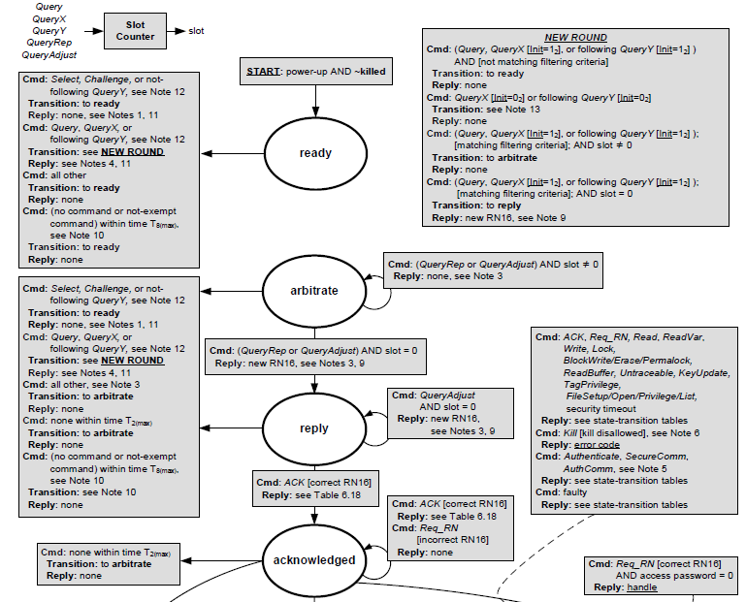
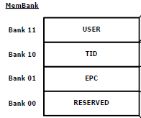
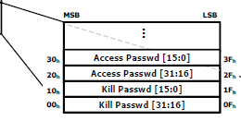
Tag memory, flags, states
We recommend that backscatter non-AP AMP STAs supports at least the following as defined by the UHF RFID Standard [2]:
Sessions and flags: 1) Inventoried flags for S0, S1, S2, S3 sessions; 2) Selected flag (SL)
Tag memory structure; EPC is mandatory. TID and USER memory may be optionally supported.
Tag states: ready, arbitrate, reply and acknowledge are mandatory; other states may be supported based on the UHF commands supported.
Tag States:
Memory Bank

Slide 4
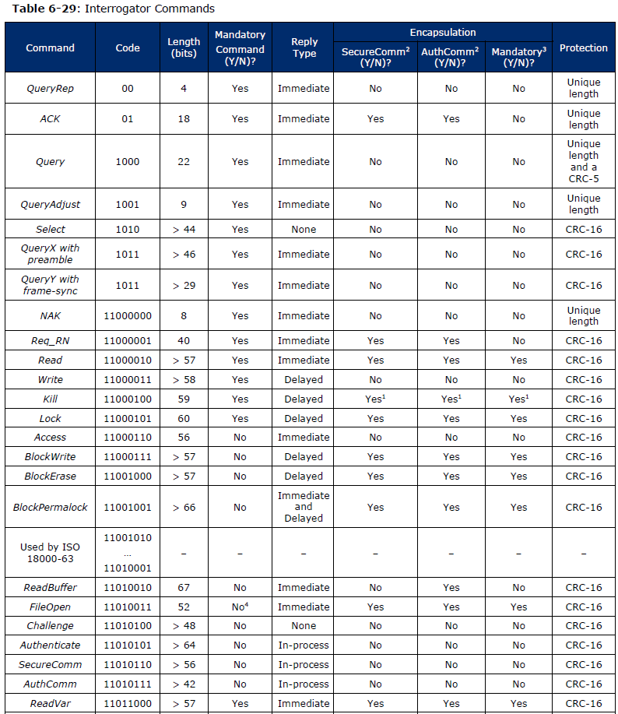
Supported UHF commands and tag replies
We recommend that backscatter non-AP AMP STAs support at least the following UHF commands and their respective replies as defined by the UHF RFID Standard [2]:
Basic set: Select, Query, QueryRep, ACK, and NAK.
Enables inventorying and reading of tag’s EPC.
Advance set: Req_RN, Read, Write, Access, Authenticate, AMP Backscatter Extension.
Enables more advanced operations like reading the TID, reading/writing USER memory, tag authentication etc.
Supports AMP specific functionalities not supported by UHF.
Other UHF commands may be supported as optional commands.
Tag replies are as defined by the UHF RFID standard. E.g.,:
Tag reply to a Query command:

Slide 5
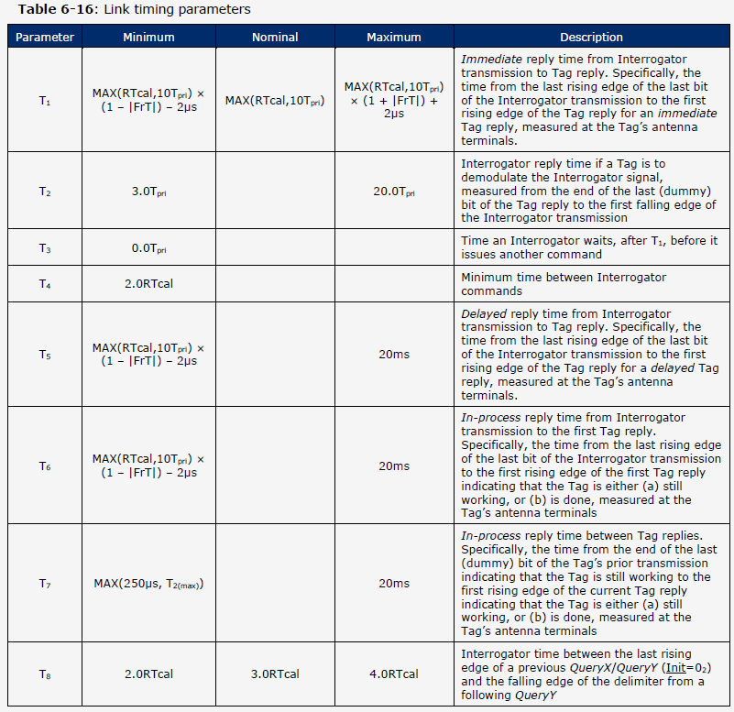
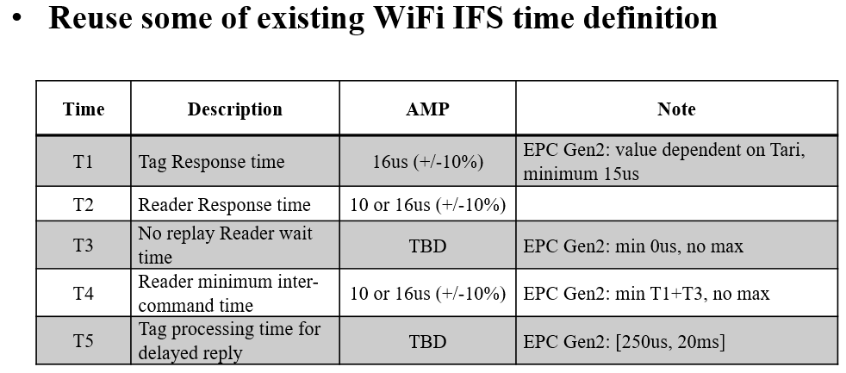
Link Timings
The Physical interface of the UHF RFID standard defines timing requirements (Table 6-16) that tags and interrogators need to meet.
We recommend that immediate reply should be supported by AMP but delayed and in-progress reply can be optional.
We agree with the proposal in [3] that AMP redefines the 3 timing parameters relevant for immediate reply (T1, T2, T4). However, further study is required to decide the appropriate values. For example, should the values be different for different uplink data rates? Also, the values for bi-static backscatter case will likely be different (and larger) than those for the mono-static backscatter case.
Below Table copied from [3]:

Slide 6
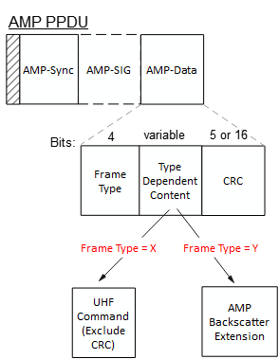
AMP frame for backscatter communication
We propose that AMP frames for backscatter communication be as simple as possible and contains:
A Frame Type field: indicates the type of the frame
Type Dependent Content field: the content depends on the frame type
CRC field: Either the 5-bits or 16-bits CRC as defined by the UHF RFID Standard but also convers the Frame Type field.
Frame Types
Frame Type | Name | Description
0 ~ X-1 | - | Used for non-backscatter communication
X | AMP UHF | AMP frames used to encapsulate UHF commands
Y | AMP Backscatter Extension | AMP frames to extend the backscatter communication
Y+1 ~ 15 | - | Reserved

Slide 7
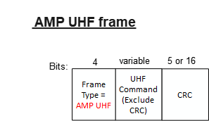
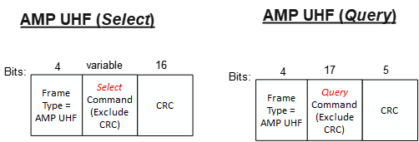
AMP UHF frame
The AMP UHF frame can be used to encapsulate UHF commands.
The Type Dependent Content field carry the UHF Command as defined in the UHF RFID Standard but excluding the CRC field.
CRC field: Either the 5-bits or 16-bits CRC as defined by the UHF RFID Standard but also convers the Frame Type field.
Example frames:

Slide 8
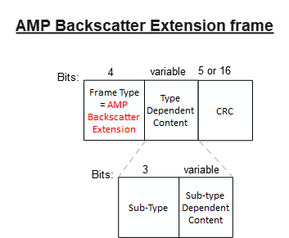
AMP Backscatter Extension frame
The AMP Backscatter Extension frame can be used to define AMP specific operations for the AMP backscatter communication.
The Type Dependent Content field carry the sub-type field and a Sub-Type Dependent Content field.
Sub-type Dependent Content field: the content depends on the frame sub-type
CRC field: Either the 5-bits or 16-bits CRC.
Sub-type (3 bits) | Frame Name | Description
0b000 | AMP PHY Param | To set AMP PHY related parameters, e.g., UL data rate etc.
0b001 | AMP Capability Request | Frame to read AMP tag’s capability (Supported data rates etc.)
0b010 – 0b111 | - | Reserved

Slide 9
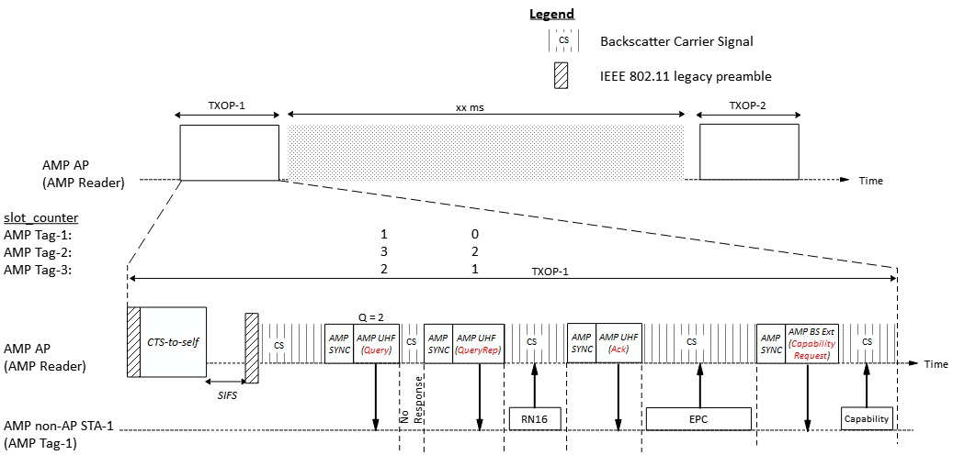
An Example

Slide 10
Summary
We proposed that the logical interface of the UHF protocol is reused for backscatter non-AP AMP STAs.
We also shared our thoughts on the relevant contents of the UHF RFID standard that may be adopted in AMP.
We also discussed a potential format for AMP frames and proposed that:
One AMP Frame Type (AMP UHF) is used to encapsulate the UHF Commands.
Another AMP Frame Type (AMP Backscatter Extension) may be used to define new functionalities specific to AMP backscattering.

Slide 11
SP 1
Do you agree to add to the 11bp SFD:
11bp supports a mode of operation in which a sub-set of the logical interface of the UHF RFID Standard is used for backscattering communication.
Applicable UHF commands are encapsulated in 802.11bp frames.
Applicable to both mono-static & bi-static backscattering.
The sub-set of the logical interface to be reused is TBD.
NOTE – The logical interface of the UHF RFID Standard is defined by the EPC® Radio-Frequency Identity Generation-2 UHF RFID Standard.

Slide 12
SP 2
Do you agree to add to the 11bp SFD:
11bp defines one AMP frame type to encapsulate a UHF command.
The frame consists of a Frame Type field, a Type-dependent Content field and a CRC field
The UHF command is carried in the Type-dependent Content field
The UHF commands supported by 11bp include: Select, Query, QueryRep, ACK, and NAK
Other UHF commands supported by 11bp is TBD
NOTE – The UHF commands are defined by the EPC® Radio-Frequency Identity Generation-2 UHF RFID Standard.

Slide 13
SP 3
Do you agree to add to the 11bp SFD:
11bp defines one AMP frame type to carry AMP specific content for backscattering.
The frame consists of a Frame Type field, a Type-dependent Content field and a CRC field.
The AMP specific content is carried in the Type-dependent Content field.
The AMP specific content is TBD.

Slide 14
References
[1] 25/045r0, Channel access for Backscatter non-AP AMP STAs (Rojan Chitrakar et. al.)
[2] EPC® Radio-Frequency Identity Generation-2 UHF RFID Standard V3.0 (GS1)
[3] 25/0061r0, AMP-monostatic-backscattering-operation (Rui Cao et. al)

