Slide 1
Channel access for Active Tx non-AP AMP STAs – follow up
Date: 7 March 2025
Name | Affiliation | Address | Phone | Email
Rojan Chitrakar | Huawei | Singapore |  | rojan.chitrakar@huawei.com
Lei Huang
Ian Bajaj
Notes:
Jul 12, 2010
Page 1

Slide 2
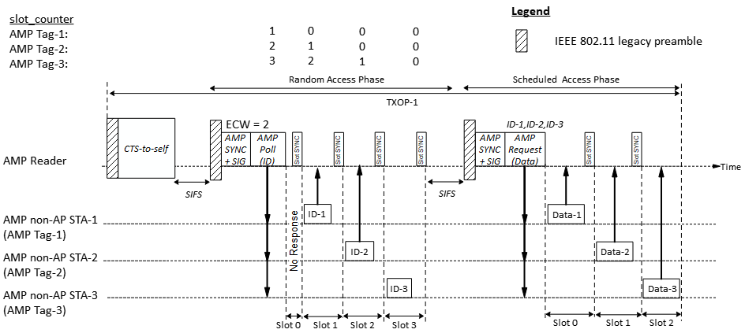
Recap: Time-slot based channel access [1]
A time-slot based channel access may be based on random access or scheduled access. An AMP Reader initiates a random access when it is not aware of the identities of the non-AP AMP STAs in its coverage, while it uses the scheduled access to communicate with AMP STAs that are known to it. The random access phase can be omitted if the AMP Reader is already aware of the AMP tag’s IDs.
Slots Sync may be transmitted at slot boundaries to help the non-AP AMP STAs to align with the slots.
Notes:
Some concerns were received in the past meeting about the overhead of Slot SYNC during the random access phase.

Slide 3
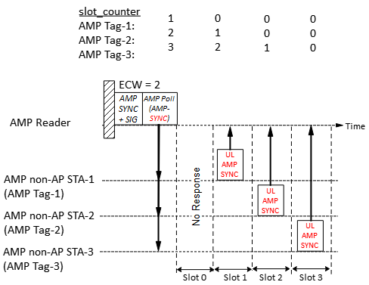
Time-slot based random access
Random access procedure:
1. The AMP Reader gains access to wireless medium and transmits a control frame (e.g., an AMP Poll frame) to start a random access session. The frame indicates:
Session ID: Identifies the random access session
The total number of random access slots = 2^{ECW}
Solicited Response Type = AMP-SYNC
2. Upon receiving an AMP Poll frame, a non-AP AMP STA randomly choose a slot_counter in the range [0, 2^{ECW} - 1]. If slot_counter is 0, the AMP STA transmits the requested response (i.e., UL AMP-SYNC) in slot 0, else it decrements the slot_counter at each slot boundary and transmits the UL AMP-SYNC in the slot in which the slot_counter reaches 0.
3. The AMP Reader records the indices of the random access slots in which it successfully receives an UL AMP-SYNC. Note - The AMP Reader may not know the identity of the AMP tag that transmitted the UL AMP-SYNC.
4. Since the Slots are not large, guard intervals of a few µS between the slots may be sufficient to prevent inter-slot collisions.
Assuming UL AMP-SYNC with 16 bits and ~10% guard interval, the slot duration required:
@250 kbps = ~70 µS; @1 Mbps = ~18 µS; @ 4 Mbps = ~4.5 µS
Even at @250 kbps and random access with 16 slots, the worst drift (@10K ppm) at the start of the 16th slot is @10 µS.
Notes:
@250 kbps, with 70 uS slots, the 16th slot starts at 1050 uS.

Slide 4
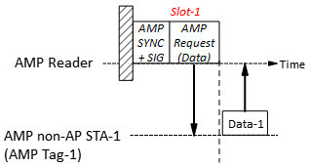
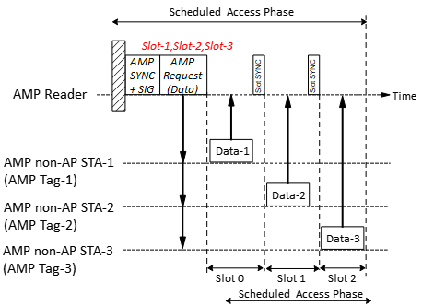
Time-slot based scheduled access
Scheduled access procedure:
The AMP Reader transmits a control frame (e.g., an AMP Request frame) assigning transmission time-slots to one or more non-AP AMP STAs based on the slot index of the Random Access phase in which it successfully received an AMP-SYNC. Random access slots in which AMP-SYNC is not received (due to no response, or collision etc.), is not assigned a time-slot in the Scheduled Access phase. The AMP Request frame may also specify the solicited response (e.g., MAC Address, Buffer Date etc.).
If an AMP STA receives an AMP Request frame and finds the index of the slot in which it transmitted in the Random Access Phase assigned a time-slot in the AMP Request frame, it transmits its response in the assigned time-slot.
If the slot duration is large (e.g., > 1 ms), the AMP Reader may transmit a Slot Sync at slot-boundaries to indicate start of a time-slot but if the slot duration is small, guard interval may be sufficient.

Slide 5
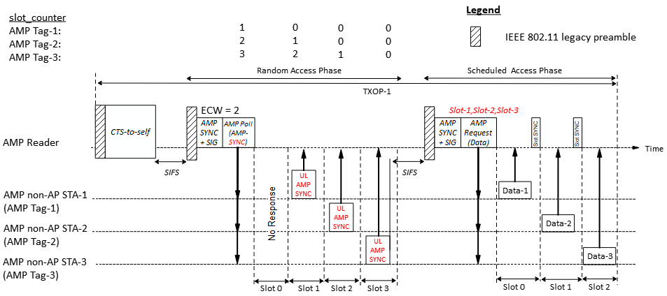
Time-slot based channel access
Example:
During random access session, Tag 1, 2 and 3 successfully transmits UL AMP-SYNC in slot 1, 2 and 3 respectively.
Subsequently, the AMP Reader schedules the tag that transmitted in Slot 1 (Tag 1) to transmit in Slot 0, the tag that transmitted in Slot 2 (Tag 2) to transmit in Slot 1 and the tag that transmitted in Slot 3 (Tag 3) to transmit in Slot 2 of the scheduled transmission session.

Slide 6
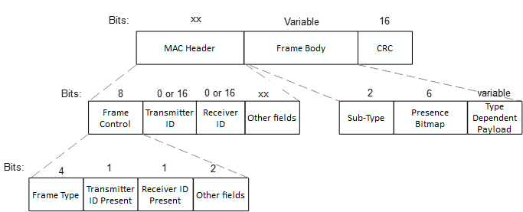
AMP frame
Similar to the views expressed in [3], [4], we propose that AMP frame be designed similar to WUR frames, only carrying the absolutely essential fields.
One AMP Frame Type (AMP Trigger) may be used to initiate time-slot based channel access
Frame Type | Name | Description
0 | AMP Trigger | AMP frame to solicit a response from non-AP AMP STAs either during random access or scheduled access.
… | …
X | AMP UHF | AMP frames used to encapsulate UHF commands
X+1 ~ 15 | - | Reserved

Slide 7
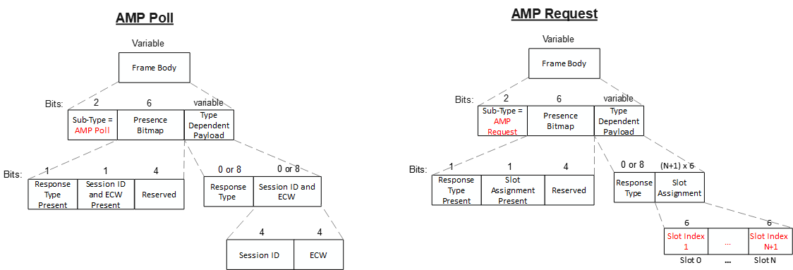
AMP Trigger frame
The parameters to be carried in the AMP Trigger frame will be different for random access and scheduled access. In order to keep the frames compact, we propose to define different sub-types of the AMP Trigger frame, e.g., AMP Poll for random access and AMP Request for scheduled access.
Slot index of the Random Access phase
Indicates that AMP-SYNC is solicited.

Slide 8
Summary
We discussed the details of the time-slot based channel access for active TX AMP STAs and propose:
The time-slot based channel access may be based on random access or scheduled access.
During random access, AMP tags may transmit only the UL AMP-SYNC field to keep the slots short.
During scheduled access, AMP Reader may assign time-slots to one or more AMP tags based on the slot index of the Random Access phase
We propose to define different sub-types of the AMP Trigger frame, e.g., AMP Poll for random access and AMP Request for scheduled access.

Slide 9
SP 1
Do you agree to add to 11bp SFD:
802.11bp supports a time-slot based channel access mechanism for Active Tx non-AP AMP STAs.

Slide 10
SP 2
Do you agree to add to 11bp SFD:
802.11bp supports a time-slot based random access mechanism for Active Tx non-AP AMP STAs:
AMP AP transmits an AMP frame to start a random access session with two or more random access time-slots.
An Active Tx non-AP AMP STA that receives the AMP frame, may randomly choose one of the random access time-slots and transmit its response in the time-slot.
Further details (e.g., frame details, how a STA choses a random access time-slot etc.) are TBD.

Slide 11
SP 3
Do you agree to add to 11bp SFD:
802.11bp supports a time-slot based scheduled access mechanism for Active Tx non-AP AMP STAs:
AMP AP transmits an AMP frame to assign one or more transmission time-slots.
An Active Tx non-AP AMP STA that receives the AMP frame, transmit its response in an assigned time-slot.
Further details (e.g., frame details, how the time-slots are assigned etc.) are TBD.

Slide 12
References
[1] 25/0046r0, Channel access for Active Tx non-AP AMP STAs (Rojan Chitrakar et. al.)
[2] 24/1776r1, Multiple access mechanisms for AMP (Chuanfeng He et. al.)
[3] 24/1811r0, Frame format discussion (Liwen Chu et. al.)
[4] 11-24/1537r2, Wireless connectivity challenges for AMP only IoT devices under 802.11 specification (Solomon Trainin)

