Slide 1
Common discovery and negotiation procedure for MAPC
Date: 2025-03-11
Authors:

Slide 2
Terminologies used in this slide deck
Terms (mainly used in this slide) | Other alternative terms | Description
Multi-AP (M-AP) coordination scheme | M-APC scheme M-AP scheme MAPC scheme | Coordination schemes discussed in TGbn such as Co-SR, Co-BF, Co-TDMA, Co-RTWT, etc
MAPC authentication |  | A function to check whether two UHR APs are able to trust each other to proceed MAPC agreement
MAPC agreement |  | A procedure that a UHR AP negotiates with one or more UHR APs that support the same MAPC scheme by performing AP ID assignment and others.
MAPC association ID (MAPC AID) | AP ID | The value to be used in the AID12 field of a frame to indicate the other UHR AP during the M-AP operation
MAPC agreement ID | MAPC management ID MAPC negotiation ID | The value to be used for management purpose to indicate a particular MAPC agreement with the corresponding set of parameters and configurations

Slide 3
MAPC framework relevant passing motions
[Motion #50]
11bn defines a common framework of a Multi-AP Coordination for various coordination schemes.
  Note - Coordination schemes such as (but not limited to): Co-SR (TXOP-based with power control), Co-BF, Co-TDMA, Co-RTWT, etc.
  [Motion #51]
11bn defines a common framework of a Multi-AP Coordination that can enable the following procedures:
Multi-AP Coordination Discovery procedure
Multi-AP Coordination agreement negotiation procedure
  Note: Details of the procedures and whether the above procedures are mandatory/optional - TBD
[Motion #120]
A UHR AP shall indicate to another AP its capability to respond in a TB PPDU or not
[Motion #135]
The sharing AP, that transmits a Trigger frame as part of a transmission sequence in a Multi-AP coordinated transmission scheme, identifies the shared AP via an AP ID carried in the AID12 field of the User Info field of the frame
  Note: the name of "sharing AP" and "shared AP" are TBD
  Note: Multi-AP coordinated transmission schemes are Co-SR, Co-BF and Co-TDMA
[Motion #147]
APs that intend to participate in Multi-AP coordination can use management frames to advertise/discover the capabilities and/or parameters of individual schemes.
[Motion #148]
APs that discovered each other and want to establish agreement(s) for Multi-AP coordination scheme(s), can use individually addressed management frames to establish the agreement(s) and negotiate parameters
  Note: The management frame can be a Public Action and/or new Action frames, and so on.

Slide 4
MAPC framework relevant passing motions
[Motion #265]
Move to add to the TGbn SFD the following:
  As a part of M-AP coordination agreement procedure, an AP may assign an AP ID to another AP with the following constraints:
  The AP ID is used for the AP to identify another AP as a coordinated AP, when necessary.
  The AP ID field has the same size and the field value has a range as defined in AID field (see 9.4.1.8)
  The AP shall ensure that the AP ID value is not assigned by the AP or by its affiliated MLD to any other STA (e.g., STA is an associated non-AP STA, an unassociated non-AP STA that has been allocated a RSID , or any other coordinated AP), or a non-AP MLD that is associated with the AP MLD
  It's TBD whether the AP ID value is greater than 2^n where n is the maximum of the value carried in the MBSSID Indicator (n) field of the Multiple BSSID element for any AP affiliated with the AP MLD that belongs to a multiple BSSID set

Slide 5
Motivation
Which AP would be one that leads/manages/initiates M-AP coordination (MAPC)?
  MAPC agreement requesting AP is just an AP which transmits a request frame to start a particular MAPC scheme and negotiate initial operating parameters to be used for the MAPC scheme
  MAPC agreement responding AP is just an AP which receives a request frame transmitted by MAPC agreement requesting AP and responds with a response frame to complete MAPC agreement negotiation
  Any AP can be MAPC agreement requesting AP or MAPC agreement responding AP. In addition, both MAPC agreement requesting AP and MAPC agreement responding AP can be a TXOP holder for MAPC operation/management
Some functional procedures between APs may be considered as a part of common negotiation procedure for a stable MAPC agreement and operation
  Authentication: Can a ‘responding AP’ trust the ‘requesting AP’ which wants to establish a MAPC agreement? If yes, then how to authenticate the requesting AP?
  ID allocation/negotiation: APs allocate AIDs (AP ID) with each other and those AIDs are used during M-AP operation if needed. An additional identifier (TBD MAPC agreement ID) can be introduced to identify a particular MAPC agreement (i.e., the corresponding MAPC scheme and its operating parameters) for future long-term management

Slide 6
Scope
The overall concept presented in this contribution is applicable to both enterprise as well as non-enterprise scenario
  For both participating and coordinating APs belonging to same domain (e.g. FT, SMD), it may be easier to use 'over-the-DS' communication for MAPC discovery and agreement/negotiation procedures
  For non-enterprise or residential scenario, the participating APs may not be able to communicate with each other (due to lack of connectivity and reachability via backend system) and hence 'over-the-air' based communication for MAPC discovery and agreement/negotiation procedures can be the feasible solution
Accordingly, 'over-the-air' based solution is the main focus of this contribution

Slide 7
Proposal:
Having ‘Authentication’ and ‘Association’ as a common negotiation functions to be applied for all MAPC scheme
Step 1) Capability exchange, announcement, discovery
  Use broadcast frame (e.g.,
  TBD advertisement/broadcast frame) [2]
Step 2) MAPC authentication
  Can be a part of unicast-based MAPC discovery
    Sharing capabilities of MAPC schemes and parameters
    Sharing credential information for authentication
Step 3) MAPC ID allocation [1,3]
  Allocate AID to each other AP
    AP 1 allocates AID to AP2
    AP2 allocates AID to AP1
  Optionally allocate another identifier to indicate a particular MAPC agreement [3]
Step 4) MAPC scheme-specific agreement [2]
  “MAPC ID allocation functionality” in step 3 can be a part of this procedure
  Initial configuration and operating parameter sets to be used for the MAPC scheme are negotiated during this step
AP1
AP2
[1. Broadcast frame-based MAPC Discovery]
Discovery of neighbor APs with MAPC capabilities
[2. Unicast-based MAPC Discovery
(with MAPC authentication)]
[3. Common MAPC agreement
(with MAPC ID allocation)]
Steps 3 and 4 can be done with a single request/response frame exchange
[4. MAPC scheme-specific agreement]
Notes:
(*비고,기존 BSS 내 AP와 non-AP STA간 association은 status code와 association ID (AID)로 응답)

Slide 8
Unicast-based MAPC Discovery
(with authentication function) example
MAPC agreement requesting AP
(AP1)
MAPC agreement responding AP
(AP2)
Authentication Server
Authentication Server
authentication request
(credential…)
MAPC authentication request element info.
(‘Requesting AP’s credential’)
…
authentication result
Update MAPC scheme list that can be negotiated with AP1 based on authentication result
authentication request
(credential…)
…
MAPC authentication response element info.
(‘Responding AP’s credential’ and
‘updated M-AP scheme list’)
authentication result
Update MAPC scheme list that can be negotiated with AP1 based on authentication result
(Optionally)
MAPC authentication confirm element info.
(‘updated MAPC scheme list’)
One of potential authentication mechanisms that can be used for this AP authentication may be a protocol similarly designed to TLS 3-way handshake.
Perform remaining MAPC agreement for one of MAPC schemes contained in the updated MAPC scheme list

Slide 9
Common MAPC Agreement Negotiation
(with ID allocation/negotiation) example
MAPC agreement requesting AP
(AP1)
MAPC agreement responding AP
(AP2)
MAPC Discovery frame
MAPC Discovery frame
MAPC agreement request frame
(including AP ID allocated by AP1 to AP2,
MAPC scheme to be used,
(opt.) MAPC agreement ID)
MAPC agreement response frame
(including AP ID allocated by AP2 to AP1,
MAPC scheme to be used (as a confirmation),
(opt.) MAPC agreement ID (as a confirmation))

Slide 10
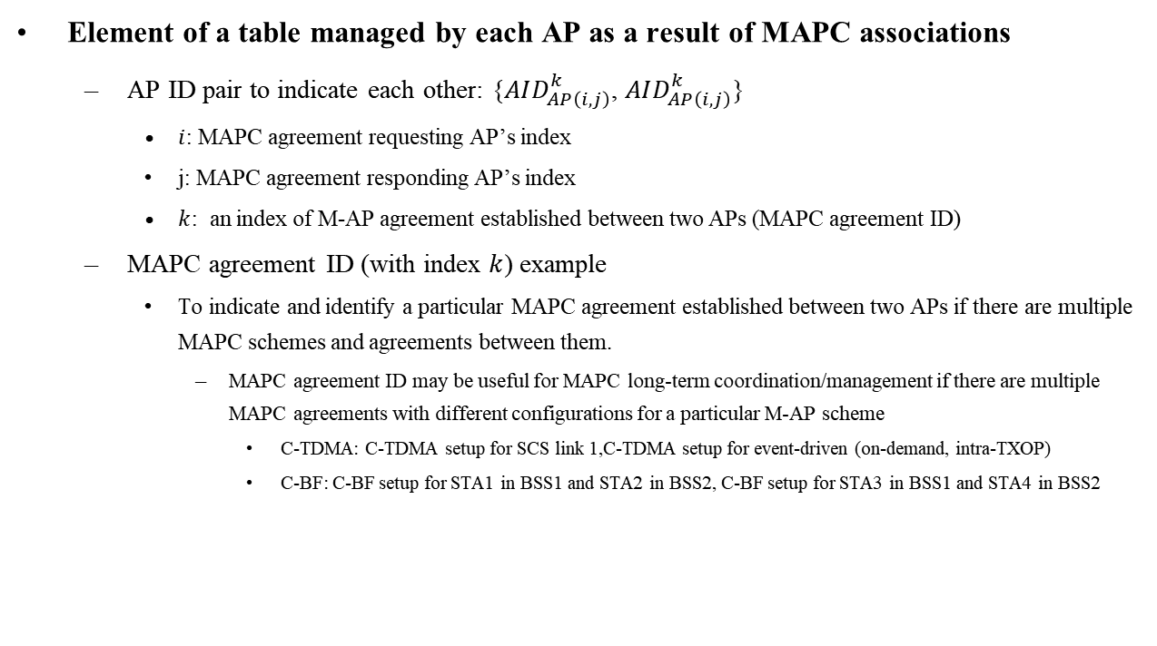
MAPC ID Table managed by each AP (Example)
Element of a table managed by each AP as a result of MAPC associations
  AP ID pair to indicate each other: {$AID_{AP\left(i,j\right)}^{k}$, $AID_{AP\left(i,j\right)}^{k}$}
    $i$: MAPC agreement requesting AP’s index
    j: MAPC agreement responding AP’s index
    $k$: an index of M-AP agreement established between two APs (MAPC agreement ID)
  MAPC agreement ID (with index $k$) example
    To indicate and identify a particular MAPC agreement established between two APs if there are multiple MAPC schemes and agreements between them.
      MAPC agreement ID may be useful for MAPC long-term coordination/management if there are multiple MAPC agreements with different configurations for a particular M-AP scheme
        C-TDMA: C-TDMA setup for SCS link 1,C-TDMA setup for event-driven (on-demand, intra-TXOP)
        C-BF: C-BF setup for STA1 in BSS1 and STA2 in BSS2, C-BF setup for STA3 in BSS1 and STA4 in BSS2
AP2
MAPC agreement 1
MAPC agreement 2
MAPC agreement 3
AP1
MAPC agreement 1
MAPC agreement 1
MAPC agreement 2
AP3
AP | AP ID | MAPC MID | MAPC scheme
AP2 | 33 | 1 | C-TDMA
AP2 | 33 | 2 | C-BF
AP2 | 33 | 3 | C-BF
AP3 | 34 | 1 | C-SR
AP3 | 34 | 2 | C-BF

Slide 11
MAPC discovery and agreement example sequence
MAPC agreement requesting AP
(AP1)
MAPC agreement responding AP
(AP2)
Public Action
(TBD MAPC Discovery request)
Unicast-based
MAPC
Discovery
MAPC capability parameter
Request-Response frame exchange
MAPC authentication info.
Check whether to trust AP1 based on MAPC auth. info
Public Action
(TBD MAPC Discovery response)
Check whether to trust AP2 based on MAPC auth. info
Public Action
(TBD MAPC Negotiation request)
MAPC
Agreement
MAPC association info. (AP ID allocation)
MAPC scheme-specific info. (e.g., Co-TDMA info, Co-BF info …)
Public Action
(TBD MAPC Negotiation response)

Slide 12
MAPC discovery and agreement example sequence
MAPC agreement requesting AP
(AP1)
MAPC agreement responding AP
(AP2)
Beacon or Public Action (TBD MAPC Advertisement)
Broadcast-based
MAPC
Discovery
MAPC capability parameter
Advertisement frame broadcasting
MAPC authentication info.
Check whether to trust AP1 based on MAPC auth. info
Beacon or Public Action
(TBD MAPC Advertisement)
Check whether to trust AP2 based on MAPC auth. info
Public Action
(TBD MAPC Negotiation request)
MAPC Agreement
MAPC association info. (AP ID allocation)
MAPC scheme-specific info. (e.g., Co-TDMA info, Co-BF info …)
Public Action
(TBD MAPC Negotiation response)

Slide 13
Conclusion
We propose to have unicast-based MAPC discovery along with broadcast-based MAPC discovery
We propose to optionally have MAPC authentication functionality as a part of unicast/broadcast-based MAPC discovery procedure so that two APs can perform mutual authentication if needed
We propose to have ID allocation functionality (including AP ID assignment and optionally including MAPC agreement management ID) as a common part of MAPC agreement negotiation
  Some MAPC scheme such as Co-RTWT may not require AP ID assignment functionality
  MAPC agreement management ID is useful for indicating a specific MAPC agreement and updating operating parameters for the indicated MAPC agreement when multiple MAPC agreements have been established between two APs

Slide 14
SP1
Do you agree that 11bn defines a common framework of a Multi-AP Coordination (MAPC) that can enable the following:
  As a part of MAPC discovery procedure, APs that passively discovered each other based on broadcast frames and want to establish agreement(s) for MAPC scheme(s), may use individually addressed management frames (e.g., Public Action frame) to optionally negotiation between two APs to check whether they are able to establish the MAPC agreement(s) before MAPC agreement negotiation
    Note: Details of the procedure to check whether they can establish an MAPC agreement and whether the above procedure is mandatory/optional - TBD

Slide 15
SP2
Do you agree that 11bn defines a common framework of a MAPC that can enable the following:
  As a part of MAPC agreement negotiation procedure, an AP assigns only one AP ID to another AP with the following constraints:
    An AP assigns only one AP ID to the same target AP
    If there is at least one active MAPC agreement and AP ID has been assigned and used for that MAPC agreement, the AP can skip assigning AP ID to another AP or it explicitly assign the same AP ID as that used by existing MAPC agreement

Slide 16
SP3
Do you agree that 11bn defines a common framework of a MAPC that can enable the following:
  As a part of MAPC agreement negotiation procedure, APs that passively and/or actively discovered each other and want to establish agreement(s) for MAPC scheme(s), may use individually addressed management frames (e.g., Public Action frame) to optionally allocate the following identifier as a purpose of long-term/short-term management of the MAPC scheme to be established:
    an identifier indicating the MAPC agreement and the corresponding set of operating parameters negotiated for that MAPC agreement
  Note : Details of the procedure and whether the above procedure is mandatory/optional - TBD

Slide 17
Reference
[1] 11-24/1217r2 Multi-AP Coordination Setup Scheme
[2] 11-24/1220 A Framework for Coordinated Access Points
[3] 11-24/1761r1 Aspects of M-AP Coordination (MAPC) agreement

