Slide 1
AMP Downlink Bandwidth Control using OFDM Spreading Waveform
Date: 2025-03-09
Authors:
Name | Affiliations | email
Steve Shellhammer | Qualcomm | shellhammer@ieee.org
Bin Tian |  | btian@qti.qualcomm.com
Pooria Pakrooh |  | ppakrooh@qti.qualcomm.com
Manideep Dunna |  | mdunna@qti.qualcomm.com
Alice Chen |  | alicel@qti.qualcomm.com

Slide 2
Introduction
In [1] we described some of the Challenges in spreading a 0.5 µs OOK symbols
However, we would still like to generate a sufficiently wide Downlink to enable maximum transmit power in both ETSI and China regulatory domains

Slide 3
Background
The Task Group agreed to the following [1]
  The preamble of an AMP DL PPDU includes L-STF, L-LTF, L-SIG, RL-SIG, and U-SIGs for AMP enabled non-AP STA and active TX non-AP AMP STA
Hence Downlink PPDUs transmitted to non-backscatter STAs begin with an OFDM preamble
So, from an implementation perspective it make sense to see if we can design the waveform so that the Sync and Data fields are constructed using OFDM

Slide 4
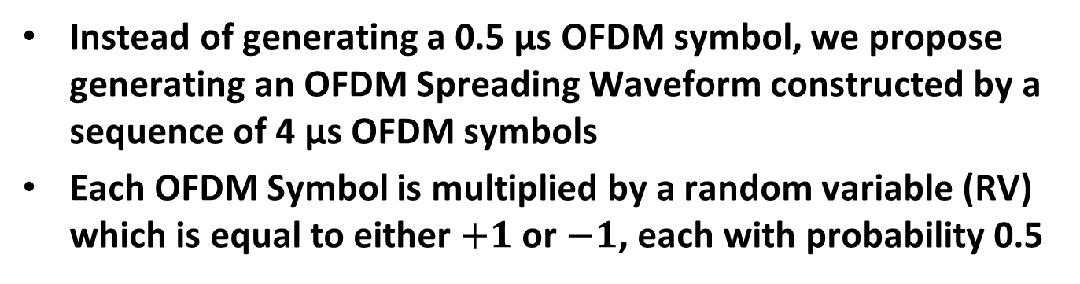
Proposed Approach
Instead of generating a 0.5 µs OFDM symbol, we propose generating an OFDM Spreading Waveform constructed by a sequence of 4 µs OFDM symbols
Each OFDM Symbol is multiplied by a random variable (RV) which is equal to either $+1$ or $−1$, each with probability 0.5
OFDM Spreading Waveform

Slide 5
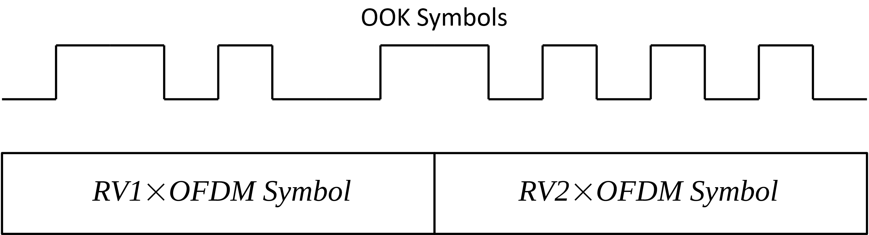
Proposed OFDM Spreading Waveform Approach
(1 Mb/s PHY)
Here we look at the 1 Mb/s OOK signal
The 0.5 µs OOK symbols are shorter in duration than the 4 µs OFDM symbols, so a portion of the 4 µs OFDM symbol will modulate each 0.5 µs OOK symbol
  We will call these portions of the OFDM Symbol “slices”
Here is an example illustration:

Slide 6
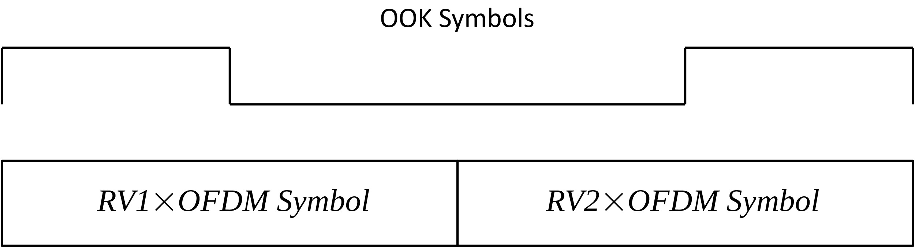
Proposed OFDM Spreading Waveform Approach
(250 kb/s PHY)
Here we look at the 250 kb/s OOK signal
The 2 µs OOK symbols are half the duration than the 4 µs OFDM symbols, so half of the 4 µs OFDM symbol will modulate each 2 µs OOK symbol
  We will call these portions of the OFDM Symbol “slices”
Here is an example illustration:

Slide 7
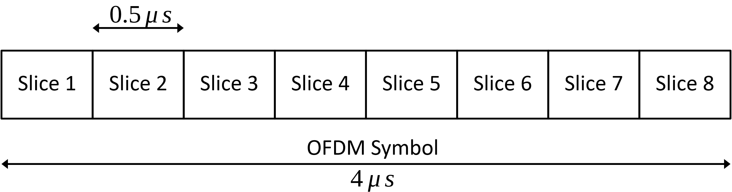
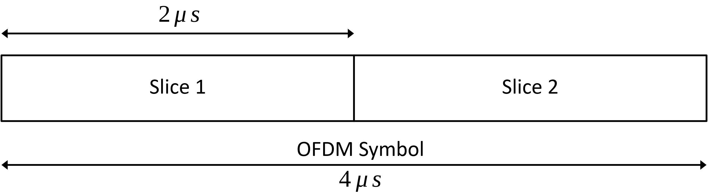
Slices of the OFDM Symbol
Eight Slices (for 0.5 µs OOK symbols)
Two Slices (for 2 µs OOK symbols)

Slide 8
Selection of the OFDM BPSK Sequence
We are free to select the OFDM BPSK Sequence
One of the considerations is the power level in the slices of the OFDM symbol which modulate the OOK Symbols
We would like those to be approximately the same power level, so each spread OOK symbol is transmitted at approximately the same power level
We want this in the 8 slices of the OFDM symbol used for the 0.5 µs OOK symbols (1 Mb/s Downlink)
And we want this in the 2 slices of the OFDM symbol used for the 2 µs OOK symbols (250 kb/s Downlink)
We are also free to select the number of OFDM Tones which are populated BPSK symbols
We can use 52 Tones like in 802.11a, or we can use fewer, if we want to simplify the required filtering of the signal, to meet the spectral mask
Here we will propose using 50 tones, to ease the filtering requirements

Slide 9
Selection of the OFDM BPSK Sequence
We did a search to provide good uniformity of the 8-slice and 2-slice power level
We made sure the power level of the weakest slice was close to the average slice power level
This is the OFDM BPSK Sequence we identified
Sequence = [0, 0, 0, 0, 0, 0, 0, 1, -1, -1, -1, -1, 1, 1, -1, 1, 1, 1, -1, 1, -1, -1, -1, -1, -1, -1, -1, 1, -1, -1, 1, -1, 0, -1, -1, 1, 1, 1, -1, -1, 1, -1, 1, 1, -1, 1, -1, -1, -1, 1, -1, 1, 1, 1, -1, -1, 1, 1, 0, 0, 0, 0, 0, 0,];

Slide 10
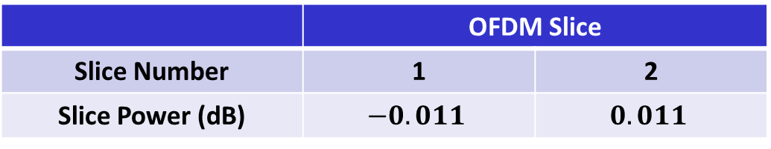
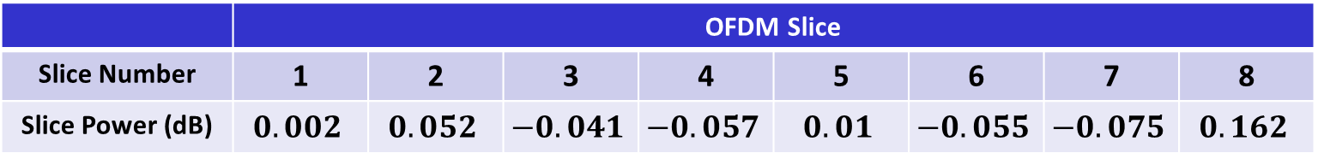
Selection of the OFDM BPSK Sequence
Here we provide the slice power levels
The average slice power level is set to zero
0.5 µs OOK Symbols
 | OFDM Slice
Slice Number | 1 | 2 | 3 | 4 | 5 | 6 | 7 | 8
Slice Power (dB) | $$0.002$$ | $$0.052$$ | $$−0.041$$ | $$−0.057$$ | $$0.01$$ | $$−0.055$$ | $$−0.075$$ | $$0.162$$
2 µs OOK Symbols
 | OFDM Slice
Slice Number | 1 | 2
Slice Power (dB) | $$−0.011$$ | $$0.011$$

Slide 11
Power Spectral Density Simulation
Generate the OFDM Spreading Waveform and modulate a sequence of 0.5 µs OOK symbols
  Subsequently we repeat the process using 2 µs OOK symbols
Apply a filter to the spread waveform to meet the OFDM spectral mask
Calculate the PSD of the unfiltered and filtered signals
Plot PSD of the unfiltered and filtered signals along with the OFDM spectral mask

Slide 12
Calculation of Maximum Allowed TX power in ETSI and China Regulatory Domains
Using filtered signal PSD, we search from over all 1 MHz sections of the PSD
Based on the power in the largest 1 MHz section we calculate the maximum allowed power based on ETSI and China PSD limits
We report that value
If that value is larger than 20 dBm we are then limited by the maximum power limit of 20 dBm

Slide 13
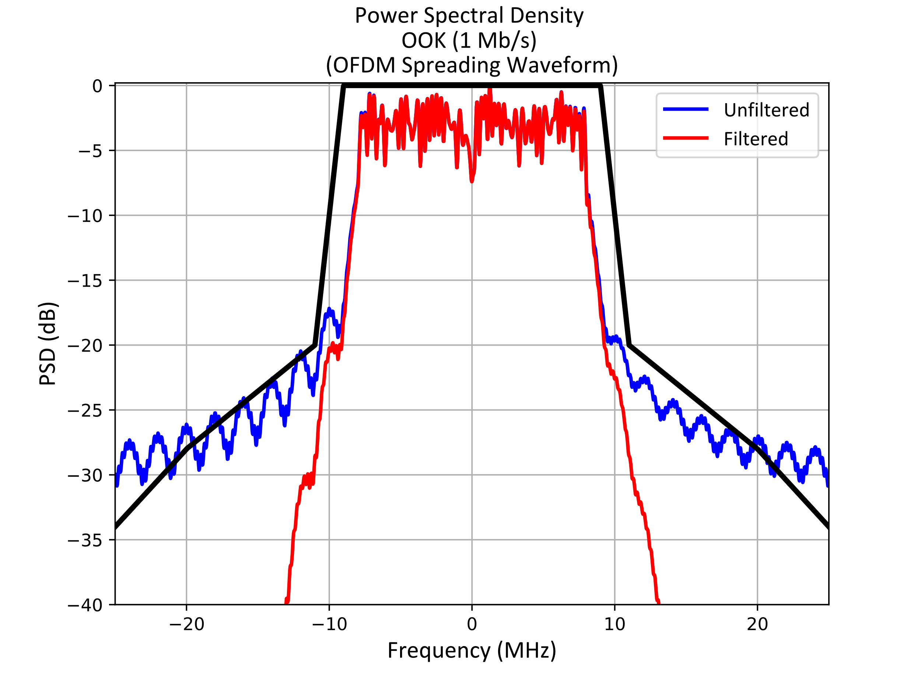
Power Spectral Density
(1 Mb/s Downlink PPDU)
Meets the OFDM Spectral Mask (as shown in Black)
Calculated the PSD TX Power limit for ETSI & China = 21.4 dBm
So, we can transmit at 20 dBm
  The absolute max TX power

Slide 14
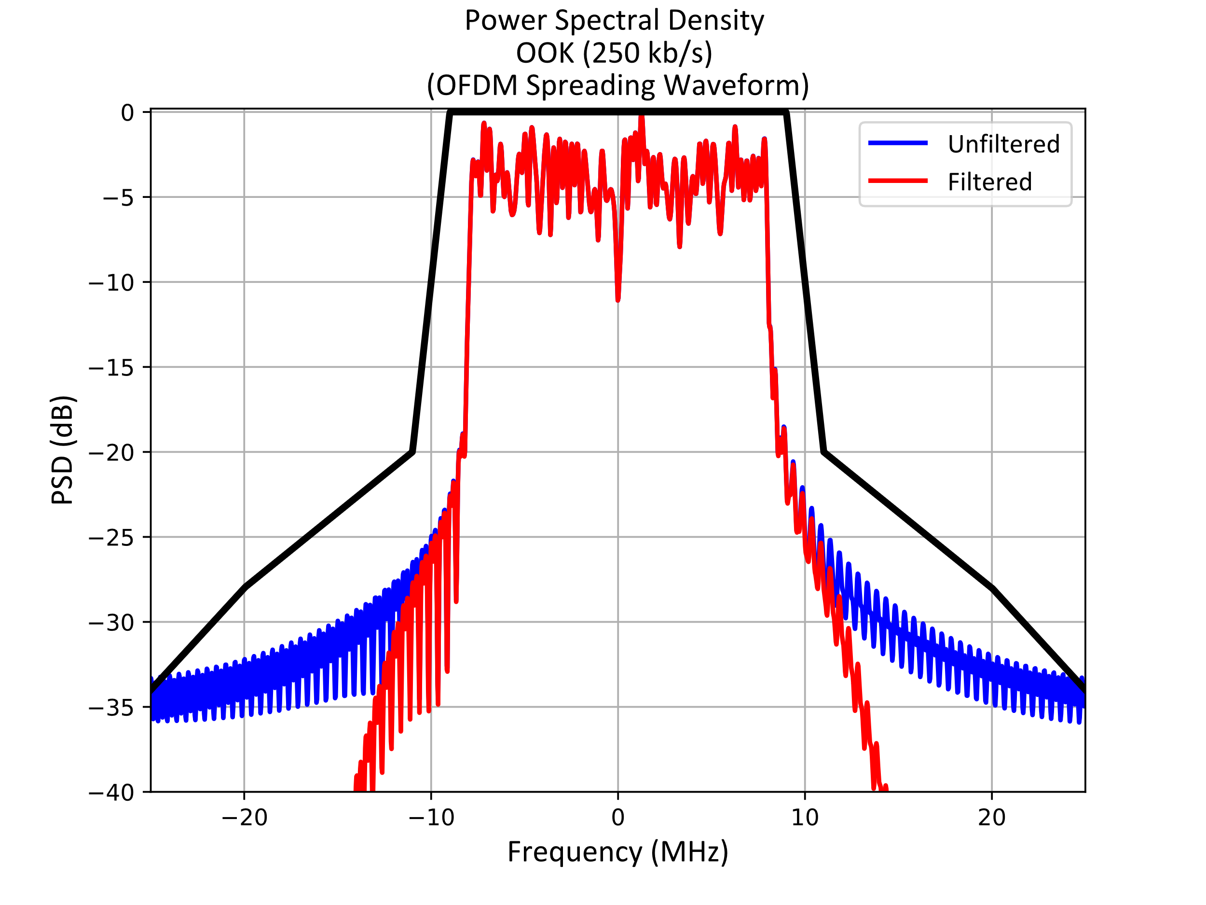
Power Spectral Density
(250 kb/s Downlink PPDU)
Meets the OFDM Spectral Mask (as shown in Black)
Calculated the PSD TX Power limit for ETSI & China = 21.2 dBm
So, we can transmit at 20 dBm
  The absolute max TX power

Slide 15
Conclusions
We proposed a OFDM Spreading Waveform to spread both the 1 Mb/s and 250 kb/s Downlink for the non-backscatter STAs
Transmission of 250 kb/s Downlink PPDU for backscatter STAs needs more discussion
The spread waveform, with filtering, meets the OFDM spectral mask
The PSD of the spread (and filtered) waveform enable the Access Point (AP) to transmit at 20 dBm, which is the maximum allowed TX power in ETSI and China regulator domains
We showed that an OFDM Symbol can be generated such that the power level of the slices of the OFDM Symbol, for each OOK Symbol, are very close to the average OFDM slice power

Slide 16
Straw Poll
Do you agree to add the following content to the 802.11bp SFD:
  The AMP Downlink PPDU shall utilize OFDM Spreading Waveform

Slide 17
References
Steve Shellhammer, et. al., “Challenges in Downlink Bandwidth Control in 1 Mb/s PPDU,” IEEE 802.11-25/0324r0, March 2025

