Slide 1
Follow-up on sync field for AMP PPDU
March 2025
Doc.: IEEE 802.11-25/0321r0
Date: 2025-03-10
Authors:
Name | Affiliation | Address | Phone | Email
Wang Ke | OPPO |  |  | wangke6@oppo.com
Jinyu Zhang |  |  |  | xuweijie@oppo.com
Weijie Xu |  |  |  | v-qiyinan@oppo.com
Yinan Qi
Sehngjiang Cui

Slide 2
Abstract
Doc.: IEEE 802.11-25/0321r0
In our previous contribution[1], we discussed the requirement, design criterion of AMP sync. A candidate sync sequence was proposed and based on it, we do comprehensive simulations to check the synchronization performance and the consequent impact on data channel decoding.
In this contribution, we further update the simulation results. Based on that, we give our proposal.

Slide 3
Recap:High-level requirements for AMP sync(1)
Doc.: IEEE 802.11-25/0321r0
In [1]. the following requirements for AMP sync are discussed.
  Different sync sequences for DL/UL for indication.
  Support two different AMP DL rate
    e.g. 1Mbps and 250kbps using 2 different sync
    A correlator can distinguish between Sync length 16 and 32.
  The Sync sequence has the same number of 1 and 0.
  Good auto-correlation
  The sequence have 3 consecutive 1/0, which can help distinguish synchronization field and data field with Manchester coding.

Slide 4
Recap: High-level requirements for AMP sync(2)
Doc.: IEEE 802.11-25/0321r0
During previous meeting, sync field for different receiver type have been discussed.
  For some device type, e.g. close-range dual-mode RFID-like AMP STA, it may not have correlator in the its receiver
Therefore, it needs to consider both receiver types with and without correlator inside.
For the AMP device without correlator, it will use sequence matching for AMP sync field detection.
  False alarm rate is the key metric, which relates to the length of sync sequence
  The sync sequence needs to be decode by the receiver, Manchester coding is necessary to guarantee the decoding performance

Slide 5
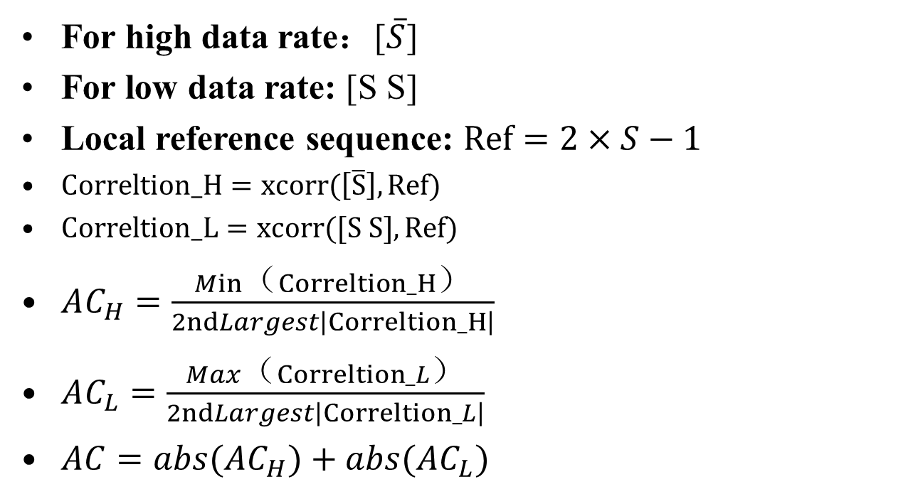
Recap: Auto-Correlation Metrics
Doc.: IEEE 802.11-25/0321r0
For high data rate：[$\overline{S}$]
For low data rate: [S S]
Local reference sequence: $Ref=2×S−1$
$Correltion_H=xcorr(\left[\overline{S}\right], Ref)$
$Correltion_L=xcorr([S S], Ref)$
$AC_{H}=\frac{Min（Correltion_H）}{2ndLargest\left|Correltion_H\right|}$
$AC_{L}=\frac{Max（Correltion_L）}{2ndLargest\left|Correltion_L\right|}$
$AC=abs(AC_{H})+abs(AC_{L})$

Slide 6
Recap: Cross-Correlation Metrics
Doc.: IEEE 802.11-25/0321r0
The Sync sequence will be correlated with other filed of the UL/DL PPDU e.g., random Manchester coding symbols to see the cross-correlation property
  The sync sequence shall maintain low cross-correlation with other filed of UL/DL PPDU

Slide 7
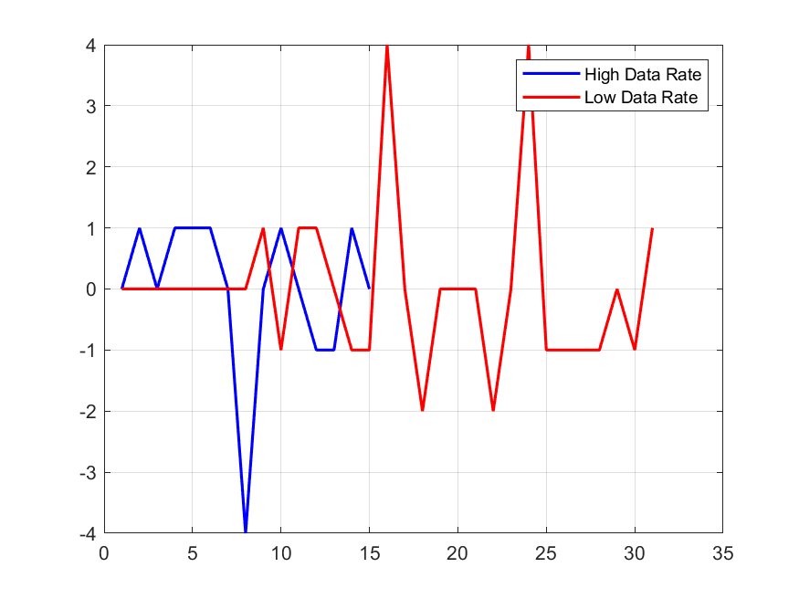
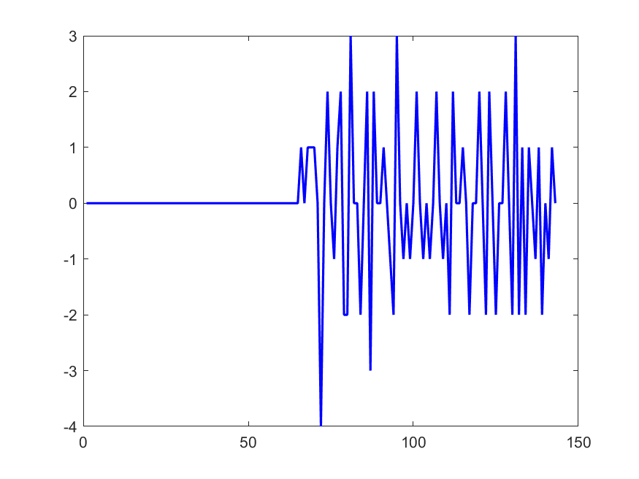
Recap: Sync sequence length(1)
Doc.: IEEE 802.11-25/0321r0
For length 8, the auto-correlation is not so good and cross-correlation with random Manchester symbols become unacceptable.
  One sequence after computer searching is '10001101'
AC_H: -4 AC_L: 2
Cross-correlation with Random Manchester symbols

Slide 8
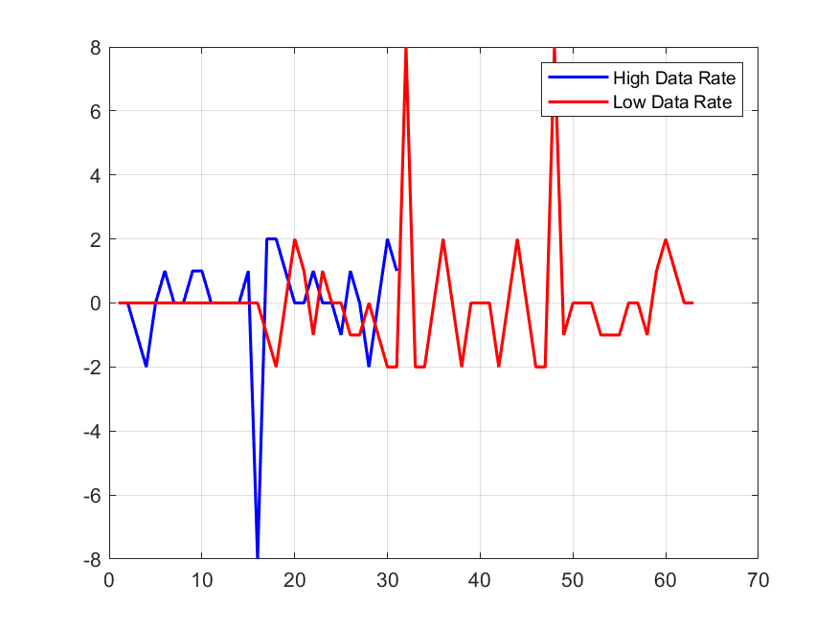
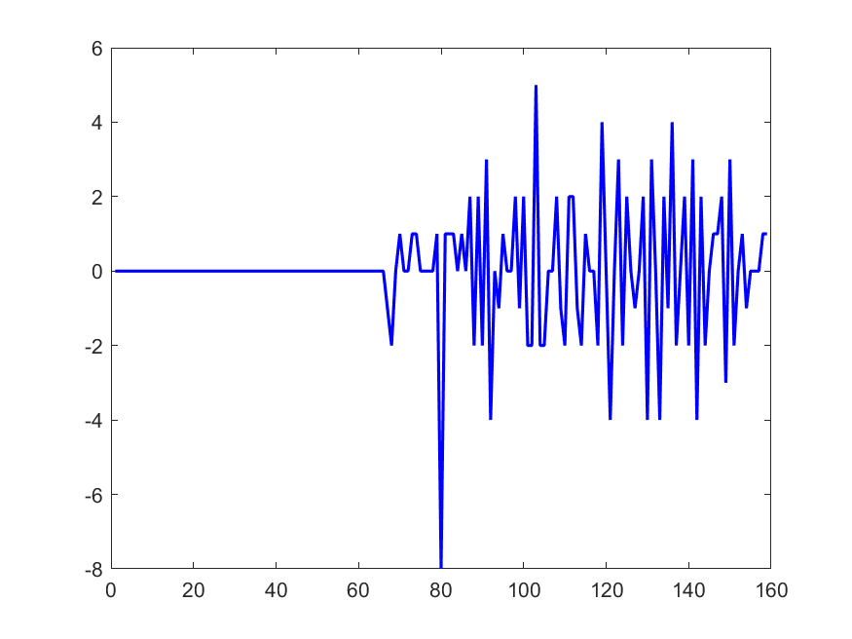
Recap：Sync sequence length(2)
Doc.: IEEE 802.11-25/0321r0
For length 16, the auto-correlation is better and cross-correlation with random Manchester symbols is good
  One candidate sequence after computer searching is '1100100101011100'
AC_H: -4 AC_L: 4
Cross-correlation with Random Manchester symbols

Slide 9
Simulation assumptions for sync performance evaluation
Doc.: IEEE 802.11-25/0321r0
  Note: For ED receiver, it directly receiver the RF signal and derive its envelope, then it samples the OOK envelope and perform correlation detection. For IF receiver, RF signal is converted to baseband signal and then it samples the baseband OOK signal and perform correlation detection.
Parameters | Values
Sync sequence | 1100100101011100
Waveform | DSSS-OOK
Channel model | Channel B/Channel D
Chip duration | 0.5/1/2µs
Sampling rate at AMP device | 2MHz/8MHz
Receiver type | ED/IF receiver (Note)

Slide 10
Synchronization performance(1)
Doc.: IEEE 802.11-25/0321r0
  Case 1-1: 2MHz sampling rate at AMP STA & Chanel B@ED receiver.
  Note that the sync error is represented as the number of sampling points.
Table 1: Sync performance when chip duration is 0.5 µs
SNR vs Sync error | -10 | -8 | -6 | -4 | -2 | 0 | 2 | 4 | 6 | 8 | 10
0 | 0.0526 | 0.0963 | 0.2086 | 0.4283 | 0.7276 | 0.9313 | 0.9879 | 0.996 | 0.9978 | 0.9986 | 0.999
1 | 0.1074 | 0.1157 | 0.111 | 0.0909 | 0.0499 | 0.0124 | 0.0025 | 0.001 | 0.0006 | 0.0003 | 0.0001
2 | 0.2423 | 0.2474 | 0.2383 | 0.197 | 0.1134 | 0.0343 | 4.90E-03 | 0.0012 | 0.0005 | 0.0005 | 0.0006
>=3 | 0.5977 | 0.5406 | 0.4421 | 0.2838 | 0.1091 | 0.022 | 4.70E-03 | 1.80E-03 | 1.10E-03 | 0.0006 | 0.0003
Table 2: Sync performance when chip duration is 1 µs
SNR vs Sync error | -10 | -8 | -6 | -4 | -2 | 0 | 2 | 4 | 6 | 8 | 10
0 | 0.0263 | 0.0597 | 0.168 | 0.4246 | 0.7812 | 0.9688 | 0.9955 | 0.9977 | 0.9985 | 0.999 | 0.9995
1 | 0.0148 | 0.0174 | 0.0196 | 0.0199 | 0.01 | 0.0017 | 0.0003 | 0.0001 | 0 | 0 | 0
2 | 0.0554 | 0.0647 | 0.0665 | 0.0525 | 0.0238 | 0.003 | 3.00E-04 | 0.0003 | 0.0002 | 0 | 0
>=3 | 0.9035 | 0.8582 | 0.7459 | 0.503 | 0.185 | 0.0265 | 3.90E-03 | 1.90E-03 | 1.30E-03 | 1.00E-03 | 5.00E-04
Table 3: Sync performance when chip duration is 2 µs
SNR vs Sync error | -10 | -8 | -6 | -4 | -2 | 0 | 2 | 4 | 6 | 8 | 10
0 | 0.0067 | 0.028 | 0.1123 | 0.4117 | 0.8378 | 0.9891 | 0.998 | 0.9991 | 0.9994 | 0.9994 | 0.9998
1 | 0.0046 | 0.0086 | 0.019 | 0.0339 | 0.0239 | 0.0029 | 0.0003 | 0 | 0 | 0 | 0
2 | 0.0011 | 0.0013 | 0.0025 | 0.0025 | 0.0009 | 0 | 0.00E+00 | 0 | 0 | 0 | 0
>=3 | 0.9876 | 0.9621 | 0.8662 | 0.5519 | 0.1374 | 0.008 | 1.70E-03 | 9.00E-04 | 6.00E-04 | 6.00E-04 | 2.00E-04

Slide 11
Synchronization performance(2)
Doc.: IEEE 802.11-25/0321r0
  Case 1-2: 2MHz sampling rate at AMP STA & Chanel B@ IF receiver.
  Note that the sync error is represented as the number of sampling points.
Table 4: Sync performance when chip duration is 0.5 µs
SNR vs Sync error | -10 | -8 | -6 | -4 | -2 | 0 | 2 | 4 | 6 | 8 | 10
0 | 0.2923 | 0.4519 | 0.6621 | 0.8669 | 0.973 | 0.996 | 0.998 | 0.9982 | 0.9984 | 0.9985 | 0.9986
1 | 0.0522 | 0.0446 | 0.0307 | 0.0158 | 0.0053 | 0.0025 | 0.0018 | 0.0018 | 0.0016 | 0.0015 | 0.0014
2 | 0.0481 | 0.0403 | 0.0264 | 0.0124 | 0.0032 | 0.0007 | 2.00E-04 | 0 | 0 | 0 | 0
>=3 | 0.6074 | 0.4632 | 0.2808 | 0.1049 | 0.0185 | 0.0008 | ####### | 0.00E+00 | 0 | 0.00E+00 | 0
Table 5: Sync performance when chip duration is 1 µs
SNR vs Sync error | -10 | -8 | -6 | -4 | -2 | 0 | 2 | 4 | 6 | 8 | 10
0 | 0.3828 | 0.5733 | 0.7939 | 0.9433 | 0.9931 | 0.9983 | 0.9988 | 0.9987 | 0.9986 | 0.9986 | 0.9986
1 | 0.0628 | 0.0555 | 0.0363 | 0.0147 | 0.0033 | 0.0016 | 0.0012 | 0.0013 | 0.0014 | 0.0014 | 0.0014
2 | 0.0352 | 0.0261 | 0.0136 | 0.0042 | 0.0005 | 0 | 0.00E+00 | 0 | 0 | 0 | 0
>=3 | 0.5192 | 0.3451 | 0.1562 | 0.0378 | 0.0031 | 1.00E-04 | 0.00E+00 | 0.00E+00 | 0 | 0 | 0
Table 6: Sync performance when chip duration is 2 µs
SNR vs Sync error | -10 | -8 | -6 | -4 | -2 | 0 | 2 | 4 | 6 | 8 | 10
0 | 0.4862 | 0.7057 | 0.8797 | 0.9664 | 0.993 | 0.9982 | 0.9986 | 0.9989 | 0.9989 | 0.9988 | 0.9988
1 | 0.1336 | 0.1165 | 0.0737 | 0.0288 | 0.0067 | 0.0015 | 0.0014 | 0.0011 | 0.0011 | 0.0012 | 0.0012
2 | 0.0324 | 0.0207 | 0.0084 | 0.001 | 0 | 0 | 0.00E+00 | 0 | 0 | 0 | 0
>=3 | 0.3478 | 0.1571 | 0.0382 | 0.0038 | 0.0003 | 3.00E-04 | 0.00E+00 | 0.00E+00 | 0 | 0 | 0

Slide 12
Synchronization performance(3)
Doc.: IEEE 802.11-25/0321r0
  Case 1-3: 2MHz sampling rate at AMP STA & Chanel D@ ED receiver.
  Note that the sync error is represented as the number of sampling points.
Table 7: Sync performance when chip duration is 0.5 µs
SNR vs Sync error | -10 | -8 | -6 | -4 | -2 | 0 | 2 | 4 | 6 | 8 | 10
0 | 0.0495 | 0.0922 | 0.1898 | 0.3863 | 0.6609 | 0.8765 | 0.9553 | 0.9758 | 0.9836 | 0.9878 | 0.99
1 | 0.1061 | 0.113 | 0.1127 | 0.1005 | 0.0619 | 0.024 | 0.0093 | 0.007 | 0.0065 | 0.0062 | 0.0063
2 | 0.2386 | 0.2439 | 0.2407 | 0.2053 | 0.1315 | 0.0526 | 1.72E-02 | 0.007 | 0.0032 | 0.0014 | 0.0007
>=3 | 0.6058 | 0.5509 | 0.4568 | 0.3079 | 0.1457 | 0.0469 | 1.82E-02 | 1.02E-02 | 6.70E-03 | 0.0046 | 0.003
Table 8: Sync performance when chip duration is 1 µs
SNR vs Sync error | -10 | -8 | -6 | -4 | -2 | 0 | 2 | 4 | 6 | 8 | 10
0 | 0.0266 | 0.0601 | 0.1563 | 0.3955 | 0.7386 | 0.9352 | 0.9793 | 0.9863 | 0.99 | 0.9912 | 0.9923
1 | 0.0168 | 0.0169 | 0.021 | 0.023 | 0.0149 | 0.0079 | 0.006 | 0.0058 | 0.0051 | 0.0055 | 0.0055
2 | 0.0566 | 0.0643 | 0.0684 | 0.0539 | 0.0223 | 0.0049 | 1.20E-03 | 0.0009 | 0.0009 | 0.0008 | 0.0005
>=3 | 0.9 | 0.8587 | 0.7543 | 0.5276 | 0.2242 | 0.052 | 1.35E-02 | 7.00E-03 | 4.00E-03 | 2.50E-03 | 1.70E-03
Table 9: Sync performance when chip duration is 2 µs
SNR vs Sync error | -10 | -8 | -6 | -4 | -2 | 0 | 2 | 4 | 6 | 8 | 10
0 | 0.0062 | 0.0247 | 0.1081 | 0.3931 | 0.8076 | 0.9698 | 0.9875 | 0.9904 | 0.9922 | 0.993 | 0.9937
1 | 0.0037 | 0.0071 | 0.017 | 0.0338 | 0.0285 | 0.0116 | 0.0061 | 0.0056 | 0.0053 | 0.0056 | 0.0052
2 | 0.002 | 0.0021 | 0.0026 | 0.0027 | 0.0013 | 0 | 1.00E-04 | 0.0002 | 0 | 0 | 0
>=3 | 0.9881 | 0.9661 | 0.8723 | 0.5704 | 0.1626 | 0.0186 | 6.30E-03 | 3.80E-03 | 2.50E-03 | 1.40E-03 | 1.10E-03

Slide 13
Synchronization performance(4)
Doc.: IEEE 802.11-25/0321r0
  Case 1-4: 2MHz sampling rate at AMP STA & Chanel D@ IF receiver.
  Note that the sync error is represented as the number of sampling points.
Table 10: Sync performance when chip duration is 0.5 µs
SNR vs Sync error | -10 | -8 | -6 | -4 | -2 | 0 | 2 | 4 | 6 | 8 | 10
0 | 0.2738 | 0.4207 | 0.6201 | 0.8154 | 0.9341 | 0.9707 | 0.9772 | 0.9787 | 0.9798 | 0.98 | 0.9805
1 | 0.0644 | 0.0642 | 0.0608 | 0.0481 | 0.0328 | 0.0265 | 0.0226 | 0.0212 | 0.0202 | 0.02 | 0.0195
2 | 0.0493 | 0.0401 | 0.028 | 0.014 | 0.0044 | 0.0006 | 1.00E-04 | 0.0001 | 0 | 0 | 0
>=3 | 0.6125 | 0.475 | 0.2911 | 0.1225 | 0.0287 | 0.0022 | 1.00E-04 | ####### | 0 | 0.00E+00 | 0
Table 11: Sync performance when chip duration is 1 µs
SNR vs Sync error | -10 | -8 | -6 | -4 | -2 | 0 | 2 | 4 | 6 | 8 | 10
0 | 0.3562 | 0.5444 | 0.7562 | 0.908 | 0.9636 | 0.9761 | 0.9782 | 0.9799 | 0.9804 | 0.9811 | 0.9811
1 | 0.0827 | 0.083 | 0.0716 | 0.0492 | 0.0328 | 0.0238 | 0.0218 | 0.0201 | 0.0196 | 0.0189 | 0.0189
2 | 0.0379 | 0.0271 | 0.0139 | 0.0051 | 0.0008 | 0 | 0.00E+00 | 0 | 0 | 0 | 0
>=3 | 0.5232 | 0.3455 | 0.1583 | 0.0377 | 0.0028 | 1.00E-04 | 0.00E+00 | 0.00E+00 | 0 | 0 | 0
Table 12: Sync performance when chip duration is 2 µs
SNR vs Sync error | -10 | -8 | -6 | -4 | -2 | 0 | 2 | 4 | 6 | 8 | 10
0 | 0.4576 | 0.67 | 0.8458 | 0.9344 | 0.9674 | 0.977 | 0.9814 | 0.9835 | 0.9847 | 0.9847 | 0.9849
1 | 0.1468 | 0.1432 | 0.1046 | 0.0599 | 0.0323 | 0.0229 | 0.0185 | 0.0164 | 0.0152 | 0.0153 | 0.0151
2 | 0.0338 | 0.0218 | 0.0078 | 0.0015 | 0.0001 | 0 | 0.00E+00 | 0 | 0 | 0 | 0
>=3 | 0.3618 | 0.165 | 0.0418 | 0.0042 | 0.0002 | 1.00E-04 | 1.00E-04 | 1.00E-04 | 1.00E-04 | 0 | 0

Slide 14
Synchronization performance(5)
Doc.: IEEE 802.11-25/0321r0
  Case 2-1: 8MHz sampling rate at AMP STA & Chanel B@ED receiver.
  Note that the sync error is represented as the number of sampling points.
Table 13: Sync performance when chip duration is 0.5 µs
SNR vs Sync error | -10 | -8 | -6 | -4 | -2 | 0 | 2 | 4 | 6 | 8 | 10
0 | 0.0067 | 0.0261 | 0.1055 | 0.3653 | 0.7883 | 0.9566 | 0.9807 | 0.9856 | 0.9883 | 0.9884 | 0.9883
1 | 0.0033 | 0.008 | 0.0199 | 0.0371 | 0.0366 | 0.0205 | 0.0116 | 0.0111 | 0.0094 | 0.0099 | 0.0108
2 | 0.0025 | 0.0023 | 0.0028 | 0.0033 | 0.0013 | 0 | 2.00E-04 | 0.0001 | 0 | 0 | 0
>=3 | 0.9875 | 0.9636 | 0.8718 | 0.5943 | 0.1738 | 0.0229 | 7.50E-03 | 3.20E-03 | 0.0023 | 0.0017 | 0.0009
Table 14: Sync performance when chip duration is 1 µs
SNR vs Sync error | -10 | -8 | -6 | -4 | -2 | 0 | 2 | 4 | 6 | 8 | 10
0 | 0.0007 | 0.0067 | 0.0652 | 0.398 | 0.8684 | 0.967 | 0.9842 | 0.9871 | 0.9881 | 0.9877 | 0.9879
1 | 0.0001 | 0.0017 | 0.0146 | 0.0533 | 0.0483 | 0.0247 | 0.0128 | 0.0113 | 0.0108 | 0.0116 | 0.0115
2 | 0.0003 | 0.0008 | 0.0032 | 0.0059 | 0.0041 | 0.0004 | 2.00E-04 | 0.0001 | 0 | 0 | 0
>=3 | 0.9989 | 0.9908 | 0.917 | 0.5428 | 0.0792 | 0.0079 | 2.80E-03 | 1.50E-03 | 1.10E-03 | 7.00E-04 | 6.00E-04
Table 15: Sync performance when chip duration is 2 µs
SNR vs Sync error | -10 | -8 | -6 | -4 | -2 | 0 | 2 | 4 | 6 | 8 | 10
0 | 0 | 0.0005 | 0.0299 | 0.4406 | 0.9109 | 0.972 | 0.9838 | 0.9877 | 0.9885 | 0.9888 | 0.9883
1 | 0 | 0.0004 | 0.0085 | 0.0693 | 0.0626 | 0.0246 | 0.0148 | 0.0112 | 0.011 | 0.0106 | 0.0113
2 | 0 | 0 | 0.0013 | 0.01 | 0.0053 | 0.0005 | 0.00E+00 | 0 | 0 | 0 | 0
>=3 | 1 | 0.9991 | 0.9603 | 0.4801 | 0.0212 | 0.0029 | 1.40E-03 | 1.10E-03 | 5.00E-04 | 6.00E-04 | 4.00E-04

Slide 15
Synchronization performance(6)
Doc.: IEEE 802.11-25/0321r0
  Case 2-2: 8MHz sampling rate at AMP STA & Chanel B@ IF receiver.
  Note that the sync error is represented as the number of sampling points.
Table 16: Sync performance when chip duration is 0.5 µs
SNR vs Sync error | -10 | -8 | -6 | -4 | -2 | 0 | 2 | 4 | 6 | 8 | 10
0 | 0.4584 | 0.6667 | 0.831 | 0.9174 | 0.9538 | 0.9692 | 0.9754 | 0.9779 | 0.9781 | 0.9798 | 0.9791
1 | 0.1612 | 0.1491 | 0.1192 | 0.0756 | 0.0459 | 0.0305 | 0.0244 | 0.0221 | 0.0219 | 0.0202 | 0.0209
2 | 0.0335 | 0.0191 | 0.0074 | 0.0016 | 0 | 0 | 0.00E+00 | 0 | 0 | 0 | 0
>=3 | 0.3469 | 0.1651 | 0.0424 | 0.0054 | 3.00E-04 | 3.00E-04 | 2.00E-04 | 0.00E+00 | 0.00E+00 | 0.00E+00 | 0.00E+00
Table 17: Sync performance when chip duration is 1 µs
SNR vs Sync error | -10 | -8 | -6 | -4 | -2 | 0 | 2 | 4 | 6 | 8 | 10
0 | 0.5577 | 0.7313 | 0.8448 | 0.9111 | 0.9504 | 0.9696 | 0.9732 | 0.9778 | 0.9795 | 0.981 | 0.9808
1 | 0.2181 | 0.1963 | 0.1382 | 0.0861 | 0.0489 | 0.0304 | 0.0267 | 0.0222 | 0.0204 | 0.019 | 0.0192
2 | 0.0616 | 0.0355 | 0.0117 | 0.0026 | 0.0003 | 0 | 0.00E+00 | 0 | 0 | 0 | 0
>=3 | 0.1626 | 0.0369 | 0.0053 | 2.00E-04 | 4.00E-04 | 0.00E+00 | 1.00E-04 | 0.00E+00 | 1.00E-04 | 0.00E+00 | 0.00E+00
Table 18: Sync performance when chip duration is 2 µs
SNR vs Sync error | -10 | -8 | -6 | -4 | -2 | 0 | 2 | 4 | 6 | 8 | 10
0 | 0.6042 | 0.7362 | 0.8375 | 0.906 | 0.95 | 0.9653 | 0.9738 | 0.9784 | 0.9806 | 0.9812 | 0.9818
1 | 0.2493 | 0.2029 | 0.1413 | 0.0903 | 0.0495 | 0.0347 | 0.0262 | 0.0216 | 0.0194 | 0.0188 | 0.0182
2 | 0.0776 | 0.0399 | 0.0158 | 0.0032 | 0.0005 | 0 | 0.00E+00 | 0 | 0 | 0 | 0
>=3 | 0.0689 | 0.021 | 0.0054 | 5.00E-04 | 5.59E-17 | 0.00E+00 | 0.00E+00 | 0.00E+00 | 0.00E+00 | 0.00E+00 | 0.00E+00

Slide 16
Synchronization performance(7)
Doc.: IEEE 802.11-25/0321r0
  Case 2-3: 8MHz sampling rate at AMP STA & Chanel D@ ED receiver.
  Note that the sync error is represented as the number of sampling points.
Table 19: Sync performance when chip duration is 0.5 µs
SNR vs Sync error | -10 | -8 | -6 | -4 | -2 | 0 | 2 | 4 | 6 | 8 | 10
0 | 0.0038 | 0.0193 | 0.0731 | 0.2427 | 0.554 | 0.7155 | 0.7488 | 0.7659 | 0.7725 | 0.7807 | 0.7839
1 | 0.0045 | 0.0102 | 0.0349 | 0.0907 | 0.1758 | 0.2077 | 0.2122 | 0.2059 | 0.205 | 0.1977 | 0.197
2 | 0.0047 | 0.0038 | 0.0053 | 0.0119 | 0.0107 | 0.0099 | 1.06E-02 | 0.0119 | 0.0102 | 0.0131 | 0.0121
>=3 | 0.987 | 0.9667 | 0.8867 | 0.6547 | 0.2595 | 0.0669 | 2.84E-02 | 1.63E-02 | 0.0123 | 0.0085 | 0.007
Table 20: Sync performance when chip duration is 1 µs
SNR vs Sync error | -10 | -8 | -6 | -4 | -2 | 0 | 2 | 4 | 6 | 8 | 10
0 | 0.0004 | 0.0044 | 0.0469 | 0.2782 | 0.6338 | 0.7353 | 0.7577 | 0.7677 | 0.7728 | 0.7778 | 0.7835
1 | 0.0004 | 0.0028 | 0.0203 | 0.1093 | 0.2182 | 0.222 | 0.2162 | 0.2114 | 0.2079 | 0.2051 | 0.1981
2 | 0.0002 | 0.0011 | 0.0066 | 0.0163 | 0.0196 | 0.0163 | 1.38E-02 | 0.013 | 0.0142 | 0.0124 | 0.0147
>=3 | 0.999 | 0.9917 | 0.9262 | 0.5962 | 0.1284 | 0.0264 | 1.23E-02 | 7.90E-03 | 5.10E-03 | 4.70E-03 | 3.70E-03
Table 21: Sync performance when chip duration is 2 µs
SNR vs Sync error | -10 | -8 | -6 | -4 | -2 | 0 | 2 | 4 | 6 | 8 | 10
0 | 0 | 0.0003 | 0.0231 | 0.3119 | 0.6814 | 0.7407 | 0.7564 | 0.7719 | 0.778 | 0.7803 | 0.7804
1 | 0 | 0.0004 | 0.0114 | 0.1371 | 0.2473 | 0.2308 | 0.2219 | 0.2098 | 0.2046 | 0.2023 | 0.2017
2 | 0 | 0 | 0.0016 | 0.0242 | 0.0267 | 0.0178 | 1.53E-02 | 0.0141 | 0.0139 | 0.0149 | 0.0156
>=3 | 1 | 0.9993 | 0.9639 | 0.5268 | 0.0446 | 0.0107 | 6.40E-03 | 4.20E-03 | 3.50E-03 | 2.50E-03 | 2.30E-03

Slide 17
Synchronization performance(8)
Doc.: IEEE 802.11-25/0321r0
  Case 2-4: 8MHz sampling rate at AMP STA & Chanel D@ IF receiver.
  Note that the sync error is represented as the number of sampling points.
Table 22: Sync performance when chip duration is 0.5 µs
SNR vs Sync error | -10 | -8 | -6 | -4 | -2 | 0 | 2 | 4 | 6 | 8 | 10
0 | 0.3628 | 0.5196 | 0.651 | 0.724 | 0.7519 | 0.7771 | 0.7884 | 0.7989 | 0.8075 | 0.806 | 0.8113
1 | 0.2183 | 0.244 | 0.2615 | 0.2449 | 0.2295 | 0.208 | 0.2008 | 0.1891 | 0.1817 | 0.1843 | 0.1787
2 | 0.0519 | 0.0401 | 0.0336 | 0.0191 | 0.015 | 0.0122 | 9.30E-03 | 0.0106 | 0.0095 | 0.0085 | 0.009
>=3 | 0.367 | 0.1963 | 0.0539 | 0.012 | 3.60E-03 | 2.70E-03 | 1.50E-03 | 1.40E-03 | 1.30E-03 | 1.20E-03 | 1.00E-03
Table 23: Sync performance when chip duration is 1 µs
SNR vs Sync error | -10 | -8 | -6 | -4 | -2 | 0 | 2 | 4 | 6 | 8 | 10
0 | 0.4602 | 0.5896 | 0.6767 | 0.7232 | 0.7516 | 0.7731 | 0.7843 | 0.7948 | 0.8007 | 0.8044 | 0.8059
1 | 0.2827 | 0.2966 | 0.2765 | 0.2498 | 0.2315 | 0.212 | 0.2037 | 0.1944 | 0.1883 | 0.1846 | 0.1842
2 | 0.078 | 0.0601 | 0.0362 | 0.0227 | 0.0143 | 0.0127 | 1.04E-02 | 0.0098 | 0.0098 | 0.0098 | 0.0089
>=3 | 0.1791 | 0.0537 | 0.0106 | 4.30E-03 | 2.60E-03 | 2.20E-03 | 1.60E-03 | 1.00E-03 | 1.20E-03 | 1.20E-03 | 1.00E-03
Table 24: Sync performance when chip duration is 2 µs
SNR vs Sync error | -10 | -8 | -6 | -4 | -2 | 0 | 2 | 4 | 6 | 8 | 10
0 | 0.4972 | 0.5973 | 0.6554 | 0.7218 | 0.7498 | 0.7731 | 0.7859 | 0.7959 | 0.8013 | 0.8065 | 0.8082
1 | 0.3214 | 0.3007 | 0.2929 | 0.2505 | 0.2345 | 0.2143 | 0.2037 | 0.1922 | 0.1885 | 0.1837 | 0.182
2 | 0.0929 | 0.0666 | 0.0389 | 0.0237 | 0.014 | 0.011 | 9.70E-03 | 0.0111 | 0.0095 | 0.0089 | 0.0089
>=3 | 0.0885 | 0.0354 | 0.0128 | 4.00E-03 | 1.70E-03 | 1.60E-03 | 7.00E-04 | 8.00E-04 | 7.00E-04 | 9.00E-04 | 9.00E-04

Slide 18
Summary of Sync performance
Doc.: IEEE 802.11-25/0321r0
 | Sync error =0 @90% Probability |  |  |  | Sync error =0 and 1 @90% Probability
Sampling rate | 2MHz |  |  |  | 8MHz
Channel Model | Channel B |  | Channel D |  | Channel B |  | Channel D
Receiver Type | ED | IF | ED | IF | ED | IF | ED | IF
Chip duration =0.5µs | ~-0.3 | -3.3 | 0.6 | -2.5 | -0.95 | -6.7 | -0.3 | -6.1
Chip duration =1µs | ~-0.7 | -4.5 | -0.3 | -4 | -2 | -8.4 | -1 | -7.5
Chip duration =2µs | ~-1.2 | -5.5 | -0.9 | -4.7 | -2.3 | -8.5 | -2.1 | -7.8

Slide 19
Impact on decoding performance(1)
Doc.: IEEE 802.11-25/0321r0
  When there is synchronization error, the impact on data decoding performance is evaluated with the following assumptions:
Parameters | Values
Date Rate | 250kpbs/1MHz
Waveform | DSSS-OOK
Channel model | Channel B/D
Chip duration | 2µs/0.5µs
Sampling rate at AMP device | 2MHz/8MHz
Coding | Manchester
Receiver type | ED receiver
synchronization error | 1 Sampling point

Slide 20
Impact on decoding performance(2)
Doc.: IEEE 802.11-25/0321r0
  Simulation results for data rate of 250kbps in channel B
Figure 1: DL PPDU decoding performance @sampling rate of 2MHz
Figure 2: DL PPDU decoding performance @sampling rate of 8MHz

Slide 21
Impact on decoding performance(3)
Doc.: IEEE 802.11-25/0321r0
  Simulation results for data rate of 1Mbps and sampling rate of 8MHz
Figure 3: DL PPDU decoding performance （Channel B）

Slide 22
Impact on decoding performance(2)
Doc.: IEEE 802.11-25/0321r0
  Simulation results for data rate of 250kbps in channel D
Figure 1: DL PPDU decoding performance @sampling rate of 2MHz
Figure 2: DL PPDU decoding performance @sampling rate of 8MHz

Slide 23
Impact on decoding performance(3)
Doc.: IEEE 802.11-25/0321r0
  Simulation results for data rate of 1Mbps and sampling rate of 8MHz
Figure 3: DL PPDU decoding performance （Channel D）

Slide 24
Observation
Doc.: IEEE 802.11-25/0321r0
Under both channel B and channel D, for sampling rate = 2MHz at AMP STA’s receiver, the required SNR is ~1dB for DL data rate of 250kbps.
Under both channel B and channel D, for sampling rate = 8MHz at AMP STA’s receiver, the required SNR is ~-2dB for DL data rate of 250kbps.
  For AMP sync of length 16, the sync performance for chip duration of 2µs is acceptable.

Slide 25
Summary
Doc.: IEEE 802.11-25/0321r0
In this submission, sync sequence for AMP is discussed. Based on the discussion, the following is proposed.
  Basic sync length is 16, one proposed sequence is
    S1= '1100100101011100’
  Chip duration of sync field is 2 µs .

Slide 26
March 2025
Doc.: IEEE 802.11-25/0321r0
Straw Poll #1
Do you agree with the following text:
  Basic AMP sync length is 16, one proposed sequence is
    S1= '1100100101011100’
  Chip duration of sync field is 2 µs .
Yes
No
Abstain
Slide 26
Weijie Xu (OPPO)

Slide 27
Reference
March 2025
Doc.: IEEE 802.11-25/0321r0
IEEE 802.11-25/0034r2 Sync field for AMP PPDU

