Slide 1
Correspondence between Energizers and AMP non-AP STAs
March 2025
Doc.: IEEE 802.11-25/0319r0
Date: 2025-03-13
Authors:
Name | Affiliation | Address | Phone | Email
Yinan Qi | OPPO |  |  | v-qiyinan@oppo.com
Weijie Xu

Slide 2
Abstract
Doc.: IEEE 802.11-25/0319r0
In this contribution, we discuss the correspondence between energizer and AMP non-AP STAs needed for WPT and excitation signals.

Slide 3
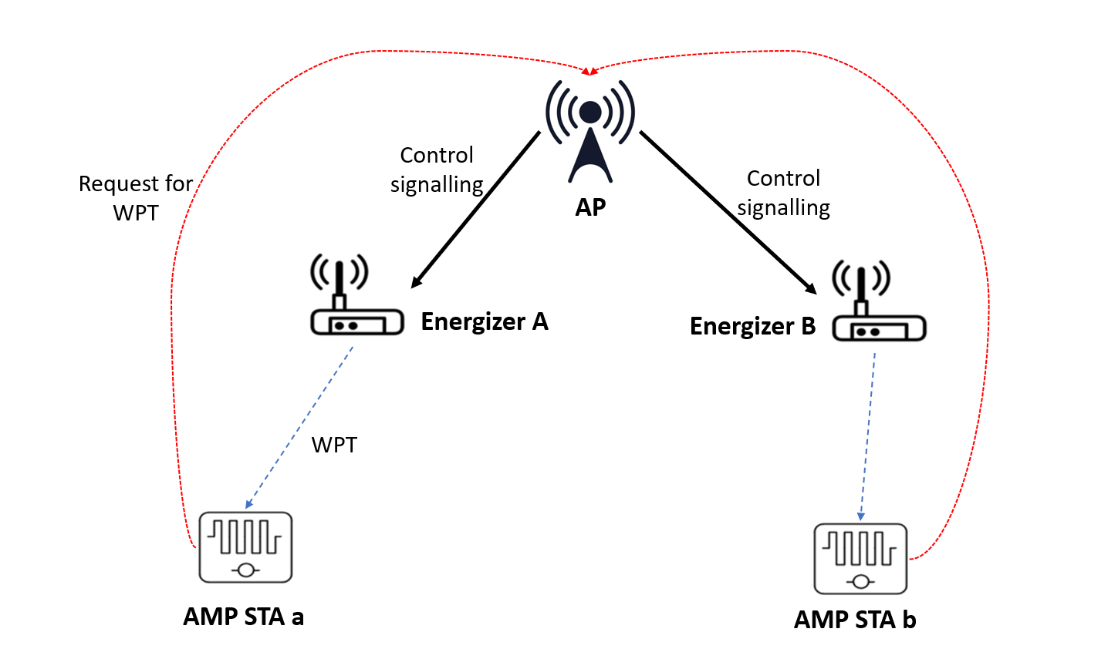
March 2025
Doc.: IEEE 802.11-25/0319r0
Motivation and Terminology
  Energizers need to provide three essential functionalities as follows [1]:
    WPT signal transmission;
    Excitation signal for backscattering at AMP devices;
    Wakeup signal for AMP enabled devices if necessary.
  Energizer signals can either be at S1G or 2.4GHz depending on configurations
    Most applicable scenario is WPT at S1G and 2.4GHz but signals for backscattering and wakeup signal at 2.4GHz.
  A single energizer can correspond to one or multiple AMP non-AP STAs
    Terminology change to avoid confusion: association [2] → correspondence
Slide 3
Yinan Qi (OPPO)

Slide 4
March 2025
Doc.: IEEE 802.11-25/0319r0
Example of Correspondence for WPT
  AMP non-AP STA a and b can send WPT requests to the AP indicating their energy level is low and WPT is needed.
  Once AP receives such requests, it can control energizer A and B, respectively, to transmit WPT signals to AMP non-AP STA a and b, respectively.
  However, if only AMP non-AP STA a requests WPT signal, AP needs to choose between A and B to activate to charge AMP non-AP STA a.
  A correspondence table can be established between energizers and AMP devices and such table should be maintained by the AP or the energizer.
 | Energizer A | Energizer B
AMP a | √ | X
AMP b | X | √
Slide 4
Yinan Qi (OPPO)

Slide 5
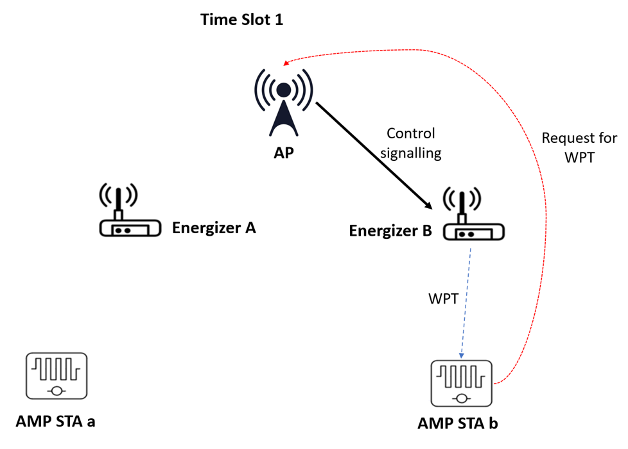
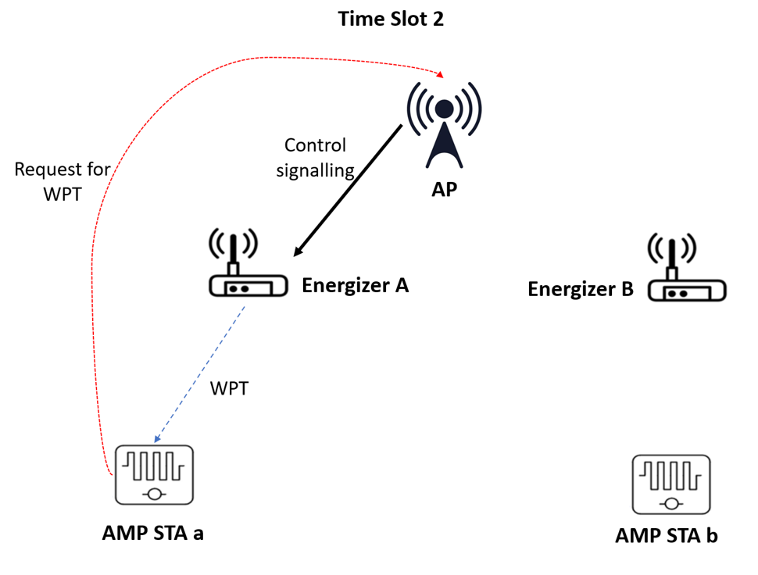
March 2025
Doc.: IEEE 802.11-25/0319r0
Example of Correspondence for WPT
  With the correspondence table, AP can activate corresponding energizer.
    Time slot 1: AMP non-AP STA b needs to be charged, energizer B is activated to transmit WPT signal to AMP non-AP STA b.
    Time slot 2: AMP non-AP STA a needs to be charged, energizer A is activated to transmit WPT signal to AMP non-AP STA a
Slide 5
Yinan Qi (OPPO)

Slide 6
March 2025
Doc.: IEEE 802.11-25/0319r0
Benefits of Correspondence
  WPT
    Energizers are activated only when corresponding AMP non-AP STAs need to be charged;
    Reduced energy consumption of energizers;
    Reduced interference to other S1G systems;
    Multiple energizers can be activated simultaneously.
  Excitation
    More critical since activating unnecessary energizers may cause interference at 2.4GHz
    When non-corresponding energizers activated, excitation signal may not reach the target AMP non-AP STAs
    Reduced energy consumption.
  Wakeup signal if it can be sent by energizers
    Same as excitation signal
Slide 6
Yinan Qi (OPPO)

Slide 7
March 2025
Doc.: IEEE 802.11-25/0319r0
How to Establish the Correspondence Table?
  Energizer initiated
    Energizer sending its own ID together with WPT/excitation/wakeup signal to the AMP non-AP STAs;
    AMP non-AP STAs then reports the energizer ID together with its own back to the AP;
    AP establish correspondence table based on the reporting.
  AP initiated
    AP instructs a particular energizer to send WPT/backscattering/wakeup in a specific radio resource, e.g., a time slot;
    AP then receives UL signal(s) from particular AMP device(s) in that specific radio resource;
    AP can establish the correspondence based on feedback from AMP devices
  Others
    Sounding between energizer and AMP devices + CSI feedback
    Position reporting from energizer and AMP devices
Slide 7
Yinan Qi (OPPO)

Slide 8
March 2025
Doc.: IEEE 802.11-25/0319r0
Maintenance of Correspondence Table
  The correspondence table can be established once and used for long time and needs to be progressively updated once energizers or AMP non-AP STAs move.
  AP maintenance: the correspondence table can be maintained by the AP as a global table.
  Energizer maintenance: the correspondence table can also be local to the energizers
    Energizers know the AMP devices that the WPT/backscattering/wakeup signal can reach.
    AP can send activation signals to all energizers together with the AMP device ID. Once the energizers receives such signal and ID, they can compare the ID and then transmit WPT/backscattering/wakeup signal accordingly.
Slide 8
Yinan Qi (OPPO)

Slide 9
March 2025
Doc.: IEEE 802.11-25/0319r0
Without Correspondence
  Without correspondence
    AP broadcasts to activate all energizer;
    AP groupcasts to activate energizers group by group until the target AMP non-AP STAs receives required signal;
    AP unicasts to activate energizers one by one until the target AMP non-AP STAs receives required signal.
  Cons without correspondence
    Long latency
    Heavy interference, leading to severe co-existence problem.
    High energy consumption
Slide 9
Yinan Qi (OPPO)

Slide 10
March 2025
Doc.: IEEE 802.11-25/0319r0
Summary
  In this contribution, we discussed the motivation and pros of establishing correspondence table between energizers and AMP non-AP STAs.
Slide 10
Yinan Qi (OPPO)

Slide 11
Reference
March 2025
Doc.: IEEE 802.11-25/0319r0
[1] “IEEE 802.11 TGbp Motion Dock,” IEEE 802.11-24/1322r6, Jan. 2025
[2] “WPT: Protocol, Waveform and PPDU,” IEEE 802.11-25/0319r1, Jan. 2025

Slide 12
March 2025
Doc.: IEEE 802.11-25/0319r0
SP1
  Do you agree to capture the following text to TGbp SFD?
    The correspondence between energizer and AMP devices that determines which energizer to activate to charge target AMP devices should be supported
Slide 12
Yinan Qi (OPPO)

