Slide 1
AMP Energizer Control
March 2025
Doc.: IEEE 802.11-25/0318r0
Date: 2025-03-13
Authors:
Name | Affiliation | Address | Phone | Email
Yinan Qi | OPPO |  |  | v-qiyinan@oppo.com
Ke Wang
Weijie Xu

Slide 2
Abstract
Doc.: IEEE 802.11-25/0318r0
In this contribution, we discuss the following issues:
AMP energizer control mechanism
AMP energizer control signalling

Slide 3
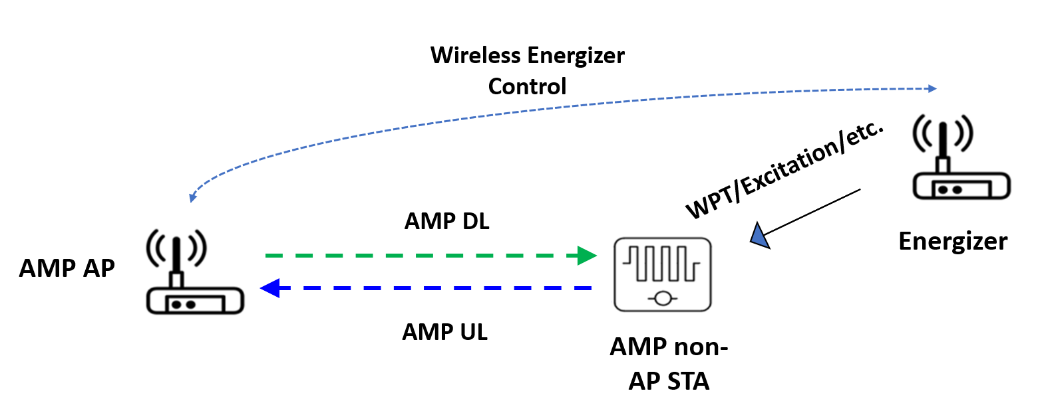
March 2025
Doc.: IEEE 802.11-25/0318r0
Recap of Progress
Agreement: IEEE 802.11bp defines a mechanism that allows control information to be sent by AMP AP STA to the AMP Energizer. The control information is TBD [1].
Energizer can transmit WPT, excitation and potentially other signals, e.g., preamble, wake-up signal, etc.
Two main challenges
How does AP control the energizers and coordinate WPT/excitation signal transmission?
What control information should be conveyed to the energizer?
Slide 3
Yinan Qi (OPPO)

Slide 4
March 2025
Doc.: IEEE 802.11-25/0318r0
Wireless Energizer Control Topology [2]
AP-AMP STA
TGbp link for active Tx and backscatter AMP devices or legacy link for AMP enabled devices with operation frequency 2.4GHz
Energizer-AMP STA
Communication: TGbp link for AMP devices, e.g., excitation, preamble, etc., on 2.4GHz
WPT: S1G
AP-energizer:
Both legacy link and TGbp link can be supported
Energizer is a new type of devices and thus can be designed to receive TGbp signals
Slide 4
Yinan Qi (OPPO)

Slide 5
March 2025
Doc.: IEEE 802.11-25/0318r0
Energizer Capability
Energizer can be regarded as a non-AP STA and follow the conventional association/authentication procedure to connect to the AMP AP.
Energizer may have different capability depending on design requirements.
Energizer may not be able to operate on both 2.4GHz and S1G;
Energizer might not be willing to active at any time if on battery;
Etc.
Energizer needs to report its own WPT related capability to the AMP AP proactively when connected to the AP or passively based on the request of the AP.
Supported frequency and BW for WPT/excitation
Maximum Tx power and whether or not the Tx power is adjustable
ID(s) of associated AMP devices that can be wirelessly charged or excited
Whether or not rely on battery
Its own position
Capability reporting only needs to be done one time.
Slide 5
Yinan Qi (OPPO)

Slide 6
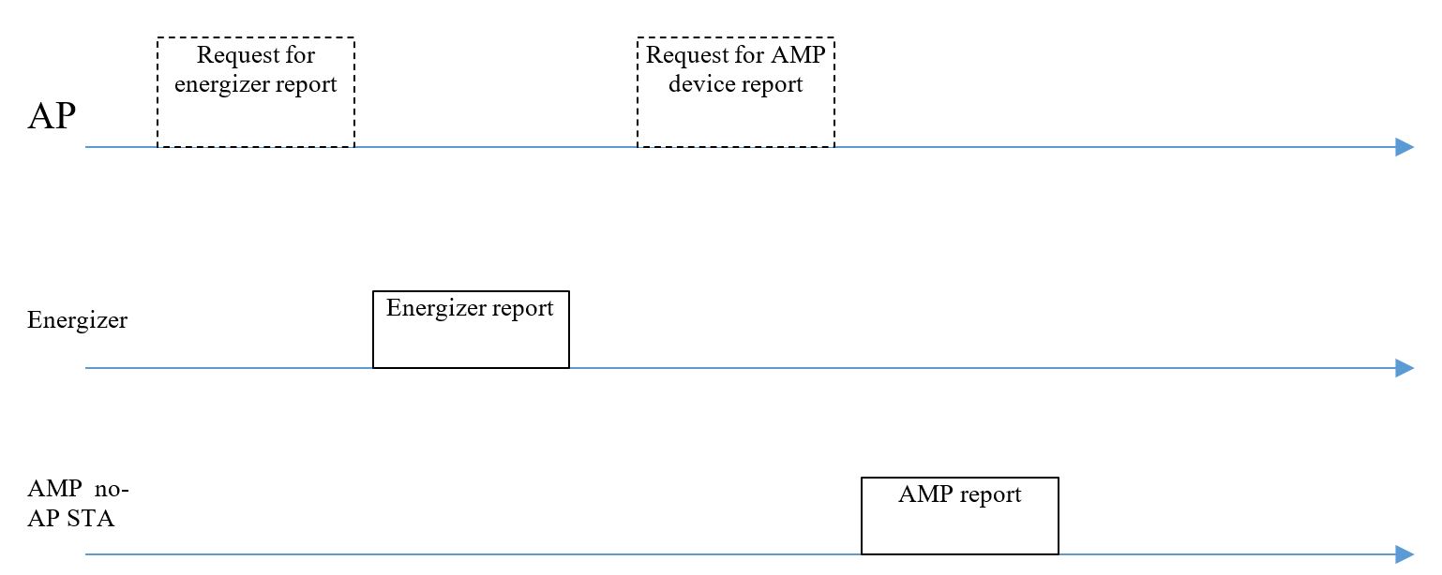
March 2025
Doc.: IEEE 802.11-25/0318r0
General WPT Procedure: Initialization
WPT can be initialized by requesting for energizer and AMP reporting to initialize the WPT configuration.
Report procedure can be either AP requested or autonomously done by energizer or AMP devices.
Slide 6
Yinan Qi (OPPO)

Slide 7
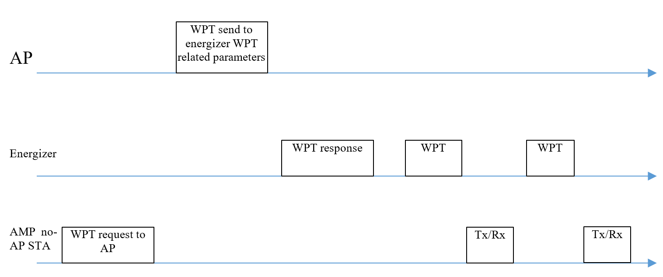
March 2025
Doc.: IEEE 802.11-25/0318r0
General WPT Procedure: Charging Procedure
WPT procedure:
AMP requests WPT (optional)
AP send WPT related parameters to energizer
Energizer acks AP request and initiate WPT
WPT and Tx/Rx procedures can repeat
AP can coordinate the energizer and AMP STA in TDM or FDM manner. For example, channel access is done by the AP and AP reserves the channel for both energizer and AMP STA.
WPT duration should be longer than certain threshold to guarantee the AMP devices are sufficiently charged.
Slide 7
Yinan Qi (OPPO)

Slide 8
March 2025
Doc.: IEEE 802.11-25/0318r0
Energizer Control Signalling: Parameters
Energizer sleep or active
WPT frequency related information including central frequency, bandwidth, etc.
WPT on/off
WPT on/off duration
Duty cycle operation related information, e.g., period, on duration, etc., when WPT is on
Indication the operation frequency: S1G or 2.4GHz
DL PPDU format for 2.4GHz if supported
Wakeup signal/PPDU format or parameters to define wakeup signal/PPDU, e.g., data rate, modulation scheme, etc.
WPT PPDU format if supported
Charging field related parameters: starting time, BW, waveform and Tx power.
Slide 8
Yinan Qi (OPPO)

Slide 9
March 2025
Doc.: IEEE 802.11-25/0318r0
Summary
In this contribution, we discussed energizer capability, control mechanism and control signalling.
Slide 9
Yinan Qi (OPPO)

Slide 10
Reference
March 2025
Doc.: IEEE 802.11-25/0318r0
[1] “IEEE 802.11 TGbp Motion Dock,” IEEE 802.11-24/1322r6, Jan. 2025
[2] “Further Consideration of WPT for AMP,” IEEE 802.11-24/1781r2, Nov. 2024.

Slide 11
March 2025
Doc.: IEEE 802.11-25/0318r0
SP1
Energizer should report its capability to AMP AP. The parameters to be reported is TBD.
Slide 11
Yinan Qi (OPPO)

Slide 12
March 2025
Doc.: IEEE 802.11-25/0318r0
SP2
The following parameters can be considered for AP to control the energizer
Energizer sleep or active
WPT frequency related information including central frequency, bandwidth, etc.
WPT on/off
WPT on/off duration
Duty cycle operation related information, e.g., period, on duration, etc., when WPT is on
Indication the operation frequency: S1G or 2.4GHz
Slide 12
Yinan Qi (OPPO)

