Slide 1
AMP UL Transmission
March 2025
Doc.: IEEE 802.11-25/0317r0
Date: 2025-03-10
Authors:
Name | Affiliation | Address | Phone | Email
Yinan Qi | OPPO |  |  | v-qiyinan@oppo.com
Ke Wang
Weijie Xu
Chuanfeng He

Slide 2
Abstract
Doc.: IEEE 802.11-25/0317r0
In this contribution, we discuss the AMP UL transmission covering below aspects
  UL transmission parameters, e.g., BW, chip duration, etc.
  How to configure UL transmission parameters, such as data rate, payload size, etc.

Slide 3
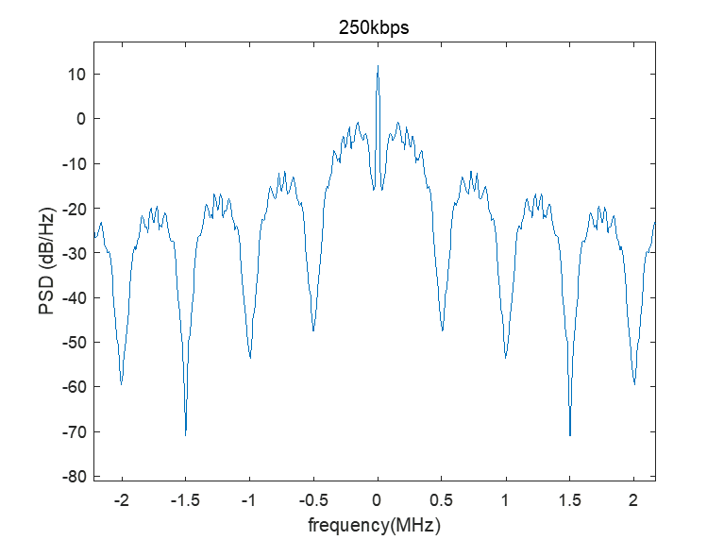
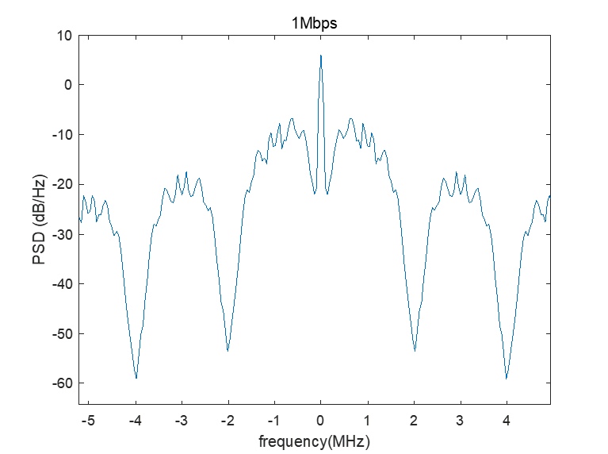
March 2025
Doc.: IEEE 802.11-25/0317r0
Chip Duration and BW
  Multiple data rates are supported for UL Tx for both backscattering devices and active devices [1],[2].
  Chip duration can scale with data rate (Manchester coded)
    2us for 250kbps;
    0.5us for 1Mbps;
    0.125us for 4Mbps.
  UL BW, e.g., BW of the main lobe, can also scale with data rate.
    Narrower BW for lower data rates (Manchester coded);
      2us → 250kbps → 1MHz;
      0.5us → 1Mbps → 4MHz;
      0.125us → 4Mbps → 16MHz.
Slide 3
Yinan Qi (OPPO)

Slide 4
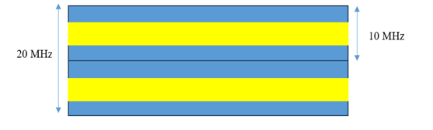
March 2025
Doc.: IEEE 802.11-25/0317r0
Chip Duration and BW
  UL BW can also scale with data rate.
    For low data rate → longer AMP device transmission duration
    Low data rate means narrower BW → FDM can be used to reduce the channel occupancy time.
    For high data rate → shorter AMP device transmission duration
    FDM can still be beneficial but may not be applicable to 4Mbps
Slide 4
Yinan Qi (OPPO)

Slide 5
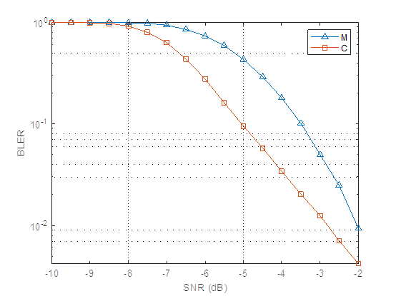
March 2025
Doc.: IEEE 802.11-25/0317r0
FEC Coding and MCS
  FEC coding: convolutional coding with coding rate 1/2
    Low encoder complexity at AMP non-AP STA
    Existing encoder can be reused
    When FEC coding is considered, chip duration and BW may need to change
  FEC coding: convolutional code
    Channel B
    Coding rate: ½
    Generator Polynomials: (2,1,7)
    Constraint Length: K=7
  Observation: convolutional code has 2.5dB and 0.8dB gain against Manchester coding for BLER=10⁻¹ and BLER=10⁻², respective.
Slide 5
Yinan Qi (OPPO)

Slide 6
March 2025
Doc.: IEEE 802.11-25/0317r0
FEC Coding and MCS
  Similar to legacy protocols, MCS table can be defined according to data rates and FEC coding.
    Data rate depends on device type
    FEC coding can be considered for certain data rates depending on complexity and link budget requirements.
    FEC coding can be on top of line coding, e.g., Manchester coding
MCS Index | Device Type | FEC Coding Rate | Data Rate
0 | Backscattering AMP device and Active AMP device | 1 | 250 kbps
1 | Backscattering AMP device and Active AMP device | 1 | 1 Mbps
2 | Active AMP device | ½ | 4 Mbps
3 | Active AMP device | 1 | 4 Mbps
Example of MCS Table
Slide 6
Yinan Qi (OPPO)

Slide 7
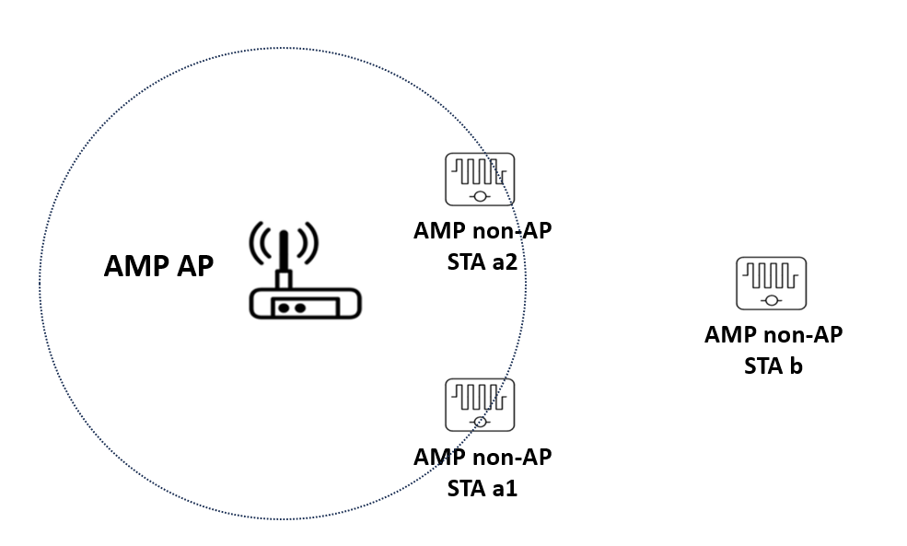
March 2025
Doc.: IEEE 802.11-25/0317r0
UL Transmission Configuration for Active Devices
  Active AMP devices
    AMP AP may trigger multiple AMP non-AP STAs simultaneously.
    AMP STA near AMP AP should transmit with higher data rate compared with AMP STAs far away from AP.
    UL Configuration parameters
      Payload size
      Data rate
      PPDU duration
      Etc.
    Sensor use case: AMP AP can have knowledge such as the channel condition between AP and STA, payload size of sensor data, e.g., from past Tx/Rx. → AP configures UL Tx parameters
Slide 7
Yinan Qi (OPPO)

Slide 8
March 2025
Doc.: IEEE 802.11-25/0317r0
UL Transmission Configuration for Active Devices
  Active AMP devices
    Inventory use case: AMP AP may not have any knowledge of the channel condition
      AP can configure the same rate for all triggered STAs
      High rate → Tx failure, e.g., STA b
      Low rate → unnecessarily long channel occupancy, e.g., STA a1 and a2
    AMP non-AP STAs can be allowed to autonomously choose its own data rate
      Such information can be conveyed in UL transmission, e.g., UL SIG if supported
Slide 8
Yinan Qi (OPPO)

Slide 9
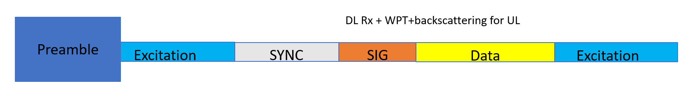
March 2025
Doc.: IEEE 802.11-25/0317r0
UL Transmission Configuration for Backscattering Devices
  UL Configuration parameters
    Duration of the excitation field for activating the AMP devices;
      AP can choose duration flexibly based on the energy related feedback from the AMP devices.
      Do not apply to the case where there is no feedback from AMP devices.
    Duration of the excitation field for backscattering communication.
      Depend on payload size, data rate, etc.
      How to configure?
        AP configures UL Tx
        AMP devices determine and indicate in UL Tx
Slide 9
Yinan Qi (OPPO)

Slide 10
March 2025
Doc.: IEEE 802.11-25/0317r0
Summary
  The following issues are discussed and analysed in this contribution
    UL transmission parameters, e.g., BW, chip duration, etc.
    How to configure UL transmission parameters, such as data rate, payload size, etc.

Slide 11
Reference
March 2025
Doc.: IEEE 802.11-25/0317r0
[1] “IEEE 802.11 TGbp Motion Dock,” IEEE 802.11-24/1322r6, Jan. 2024
[2] “AMP PPDU Design,” IEEE 802.11-25/0317r0, Jan. 2025

Slide 12
SP 1
March 2025
Doc.: IEEE 802.11-25/0317r0
  For AMP Uplink transmission with Manchester coding only, the chip duration and the main lobe BW scale with data rates as follows.
  250kbps: chip duration = 2μs, BW = 1MHz;
  1Mbps: chip duration = 0.5μs, BW = 4MHz;
  4Mbps: chip duration = 0.125μs, BW = 16MHz.
  If FEC coding is supported, the chip duration and the main lobe BW are TBD.

Slide 13
SP 2
March 2025
Doc.: IEEE 802.11-25/0317r0
  For AMP Uplink transmission, convolutional code can be supported as follows.
  Coding rate: ½
  Generator Polynomials: (2,1,7)
  Constraint Length: K=7
  Whether or not the convolutional code is applied to all data rates and device types is TBD.

Slide 14
SP 3
March 2025
Doc.: IEEE 802.11-25/0317r0
  For AMP Uplink transmission, MCS table can be defined. Details are TBD.

Slide 15
SP 4
March 2025
Doc.: IEEE 802.11-25/0317r0
  For AMP UL transmission, the transmission parameters, e.g., data rate, is configured by the AP
  AMP non-AP STA configuration can also be supported as optional feature.

