Slide 1
Follow-up on AMP PPDU Design
March 2025
Doc.: IEEE 802.11-25/0316r0
Date: 2025-03-11
Authors:
Name | Affiliation | Address | Phone | Email
Yinan Qi | OPPO |  |  | v-qiyinan@oppo.com
Weijie Xu
Chuanfeng He
Ke Wang
Shengjiang Cui
Zhisong Zuo

Slide 2
Abstract
Doc.: IEEE 802.11-25/0316r0
In this contribution, we discuss the remaining open issues in AMP PPDU design covering issues such as preamble, synchronization, SIG, data field, PPDU format and UL transmission configuration.

Slide 3
March 2025
Doc.: IEEE 802.11-25/0316r0
DL Preamble Design
Preamble for Active Tx and AMP enabled devices
Agreement: The preamble of an AMP DL PPDU includes L-STF, L-LTF, L-SIG, RL-SIG, and U-SIGs for AMP enabled non-AP STA and active TX non-AP AMP STA in 2.4 GHz [1].
Multi-carrier OFDM with BW 20MHz
How to configure individual fields in L-SIG?
Rate: configured as an unsupported rate
Differentiate from WUR where rate is always configured as MCS0
Other legacy devices can stop reception once detecting unsupported rate
Length: configured to indicate only the DL part without excitation fields in DL PPDU
AP may not have the knowledge of the duration for UL transmission because e.g., lack of knowledge for payload size.
Slide 3
Yinan Qi (OPPO)

Slide 4
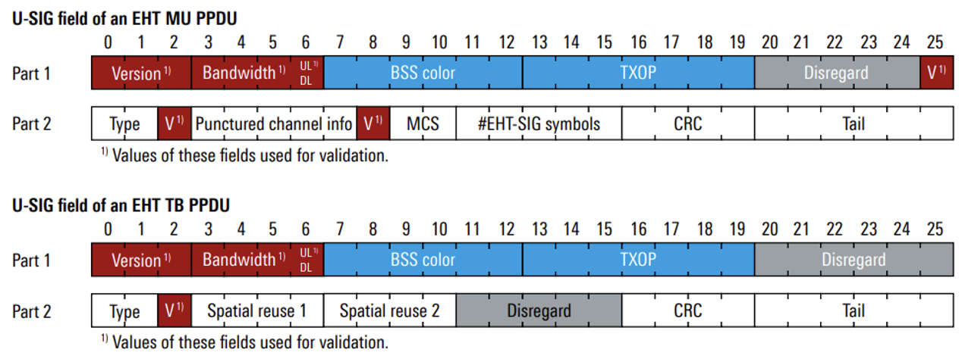
March 2025
Doc.: IEEE 802.11-25/0316r0
DL Preamble Design
How to configure individual fields in RL-SIG?
Instead of repetition of L-SIG, may consider other options to differentiate 802.11bp PPDU from legacy PPDU
How to configure individual fields in U-SIG?
Two U-SIG formats available but need to choose only one for 802.11bp
How to differentiate 802.11bp PPDU from 802.11be and 802.11bn PPDU?
Validation fields, e.g., version, BW: for example, version field can be configured different from 802.11be and 802.11bn
UL/DL: configured as DL if there is no excitation field and UL otherwise
Slide 4
Yinan Qi (OPPO)

Slide 5
March 2025
Doc.: IEEE 802.11-25/0316r0
DL Preamble Design
Additional preamble format, e.g., 802.11b preamble for backscattering
Single carrier DSSS with BW 22MHz
How to configure individual fields in preamble?
SIGNAL can be configured with unsupported rate, so that other legacy devices can stop reception.
Service field can be configured different from 802.11b or 802.11g and some bits can be used to indicate 802.11bp related information.
Length can be configured to indicate only the DL part without excitation fields in DL PPDU.
Differentiate 802.11bp from 802.11b and 802.11g.
Slide 5
Yinan Qi (OPPO)

Slide 6
March 2025
Doc.: IEEE 802.11-25/0316r0
Synchronization
Asymmetric synchronization design for UL and DL
Different processing capability at AP and AMP non-AP STAs
Different link budget for UL and DL
Different sync sequences in terms of pattern and/or length for DL/UL to differentiate UL and DL
DL synchronization design
Synchronization sequence length: 16 bits for 1Mbps with high SNR and 32 bits for 250kbps with low SNR
Chip duration: same chip duration for 1Mbps and 250kbps for reduced complexity at AMP non-AP STA side
UL synchronization design
A single synchronization sequence can be used for multiple data rates
Chip rate can scale with data rate and short chip duration is used for higher rate with higher SNR to reduce signalling overhead
AP can do blind detection trying various chip duration if lack of knowledge of UL data rate
Slide 6
Yinan Qi (OPPO)

Slide 7
March 2025
Doc.: IEEE 802.11-25/0316r0
SIG Field
DL SIG fields
Length
Backscatter indication: together with other fields can indicate CW info to energizers
UL configuration to configure the following UL transmission in followed excitation field
For backscatter devices, they can still transmit UL using excitation even without successful decoding of DL data, decouple DL data and UL
Can be used by energizers to transmit CW
CRC
Pros of DL SIG
SIG can convey useful information for energizers assuming AMP DL PPDU can be read by energizers
Other AMP non-AP can read the length fields and go to sleep to save energy
UL SIG might be needed in some cases
AP has no knowledge of UL payload size, FEC if applied, and data rate if autonomously chosen by AMP non-AP devices [2]
Slide 7
Yinan Qi (OPPO)

Slide 8
March 2025
Doc.: IEEE 802.11-25/0316r0
Payload Size
Flexible payload size configuration for DL and UL
Different from 802.11ba where many management and control frames are transmitted by the main radio
Data frame
ID(s) of AMP non-AP STAs for sensor reporting
EH related information reporting
Other frames
Management frame such as triggering frame.
For data frame, 802.11ba can still be a starting point
Frame body is m*n
m is the size of AMP non-AP STA ID, e.g., AID or compressed AID
n is the number of AMP non-AP STAs to be addressed
How to configure payload size?
DL SIG or MAC header
Slide 8
Yinan Qi (OPPO)

Slide 9
March 2025
Doc.: IEEE 802.11-25/0316r0
DL PPDU: Flexible BW and Waveform
DL PPDU
Different BW and waveforms can be considered for different fields including preamble, excitation, data, etc., to achieve optimized performance
Active Tx
Preamble: 20MHz with OFDM waveform
AMP part: no less than 10 MHz but can be DSSS waveform
Close-range backscattering
Preamble
20MHz with OFDM waveform
22MHz with DSSS waveform
AMP part
Excitation field for activating: BW should not be too narrow
Data field: same design as excitation
Slide 9
Yinan Qi (OPPO)

Slide 10
March 2025
Doc.: IEEE 802.11-25/0316r0
DL PPDU: Flexible BW and Waveform
Bi-static backscattering
Different fields can be transmitted by separated nodes
AP: DL sync, SIG and data
Energizer: excitation
Different BW and waveform is more applicable
BW and waveform configuration
Can either be pre-defined or flexibly configured
Trade-off between performance and signalling overhead/complexity.
Slide 10
Yinan Qi (OPPO)

Slide 11
March 2025
Doc.: IEEE 802.11-25/0316r0
PPDU Format
DL PPDU format
AMP device can be assumed with energy storage so the excitation part is purely for backscattering
Sync may be needed for AMP devices to know when the backscattering begins
AP has full control of the energizer to avoid misuse of excitation field
UL PPDU format for backscattering
UL PPDU for backscattering can be defined as follows:
IEEE 802.11bp shall specify, in 2.4 GHz, an AMP UL PPDU for AMP non-AP STAs supporting backscattering transmission that contains at least AMP-UL-Sync field and AMP-UL-Data field.
Note: This UL PPDU is backscattered by the AMP non-AP STA within one excitation field which can be contained in a DL PPDU
Notes:
Preamble + Sync + excitation

Slide 12
March 2025
Doc.: IEEE 802.11-25/0316r0
Summary
The following issues are discussed and analysed in this contribution
Preamble design
Synchronization design for both DL and UL
DL/UL SIG
Payload size
DL and UL PPDU format

Slide 13
Reference
March 2025
Doc.: IEEE 802.11-25/0316r0
[1] “IEEE 802.11 TGbp Motion Dock,” IEEE 802.11-24/1322r6, Jan. 2025
[2] “AMP UL Transmission,” IEEE 802.11-25/0317r0, Mar. 2025

Slide 14
SP 1
March 2025
Doc.: IEEE 802.11-25/0316r0
The preamble of an AMP DL PPDU for AMP enabled non-AP STA and active TX non-AP AMP STA should be configured as follow,
L-SIG
Rate - configured as an unsupported rate
Length - indicate only the DL part without excitation fields in DL PPDU
U-SIG
Version field - configured different from 802.11be and 802.11bn
UL/DL - configured as DL if there is no excitation field and UL otherwise

Slide 15
SP 2
March 2025
Doc.: IEEE 802.11-25/0316r0
IEEE 802.11bp will specify, in 2.4 GHz, DL synchronization sequence length with length 16 bits for 1Mbps and 32 bits for 250kbps. Chip duration is the same for all data rates, e.g., 2us.

Slide 16
SP 3
March 2025
Doc.: IEEE 802.11-25/0316r0
IEEE 802.11bp will specify, in 2.4 GHz, a single UL synchronization sequence length with chip duration same as data field.

Slide 17
SP 4
March 2025
Doc.: IEEE 802.11-25/0316r0
An AMP Downlink PPDU shall contain an AMP-SIG field containing at least following information:
Length indication
Backscatter indication bit
CRC
UL configuration
Details TBD

Slide 18
SP 5
March 2025
Doc.: IEEE 802.11-25/0316r0
IEEE 802.11bp will specify additionally, in 2.4 GHz, an AMP Downlink PPDU format containing at least an 802.11 preamble field and an Excitation field.
AMP-Sync field is TBD

Slide 19
SP 6
March 2025
Doc.: IEEE 802.11-25/0316r0
IEEE 802.11bp shall specify, in 2.4 GHz, an AMP UL PPDU for AMP non-AP STAs supporting backscattering transmission that contains at least AMP-UL-Sync field and AMP-UL-Data field.
Note: This UL PPDU is backscattered by the AMP non-AP STA within one excitation field which can be contained in a DL PPDU.

