Slide 1
Further Discussion on Downlink Sync Field Design
March 2025
Date: 2025-03-11
Authors:
Name | Affiliations | Address | Phone | Email
Bin Qian | Huawei | Shenzhen, China |  | qianbin14@huawei.com
Lumin Liu |  | Singapore
Lei Huang |  | Singapore
Panpan Li |  | Singapore
Notes:
September 2012

Slide 2
Recap of Current Consensus
March 2025
Motion #18 [1]: The AMP-Sync field in the AMP Downlink PPDU in 2.4 GHz is defined with a chip duration of 2 us for backscattering cases
Motion #33 [1]: IEEE 802.11bp defines at least one AMP-Sync in the AMP Downlink PPDU in 2.4 GHz for backscatter communication, and at least one AMP-Sync in the AMP Downlink PPDU in 2.4 GHz for non-backscatter communication. The AMP-Sync is independent of the integrated and non-integrated deployment.
This contribution further refines the chip duration and Sync field length parameters

Slide 3
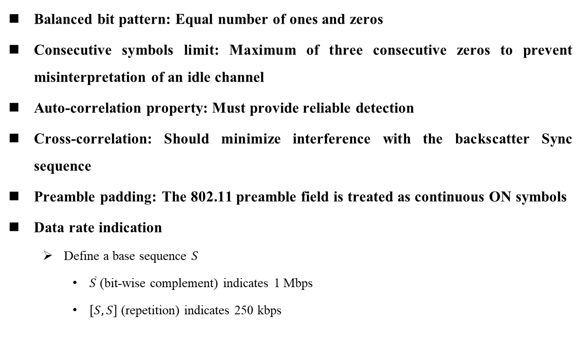
Sync Sequence Design Criteria: Non-backscatter Communication [2-3]
March 2025
Balanced bit pattern: Equal number of ones and zeros
Consecutive symbols limit: Maximum of three consecutive zeros to prevent misinterpretation of an idle channel
Auto-correlation property: Must provide reliable detection
Cross-correlation: Should minimize interference with the backscatter Sync sequence
Preamble padding: The 802.11 preamble field is treated as continuous ON symbols
Data rate indication
  Define a base sequence $S$
    $\overline{S}$ (bit-wise complement) indicates 1 Mbps
    $\left[S, S\right]$ (repetition) indicates 250 kbps

Slide 4
Sync Sequence Design Criteria: Backscatter Communication
March 2025
Invalid Manchester pattern inclusion [4]
  Allow invalid patterns (exactly three consecutive zeros or at least three consecutive ones) as part of the pattern
Valid Manchester pattern termination: Must end with a valid Manchester pattern (e.g., 10 or 01)
Starting symbol: Begin with 0 to distinguish from the 802.11 preamble or Excitation field
Sequence Length: A short sequence (e.g., length 8) is sufficient due to the high SNR at the STA [2, 5]

Slide 5
Chip Duration Considerations
March 2025
Uniformity
  Non-backscatter devices should adopt a consistent chip duration, enabling a single correlation process at the STA
Data Rate Constraint
  The chip duration is constrained by the 250 kbps data rate, which demands higher reliability

Slide 6
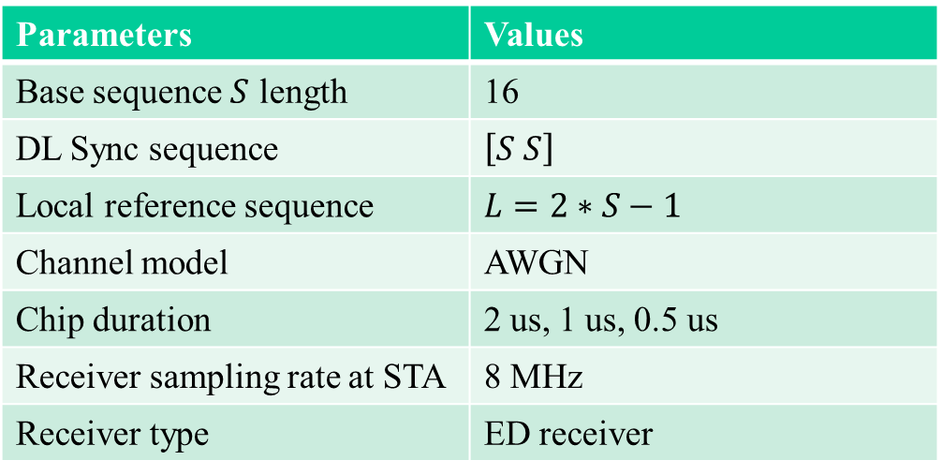
Chip Duration Simulation (1/2)
March 2025
Parameters | Values
Base sequence $S$ length | 16
DL Sync sequence | $\left[S S\right]$
Local reference sequence | $$L=2∗S−1$$
Channel model | AWGN
Chip duration | 2 us, 1 us, 0.5 us
Receiver sampling rate at STA | 8 MHz
Receiver type | ED receiver

Slide 7
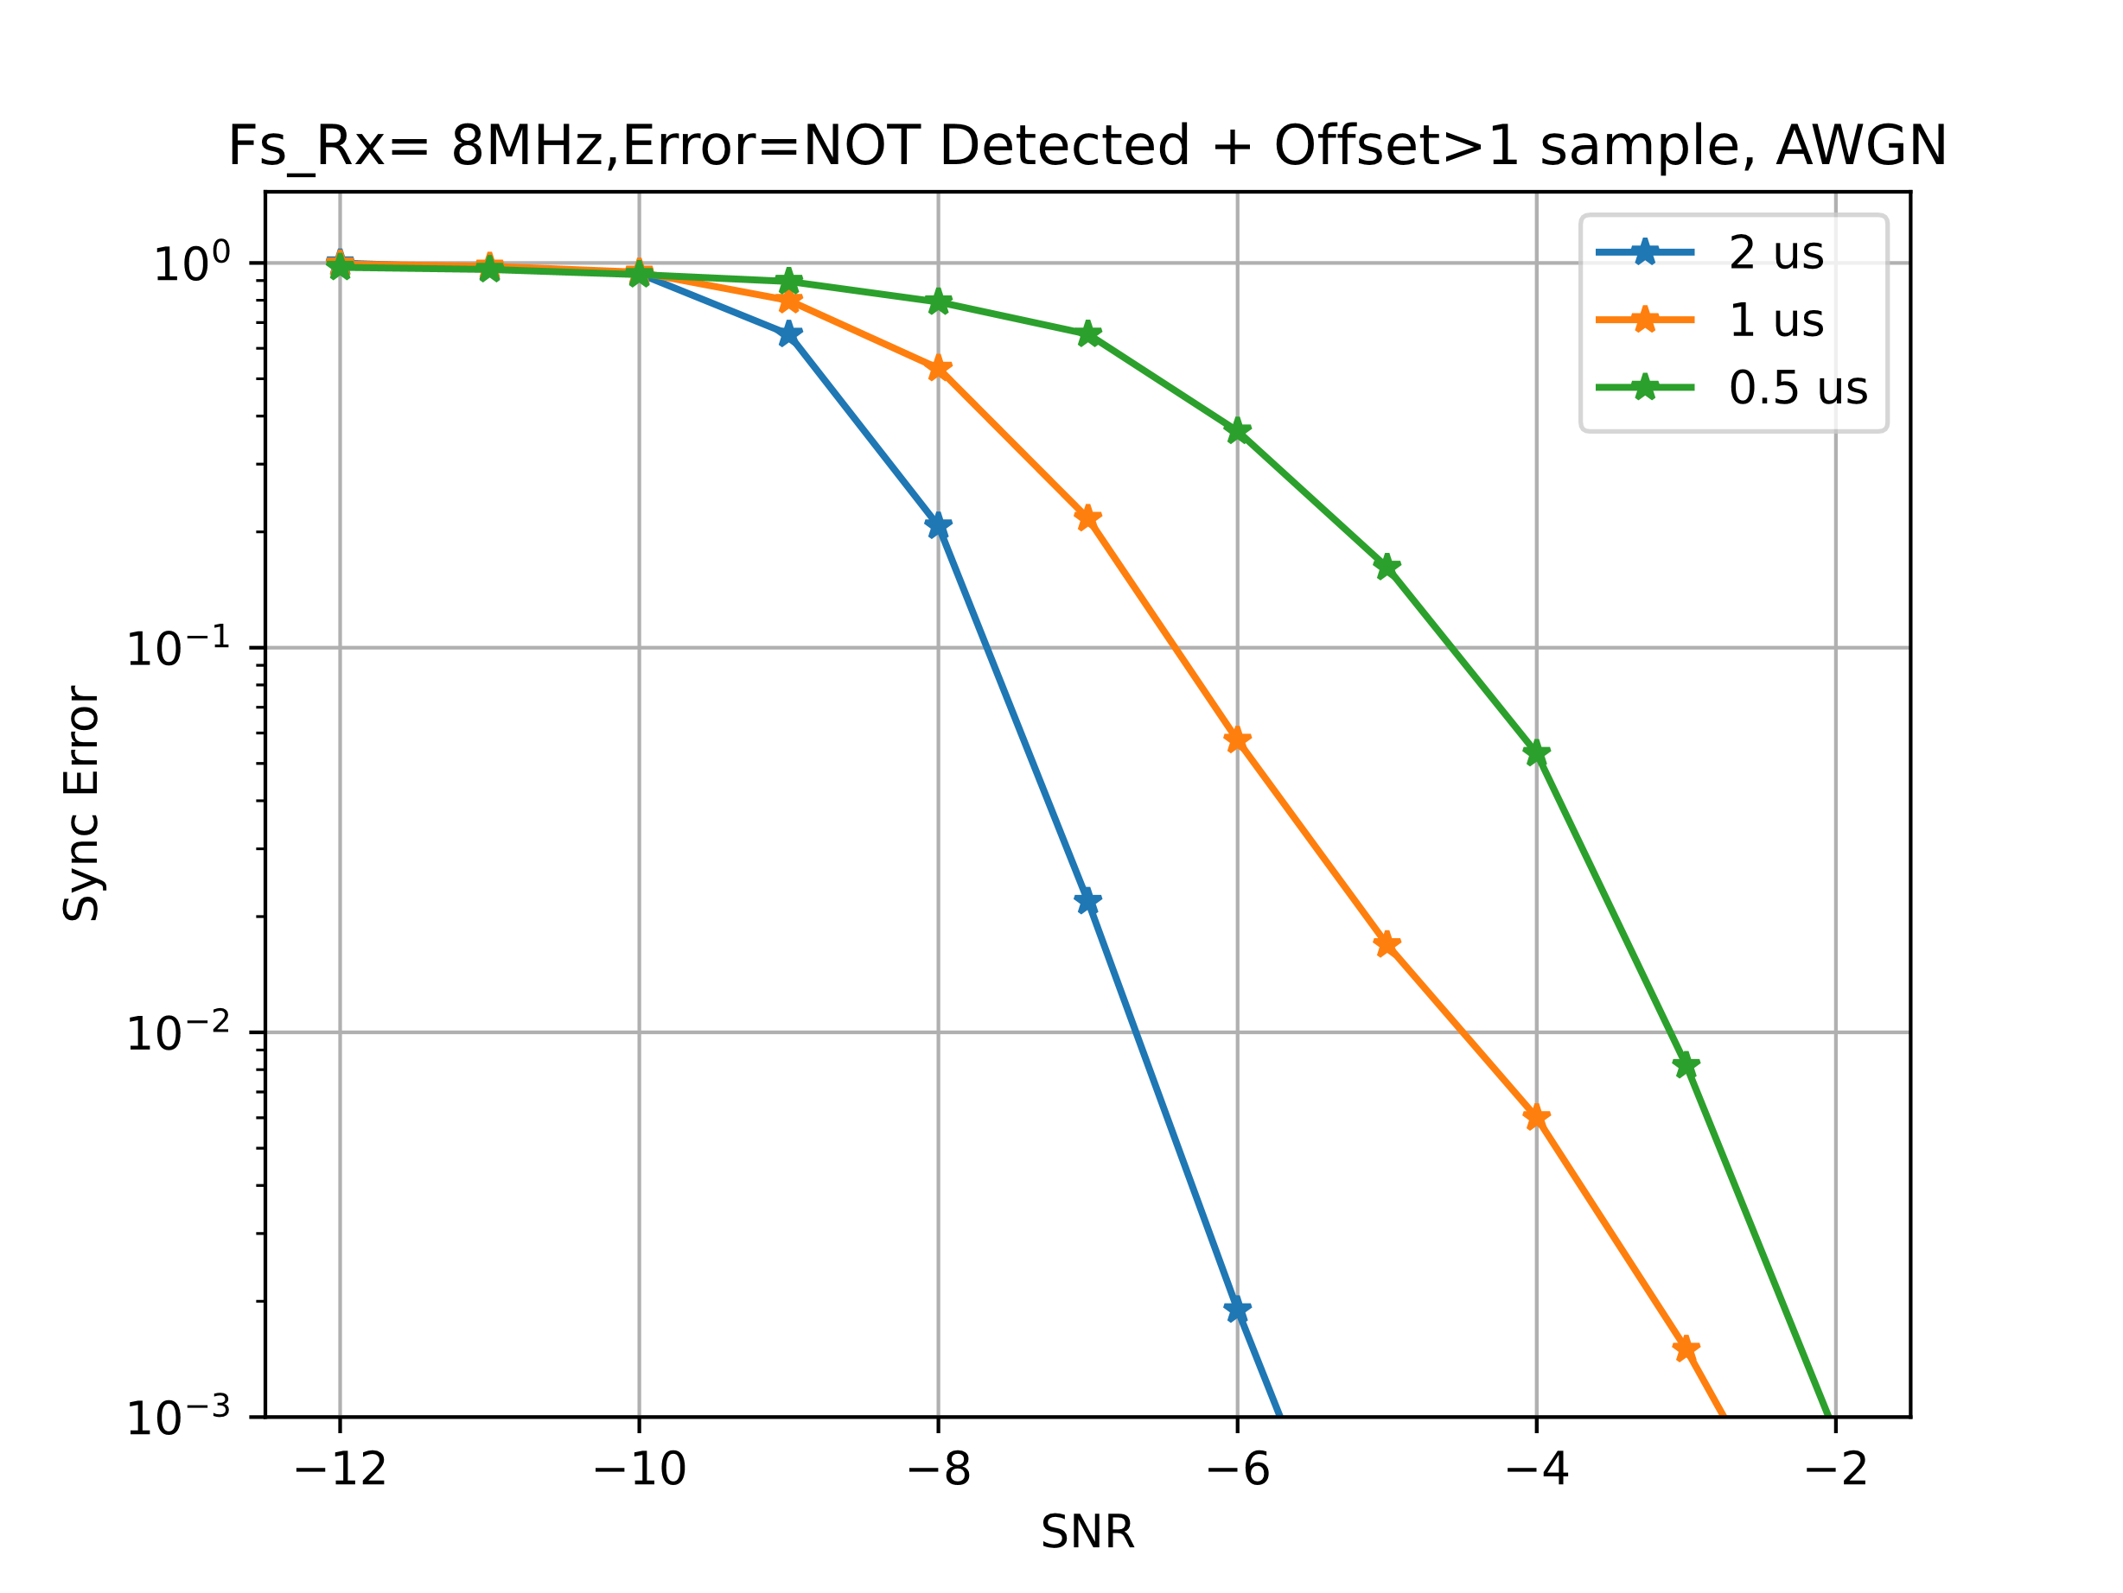
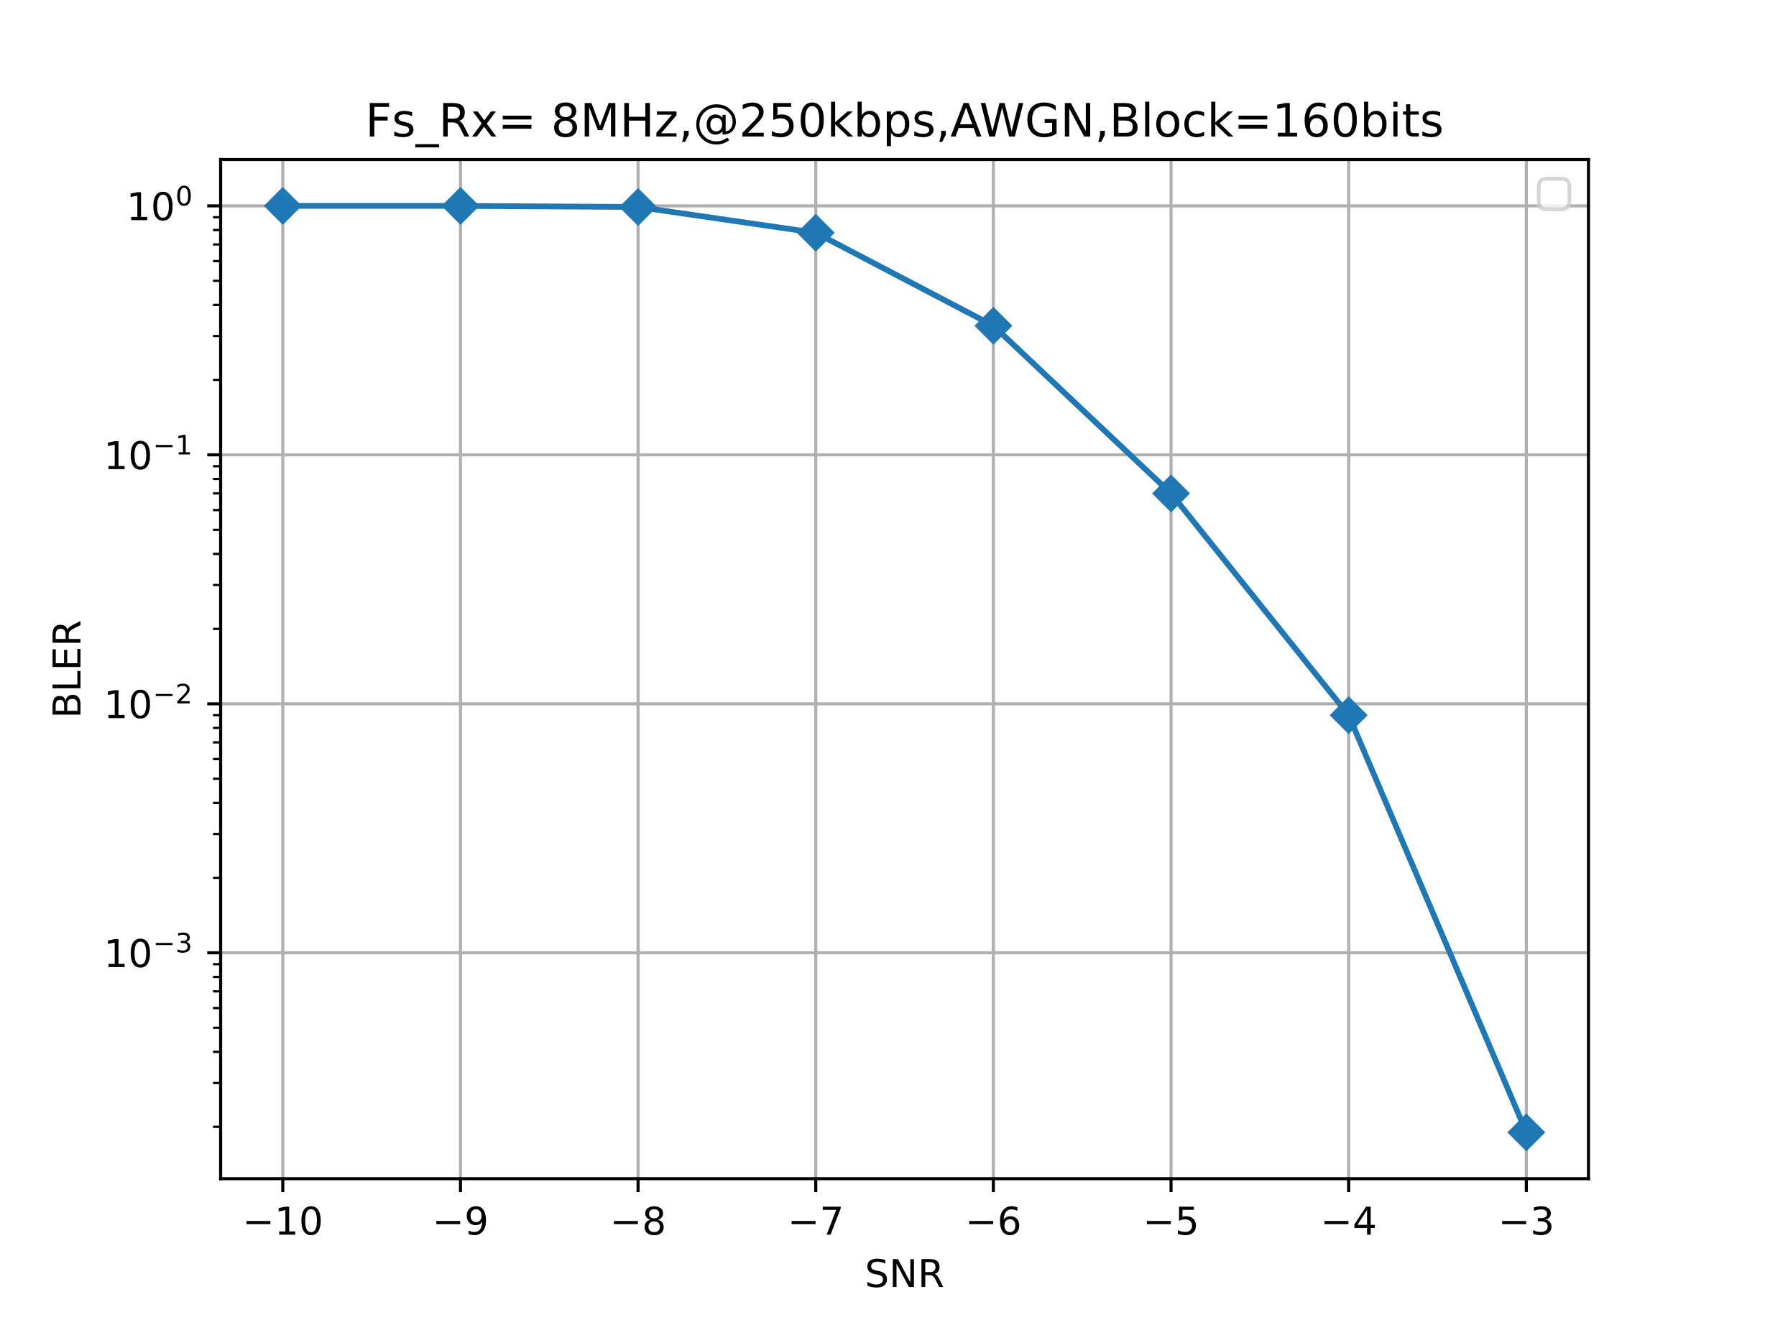
Chip Duration Simulation (2/2)
March 2025
Sync detection performance
Data decoding performance
At 0.5 us, the Sync detection performance is lower than that of data decoding
At 1 us, the Sync detection performance shows an improvement, yet the performance margin remains limited
Simulation results indicate that a chip duration of 2 us delivers robust Sync detection performance

Slide 8
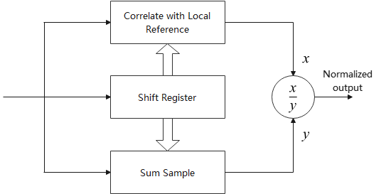
Sequence Length Considerations (1/2)
March 2025
Reliability requirement: The Sync field must be more reliable than the data field for stable synchronization
Impact of Manchester encoded data: Random Manchester encoded data can degrade auto-correlation performance
Normalized correlation peak [6] could be used to evaluate the effect of random Manchester encoded data on Sync field reliability

Slide 9
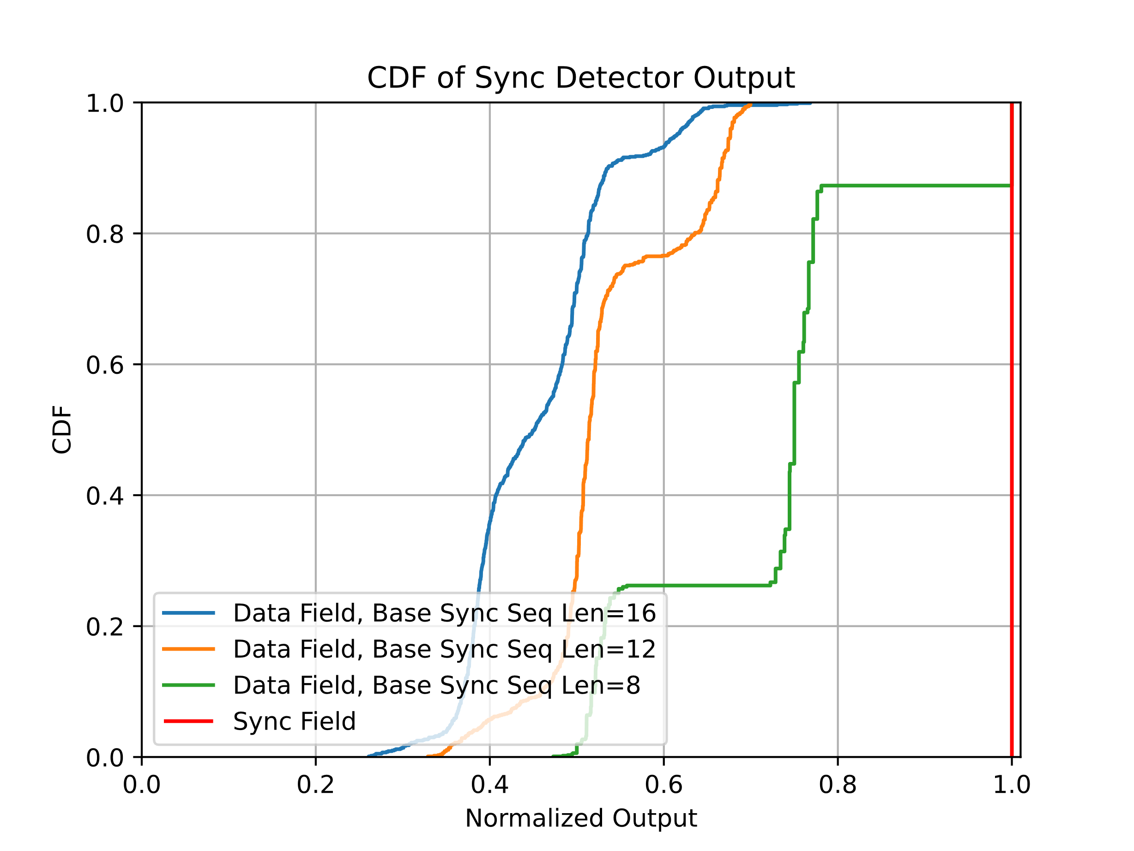
Sequence Length Considerations (2/2)
March 2025
A base sequence length of 8 shows high cross-correlation with the data field, risking false detections

Slide 10
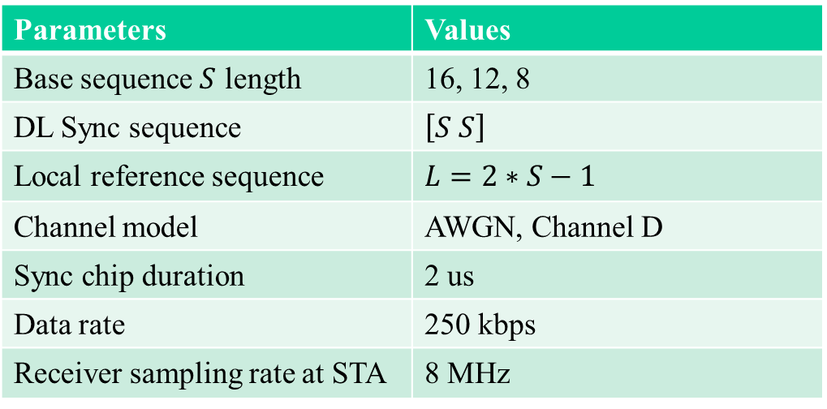
Sequence Length Simulation (1/3)
March 2025
Parameters | Values
Base sequence $S$ length | 16, 12, 8
DL Sync sequence | $\left[S S\right]$
Local reference sequence | $$L=2∗S−1$$
Channel model | AWGN, Channel D
Sync chip duration | 2 us
Data rate | 250 kbps
Receiver sampling rate at STA | 8 MHz

Slide 11
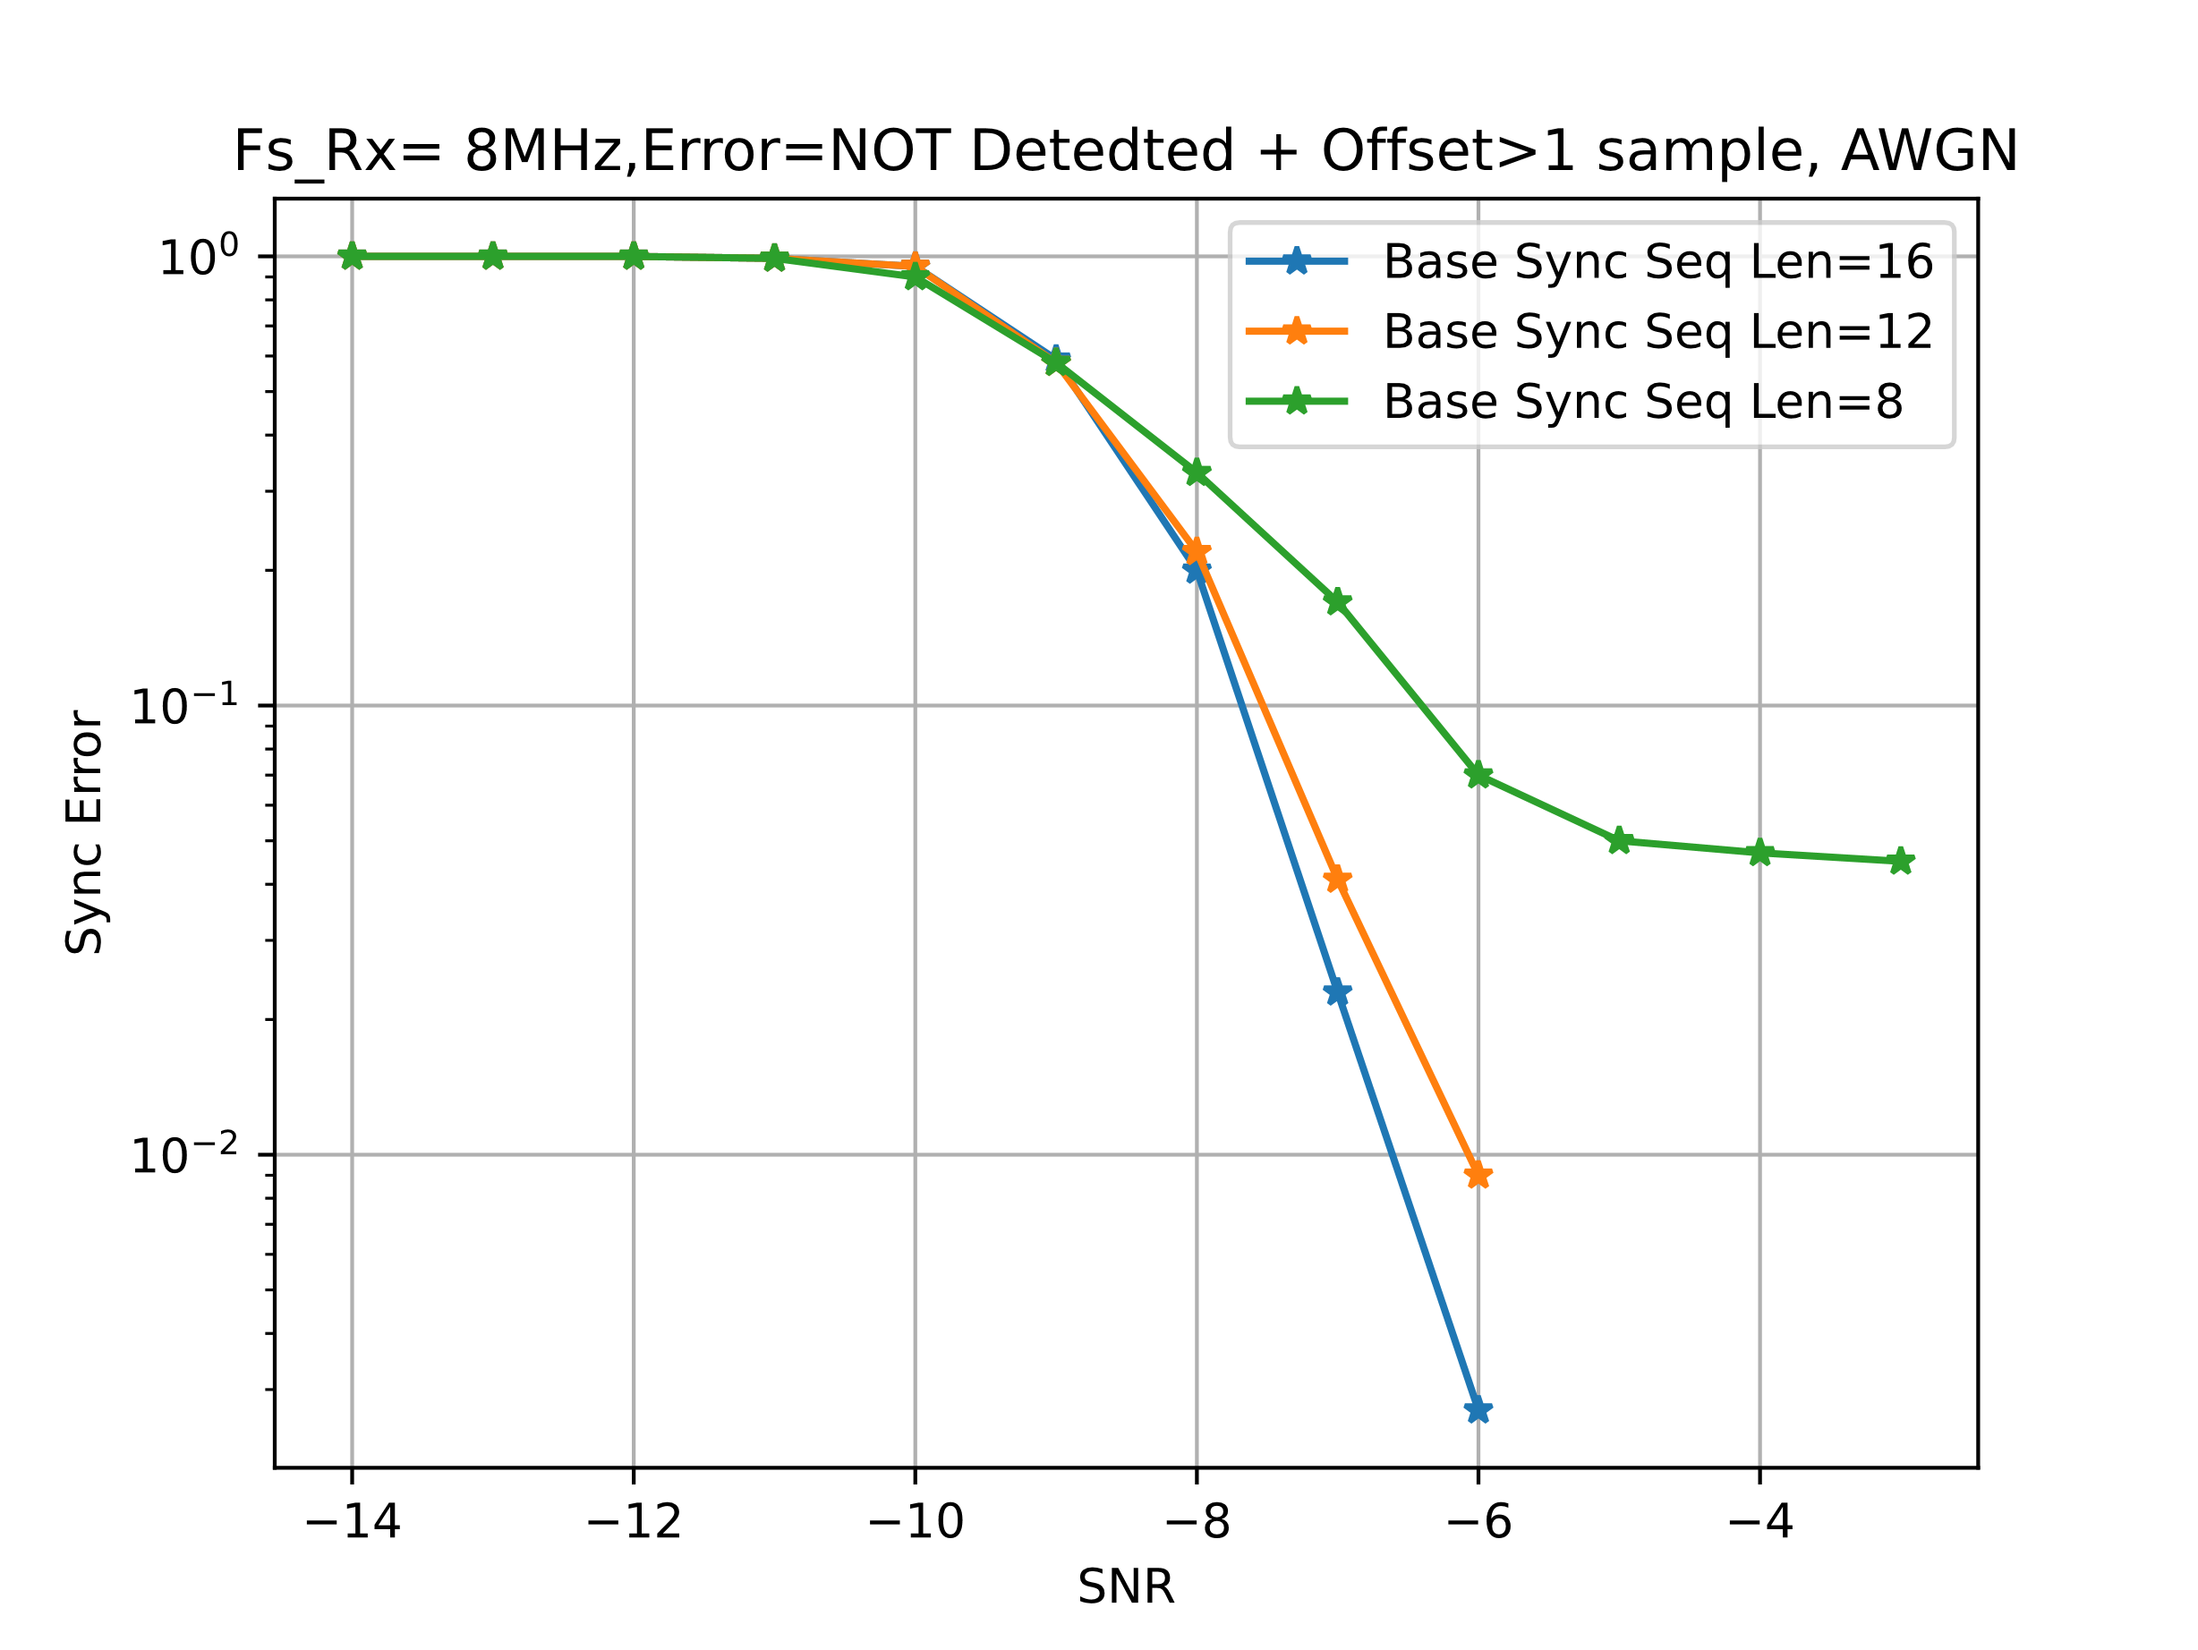
Sequence Length Simulation (2/3)
March 2025
Sync detection performance
Data decoding performance
A base Sync sequence length of 8 shows an evident error floor

Slide 12
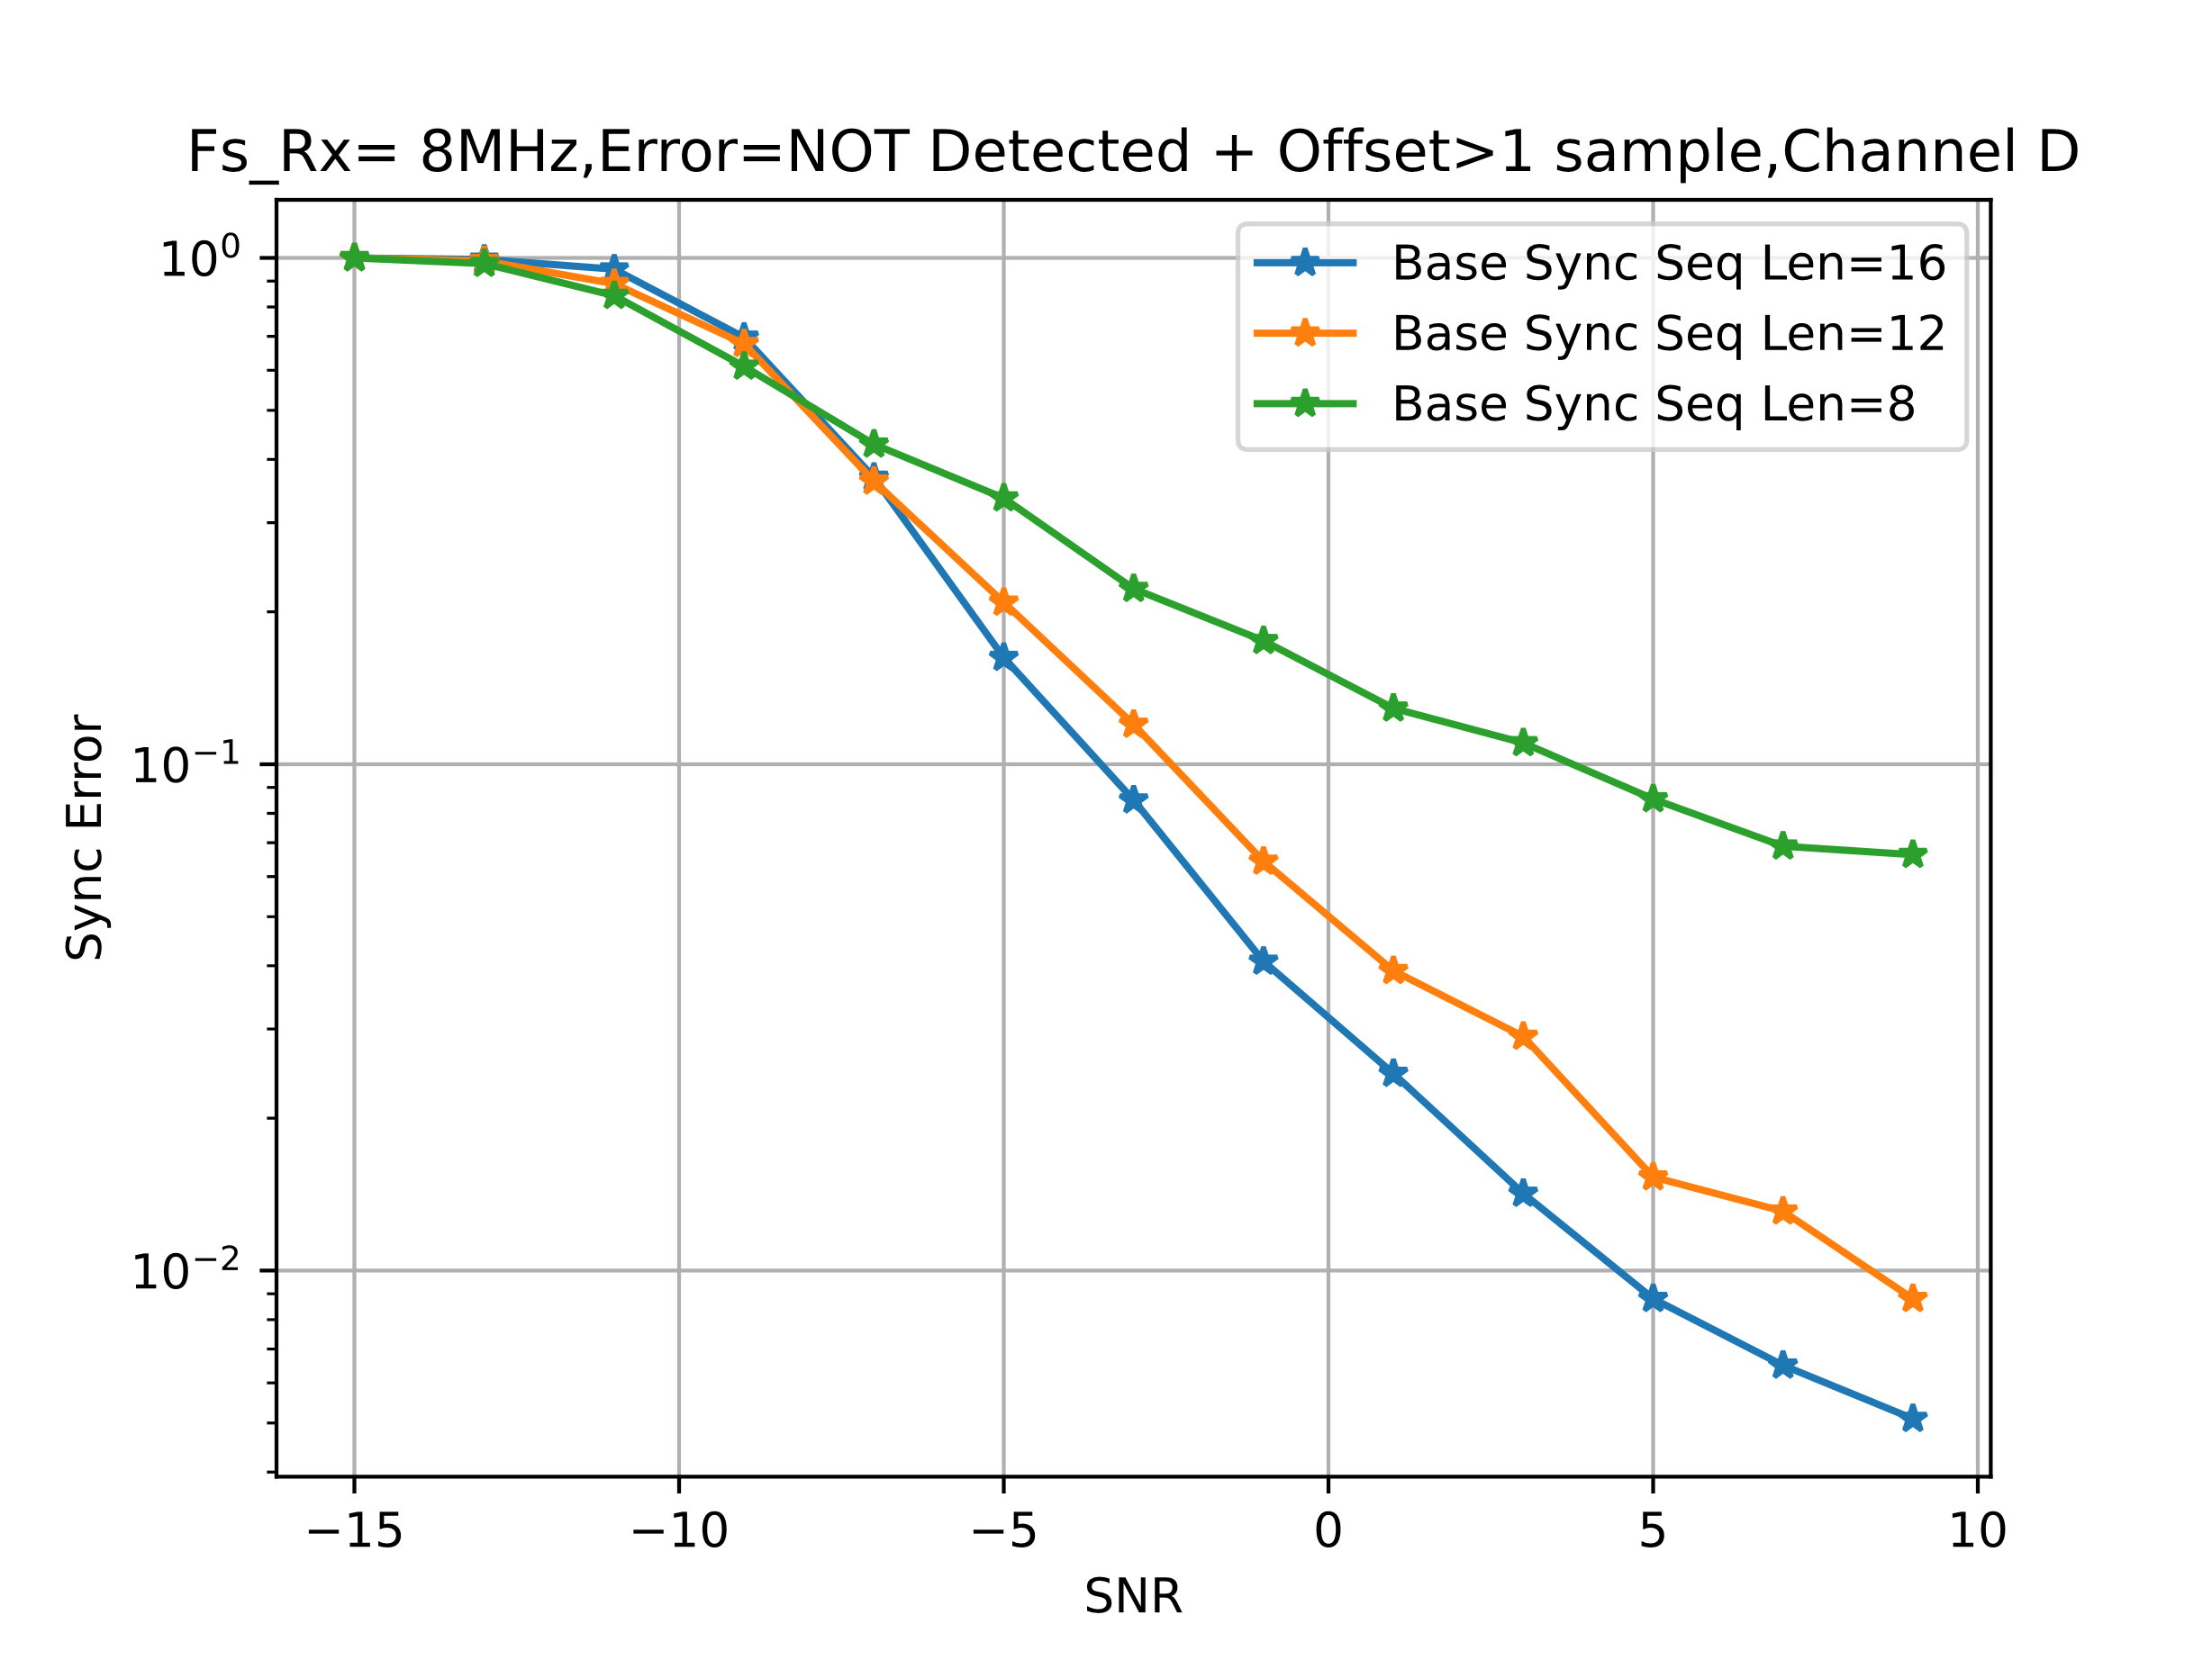
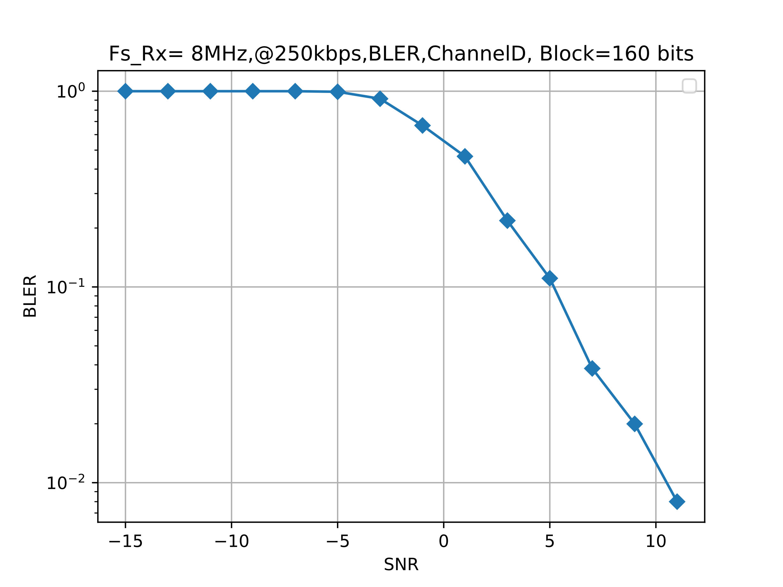
Sequence Length Simulation (3/3)
March 2025
Sync detection performance
Data decoding performance
Although base sequence lengths of 12 and 16 meet the 20-byte payload data decoding requirements, a length of 16 provides a better performance margin
Based on simulation results, we recommend adopting a base Sync sequence length of 16

Slide 13
Summary
March 2025
AMP-Sync field design criteria overview
  Cross-correlation between non-backscatter and backscatter Sync fields must be minimized to reduce false alarms
Chip duration
  A uniform 2 us chip duration is suggested to simplify receiver design and meet the 250 kbps reliability requirement
Sync sequence length
  Non-backscatter: Length-16 for 1 Mbps and Length-32 for 250 kbps
  Backscatter: Length-8 is sufficient

Slide 14
References
March 2025
[1] 11-24-1322-06-00bp-tgbp-motion-dock
[2] 11-25-0047-00-00bp-follow-up-on-downlink-sync-field-design
[3] 11-25-0034-00-00bp-sync-field-for-amp-ppdu
[4] 11-24-1797-00-00bp-design-considerations-of-dl-data-rate-and-sync
[5] 11-25-0075-02-00bp-further-thoughts-on-amp-dl-ppdu-for-mono-static-backscattering
[6] 11-18-1201-00-00ba-concerns-about-sync-detector-false-alarms

Slide 15
Straw Poll #1
March 2025
Do you agree to add following content to TGbp SFD:
  The AMP-Sync field in AMP Downlink PPDU in 2.4 GHz is defined with chip duration of 2us for non-backscattering communication

Slide 16

Straw Poll #2
March 2025
Do you agree to add following content to TGbp SFD:
  For Active Tx non-AP AMP STA and AMP Enabled non-AP STA, the AMP-Sync field structure in the AMP Downlink PPDU in 2.4 GHz depends on the data rate of the AMP-Data field. When the AMP-Data field data rate is 1 Mbps, the structure of the AMP-Sync field is $\overline{S}$, where $S$ is a sequence of 16 bits, and $\overline{S}$ is the bit-wise complementary sequence of $S$. When the AMP-Data field data rate is 250 kbps, the structure of the AMP-Sync field is $\left[S S\right]$. The specific bit sequence of $S$ is TBD.

Slide 17
Appendix
March 2025
Base sequence used
  Length 16: (1) 1 1 0 0 0 1 1 0 1 0 0 0 1 0 1 1; (2) 0 0 1 1 0 1 0 1 1 0 1 0 0 0 1 1
  Length 12: 0 1 0 1 1 0 0 0 1 1 0 1
  Length 8: 0 1 0 1 1 0 0 1

