Slide 1
BSR in M-STA BA
Date: 2025-04-03
Name | Affiliations | Address | Phone | email
Seongho Byeon | Samsung Electronics |  |  | sh.byeon@samsung.com
Jack Jonghyo Lee
Jaheon Gu
Jennifer Jihye Lee
Jinho Choi
Jonghoe Koo
Jungjun Kim
Suhwook Kim
Taeyoung Ha

Slide 2
Preliminaries
Our Consensus
  [Motion #138] TGbn uses Multi-STA BA for Initial Control Response frame (ICR) for DL and UL, at least when carrying the unavailability information
  [Motion #141] TGbn defines a special Feedback Per AID TID Info field (name TBD) that carries control feedback in the Multi-STA BA frame
    The control feedback (i.e., unavailability indication) is carried instead of the BlockAck Bitmap in that Feedback Per AID TID Info field
    The Ack Type subfield of the Per AID TID Info field is set to 0 and the TID subfield of the Per AID TID Info field is set to a reserved value
    The AID11 subfield of this Per AID TID Info field is set to a reserved TBD value if the control feedback is addressed to all STAs or to the AID11 that identifies the intended recipient STA
    The Starting Sequence Number field of this Per AID TID Info field is reserved
  [Motion #151] 11bn allows Multi-STA BA to carry one or more types of feedback (e.g., unavailability) information
    How to include feedback information is TBD.
  [Motion #152] An individually addressed BSRP Trigger, used as an ICF, can indicate whether the responding PPDU is a non-HT (duplicate) PPDU and contains a multi-STA BA?
    The indication (TBD whether reserved value or a reserved bit) is carried in the Common Info field of the BSRP Trigger frame
  [Motion #343] 11bn allows a Multi-STA BA frame to include both Block Ack Bitmap and Feedback information if the preceding PPDU includes QoS Data frame(s) that solicit an immediate response (e.g., Ack or BlockAck context) and the non-AP STA is operating in a mode that allows inclusion of feedback information(e.g. DUO mode).
[Note] Not responding to BSRP trigger frame with BSR is unnatural, literally speaking.
This presentation considers methods to send BSR regardless of PPDU formats in M-STA BA.

Slide 3
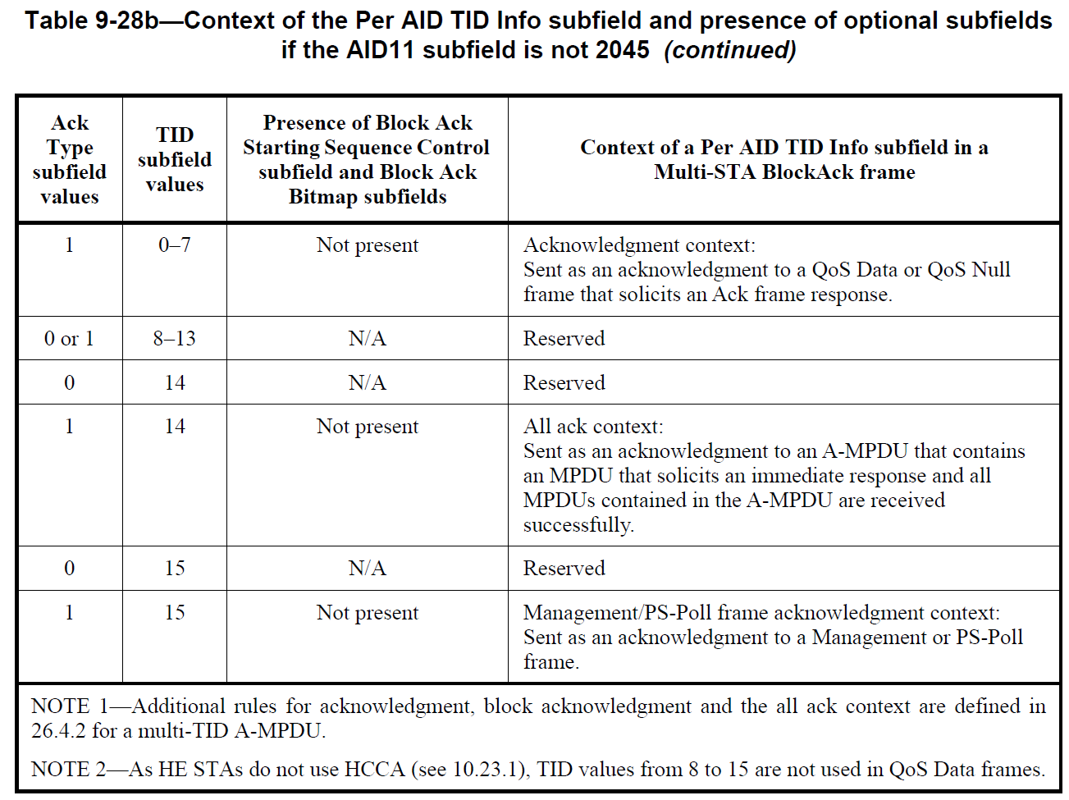
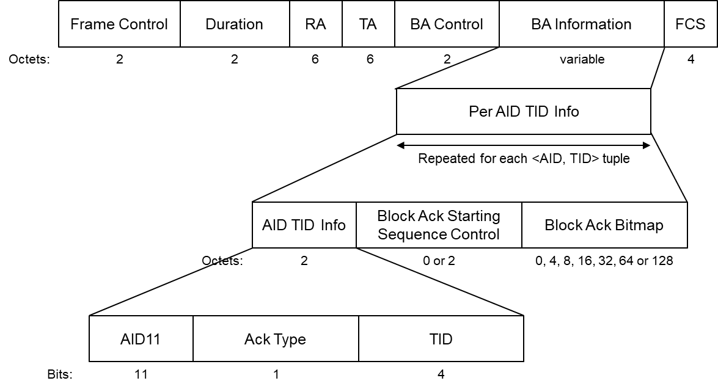
M-STA BA for feedback
[Review] General Extension of Multi-STA BlockAck (M-STA BA)
  Various UHR features uses BSRP trigger frame as ICF, soliciting M-STA BA as ICR
  Initial Control frame Response (ICR)
    Multi-STA BA is a good example as shown in the figure [1-3]
      Good and flexible container for carrying the dynamic feedbacks (unavailability), security fields, and padding in Per AID TID Info
    Possible to indicate a new control information combining with Ack Type and TID,
    by assigning a specific AID for feedback,
      A value of 2008 in the AID11 subfield is used to identify a Per AID TID Info field that carries feedback (e.g., DUO) that applies to all receiving UHR STAs, with the combination of Ack Type and TID subfield values set to one of the reserved values (e.g., Act Type of 0 and TID of 13 for DUO feedback) [4]

Slide 4
BSR in M-STA BA
We are mainly targeting to the case of M-STA BA frame of non-HT duplicate format as a response to BSRP trigger frame
  [Note] BSR incursion in M-STA BA even attached in TB PPDU format is easily possible
Examples how to format BSR used in Block Ack Bitmap
  Reuse of one or more QoS Control fields
    Each of 2 bytes can indicate BSR of a single TID (Two TIDs for 4 bytes, four TIDs for 8 bytes, or eight TIDs for 16 bytes, etc.)
    B4-B7 (4 bits) in QoS Control fields are reserved in this case
  Reuse of BSR control in A-Control (or Enhanced BSR defined in TGbn)
    4 bytes can indicate a BSR of the multiple TID (May use multiple BSR controls in Block Ack Bitmap (multiple of 4 bytes))
    B0-B5 (6 bits) in A-Control field are reserved in this case
Octets:
2
0 or 2
0, 4, 8, 16, 32, 64 or 128
DUO feedback
…
AID TID Info
Block Ack Starting Sequence Control
Block Ack Bitmap
BSR
AID11
AID of receiver
Ack Type
0
TID
13
Fragment number
Bitmap Size
Starting Sequence Number
4 bits for Feedback Type subfield
Bits:
11
1
4
Bits:
4
12
[NOTE] a combination of Act Type and TID value indicates that this field contains feedback information. For example, AID11 of 0 (to the AP) with Act Type 0 + TID 13 and Feedabck type equal to 2 can denote BSR incursion in Block Ack Bitmap

Slide 5

BSR in M-STA BA
M-STA BA enhancement for BSR examples
  When a BSRP trigger frame, ICF, solicits a non-HT format M-STA BA as an ICR
    DUO
    Co-TDMA polling (Motion #270)
BSRP TF as ICF
Frame exchanges
DUO AP
SIFS
(Non-HT)
M-STA BA as ICR
DUO STA
SIFS
STA performing DUO can inform the AP of its unavailability duration within the AP's TXOP through M-STA BA. This non-HT format M-STA BA can also include BSR of DUO STA in the BA information field
DUO AP
AP’s TXOP
DUO STA
Unavailability
BSRP TF as ICF
Frame exchanges
within Sharing AP’s BSS
MU-RTS TXS
Sharing AP
SIFS
SIFS
SIFS
(Non-HT)
M-STA BA as ICR
CTS
Frame exchanges
within Shared AP’s BSS
Shared AP
SIFS
SIFS
The Shared AP (or polled AP, herein) can inform the Sharing AP of its intention of participating in Co-TDMA within the Sharing AP's TXOP through M-STA BA. This non-HT format M-STA BA can also include BSR of the Shared AP STA in the BA information field

Slide 6
Conclusion
In this presentation, we emphasized once again that M-STA BA is good and flexible containers for carrying the control feedbacks as an ICR, and also discussed the possibility of BSR incursion in M-STA BA to respond to BSRP trigger frame.

Slide 7
Straw Poll 1
Do you agree that in 11bn, when a Multi-STA BlockAck is being sent as an ICR, BSR can be included as a context of feedback in the Multi-STA BlockAck?
[Note 1] ICF soliciting M-STA BA that includes BSR as an ICR is BSRP TF.
Y / N / A

Slide 8
Straw Poll 2
Do you agree that in 11bn, BSR is carried in a Per AID TID Info field of Multi-STA BlockAck?
[Note 1] The Ack Type subfield of the Per AID TID Info field is set to 0 and the TID subfield of the Per AID TID Info field is set to 13. The AID11 subfield of this Per AID TID Info field is set to 2008 value if the control feedback is addressed to all STAs or to the AID11 that identifies the intended recipient STA
[Note 2] A Feedback Type field (4-bit field – B12 to B15 of the “Block Ack Starting Sequence Control” field) which is set to TBD to indicate that this Per AID TID Info field is carrying BSR.
Y / N / A

Slide 9
References
[1] 11-24/1226r0 Initial control frames and initial control response design (Laurent Cariou, Intel)
[2] 11-24/1558r2 In-Device Coexistence – Follow up (Sherief Helwa, Qualcomm)
[3] 11-24/1247r0 ICF and ICR Design For Coex (Abdel Karim Ajami, Apple)
[4] 11-24/2040r9 PDT MAC Coexistence (Laurent Cariou, Intel)

Slide 10
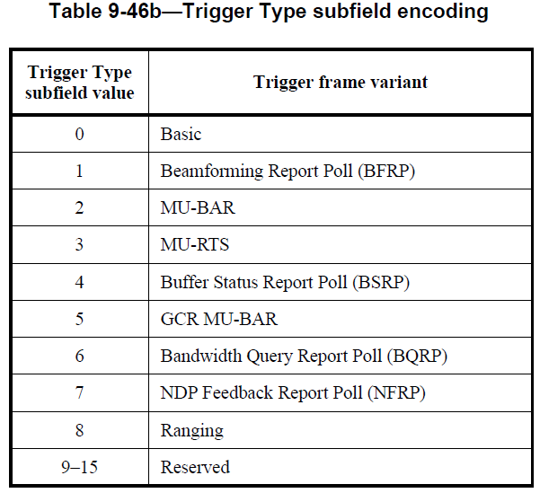
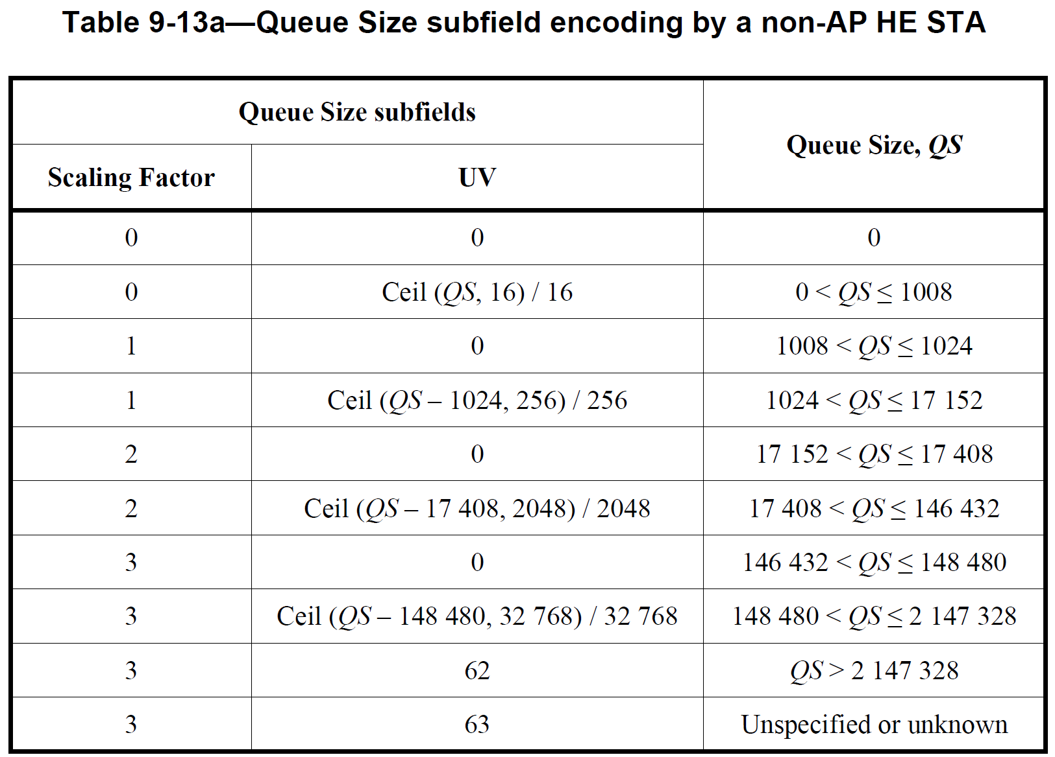
Buffer Status Report (BSR)
BSRP Trigger frame
  Trigger type subfield value in Common Info field of Trigger frame is 4
  Initial control frame (ICF) for EMLSR operation in IEEE 802.11be
    Various UHR features consider BSRP Trigger frame as an ICF
26.5.5 Buffer status report operation
  A non-AP STA delivers buffer status reports (BSRs) to assist its AP in allocating UL MU resources
    It can either implicitly deliver BSRs in the QoS Control field or BSR Control subfield of any frame transmitted to the AP (unsolicited BSR) or explicitly deliver BSRs in any frame sent to the AP in response to a BSRP Trigger frame (solicited BSR).
  QoS Control field (16 bits) for QoS Data or QoS Null frames
    B4 set to 1 ➔ Queue Size subfield exists
    B0-B3 for TID (4 bits)
    B8-B13 UV (6 bits) w/ B14-B15 (2 bits) for Scaling Factor
  9.2.4.6a.4 BSR Control in A-Control (32 bits)
    HT control (32 bits) w/ B0 and B1 set to 1: A-Control (B2-B32)
    ➔ BSR has 30 bits
      ControlID value 3 (B0-B3) means Buffer Status Report
      Remaining 26 bits are actual BSR
12 bits

Slide 11
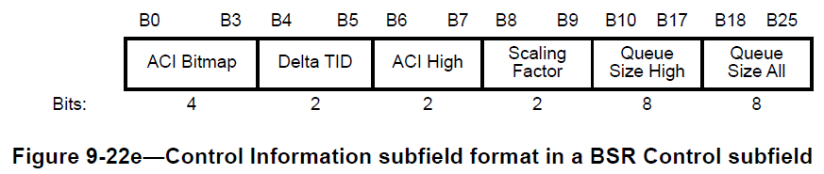
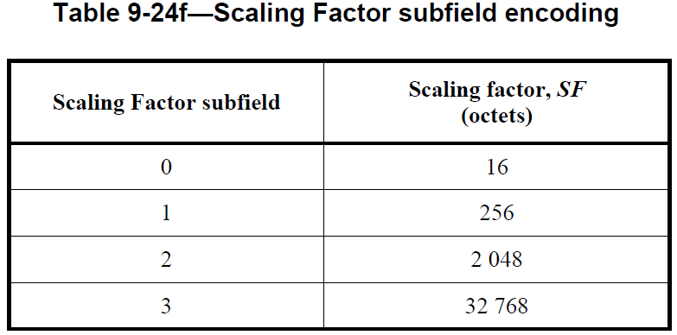
Buffer Status Report (BSR)
26.5.5 Buffer status report operation (Cont.)
  9.2.4.6a.4 BSR Control in A-Control (32 bits)
  BSR subfield format (26 bits)
    ACI Bitmap: The access categories for which the buffer status is reported
    Delta TID: The number of TIDs for which the STA is reporting the buffer status, together with the values of the ACI Bitmap subfield
    ACI High: The ACI of the AC for which the BSR is indicated in the Queue Size High subfield
    Scaling Factor: The unit SF, in octets, of the Queue Size High and Queue Size All subfields
    Queue Size High: The amount of buffered traffic, in units of SF octets, for the AC identified by the ACI High subfield that is intended for the STA identified by the receiver address of the frame containing the BSR Control subfield
    Queue Size All: The amount of buffered traffic, in units of SF octets, for all the ACs identified by the ACI Bitmap subfield that is intended for the STA identified by the receiver address of the frame containing the BSR Control subfield
    The queue size values in the Queue Size High and Queue Size All subfields
    are the total sizes, rounded up to the nearest multiple of SF octets,
    of all MSDUs and A-MSDUs buffered at the STA in the delivery queues
    used for MSDUs and A-MSDUs with AC(s) that are specified
    in the ACI High and ACI Bitmap subfields, respectively

