Slide 1
UL Monostatic and Bistatic Range Extension Considerations
Date: 2025-03-xx
Authors:

Slide 2
Abstract
The uplink (UL) range for AMP backscattering (BS) in mono-static operation is constrained by constant TX-RX AP (reader) self-leakage. This self-leakage does not limit the maximum excitation the reader can provide for energy harvesting (EH), but it does dictate lower excitation power levels for BS and imposes dynamic range constraints on the reader. These constraints set a practical upper limit for the UL range in standard mono-static mode.
However, amplifying the backscattered signal can extend the UL range, provided that the available power for EH is sufficient for the specific use case.
In bi-static operation, the direct carrier leakage is typically lower than the self-leakage in mono-static operation, which allows for higher excitation power for BS. As a result, bi-static operation enables longer UL ranges compared to mono-static mode. Longer UL ranges require longer EH ranges, which introduces a charging challenge, especially when BS amplification is applied to the tag.
This discussion looks at potential AMP tag enhancements for achieving range extension in both mono-static and bi-static operation modes.

Slide 3
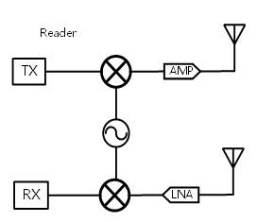
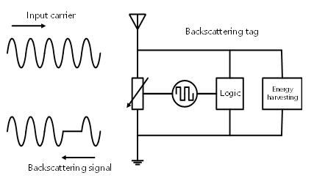
Background: 2.4 GHz Mono-Static Backscattering [1], [3]
Example : AP DR= 50 dB, AMP tag BS Loss 5 dB, Antenna gains = 0 dB, SNR_{min}= 3dB,
BS excitation waveform power P_{EX_B} = 0 dBm, Charging power (2.4GHz) P _{EX_C} = 10 dBm
Leakage signal: 0dBr
D [cm]
P_{Lk}
P_{EX_B} = 0 dBm
WiFi AMP reader
AMP tag
AP
Dynamic Range
Self Leakage 20dB
BS
Loss
BS signal
P_{RX}
P_{Lk} -20 dBm
SNR
Rx noise floor: e.g. -50dBr
D [cm] | P_{EX_B} [dBm] | P_{BS} [dBm] | P_{RX} [dBm] | P_{Lk} [dBm] | P_{Lk} -P_{RX} [dB] | SNR[dB] | P_{EX_C} [dBm] | P_{EH} [dBm]
10 | 0 | -25 | -45 | -20 | 25 | 25 | 10 | -10
20 | 0 | -31 | -57 | -20 | 37 | 13 | 10 | -16
40 | 0 | -37 | -69 | -20 | 49 | 1 | 10 | -22
40 cm range is limited by the BS loss

Slide 4
2.4 GHz Mono-Static Backscattering Range Extension
Leakage signal: 0dBr
Implement BS amplification [3] to improve SNR
D [cm] | P_{EX_B} [dBm] | BS_{Loss} [dB] | P_{RX} [dBm] | P_{Lk} [dBm] | P_{Lk} -P_{RX} [dB] | SNR[dB] | P_{EH} [dBm]
40 | 0 | 5 | -69 | -20 | 49 | 1 | -22
40 | 0 | 3 | -67 | -20 | 47 | 3 | -22
P_{Lk} -P_{RX}
AP
Dynamic Range
40 cm range is enabled by reducing the BS_{Loss} to 3 dB
BS signal
Can we follow a similar approach to achieve an 80 cm range?
SNR
D [cm] | P_{EX_B} [dBm] | BS_{Loss} [dB] | P_{RX} [dBm] | P_{Lk} [dBm] | P_{Lk} -P_{RX} [dB] | SNR[dB] | P_{EH} [dBm]
80 | 0 | 5 | -81 | -20 | 61 | -11 | -28
80 | 0 | -9 | -67 | -20 | 47 | 3 | -28
80 | 0 | -10 | -66 | -20 | 46 | 4 | -28
Rx noise floor: e.g. -50dBr
80 cm range is enabled in theory by a total BS gain of > -5+14 = 9 dB

Slide 5
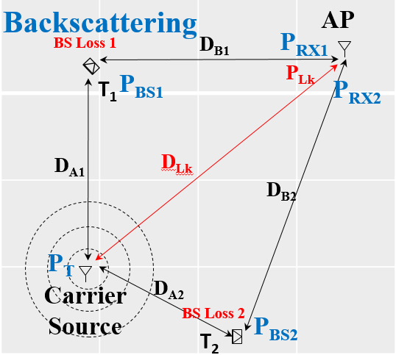
Revisit - 2.4 GHz Bistatic Uplink [3]
Link Assumptions
P_{EX_B} = P_{EX_C} | 20 dBm
Backscattering Loss | 5 dB
Reader Effective DR | 50 dB
Reader min SNR | 3 dB
Antenna Gains | 0 dB
FRIIS & SNR [dB]
D_{A}, D_{B}, D_{Lk} [m] | P_{BS} [dBm] | P_{RX} [dBm] | P_{Lk} [dBm] | P_{Lk} -P_{RX} [dB] | SNR[dB] | P_{EH} [dBm]
0.7, 0.7, 1 | -22 | -59 | -20 | 39 | 11 | -17
1, 1, 1.4 | -25 | -65 | -23 | 42 | 8 | -20
1, 5, 5 | -25 | -79 | -34 | 45 | 5 | -20
1.4, 1.4, 2 | -28 | -71 | -26 | 45 | 5 | -23
2, 2, 3.1 | -31 | -77 | -30 | 47 | 3 | -26
We can improve SNR and extend UL range, utilizing backscattering gain.

Slide 6
Extended Range 2.4 GHz Bistatic Uplink [2]
Link Assumptions
P_{EX_B} = P_{EX_C} | 20 dBm
Reader Effective DR | 50 dB
Reader min SNR | 3 dB
Antennas Gain | 0 dB
FRIIS & SNR [dB] for backscattering gain of 1 dB (e.g. 5 dB loss + 6 dB gain):
D_{A}, D_{B}, D_{Lk} [m] | P_{BS} [dBm] | P_{RX} [dBm] | P_{Lk} [dBm] | P_{Lk} -P_{RX} [dB] | SNR[dB] | P_{EH} [dBm]
2, 2, 3.1 | -25 | -71 | -30 | 41 | 9 | -26
4, 4, 6.2 | -31 | -83 | -36 | 47 | 3 | -32
Hence, we can improve SNR and range, utilizing backscattering gain,
FRIIS & SNR [dB] for backscattering gain of 7 dB (e.g. 5 dB loss + 12 dB gain):
D_{A}, D_{B}, D_{Lk} [m] | P_{BS} [dBm] | P_{RX} [dBm] | P_{Lk} [dBm] | P_{Lk} -P_{RX} [dB] | SNR[dB] | P_{EH} [dBm]
4, 4, 6.2 | -25 | -77 | -36 | 41 | 9 | -32 @ 2.4GHz
8, 8, 12.4 | -31 | -89 | -42 | 47 | 3 | -38 @ 2.4GHz
8 meter range is achievable by implementing a total BS gain of > 7 dB, yet P_{EH} maybe too low.

Slide 7
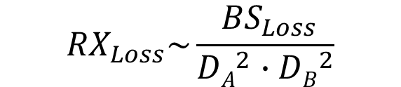
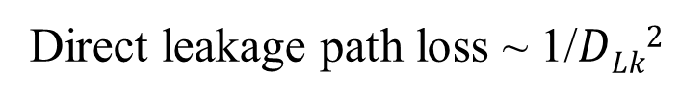
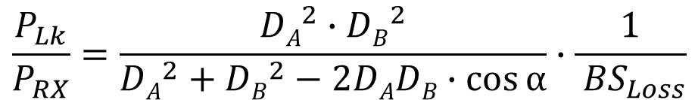
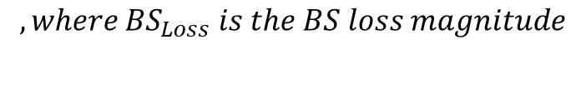
Extending the UL Range in 2.4 GHz Bistatic Uplink
Direct leakage path derivation:
P_{BS1}
AP
Bi-Static
Direct Lk
$$DLk2={DA}^{2}+{DB}^{2}−2DADB∙\cos{α}$$
BS_{Loss} 1
D_{B1}
P_{RX1}
$$, where α is the BS angle$$
T₁
P_{Lk}
P_{Lk}
α₁
P_{RX2}
Direct leakage path loss ~ 1/$DLk2$
$${RX}_{Loss}\sim \frac{{ BS}_{Loss}}{{DA}^{2}∙{DB}^{2}}$$
D_{A1}
D_{Lk}
RX path loss:
D_{B2}
$, where{ BS}_{Loss} is the BS loss magnitude$e
RX signal
Direct leakage to RX signal ratio:
P_{T}
P_{RX}
Carrier Source
α₂
$$\frac{P_{Lk}}{P_{RX}}=\frac{{DA}^{2}∙{DB}^{2}}{{DA}^{2}+{DB}^{2}−2DADB∙\cos{α}}∙\frac{1}{{ BS}_{Loss}}$$
D_{A2}
P_{BS2}
T₂
BS_{Loss} 2
Rx noise floor
While D_{A}, D_{B} and $α$are dictated by the deployment scenario. Increasing the BS loss magnitude${ BS}_{Loss}$reduces the ratio between the direct leakage and the RX signal.

Slide 8
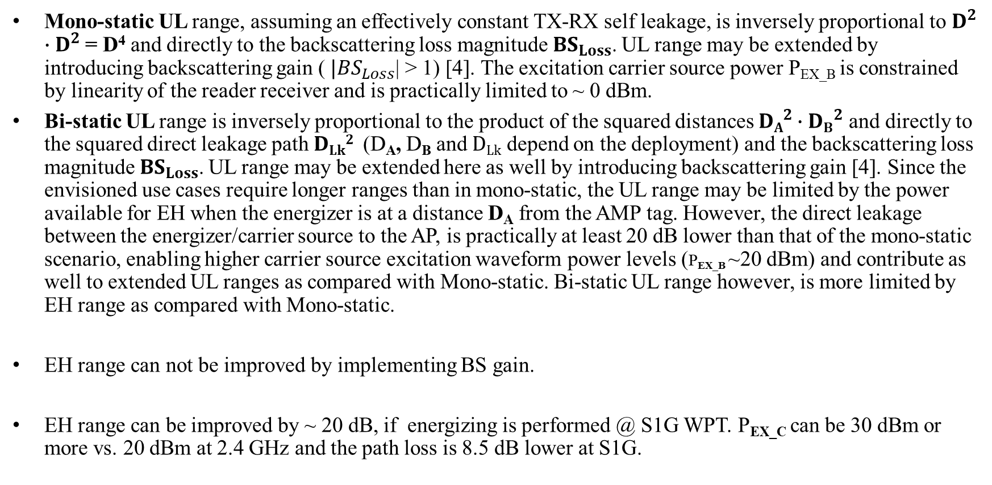
Extended Backscattering Range Discussion:
Mono-static UL range, assuming an effectively constant TX-RX self leakage, is inversely proportional to $D^{2}∙D^{2}$= D⁴ and directly to the backscattering loss magnitude${ BS}_{Loss}$. UL range may be extended by introducing backscattering gain (${ |BS}_{Loss}$| > 1) [4]. The excitation carrier source power P_{EX_B} is constrained by linearity of the reader receiver and is practically limited to ~ 0 dBm.
Bi-static UL range is inversely proportional to the product of the squared distances ${DA}^{2}∙{DB}^{2}$and directly to the squared direct leakage path $DLk2$ (D_{A}, D_{B} and $DLk$ depend on the deployment) and the backscattering loss magnitude${ BS}_{Loss}$. UL range may be extended here as well by introducing backscattering gain [4]. Since the envisioned use cases require longer ranges than in mono-static, the UL range may be limited by the power available for EH when the energizer is at a distance D_{A} from the AMP tag. However, the direct leakage between the energizer/carrier source to the AP, is practically at least 20 dB lower than that of the mono-static scenario, enabling higher carrier source excitation waveform power levels (P_{EX_B} ~20 dBm) and contribute as well to extended UL ranges as compared with Mono-static. Bi-static UL range however, is more limited by EH range as compared with Mono-static.
EH range can not be improved by implementing BS gain.
EH range can be improved by ~ 20 dB, if energizing is performed @ S1G WPT. P_{EX_C} can be 30 dBm or more vs. 20 dBm at 2.4 GHz and the path loss is 8.5 dB lower at S1G.
Slide 8

Slide 9
Revisit Standard AMP BS Tag and Proposed Enhancement
We have focused on low power/short range passive backscattering AMP tags so far.
It may be beneficial to consider an enhanced extended range semi-active AMP tag
with EH at S1G
BS tags operating in a bi-static mode that use a BS amplifier, will require more power and higher P_{EH}, especially when located further from the energizer. This requirement can be met when charging at S1G.
Mono-static tags can also speed up charging times at S1G
AMP Tag Type | Bi-Static Range | UL power Consumption | Power Storage / Capacitor | Antenna Frequency | Harvesting | Backscattering
Standard | ~ 2 M | < 10 uW | C pF | 2.4 GHz | 2.4 GHz | Passive / Switching only
Enhanced | ~ 10 M | < 50-100 uW [4] | 5-10∙C pF | S1G & 2.4 GHz | S1G (*) | Semi-Active / Switch & Amplify
* S1G is preferred for extended range/shorter duration EH. Harvesting at 2.4 GHz,
maybe used for backup

Slide 10
Further Energizing and Backscattering Considerations [2]
Read control Exchange
Backscattering data read
AMP Reader
AMP Energizer
AMP Tag
AMP DL PPDU
AMP DL PPDU
WPT for charging
Excitation signal for backscattering
WPT for charging
Proposed
S1G WPT
Backscatter Response
Backscatter backscattering
S1G
2.4 GHz
S1G
Wakeup portion (and subsequent recharges) can be performed at S1G, as this increases P_{EH} by ~20 dB, enabling “extended range” energizing .
Read control exchange, and backscatter data read at 2.4 GHz
Slide 10

Slide 11
Summary
BS gain can be utilized to extend both mono-static and bi-static UL range. The BS range which is limited by the self or direct carrier leakages given the available AP DR performance, benefits an improved SNR when the BS signals are amplified as compared with the leakages.
Mono-static UL range of about 80 cm may be achieved with reasonable P_{EH} power levels and bi-static UL range of 8 meter may be achieved with WPT @ S1G as with active tags
Such “semi-active/enhanced BS tags” may extend the range of BS tags
Slide 11

Slide 12
References
11-24-0798r0 “Close-range AMP WiFi Reader Feasibility Study
Follow up”; Rui Cao (NXP)
11-24-1798r0 “Backscattering UL data rate and modulation”; Rui Cao (NXP)
11-25-0030r0 “AMP UL Bi-Static Leakage and Dynamic-Range Implications”; Dror Regev (Huawei)
11-22/1893r0 “Ambient Power Enabled IoT Technologies” Hao Min (Shanghai Quanray Electronics)
Slide 12

