Slide 1
AMP Downlink and Backscattering Carrier Waveform
Date: 2025-03-10
Authors:

Slide 2
Introduction
In Jan. meeting, the group agreed to define OFDM preamble for AMP DL PPDU [1]
How to define the carrier waveform for OOK modulation for both DL and backscattering?
  CW vs DSSS vs OFDM [2,3,4,5]
Question on the need for DSSS preamble?

Slide 3
Recap: DL PPDU for Backscattering
802.11 Preamble | AMP SYNC | AMP Data | Excitation | …
DL PPDU
  802.11 preamble + SYNC + AMP data + Excitation + more
  SIG field TBD
OFDM preamble:
  L-STF, L-LTF, L-SIG, RL-SIG, U-SIG
OOK is defined as the modulation for AMP SYNC, Data and backscattering (on Excitation field(s))
  DL data rate: 250kbps (2us ON and 2us OFF)
  UL data rates: 250kbps and 1mbps (0.5us ON and 0.5us OFF)

Slide 4
Carrier Waveform Considerations (1/3)
Format uniformity for DL PPDU
  OFDM preamble → OFDM carrier waveform
  DSSS preamble → DSSS carrier waveform
  Mixed format is not preferred unless necessary: Easy to implement at WiFi Reader
Repeated carrier waveform is preferred for OOK modulation in backscattering operation
  Easier for Tx implementation
  Automatically serve as reference symbol for leakage estimation
AMP Data | … | AMP Data | Reference Symbol | Reference Symbol | Excitation Symbol | … | Excitation symbol

Slide 5
Carrier Waveform Considerations (2/3)
Lower PAPR for carrier symbol
  Higher Tx power
  Backscattering Rx: less AGC backoff → longer range
  Small variation in “ON” chip energy
    250Kbps: 2us “ON”
    1Mbps: 0.5us “ON”
Carrier Symbol
 | …
DL
UL
UL
2us | 2us
2us | 2us
 | …
2us | 2us
2us | 2us
 | …
0.5 us | 0.5 us | 0.5 us | 0.5 us | 0.5 us | 0.5 us | 0.5 us | 0.5 us
0.5 us | 0.5 us | 0.5 us | 0.5 us | 0.5 us | 0.5 us | 0.5 us | 0.5 us

Slide 6
Carrier Waveform Considerations (3/3)
Low PAPR waveform candidates
Single-tone CW:
  Tx power limitation in some regions → >10MHz BW was agreed
DSSS waveform
  Single carrier waveform, 2~3dB
OFDM waveform
  STF symbol (~2dB): may cause legacy WiFi devices to false detect
  LTF symbol (~3dB): preferred
  Newly optimized symbol: flexible BW, non-BPSK signal
    Added complexity with limited benefits

Slide 7
Carrier Waveform Comparison
Single-tone vs OFDM vs DSSS
  LTF is used as the OFDM base symbol
“ON” energy variation
DL Tag Rx performance
UL backscattering Reader performance

Slide 8
“ON” Energy Variation
-0.06
0.06
2us boundary: [0.06, -0.06] dB
Full swing: ~0.5dB
0.5us boundary: [-0.66, 0.65, -0.08, 0.23,
-0.45, -0.16, 0.03, 0.30] dB
Full swing: 2.5dB

Slide 9
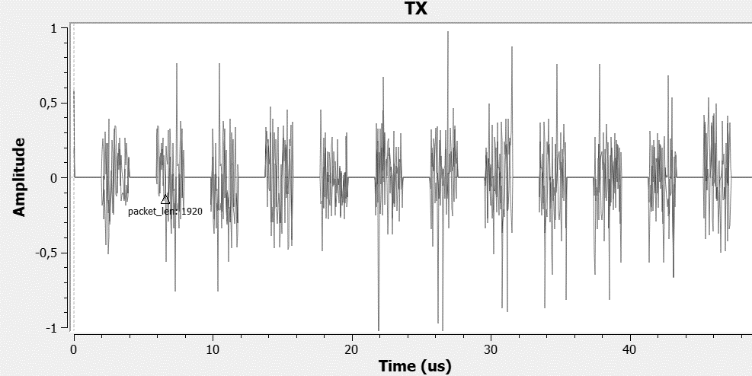
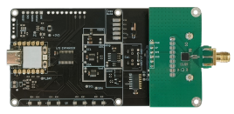
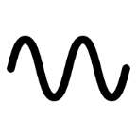
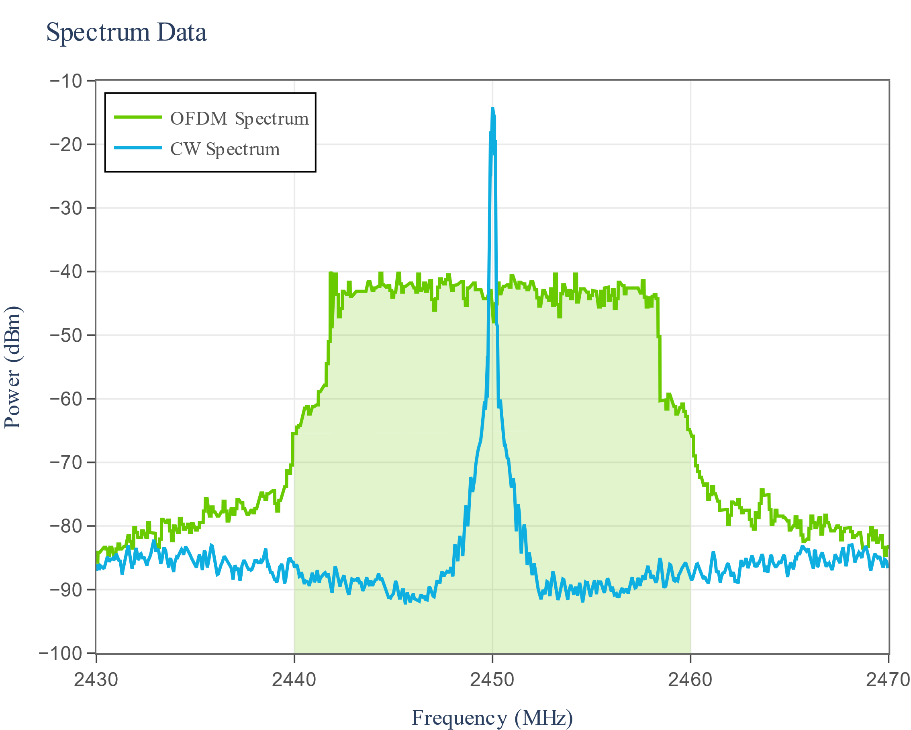
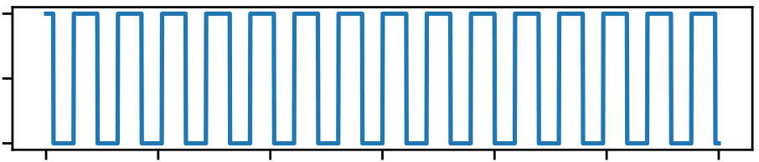
Tag Receive Experiment
AMP Backscattering Tag
2 µs
2 µs
2 µs
. . .
2.45 GHz
carrier
2 µs
2 µs
2 µs
. . .
…captured on oscilloscope
0 µs
10 µs
20 µs
. . .
demod_out signal
Example Spectrum | for illustrative purposes only

Slide 10
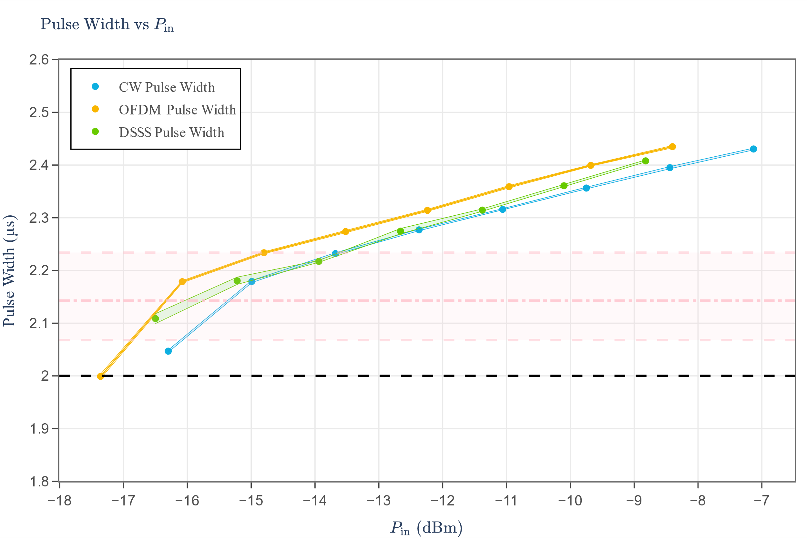
Tag Demodulation Evaluation
pulse width max: 2.234 µs
pulse width mean: 2.143 µs
pulse width min: 2.068 µs
CW:
-16.3 dBm
OFDM:
-17.36 dBm
DSSS:
-16.5 dBm
The pulse width variation is small for all three carrier waveforms
OFDM can reach slightly longer range: ~1dB to CW tone

Slide 11
Tag Energy Harvesting
CW Reference (VNA)
CW
OFDM diff CW mean: 2.84%
DSSS diff CW mean: 1.71%
OFDM
x+22
DSSS
x+20
x+18
x+16
Power Conversion Efficiency (%)
x+14
x+12
~ 1.71 % improvement
x+10
DSSS
x+8
~ 2.84 % improvement
x+6
OFDM
x+4
x+2
x
-24
-23
-22
-21
-20
-19
-18
-17
-16
-15
-14
-13
-12
-11
-10
-9
-8
-7
OFDM and DSSS waveform have slightly better EH efficiency

Slide 12
AMP Reader Performance
250kbps with 2us pulse: negligible performance among three waveforms
1mbps with 0.5us pulse: within 1dB difference between OFDM and DSSS

Slide 13
OFDM Tx Spectrum
The spectrum of LTF sequence is lower than random data due to lower PAPR: Random phase to mitigate spectrum spikes
Growth of OOK modulation does not limit Tx power compare with data

Slide 14
Summary
OFDM carrier waveform has similar performance as DSSS waveform
  both DL Tag Rx and UL backscattering Reader Rx
The Tx spectrum of OOK modulated on LTF OFDM symbol is comparable to random data
Suggest to define OFDM as the carrier waveform for DL and OOK based backscattering communication
LTF OFDM symbol is a good candidate

Slide 15
References
[1] 11-24/1859, ppdu-preamble-follow-up
[2] 11-24/1557, dl-ppdu-design-considerations
[3] 11-24/1798, Backscattering UL data rate and modulation
[4] 11-24/1780, further-discussion-on-amp-ppdu-design
[5] 11-24/1802, ook-generation-for-amp-dl

Slide 16
SP
Do you agree to add the following to 11bp SFD?
The SYNC, Data field and Excitation field of 11bp DL PPDU use OFDM symbol as carrier signal for OOK modulation

Slide 17
SP
Do you agree to add the following to 11bp SFD?
The AMP portion of the AMP Downlink PPDU is defined as the repetition of a predefined 4us OFDM symbol with random phase applied to each OFDM symbol

Slide 18
SP
Do you agree to add the following to 11bp SFD?
The predefined 4us OFDM symbol is generated by performing 64-point IFFT of the LLTF sequence and pre-append the last 0.8us waveform as the cyclic prefix

Slide 19
SP
Do you agree to add the following to 11bp SFD?
The per-symbol random phase applies to each base OFDM symbol is generated the same as the pseudo-random sequence used for data scrambling.

Slide 20
Appendix

Slide 21
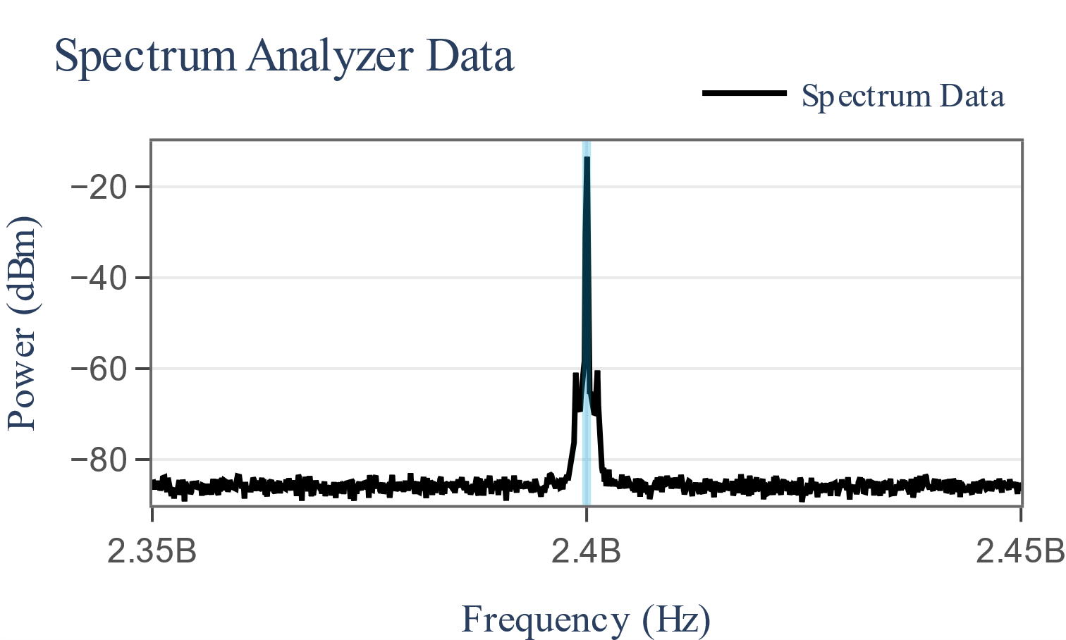
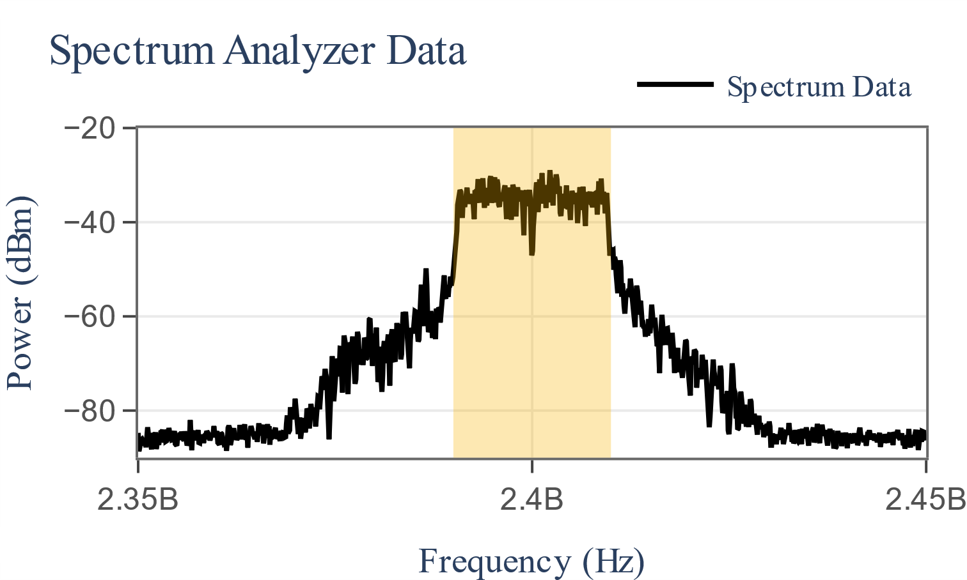
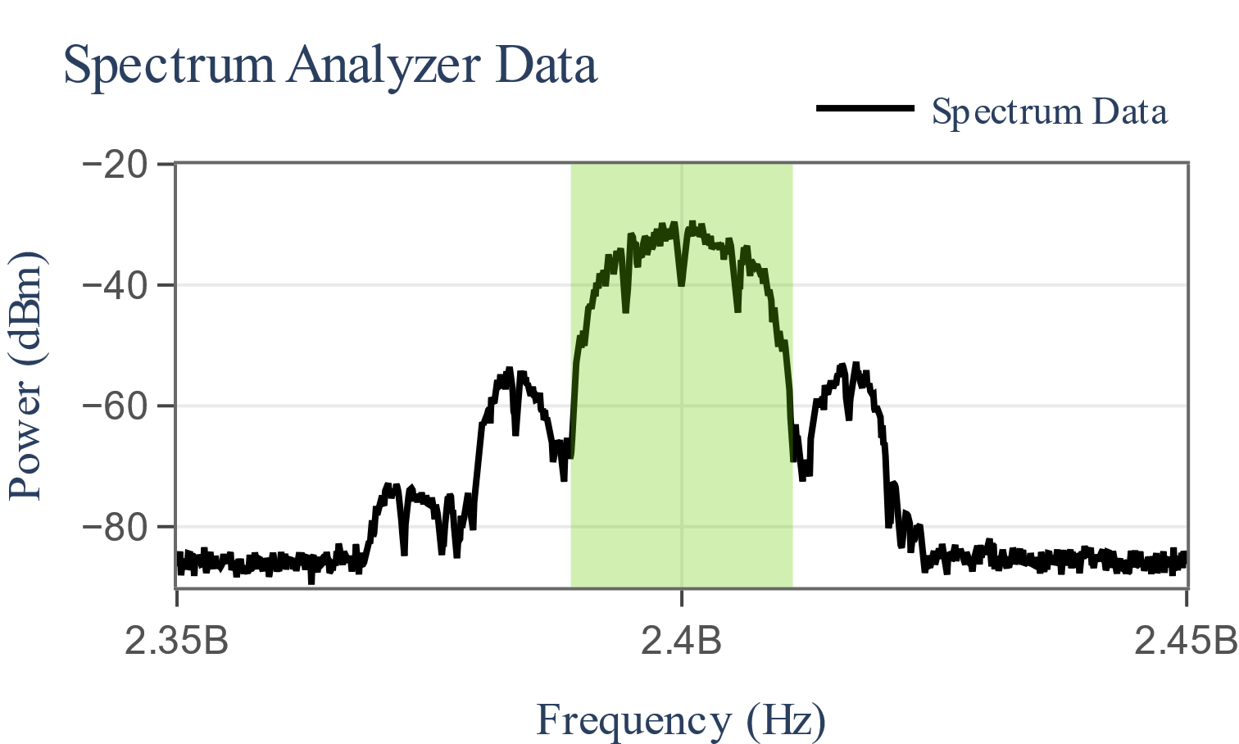
Carrier Signal Spectrum
CW (1 MHz)
OFDM (20 MHz)
DSSS (22 MHz)

Slide 22
Reader Performance: distance

Slide 23
Tx Spectrum Analysis with OOK

