Slide 1
Reachability of mmWave Link- Follow Up
Date: 2025-04-08
Authors:
Name | Affiliation | Address | Phone | Email
Insik Jung | LG Electronics | 19, Yangjae-daero 11gil, Seocho-gu, Seoul 137-130, Korea |  | insik0618.jung@lge.com
Eunsung Park |  |  |  | esung.park@lge.com
Insun Jang |  |  |  | insun.jang@lge.com
Dongju Cha |  |  |  | dongju.cha@lge.com
Jinsoo Choi |  |  |  | js.choi@lge.com
HanGyu Cho |  |  |  | hg.cho@lge.com
Sang Kim |  | 10680 Treena St 550, San Diego CA 92131 |  | sanggook.kim@lge.com

Slide 2
Introduction
MmWave reachability estimation in sub-7GHz band can provide following benefits
  It can prevent direct scanning of mmWave link so that STA computation burden can be minimized
  It doesn’t require mmWave beam training procedure for the reachability estimation, which consumes lots of wireless medium
However, estimation in sub-7GHz only can be risky
  mmWave specific characteristics can emerge (e.g., blockage)
Therefore, we propose a two-step reachability estimation for IMMW
  First step is the estimation in sub-7GHz, aiming rough estimation
  Second step is the estimation in mmWave band, using beam training procedure

Slide 3
Reachability Estimation Structure
Initial Reachability Estimation in Sub-7GHz [1]
  Rough estimation which cannot fully consider mmWave characteristics
  Find STAs which are highly likely to be reachable in mmWave band
Reachability Update in mmWave
  Conduct beam traning only to the STAs which are initially estimated as ‘reachable’
  Based on the RSSI obtained in beam training procedure, reachabilty can be updated
Initial reachability estimation in sub-7GHz
Reachability update in mmWave
AP
AP
blockage
Beam training of STA 1 and STA 3
blockage
STA 1
reachable
STA 1
reachable
STA 3
reachable
STA 3 (Updated)
Reachable
→ Unreachable
STA 2
unreachable
STA 2
unreachable

Slide 4
Initial Reachability Estimation (1/2) [1]
AP side reachability estimation
  APs need the reachability estimation for proper scheduling
  To reduce the STA side computation burden
DL reachability estimation
  For the reachability estimation, an AP needs mmWave RX antenna gain of the STA and pathloss
  For the path-loss estimation, an AP needs EIRP of sub-7 UL transmission
UL reachablity estimation
  For the reachability estimation, an AP needs mmWave EIRP of the STA and pathloss
  For the path-loss estimation, an AP needs EIRP of sub-7 UL transmission

Slide 5
Initial Reachability Estimation (2/2) [1]
Reachability announcement
sAP
Reachability estimation
    DL reachability
    UL reachability
Required parameters for mmWave reachability . estimation
sSTA
    Transmit power of the non-AP STA in mmwave link
    Transmit antenna gain of the non-AP STA in mmwave link
    Receive antenna gain at the non-AP STA side in mmwave link
    Transmit power of the non-AP STA in sub-7GHz link
    Transmit antenna gain at the non-AP STA side in sub-7GHz link
EIRP of mmWave
EIRP of sub-7
    sAP: AP in a sub-7GHz link
    sSTA: STA in a sub-7GHz link

Slide 6
Practical Reachability Estimation
Next step of the initial reachability estimate
  For the STAs which are estimated as ‘reachable’, AP conducts beam training procedure to be ready for data transmission
  Not only to align the beam direction, beam training can be utlized to estimate the practical reachability
  We can measure the actual RSSI with the best beam directions determined in the beam training procedure
  Based on the actual RSSI, we can estimate the practical reachability
Best TX beam
Best RX beam

Slide 7
Practical Reachability Estimation Example (1/2)
Beam Training Methods
  AP announces the beamforming training (BFT) period in a sub-7GHz link
  Multiple STAs may participate in the BFT procedure.
  Detailed beam training schedule/procedure/signaling needs further discussion
mAP
Beam Training Procedure
mSTA(s)
Beam training schedule frames
sAP
Reachability Response
DL reachability
sSTA(s)
    mAP: AP in a mmWave link
    mSTA: STA in a mmWave link

Slide 8
Practical Reachability Estimation Example (2/2)
Reachability Response in the Sub-7 GHz link
  We may need a “Reachablilty Response” frame transmitted from STAs for the AP to clearly notice the practical reachability
    AP then can manage those reachable/unreachable STAs properly
  If the BFT was successful, both AP and STA can notice that the link is practically reachable
  If the BFT was not successful, there are some ambiguities as follows
    If STA(s) is dedicated, AP can’t distinguish whether the link was not reachable or the medium was busy during BFT period. Signaling of ‘DL Reachability’ in “Reachability Response” frame may solve this issue
      E.g., 0: reachable, 1: unreachable, 2: unknown (medium busy)
    If STA(s) is not dedicated, AP can’t notice which STA tried the BFT. STA may need to transmit “Reachability Response”frame including the ‘DL Reachability’ field to notify that.
      E.g., 0: reachable, 1: unreachable

Slide 9
Conclusion
We have proposed two step reachability estimation method for mmWave band
  First step is a rough estimation in sub-7GHz link
  Second step is a practical estimation in mmWave link using the beam-training procedure

Slide 10
Reference
[1] 11-24-0805-01, Reachability of mmWave Link, LGE
[2] 11-24-0823-01, IMMW further simplications to promote IMMW adoption, Samsung

Slide 11
mmWave Reachability
System Model
AP
MLD
Non-AP MLD
Link 1 (L1) : sub-7GHz link
AP 1
STA 1
Link 2 (L2) : mmWave link
AP 2
STA 2
We want to estimate link 2’s reachability using frame exchanges in link 1

Slide 12
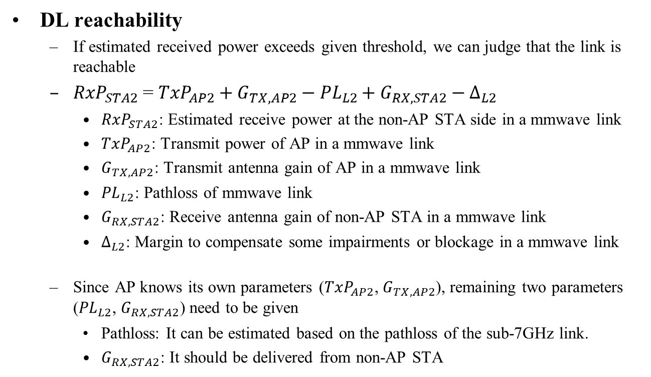
Reachability Estimation (1/4)
DL reachability
  If estimated received power exceeds given threshold, we can judge that the link is reachable
  ${RxP}_{STA2}$ = ${TxP}_{AP2}+G_{TX,AP2}−{PL}_{L2}+G_{RX,STA2}−∆_{L2}$
    ${RxP}_{STA2}$: Estimated receive power at the non-AP STA side in a mmwave link
    ${TxP}_{AP2}$: Transmit power of AP in a mmwave link
    $G_{TX,AP2}$: Transmit antenna gain of AP in a mmwave link
    ${PL}_{L2}$: Pathloss of mmwave link
    $G_{RX,STA2}$: Receive antenna gain of non-AP STA in a mmwave link
    $∆_{L2}$: Margin to compensate some impairments or blockage in a mmwave link
  Since AP knows its own parameters (${TxP}_{AP2}$, $G_{TX,AP2}$), remaining two parameters (${PL}_{L2}$, $G_{RX,STA2}$) need to be given
    Pathloss: It can be estimated based on the pathloss of the sub-7GHz link.
    $G_{RX,STA2}$: It should be delivered from non-AP STA

Slide 13
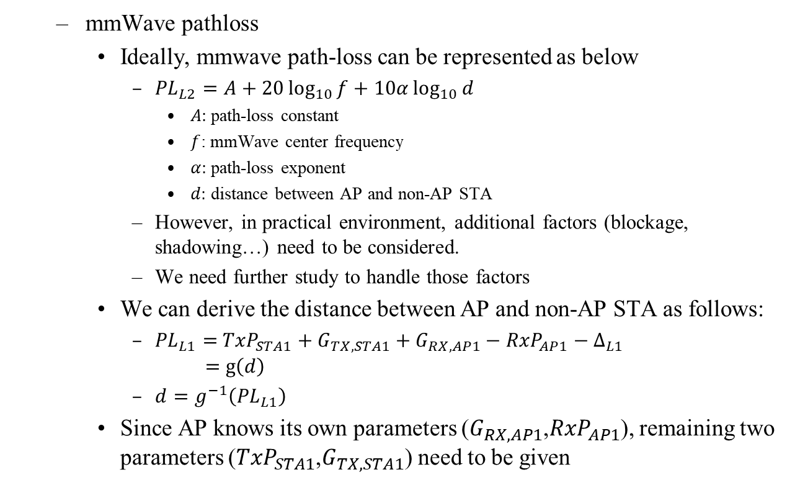
Reachability Estimation (2/4)
  mmWave pathloss
    Ideally, mmwave path-loss can be represented as below
      ${PL}_{L2}=A+20\log_{10}{f}+10α\log_{10}{d}$
        $A:$path-loss constant
        $f$: mmWave center frequency
        $α:$ path-loss exponent
        $d:$ distance between AP and non-AP STA
      However, in practical environment, additional factors (blockage, shadowing…) need to be considered.
      We need further study to handle those factors
    We can derive the distance between AP and non-AP STA as follows:
      ${PL}_{L1}=$ ${TxP}_{STA1}+G_{TX,STA1}+G_{RX,AP1}−{RxP}_{AP1}−∆_{L1}$
      $=$ $g\left(d\right)$
      $d=g^{−1}\left({PL}_{L1}\right)$
    Since AP knows its own parameters ($G_{RX,AP1}$,${RxP}_{AP1}$), remaining two parameters (${TxP}_{STA1}$,$G_{TX,STA1}$) need to be given

Slide 14

Reachability Estimation (3/4)
  In summary, the parameters below should be delivered from non-AP STA for DL reachability estimation
    $G_{RX,STA2}$: RX antenna gain at the non-AP STA side in mmwave link
    ${TxP}_{STA1}:$ Transmit power of the non-AP STA in sub-7GHz link
    $G_{TX,STA1}$: TX antenna gain at the non-AP STA side in sub-7GHz link

Slide 15
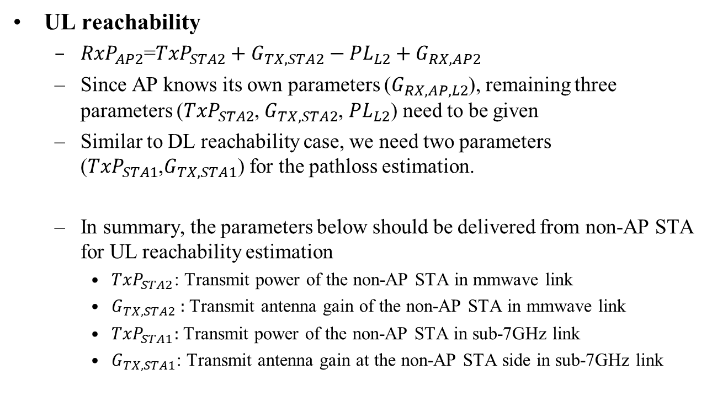
Reachability Estimation (4/4)
UL reachability
  ${RxP}_{AP2}$=${TxP}_{STA2}+G_{TX,STA2}−{PL}_{L2}+G_{RX,AP2}$
  Since AP knows its own parameters ($G_{RX,AP,L2}$), remaining three parameters (${TxP}_{STA2}$, $G_{TX,STA2}$, ${PL}_{L2}$) need to be given
  Similar to DL reachability case, we need two parameters (${TxP}_{STA1}$,$G_{TX,STA1}$) for the pathloss estimation.
  In summary, the parameters below should be delivered from non-AP STA for UL reachability estimation
    ${TxP}_{STA2}$: Transmit power of the non-AP STA in mmwave link
    $G_{TX,STA2}$ : Transmit antenna gain of the non-AP STA in mmwave link
    ${TxP}_{STA1}:$ Transmit power of the non-AP STA in sub-7GHz link
    $G_{TX,STA1}$: Transmit antenna gain at the non-AP STA side in sub-7GHz link

Slide 16
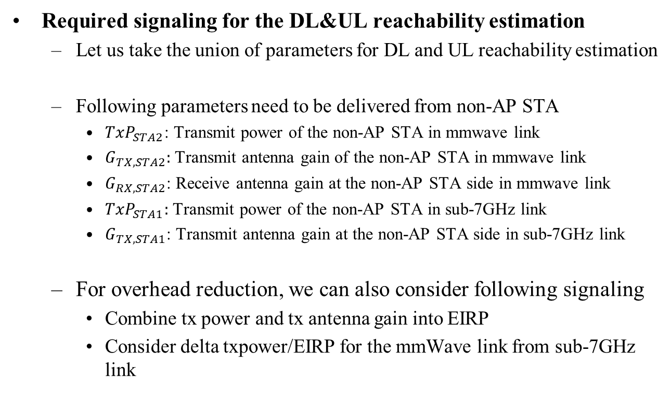
Required Signaling
Required signaling for the DL&UL reachability estimation
  Let us take the union of parameters for DL and UL reachability estimation
  Following parameters need to be delivered from non-AP STA
    ${TxP}_{STA2}$: Transmit power of the non-AP STA in mmwave link
    $G_{TX,STA2}$: Transmit antenna gain of the non-AP STA in mmwave link
    $G_{RX,STA2}$: Receive antenna gain at the non-AP STA side in mmwave link
    ${TxP}_{STA1}:$ Transmit power of the non-AP STA in sub-7GHz link
    $G_{TX,STA1}$: Transmit antenna gain at the non-AP STA side in sub-7GHz link
  For overhead reduction, we can also consider following signaling
    Combine tx power and tx antenna gain into EIRP
    Consider delta txpower/EIRP for the mmWave link from sub-7GHz link

