Slide 1
Efficient Coex For Non-AP STAs
Feb 2025
Authors:
Name | Affiliation | Phone | email
Brian Hart | Cisco Systems |  | brianh@cisco.com
Binita Gupta | Cisco Systems
Malcolm Smith | Cisco Systems
Juan Carlos Zuniga | Cisco Systems
Stephen Orr | Cisco Systems
Javier Contreras | Cisco Systems
Pelin Salem | Cisco Systems

Slide 2
Situation SFD defines both Periodic and Non-Periodic (Dynamic) Unavailability Operation: PUO and DUO [1]; with privacy implications
PUO:
“11bn defines a mechanism for a non-AP STA to report unavailability at TXOP level and define or reuse/update existing mechanism for a non-AP STA to report long term (periodic) unavailability. [Motion #30, [1] and [66-82]]”
DUO:
“The AP maintains up to one dynamic unavailability report per STA … [Motion #143, [1] and [217]]”
Some non-AP STAs might lack the integration and/or compute (and/or other reasons) to ascertain that their unavailability windows are actually periodic; and might instead report multiple DUO events instead of one PUO sequence

Slide 3
Problem DUO is much less efficient that PUO and brings non-negligible overheads
For a 60 min telecon with BLE audio earbuds (e.g., 20 msec ISO intervals):
PUO could be used with “1” (+ sporadic updates for drift) message per hour
DUO would require up to 50 messages per second; often sent in SU PPDUs
Each consumes 22+8 octets at 6 Mbps non-HT PPDU + SIFS: 80 usec or 0.4% of the channel
At modest scale (e.g., 30 such STAs), DUO PPDUs consume 12% of the channel; CSMA/CA overheads are extra
Unavailability SPs
~One-time PUO overhead
Ongoing DUO overheads (related active traffic not shown)

Slide 4
Solution (1/2) Support for DUO be conditional on support for PUO
Since PUO is always more efficient than DUO, make support for DUO be conditional on support for PUO

Slide 5
Solution (2a/2) Enable an AP to sent an unsolicited PUO message to the STA to side-step STA limitations and regain efficiency
Given that many APs can detect the periodicity of radars, even in the presence of wireless collisions that make some radar pulses undetectable, it is likely that the such APs can discern the non-AP STA’s unavailability pattern
Such APs should be able to send a protected unsolicited PUO report to the STA: “AP detects the following PUO unavailability pattern from the STA; and will treat the STA as unavailable accordingly even in the absence of DUO messages.”
STA does not need to do anything except:
Successfully transmit to the AP during the reported PUO unavailability pattern when the STA wishes to cancel the AP’s reported behavior
STA might (should) suspend signaling, via DUO, its unavailability events covered by the unsolicited PUO report
Benefits
Even a limited client gains the benefits of PUO operation
The system gains the benefit of efficient PUO signaling rather than inefficient DUO signaling

Slide 6
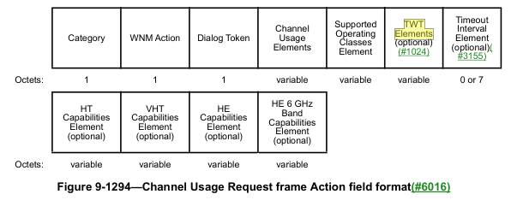
Solution (2b/2) Unsolicited PUO Report Can Use TWT P2P (via unsolicited Channel Usage Request frame from AP)
Channel Usage Request frame
No CU elements or Supported Operating Classes element; no Capabilities elements
With one or more TWT elements, for:
Type = Individual TWT SP, Setup Cmd = Accept TWT
Key parameters are populated: Target Wake Time, TWT Wake Interval Mantissa, and TWT Wake Interval Exponent

Slide 7
Summary
A non-AP STA sending DUO messages to its associated AP for periodic unavailability is inefficient
PUO should be used whenever possible, given its vastly greater efficiency
We can encourage this by making support for DUO conditional on support for PUO
Otherwise, it is desirable for system efficiency if the AP can send an unsolicited PUO report to the STA, so that the STA’s DUO messages can be suspended while STA’s unavailability constraints continue to be honored

Slide 8
Strawpoll 1
Do you agree to add the following text to the 11bn SFD:
Support for DUO is conditional on support for PUO.
Y / N / A

Slide 9
Strawpoll 2
Do you agree to add the following text to the 11bn SFD:
UHR defines how an AP may send an unsolicited PUO report to a non-AP STA that is sending DUO messages that indicate an underlying periodic unavailability.
Y / N / A

Slide 10
References
[1] 24/209r8 “Specification Framework for TGbn”, Ross Jian Yu

Slide 11
Backup

