Slide 1
Long-Range Backscatter Device Capabilities
Date: 2025-03-10
Authors:

Slide 2
Abstract
This presentation is a follow-on to 25/0267, SFD Review for Long-Range Backscatter.
In that presentation,
  We identified the features implied by the SFD as related to the receiver and transmitter capabilities of a Backscatter non-AP AMP STA.
  We discussed gaps in the current SFD for both close-range and long-range backscatter applications.
Here, we present an example scenario for both long-range and close-range backscatter modes.

Slide 3
Background
In trying to define a long-range backscatter mode, and on further discussion, the group still had some questions.
  What specific SFD features would be required to enable a long-range backscatter mode?
Combined channel shifting and bit flipping. (SSB and PSK modulation in the Uplink) | [3-4]
1 Mb, 2 Mb DSSS in the AMP Excitation field | This (and previous) presentations
Medium protection mechanisms for long range backscatter | [5]

Slide 4
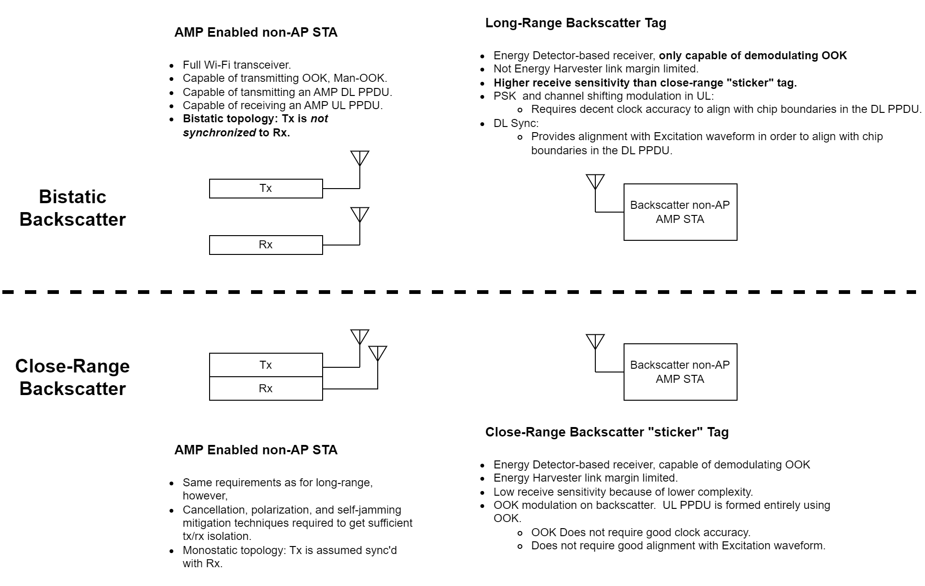
Putting It All Together

Slide 5
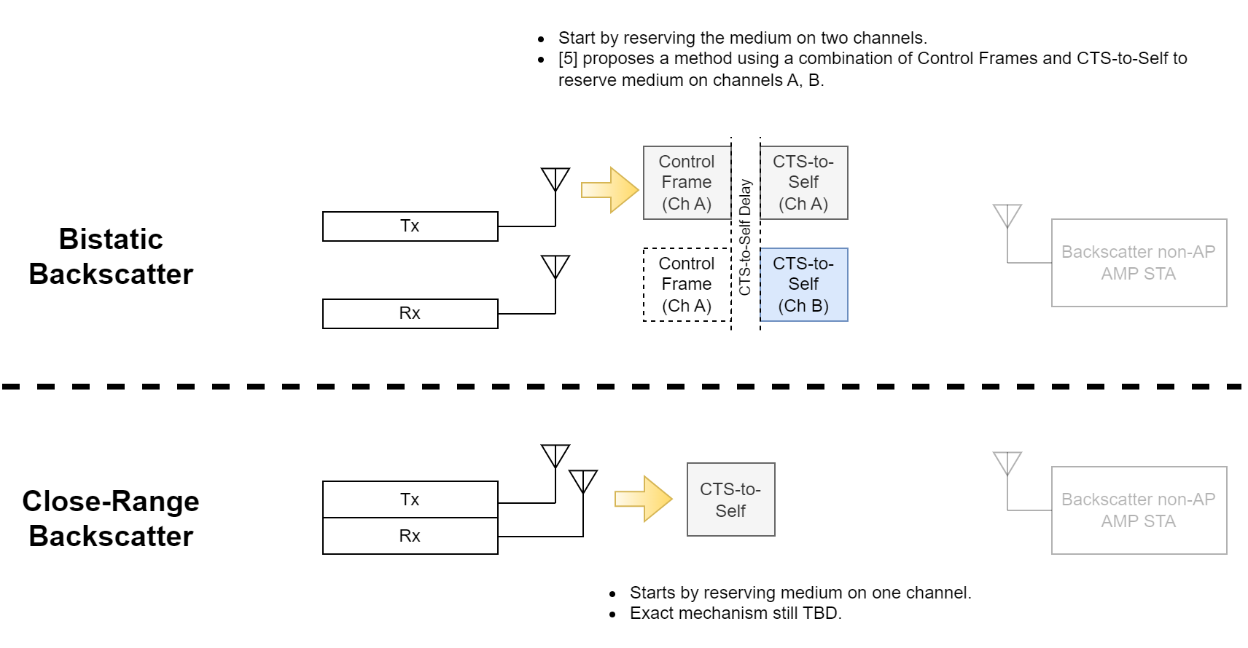
Putting It All Together (2)

Slide 6
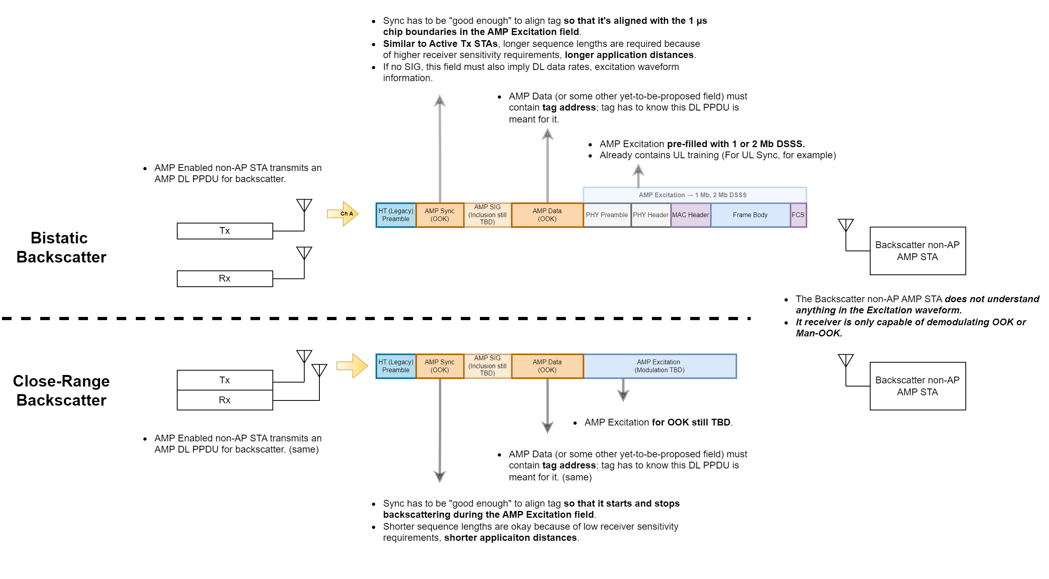
Putting It All Together (3)

Slide 7
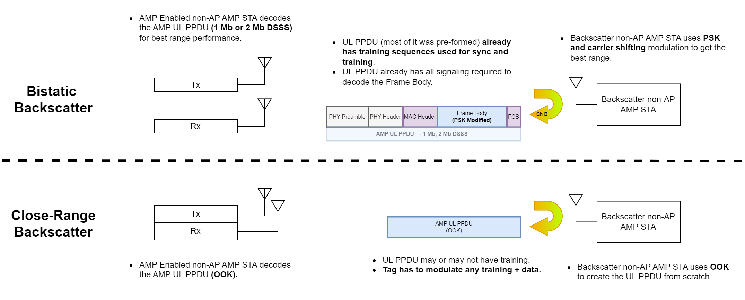
Putting It All Together (4)

Slide 8
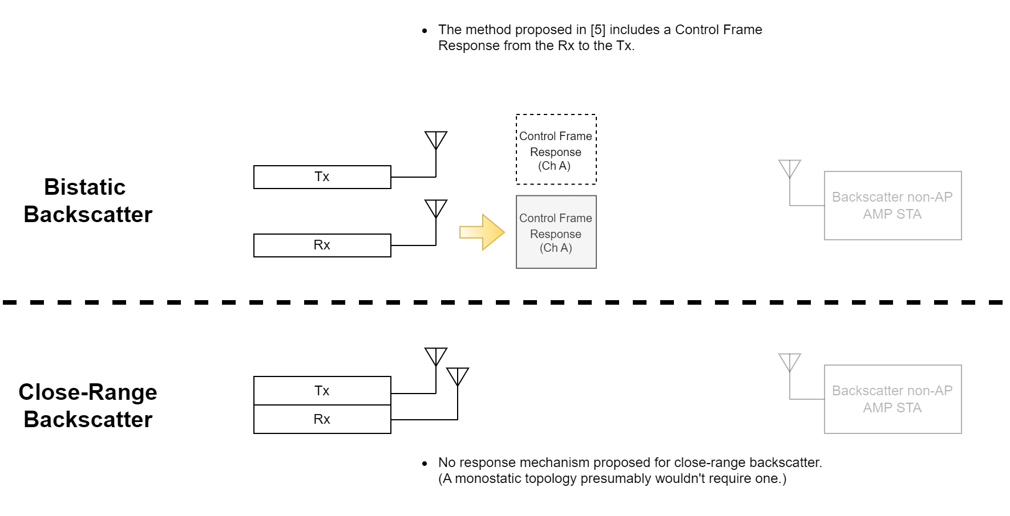
Putting It All Together (5)

Slide 9
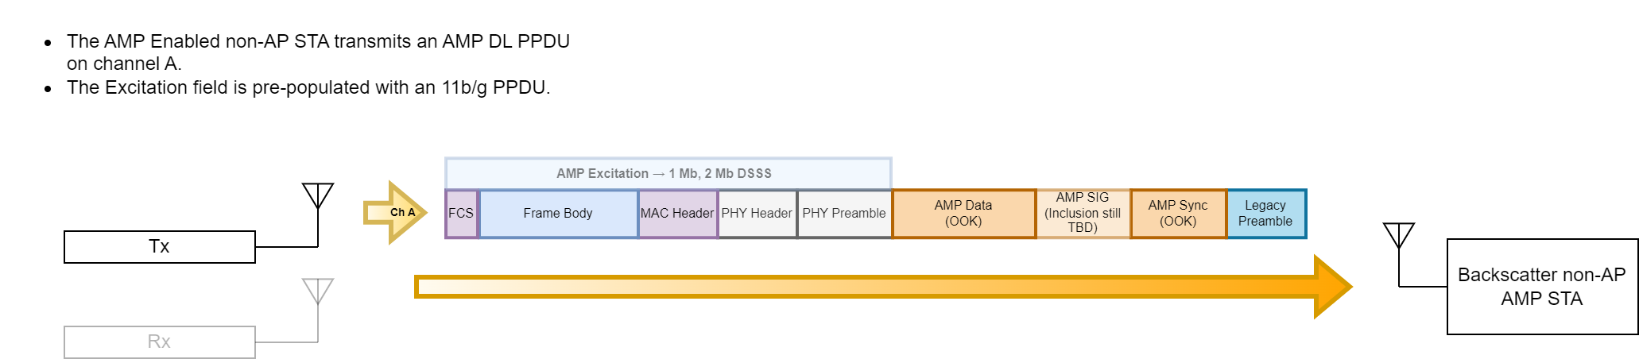
SSB & PSK Backscatter Modulation

Slide 10
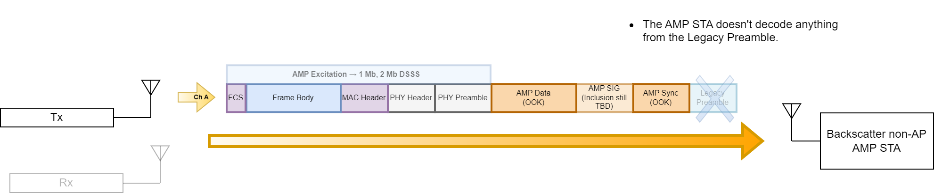
SSB & PSK Backscatter Modulation (2)

Slide 11
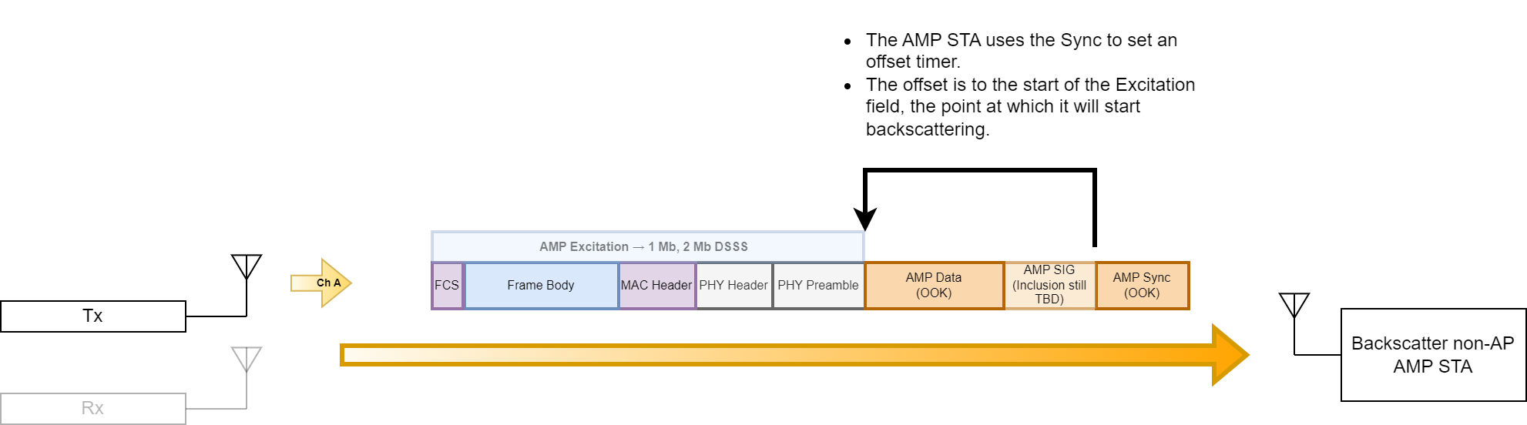
SSB & PSK Backscatter Modulation (3)

Slide 12
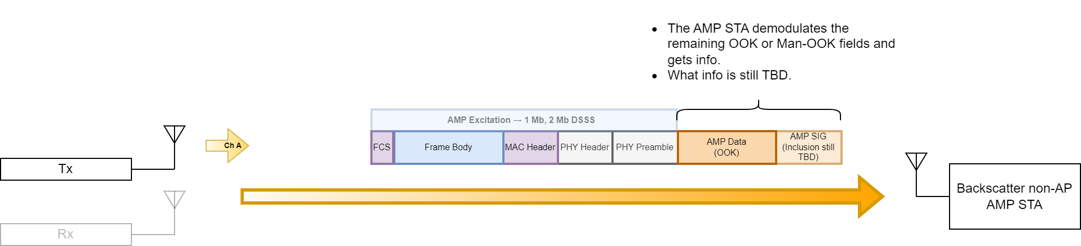
SSB & PSK Backscatter Modulation (4)

Slide 13
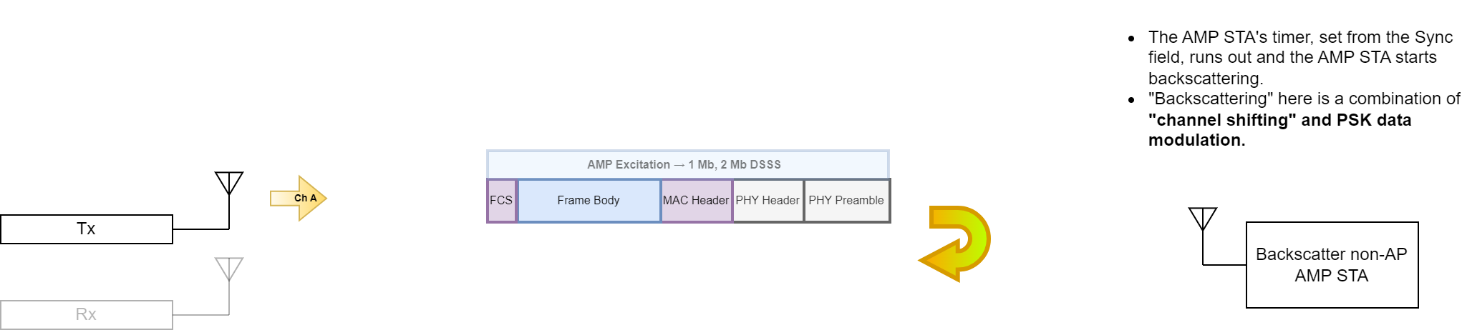
SSB & PSK Backscatter Modulation (5)

Slide 14
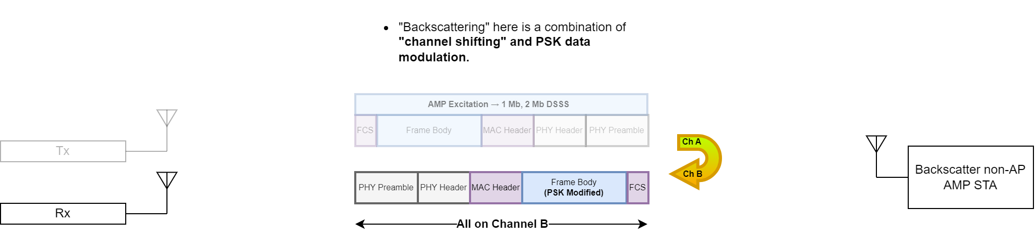
SSB & PSK Backscatter Modulation (6)

Slide 15
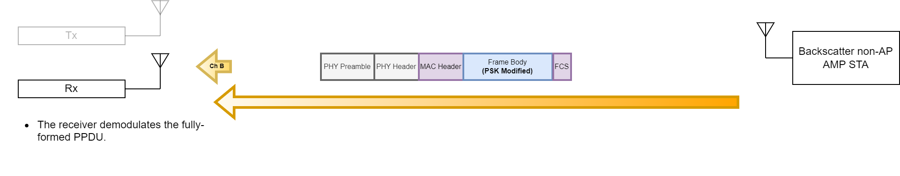
SSB & PSK Backscatter Modulation (7)

Slide 16
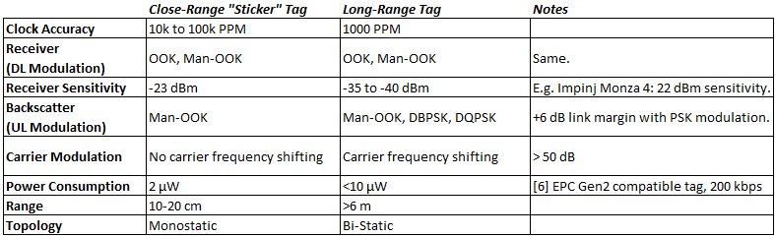
Device Capabilities Summary

Slide 17
Conclusion
In this presentation, we covered an example exchange for the long-range and close-range backscatter modes.
The examples referred to features implied in the current draft SFD.
We also discussed the proposed capabilities required for long-range backscatter.
  SSB or channel center frequency shifting for greatly increased link margin.
  PSK data modulation for higher receive sensitivity versus OOK.
  Pre-formed coherently modulated DSSS PPDU in the Excitation field, complete with training for long-range bistatic backscatter applications.

Slide 18
Straw Polls
SP1:
Do you agree to add the following content to TGbp SFD?
11bp defines at least one backscattering mode that supports using DSSS within the Excitation field of an AMP DL PPDU.

Slide 19
References
[1] Qi, Yinan, Specification framework for TGbp, 11-24/1613, September 2024.
[2] Costa et al., SFD Review for Long-Range Backscatter, 11-25/0267, March 2025.
[3] Costa et al., PSK Modulation for Long-Range Backscatter, 11-25/0266, March 2025.
[4] Costa et al., Single Side Band Backscatter Modulation, 11-25/0265, March 2025.
[5] Nishat et al., Long-range Backscatter Protection Mechanisms, 11-25/0264, March 2025.
[6] M. Zgaren et al., "EPC Gen-2 UHF RFID tags with low-power CMOS temperature sensor suitable for gas applications," 2016 14th IEEE International New Circuits and Systems Conference (NEWCAS), Vancouver, BC, Canada, 2016, pp. 1-4.

