Slide 1
PSK Modulation for Long-Range Backscatter
Date: 2025-03-10
Authors:

Slide 2
Abstract
In the following, we review data modulation techniques in long-range backscatter applications.
More specifically, we discuss “bit flipping” (DBPSK, DQPSK) and compare the advantages and disadvantages with OOK.

Slide 3
Background
In [1], we presented some advantages of using a 1 Mb DSSS waveform in the excitation field to facilitate long-range backscatter modulation.
  Selectively flipping bits in a DBPSK sequence can be done with a simple energy-efficient backscatter transceiver.
  This technique allows legacy STAs to receive and decode the backscattered frame.
  Takes advantage of an asymmetrical link: Much of the complexity of forming the PPDU lies with the infrastructure, not the Backscatter AMP STA.
  Longer range: 1 Mb DSSS offers the best receive sensitivity of any 802.11 waveform.
  2 Mb DSSS (DQPSK) offers shorter preambles, and is also possible using the same transceiver architecture.

Slide 4
Background (2)
On further discussion, the group still had some questions.
  How would we implement a Single Sideband (SSB) modulation scheme?
  Comparing this with OOK modulation, how can we harvest energy while backscattering?
  How do we combine channel shifting and bit flipping modulation in practice?
  How do we reserve the medium on two channels?
SSB modulation | [3]
Energy harvesting opportunity | [3]
Combined channel shifting and bit flipping | This presentation.
Medium protection mechnaims for long range backscatter | [4]

Slide 5
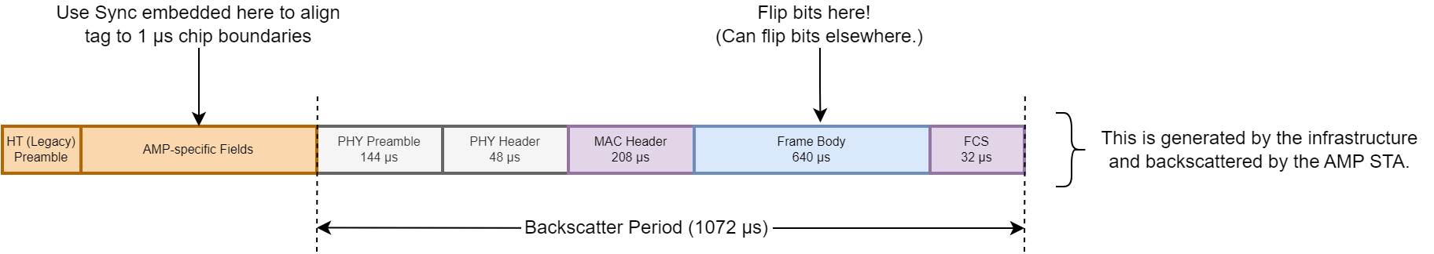
Review: DSSS Waveform for Backscatter Operations (DBPSK)
Take the example where we’d like to backscatter a 1 Mb DSSS frame which is embedded in the Excitation field of an AMP PPDU. [3]
  With 1Mb/s DBPSK (over Barker sequence), a simple backscatter switch going from open to close will result in a 180º phase shift on the reflected bit – i.e. the bit will be flipped.
  The AMP STA can synchronize its timing from AMP Sync field(s). From this, the AMP STA can determine when to start modifying bits on backscatter.
  The scrambling process can be taken into account such that the resulting bits after the receiver’s descrambler represent the AMP STA’s data bits.
Example from [3].

Slide 6
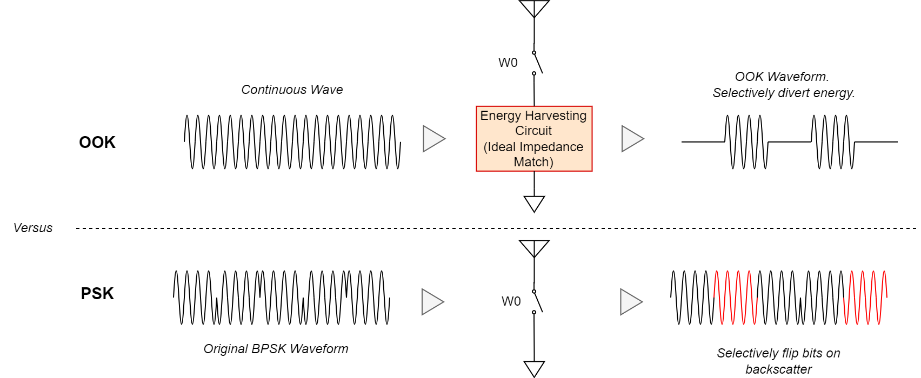
BPSK Bit Flipping Versus OOK: Implementation
Similar to OOK, basic bit flipping for BPSK modulation is very simple.
In the simplest example, a backscatter transceiver switches between an open/short to impart a 180º/0º phase shift on the incoming signal on reflection.
OOK can switch between a real and reactive load to selectively reflect or not reflect energy.

Slide 7
Phase Modulation Versus OOK
Phase modulation in backscatter has several advantages versus OOK, especially when considering long-range backscatter.
  Higher receiver sensitivity (about 3 dB improvement).
  Higher backscatter efficiency gets more energy back on the air in the uplink (about 3 dB improvement).
  OOK transceivers must construct and modulate the entire uplink frame (training sequence + data + headers, etc.). OOK cannot modify existing bits in the downlink sequence.
  PSK modulation: more of the uplink PPDU is pre-formed in the downlink; The backscatter AMP STA is capable of flipping the bits in the existing DL sequence.

Slide 8
Combined PSK Data Modulation and SSB Carrier Modulation
For backscatter, it’s important to note that the act of Phase Modulation for data, and Frequency Modulation for carrier shifting can be done using the same circuit.
The only difference is how quickly we switch between phases and in what order.
In general, we can modulate data to any order PSK constellation.
  Each phase shift requires its own reactive load or phase shift.
  Here, we consider DBPSK, DQPSK => 1 Mb, 2 Mb DSSS.

Slide 9
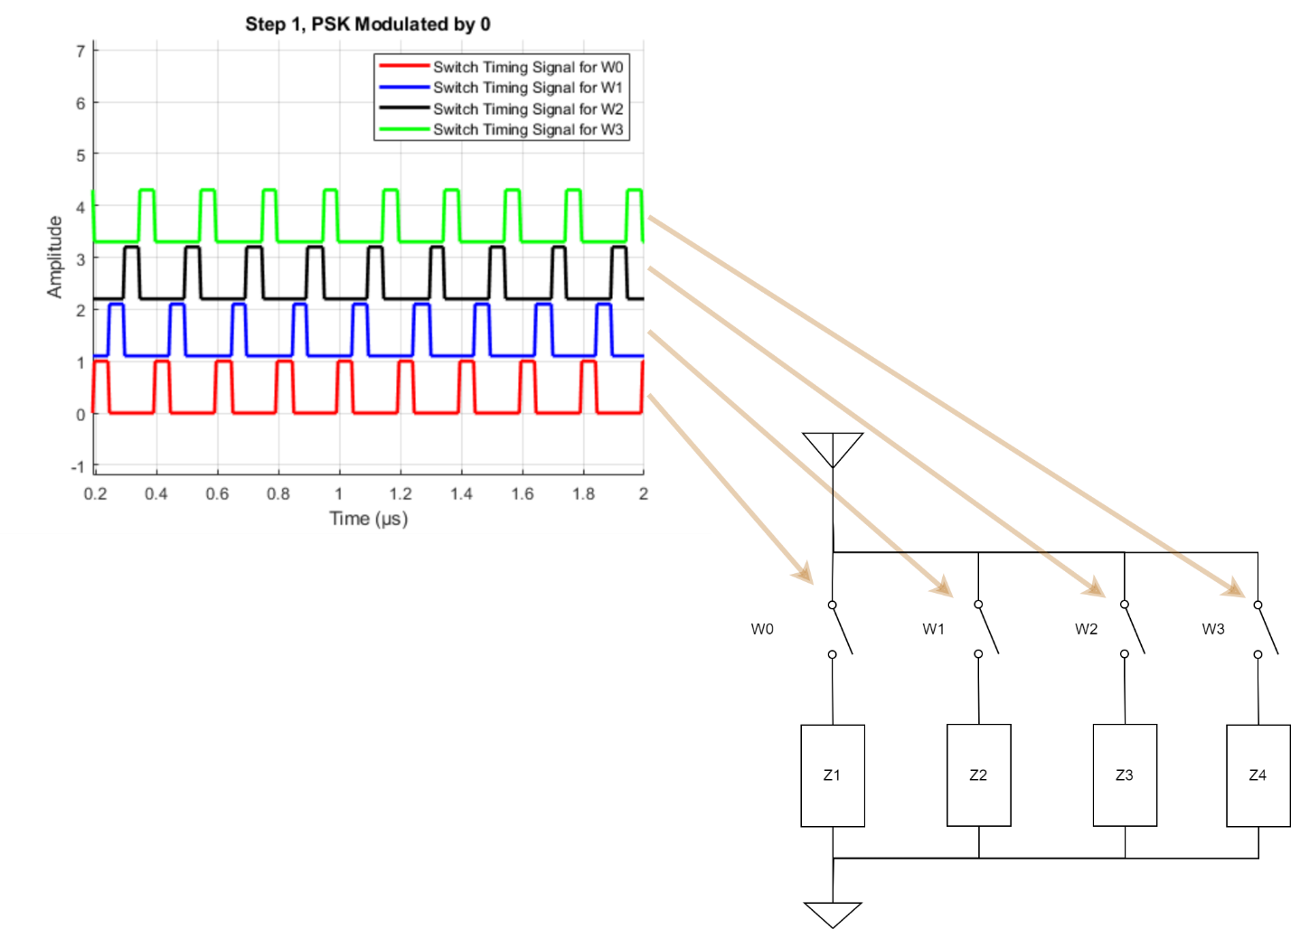
Combined PSK Data Modulation and SSB Carrier Modulation (2)
Consider the switched impedance topology from [3].
This topology switches through four separate impedances to impart four different phase shifts.

Slide 10
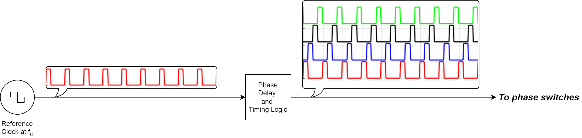

Combined PSK Data Modulation and SSB Carrier Modulation (2)
For SSB carrier modulation, we can generate the switching signals from a single clock source running at $f_{c}$ Hz.

Slide 11
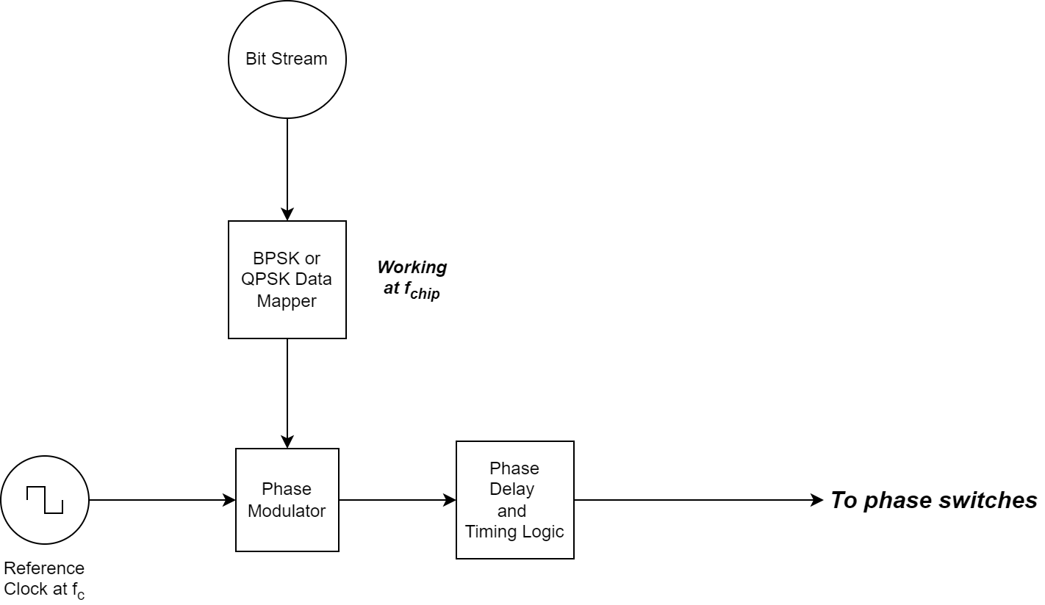
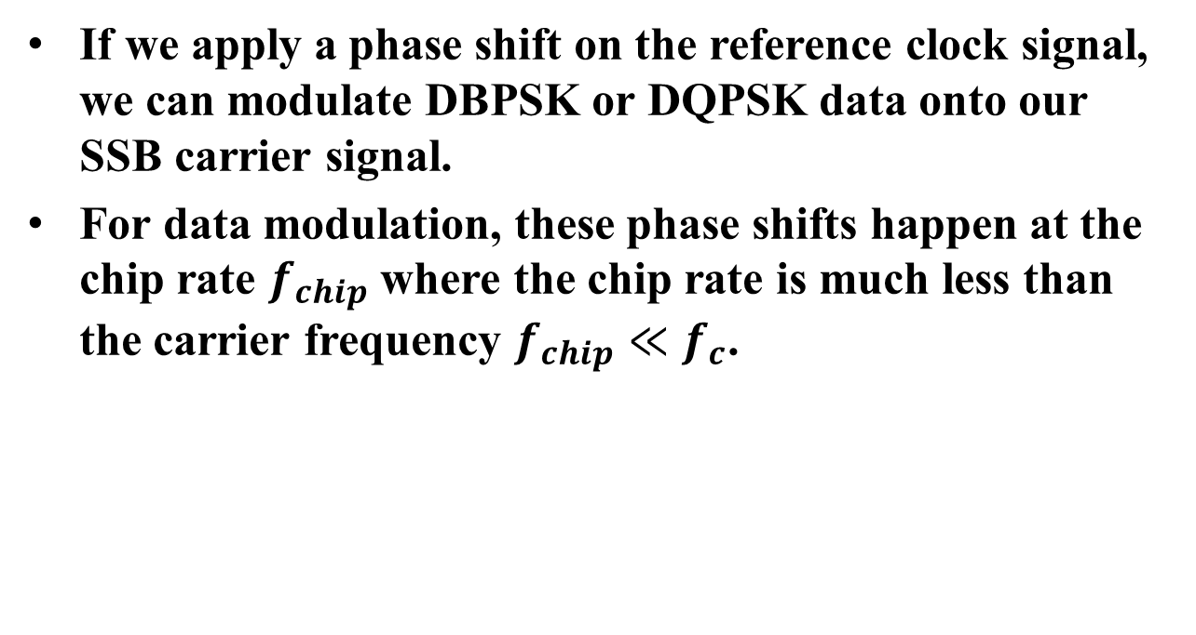
Combined PSK Data Modulation and SSB Carrier Modulation (3)
If we apply a phase shift on the reference clock signal, we can modulate DBPSK or DQPSK data onto our SSB carrier signal.
For data modulation, these phase shifts happen at the chip rate $f_{chip}$ where the chip rate is much less than the carrier frequency $f_{chip}≪f_{c}$.

Slide 12
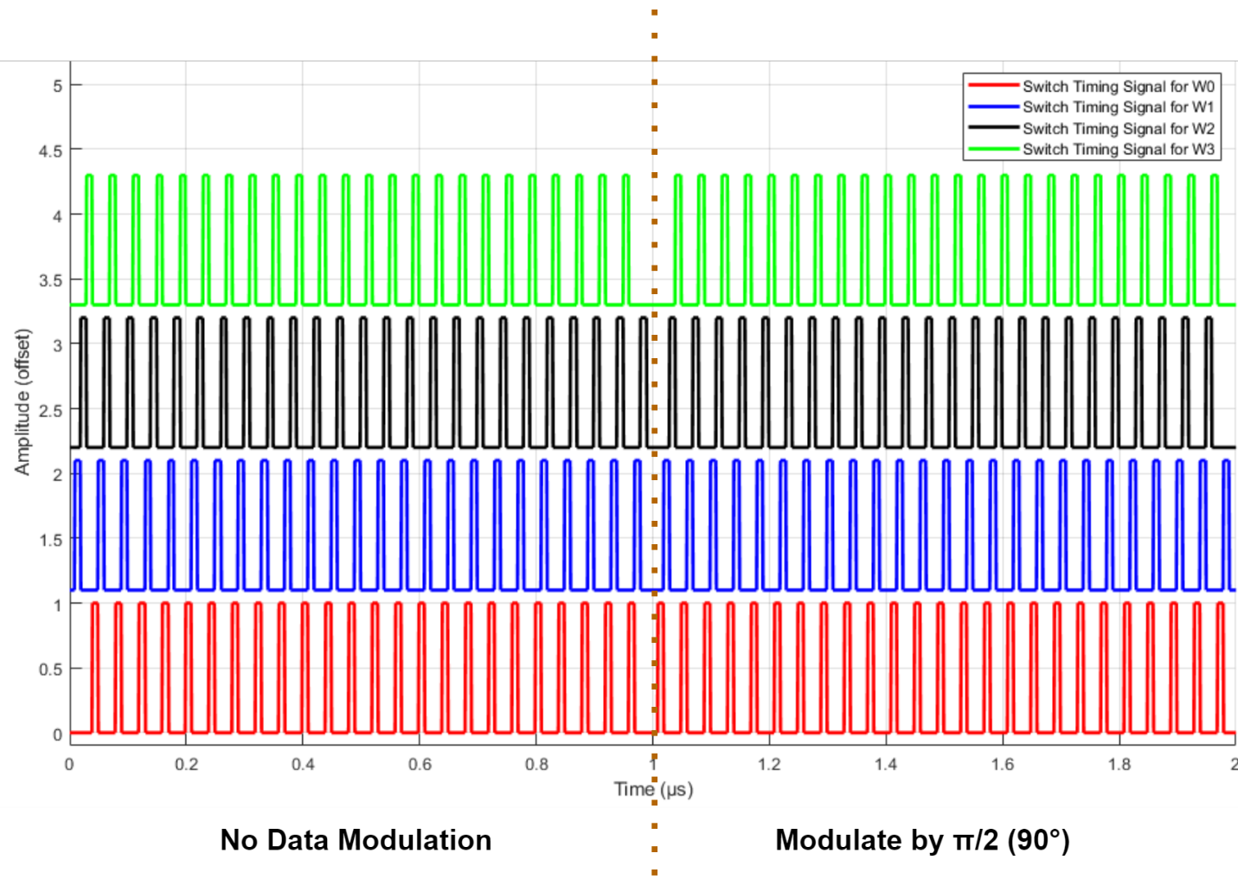
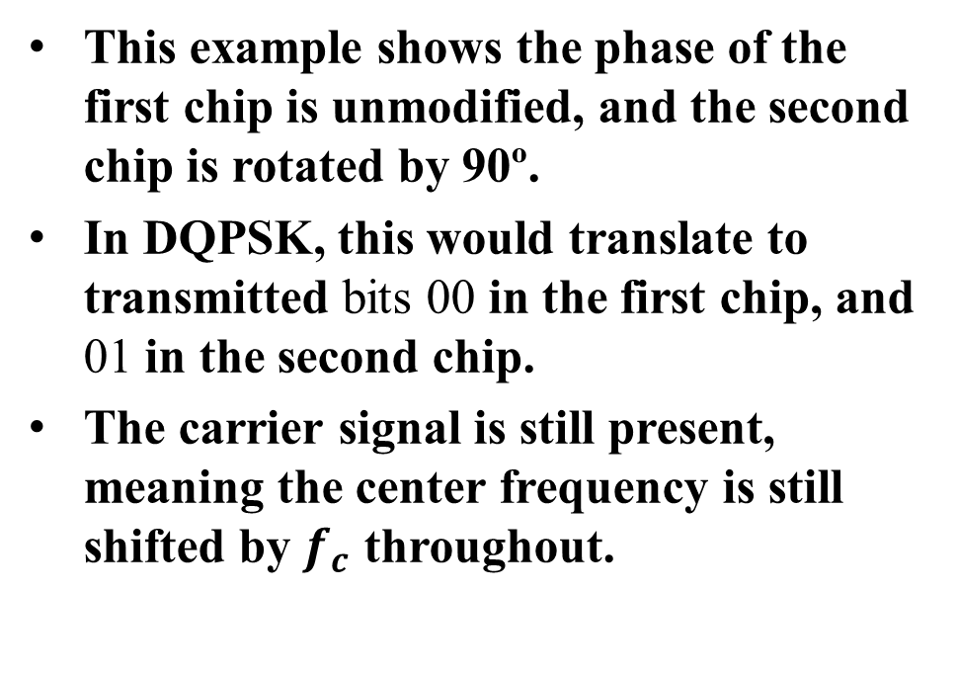
Combined PSK Data Modulation and SSB Carrier Modulation (3)
This example shows the phase of the first chip is unmodified, and the second chip is rotated by 90º.
In DQPSK, this would translate to transmitted bits 00 in the first chip, and 01 in the second chip.
The carrier signal is still present, meaning the center frequency is still shifted by $f_{c}$ throughout.

Slide 13
Conclusion
In this presentation, we reviewed a backscatter technique for encoding data using PSK modulation, or “bit-flipping”.
This technique uses “carrier shifting” or SSB modulation [3].
  Both “bit-flipping” and “carrier shifting” can be done at the same time during long-range backscatter.
PSK modulation has several advantages over OOK
  3 dB advantage in receiver sensitivity, 3 dB advantage in backscatter efficiency (=6 dB potential link margin improvement).
  Much of the AMP Uplink PPDU is pre-formed in the AMP Downlink PPDU; the Backscatter AMP STA only modifies bits in the existing DL sequence.

Slide 14
Straw Polls
SP1:
Do you agree to add the following content to TGbp SFD?
In the uplink, 11bp defines at least one mode of backscattering that supports DBPSK and DQPSK modulation.

Slide 15
References
[1] Kezys et al., Low Complexity Backscatter AMP STA, 11-24/2002, November 2024.
[2] Sanderovich et al., MSK Performance For 802.11bp, 11-24/0854, May 2024.
[3] Costa et al., Single Side Band Backscatter Modulation, 11-25/0265, March 2025.
[4] Nishat et al., Long-range Backscatter Protection Mechanisms, 11-25/0264, March 2025.
[5] Costa et al., Follow-up on Channel Shifting in Backscatter, 11-24/2128, January 2025.
[6] EPC® Radio-Frequency Identity Generation-2 UHF RFID Standard, Release 3.0, Ratified Jan 2024. Available: https://ref.gs1.org/standards/gen2/

