Slide 1
Single Side Band Backscatter Modulation
Date: 2025-03-10
Authors:

Slide 2
Abstract
In the following, we present more details about channel shifting in backscatter communications.
More specifically, we present the theory and circuit topology for Single Side Band channel shifting.

Slide 3
Background
In [1-2], we presented the concept of channel shifting in long-range backscatter operations. Advantages are
Large signal-to-interference margin (50 dB) increases link margin overall for long-range applications.
Backscattering results in a new PPDU on a separate channel, with its own preamble for training the receiver. This has many advantages for bistatic backscatter.
Channel shifting involves a simple architecture with relatively low power consumption.

Slide 4
Background (2)
On further discussion, the group still had some questions.
When channel shifting in backscatter, how would we implement a Single Sideband (SSB) modulation scheme?
Comparing this with OOK modulation, how can we harvest energy while backscattering?
How do we combine channel shifting and bit flipping modulation in practice?
How do we reserve the medium on two channels?
SSB modulation | This presentation.
Energy harvesting opportunity | This presentation.
Combined channel shifting and bit flipping | [4]
Medium protection mechanisms for long range backscatter | [5]

Slide 5
Review: Channel Shifting
Vital to enabling long-range backscatter applications.
Simple method to reduce self-interference and increase link margin by >50 dB.
Does not require additional DSP (cancellation techniques).
Enables us to backscatter a fully formed, backward compatible PPDU.
Requires very little power.
In our example, the 50 MHz clock was shown to consume about 225 nJ per backscatter period. [3]

Slide 6
Review: Single Sideband Modulation
A traditional quadrature mixer shifts a message signal $m\left(t\right)$ to one “side band” of a carrier signal.
Using Euler’s Formula, we can express a quadrature mixer as a single multiplication.
This has some important implications,
Single sideband modulation is just a phase rotation, where we complete one rotation in $1/{f_{c}}$ seconds.
Single sideband modulation is more clearly expressed in the frequency domain via its Fourier transform.

Slide 7
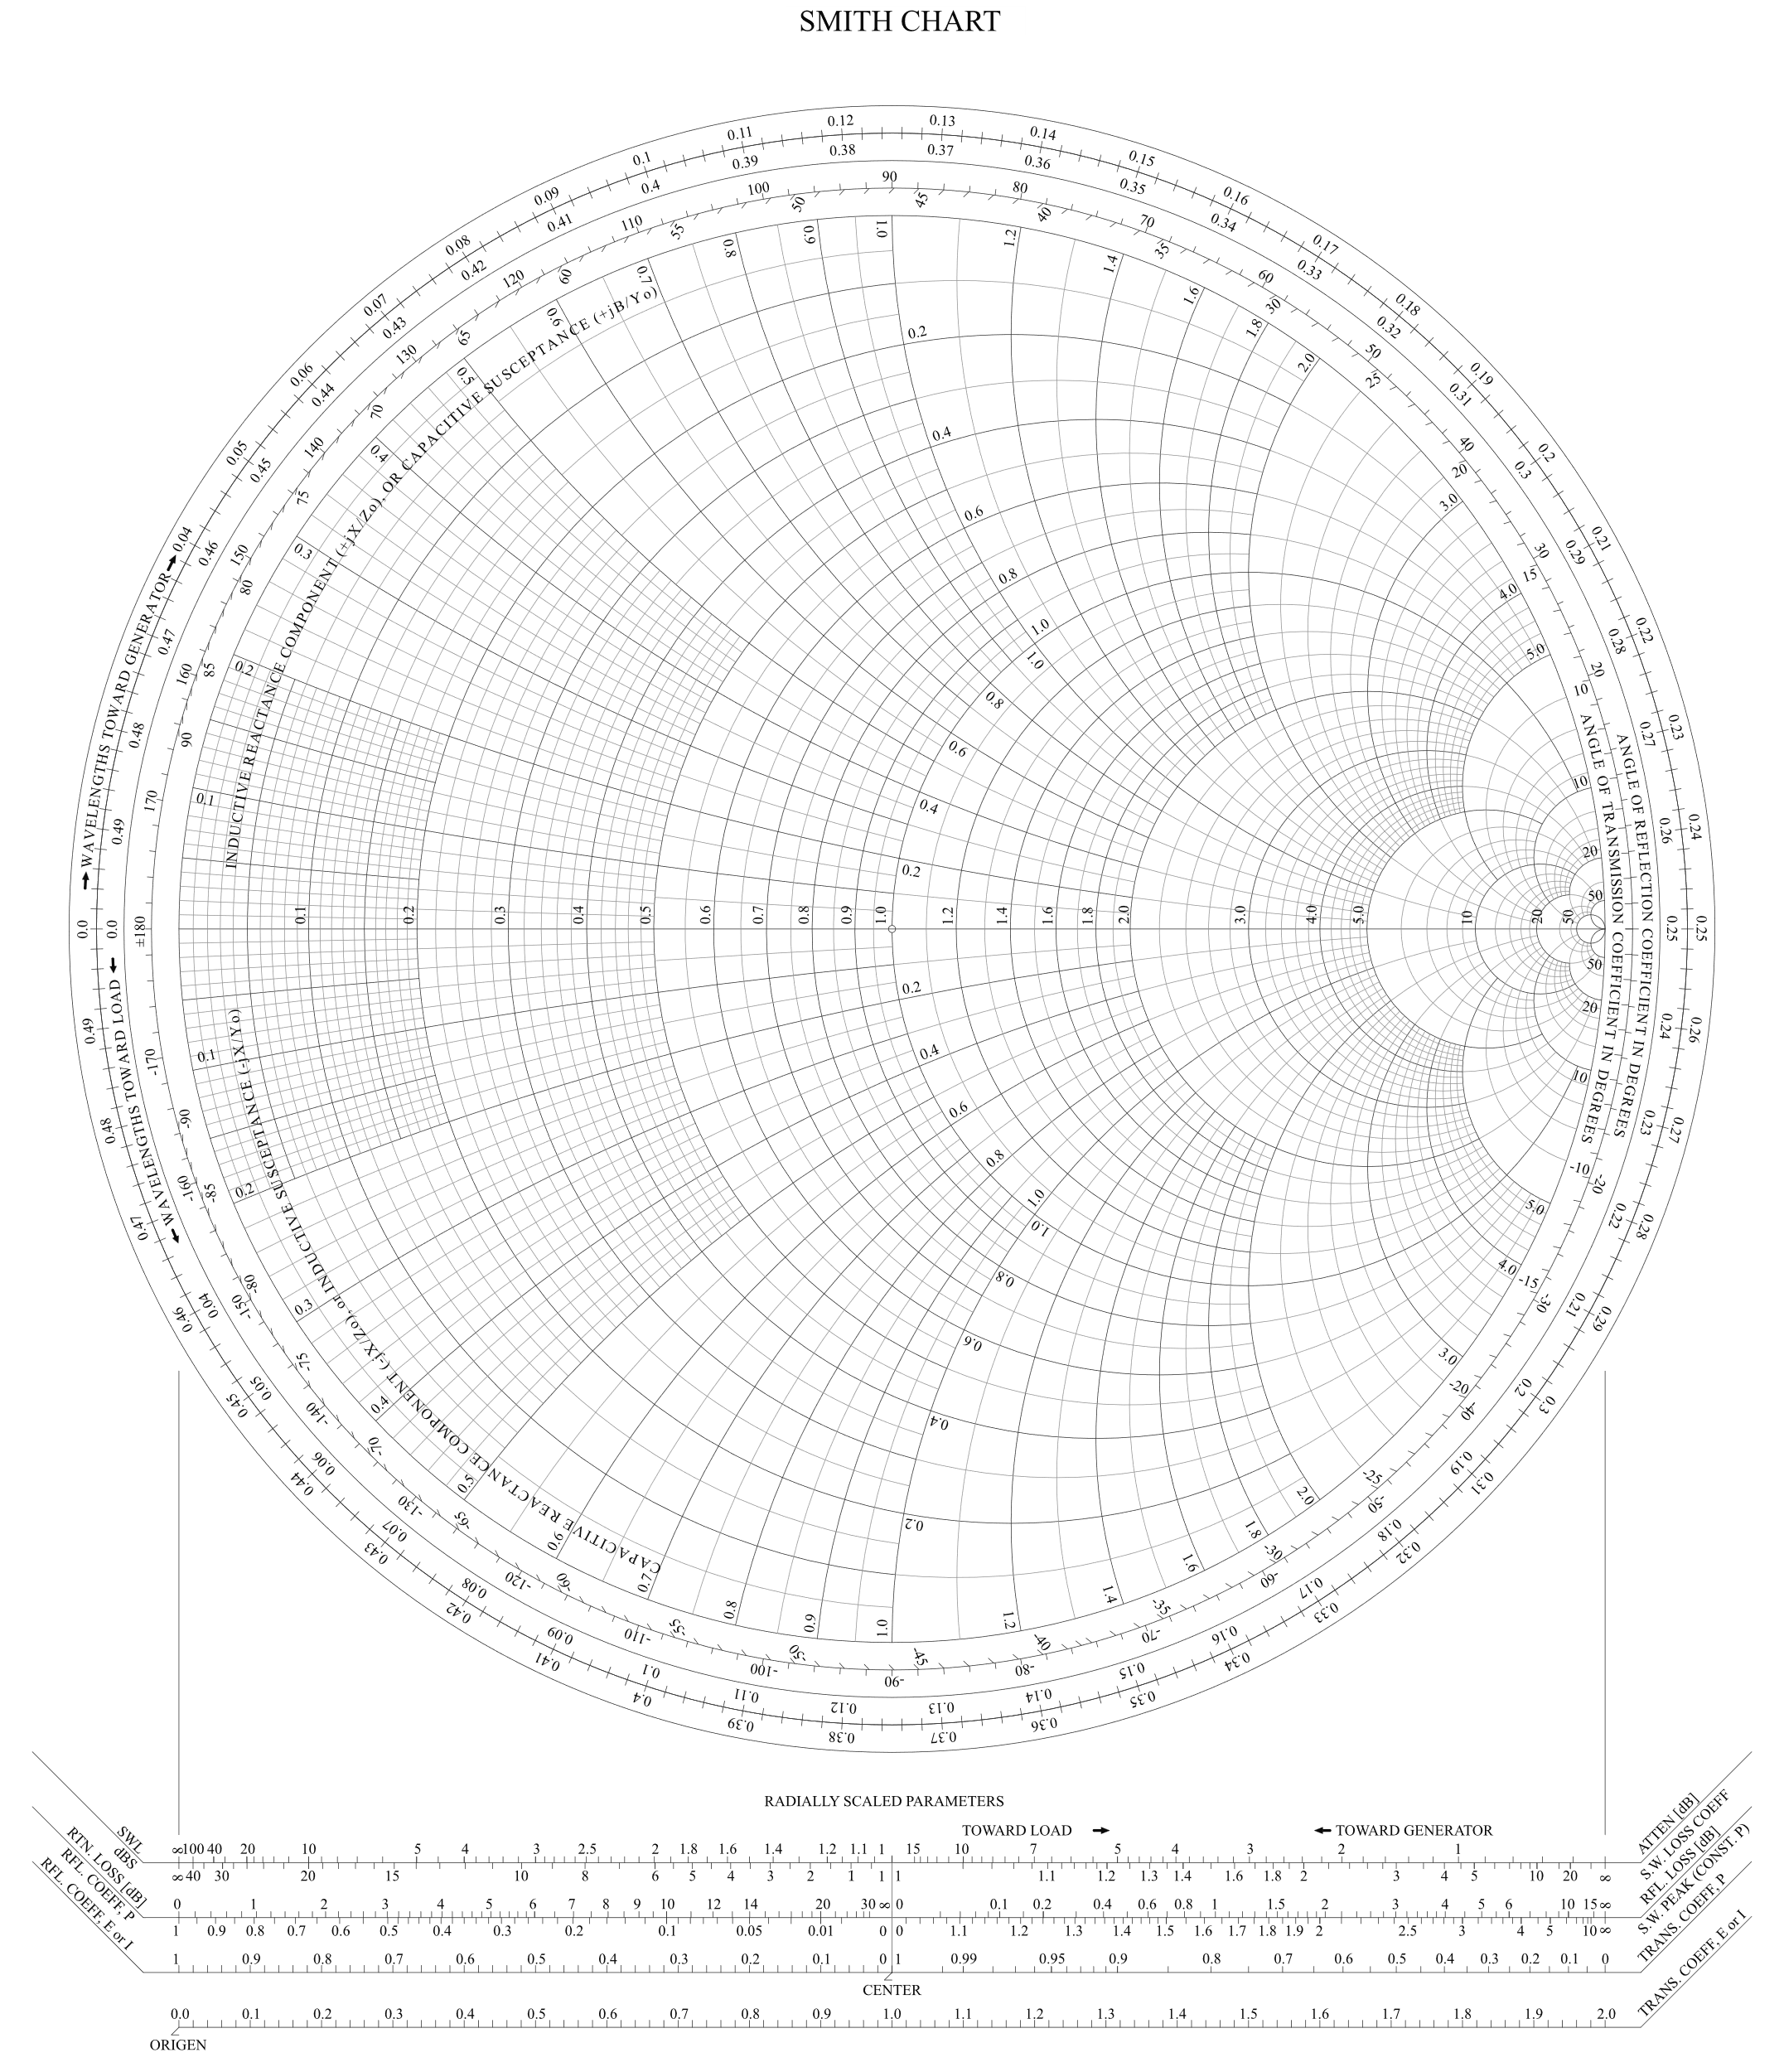
Sampled Phase Rotation and SSB Modulation
We can implement discrete phase rotations using purely reactive impedance transformations.
We can modulate any incident signal up to a carrier $f_{c}$ by rotating it through discrete points on the unit circle, completing one rotation in $1/{f_{c}}$ seconds.
Reactive impedance transformations can be implemented using a combination of inductive and capacitive elements.
Each impedance is switched in sequence.

Slide 8
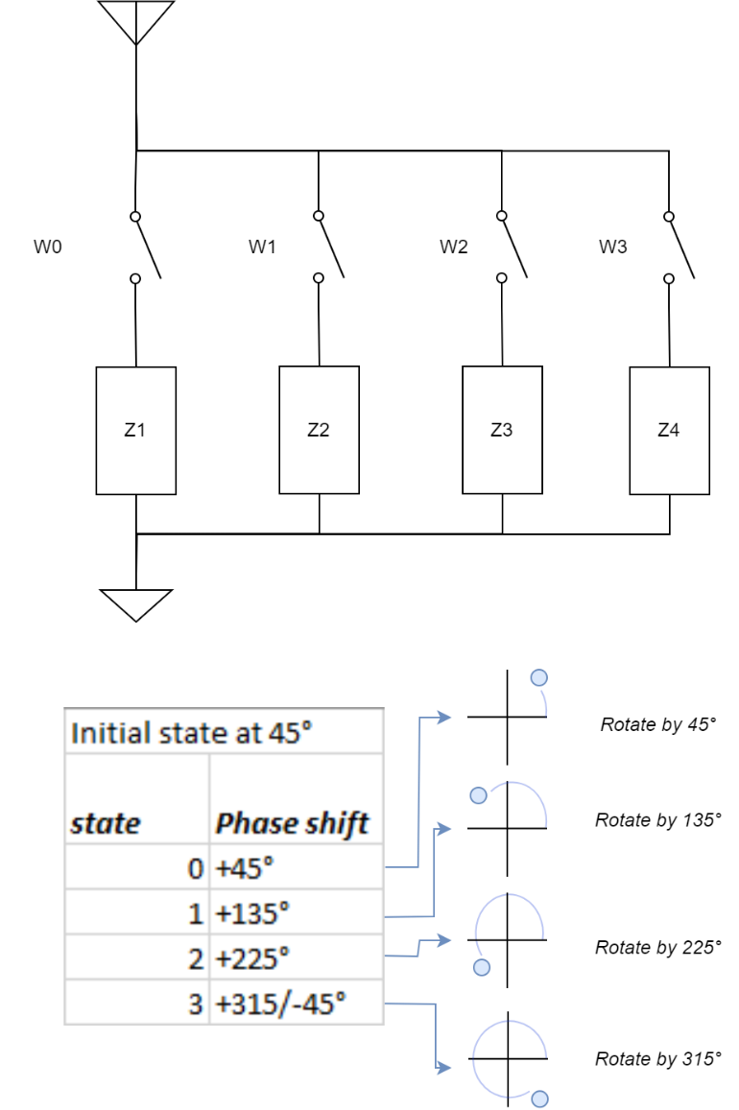
Sampled Phase Rotation and SSB Modulation
Consider the following example.
Using a four-state switched impedance network, we can rotate an incident signal through four discrete points on the unit circle.
Adding inductance increases phase angle (rotate counter-clockwise)
Adding capacitance decreases phase angle (rotate clockwise)
At our carrier frequency, we can tune each impedance to rotate to any given angle.
In this simple example, the initial state rotates the incident signal to 45º, with each successive state rotating another 90º.

Slide 9
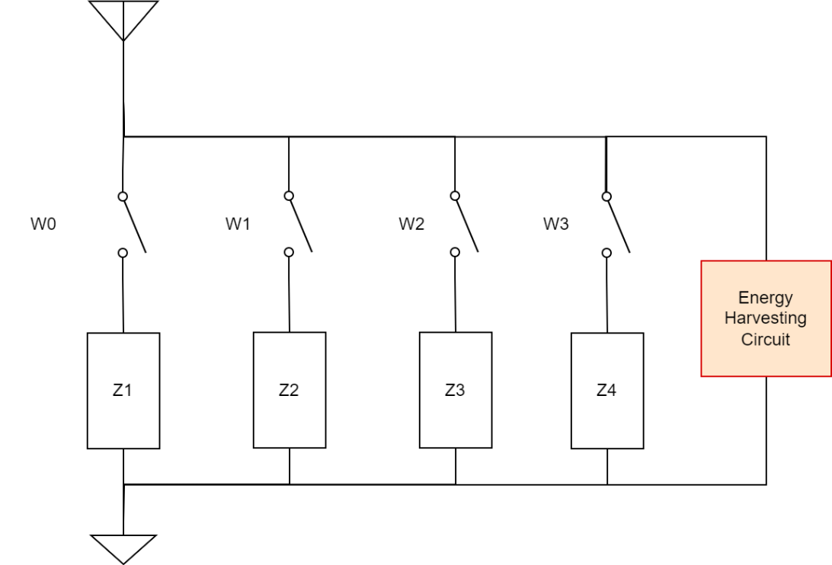
SSB Modulation and Energy Harvesting
In order to achieve maximum backscatter efficiency, we try to present purely reactive loads.
Backscatter efficiency is the ratio of energy incident on the antenna to the energy reflected back out the antenna.
Maximizing this ratio maximizes the link margin for long range applications.
The amount of energy we harvest directly affects the backscatter efficiency.
In this way we can trade off energy harvested for backscatter efficiency (sacrificing range).

Slide 10
SSB Modulation and Energy Harvesting (2)
The energy harvesting circuit in the topology presented here could also be designed to take 3 dB of the incident power and divert it to an energy storage element.
As an example, OOK would result in about half the energy being diverted to the EH circuit while backscattering.
This would result in an approximate 3 dB hit in backscatter efficiency.

Slide 11
Conclusion
In this presentation, we discussed channel shifting using Single Side Band (SSB) modulation for long-range backscatter operation.
In companion presentations [4-5], we also discuss data modulation and protection mechanisms.
We reviewed the theory behind SSB modulation.
We showed an example circuit topology for implementing SSB modulation in a long-range Backscatter AMP STA.
We discussed how this same topology could be used to harvest energy while backscattering, similar to using OOK modulation in backscatter.
SSB modulation during backscatter is a simple method for mitigating self-jamming and significantly increasing link margins for long-range backscatter applications.

Slide 12
Straw Polls
SP1:
Do you agree to add the following content to TGbp SFD?
11bp defines one mode of long-range backscattering with a carrier center frequency shift.

Slide 13
References
[1] Kezys et al., Low Complexity Backscatter AMP STA, 11-24/2002, November 2024.
[2] Costa et al., Frequency Shifting in Backscatter Operations, 11-24/1687, November 2024.
[3] Costa et al., Follow-up on Channel Shifting in Backscatter Operations, 11-24/2128, January 2025.
[4] Costa et al., PSK Modulation for Long-Range Backscatter, 11-25/0265, March 2025.
[5] Nishat et al., Long-range Backscatter Protection Mechanisms, 11-25/0264, March 2025.

