Slide 1
Long-Range Backscatter Protection Mechanisms
Date: 2025-03-10
Authors:

Slide 2
Abstract
Follow up on our presentation 11-24/2128 Follow-up on Channel Shifting in long-range Backscatter Operations
How do we reserve medium use on two channels?

Slide 3
Review: Frequency Shifting in Backscatter Operations [1]
Effective method for reducing self-jamming in long-range backscatter operations.
With this method, the link margin was related directly to
The receiver’s ability to reject adjacent channel interference.
The receiver can decode signals in the presence of in-band interferers.
The transmitter’s emissions mask.
This technique enables long-range backscatter.
This technique forms an uplink PPDU that is compatible with legacy STAs.

Slide 4
Extending AMP non-AP STAs
In [2] different types of AMP non-AP STAs are proposed
Active transmitter non-AP AMP STAs (Active AMP tags)
Dual-mode backscatter non-AP AMP STAs (Dual-mode backscatter AMP tags)
AMP-only backscatter non-AP AMP STAs (Single-mode backscatter AMP tags)
We want to define a mode of operation based on the third type to support long-range Backscatter with channel shifting.
Use similar channel allocation.
CTS-to-Self is used for channel allocation.

Slide 5
Medium Usage on Multiple Channels
Requirements
The transmission needs to protect a TXOP on both channels. (the excitation signal and the backscattered signal).
It would be preferable for the excitation and backscattered signal to be transmitted on non-adjacent channels (e.g, channel 1 and 11 in the 2.4 GHz spectrum).
The TXOP protection mechanism needs to work for legacy 802.11 STAs.

Slide 6
Medium Usage on Multiple Channels
The Backscatter AP AMP STA (Initiator) and AMP-assisted STA (Receiver) operate initially on the same channel.
The Initiator STA (can be an AMP assisting AP) synchronizes the TXOP with the Receiver STA.
The Initiator STA sends a control frame on the excitation channel to initiate the process.
Receiver STA changes its operating channel to the Backscatter channel to receive the backscattered PPDU.

Slide 7
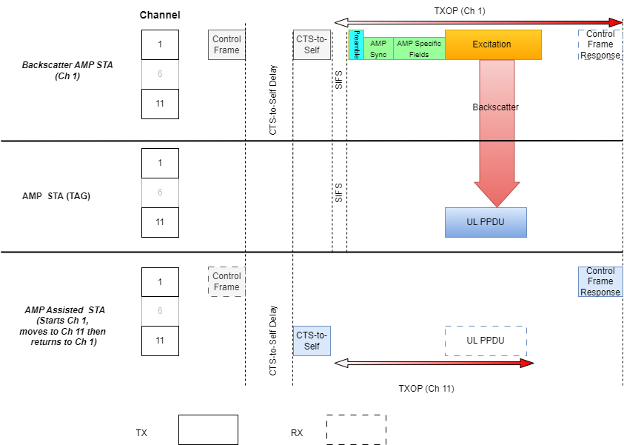
Medium Usage on Multiple Channels
The Initiator STA transmits a control frame to setup the backscatter TXOP. After the backscattered PPDU has been received, the Receiver STA transmits a control frame to acknowledge receipt of the backscatter PPDU after the backscatter TXOP completes.

Slide 8
AMP Control frame to initiate backscatter TXOP
The Initiator STA could use the Bandwidth Signaling TA to include additional information, which would be:
The backscatter channel information
CTS-to-Self delay
TXOP duration
Excitation duration
Address of multiple tags for a sequence of Backscatter (optional)

Slide 9
AMP control frame to acknowledge backscatter TXOP
The response control frame acknowledges completion of the TXOP and provides the status for the receipt of the Backscatter PPDU.
Receiver can send additional information back to the initiator like:
Channel access overhead on the backscatter channel
Data sent from the Tag for the initiator

Slide 10
Conclusion
The design of a channel protection mechanism for long-range Backscatter is presented.
The proposed mechanism uses a CTS-to-Self to reserve channels for the backscatter TXOP
The proposed mechanism uses control frames to allow the Initiator STA to synchronize the backscatter TXOP with the Receiver STA, and to allow the Receiver STA to provide acknowledgement to the Initiator STA on the completion of the TXOP

Slide 11
References
[1] Costa et al., Frequency Shifting in Backscatter Operations, 11-24/1687, November 2024.
[2] Rojan et al., AMP time-based channel access discussions, 11-24/1805r0

