Slide 1
Provisioning Protocol for long range AMP IoT devices
Date: 2025-xx-xx
Authors:

Slide 2
Abstract
An AMP IoT device provisioning protocol that can achieve the following is required:
Establish a trusted relationship between the AMP IoT device and the infrastructure
Compatible with both long range backscatter and active transmission devices
Establish authentication (mutual), achieve confidentiality and integrity.
Configure the AMP IoT device with a local address which is significantly shorter than the IoT device’s secret identity

Slide 3
Background
Long range backscatter offer a different set of opportunities to close range backscatter (different use cases : i.e. smart manufacturing/power grid => characteristics and security requirements are different).
While onboarding, vetting of AMP devices being added to the network is required.
Onboarding should be highly automated
End-to-end security protection is required for services involving AMP non-AP STA.
Security should be enforced very early during device onboarding .
Asymmetric channel with very limited DL

Slide 4
Constraints
Minimize the number of downlink messages (from the infrastructure to the AMP non-AP STA.
AMP non-AP STA should not blindly trust an infrastructure that claims possession of its public key: additional proof of knowledge of non-AP STA’s secret identity is required.
Should be AMP non-AP STA’s uplink mode of operation agnostic
Should not use digital certificates
AMP non-AP STA reprovisioning should be possible

Slide 5
Fundamental assumptions
The AMP non-AP STA interacts with the Infrastructure through a Gateway
The AMP non-AP STA might non posses a MAC address in the 802.11 sense
The RX and TX function of the Infrastructure might be collocated on the Gateway
An Authentication Server (AS) might be used (Radius) The AS and Gateway might be collocated.
When not collocated, AS and Gateway can establish a trusted communication channel between them. The AS uses two distinct keys for communication with the GW and the AMP non-AP STA.
When not collocated, AS and Gateway can establish a trusted communication channel between them.
The AMP non-AP STA’s Serial Number & Public Key record are located on the AS. Proof of ownership of these establishes the non-AP STA trust to the AS.
The AMP non-AP STA’s Serial Number & Public Key record update mechanism on the AS is out of the context of this proposal
The Gateway sends a broadcast message to AMP non-AP STA devices to initiate provisioning
Proof of possession of the AMP non-AP STA’s Public Key by the Gateway establishes the AMP non-AP STA trust in the Gateway

Slide 6
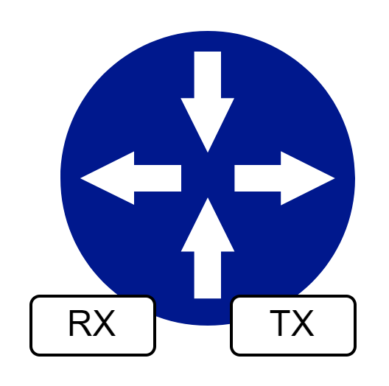
Proposal: AMP non-AP STA provisioning mechanism and address allocation (bootstrapping)
Gateway
The AMP is in provisioning mode and stays in this mode until it has received its local address
Provisioning is initiated by scanning a QR code using and APP on a smartphone
Prov_Init(HASH(A_pubk))
Gateway has trusted connection to AS
2
APP
Hash(A_pubk)
1
After manufacturing AMP device, A contains:
A_pubk, A_privk,
A_SN and AS_pubk
AMP device in Provisioning Mode

Slide 7
Proposal: AMP non-AP STA provisioning mechanism and address allocation

Slide 8
Proposal: AMP non-AP STA provisioning mechanism and address allocation (temporal key derivation)
A = TAG_SN || AS_pubk
PRK = HKDF-Extract(<>, A)
Tk1 = HKDF-Expand(PRK,GWID||TK_NONCE||LOCAL_ADDR||”TK1”,16)
Tk2 = HKDF-Expand(PRK,GWID||TK_NONCE||LOCAL_ADDR||”TK2”,16)
Both AS and AMP device can derive the Tks
Tks are send by the AS to the GW
No need to send the Tks to the AMP device

Slide 9
Proposal: AMP non-AP STA provisioning mechanism and address allocation (session keys derivation)
PRK
TK1
TK2
Cntr==i
Ek1_{i}
EK2_{i}
Cntr==i
Ekx_{i} = HKDF-Expand(TKx,”CNTR”,16)
GW instructs the tag which Tkx to use
Counters start at zero and Re-key command advance the counter
The Ekx_{i} keys have a very short lifetime (determined by the GW)
Ekx_{i} can be used as a seed for the next PRK

Slide 10
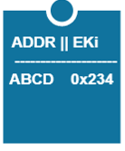
Proposal: AMP non-AP STA provisioning mechanism and address allocation (data protection)
Gateway
Gateway
REQ_SENSOR_DATA(ABCD) Protected by EKi 0x234
RES_SENSOR_DATA() Protected by EKi 0x234
AMP device in Normal Mode
AMP device in Normal Mode

Slide 11
Conclusion
A provisioning protocol that uses only one DL message from the infrastructure to the AMP IoT device was presented
The presented provisioning protocol allows AMP non-AP STA local address allocation
The presented provisioning protocol allows mutual authentication between the AMP non-AP STA and the infrastructure.
The presented provisioning protocol allows symmetric key establishment

Slide 12
Straw Polls
SP1:
Do you agree that the AMP non-AP STA could be allocated a local/short address?

Slide 13
Straw Polls
SP2:
Do you agree that the AMP non-AP STA could be allocated a local/short address with a maximum of 2 downlink transactions?

Slide 14
Straw Polls
SP3:
Do you agree that the AMP non-AP STA should establish a secured relationship with a Gateway/ Authentication Server.

Slide 15
References

