Slide 1
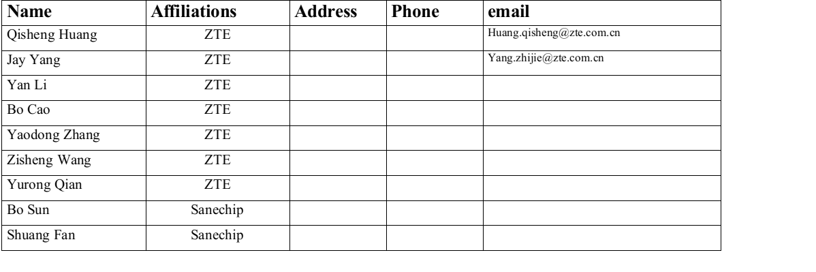
Partial(Overlapping) Bandwidth Sounding for Coordinated Beamforming

Slide 2
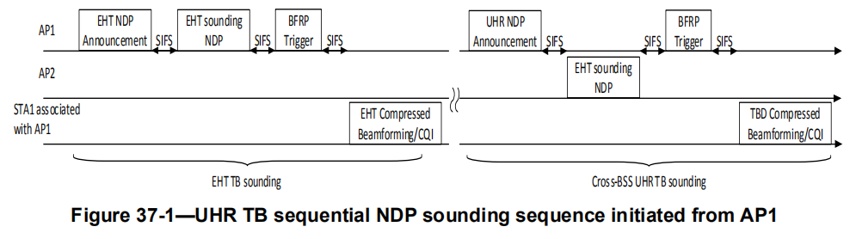
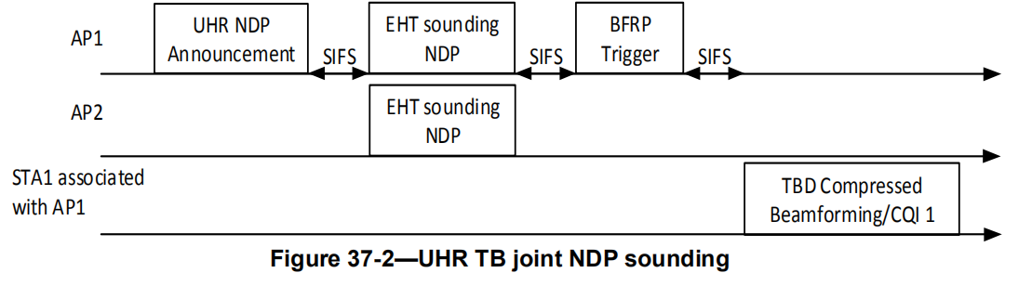
Recap of 802.11bn Draft 0.1

Slide 3
Observation on Bandwidth Mismatch
Practical Bandwidth Mismatches:
  In real-world deployments, it is rare for APs and STAs to have exactly matching bandwidths. Cases where BW_AP1≠BW_AP2 or BW_STA1≠BW_STA2 are more common, making the current protocol inefficient for broader application.
Lack of Protocol Design for Such Cases:
  The current protocol does not define a negotiation mechanism to form a beamforming group when bandwidth mismatches exist among APs and STAs.
Seek for Reducing Feedback Overhead in UHR Sounding
  The feedback data volume for both STAs in Co-BF is large. However, since interference only occurs in the overlapping frequency bands, leveraging this fact can help reduce feedback overhead.

Slide 4
Consideration
Main Purpose: Find a way to realize Co-BF with minimum feedback overhead
Beamforming is at subcarrier level
  Beamforming is performed at the granularity of subcarriers
  The primary objective of coordinated beamforming is to mitigate interference between APs during simultaneous downlink transmissions.
Interference Identification for Effective Beamforming
  To ensure the minimum required effectiveness of coordinated beamforming for interference suppression, it is sufficient to identify only the subcarriers where interference occurs.
Reduced Feedback Overhead in Sounding Stage
  This approach significantly reduces the feedback overhead during the sounding phase by focusing only on the interfering subcarriers instead of the entire bandwidth.

Slide 5
Motivation
Main idea:
Pre-Sounding Frame Exchange for Overlapping Bandwidth: Before starting the Sounding measurement in Co-BF, control frame exchange process is utilized to identify the bandwidth where interference occurs.
Might Co-BF Only on Overlapping Interfering Bandwidth: In the following Co-BF process, Co-BF is applied only to the overlapping bandwidth segments where interference is detected, improving efficiency and reducing computational overhead.

Slide 6
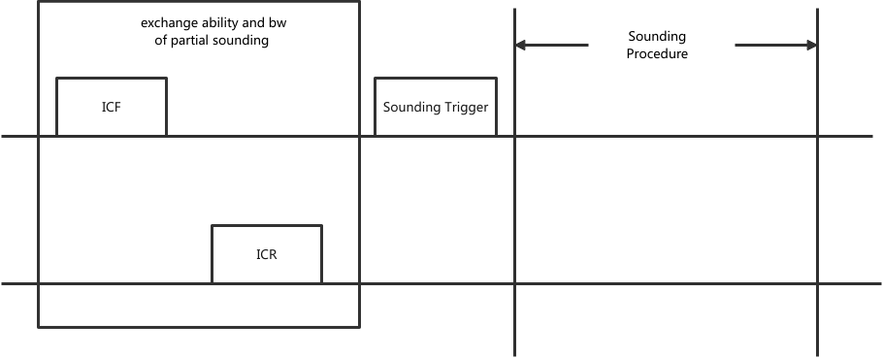
Partial(Overlapping) Bandwidth Sounding -1
Bandwidth Exchange and Sounding within a TXOP:
  Within a single TXOP during each sounding process, the initiating AP and cooperating AP
  exchange information about the sounding bandwidth . Subsequently, the measurement process
  for the overlapping bandwidth segments is announced and initiated using a trigger frame.
BW Reporting

Slide 7
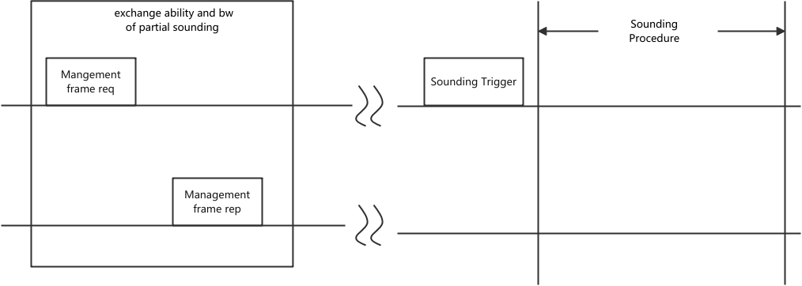
Partial(Overlapping) Bandwidth Sounding -2
Bandwidth Exchange and Channel Measurement in Multi-AP Initialization:
  During the initialization phase of a multi-AP beamforming group, the initiating AP and cooperating AP exchange information about the operating bandwidth . At the start of the UHR souding process, the initiating AP announces and triggers the measurement of the overlapping bandwidth segments using an NDPA frame.
BW Reporting

Slide 8
Summary
Considering the Practical Bandwidth Mismatches in deployment 。
Therefore try to find a way to realize Co-BF at with minimum feedback overhead
  Before starting the Sounding measurement in Co-BF, an additional frame exchange process is introduced to identify the bandwidth where interference occurs.
  In the following Co-BF process, Co-BF is applied only to the overlapping bandwidth segments where interference is detected, improving efficiency and reducing computational overhead.

Slide 9
Staw Poll
Do you agree to include overlapping bandwidth sounding for Co-BF in 11bn?
  The method to determine specific sounding bandwidth is TBD.

Slide 10
THANK YOU ☺

Slide 11
Reference
[1]802.11bn PAR

