Slide 1
M-AP CoBF Sounding Sequence
Date: 02-15-2025
Authors:
Name | Affiliation | Address | Phone | Email
Arik Klein | Huawei Technologies |  |  | arik.klein@huawei.com
Genadiy Tsodik |  |  |  | genadiy.tsodik@huawei.com
Shimi Shilo |  |  |  | Shimi.Shilo@huawei.com
Oded Redlich |  |  |  | oded.redlich@huawei.com

Slide 2
Introduction
TGbn has agreed to adopt the following coordination schemes: Co-SR (TXOP-based with power control) and Co-BF (TGbn SFD, Motion #29)
In addition, for M-AP Co-BF transmission, TGbn has agreed to support 2 variants of preceding CoBF Sounding methods:
  Sequential CoBF Sounding
  Joint CoBF Sounding
This presentation revisits the challenges of the proposed sequences for the CoBF Sounding.

Slide 3
Background
According to TGbn SFD [1]:
The sequential NDP based sounding protocol will be as shown below for Co-BF
  Sounding happens one BSS at a time
  NDPA only addresses the in-BSS STAs
  MAC related additional frames are TBD
Motion #100

Slide 4
Background
According to TGbn SFD [1]:
The joint NDP based sounding protocol will be as shown below for Co-BF
  Sounding happens for one BSS’s STAs at a time
  NDPA only addresses the in-BSS STAs
  MAC related additional frames are TBD
  Joint NDP based feedback will be based on large V-based feedback where the eigen-vectors span the antennas across both APs
Motion #101

Slide 5
Challenges in proposed sequences (1)
The proposed sounding sequence is based on the concept that participating STAs will exchange frames only with their associated AP.
Following this concept leads to:
  “2-in-a-box” / “Ping- Pong” sequence
    The “cross-BSS” part of the proposed
    sequential sounding sequence involves the
    subsequent transmission of 2 PPDUs by 2APs
    (within SIFS!), that have to carefully “listen” to each other:
      (1) The transmission of the Sounding NDP by AP2 is pending on the correct reception of preceding NDPA (transmitted by AP1)
      (2) The transmission of the BFRP TF by AP1 is pending on the correct reception of the Sounding NDP (transmitted by AP2)
    This “portion” is prone to failures and unexpected behavior of the non-AP STAs in case where an AP has not correctly received the end of the previous PPDU (transmitted by the other AP), as also mentioned in [2]
    Lack of one “PoC” AP that is responsible for the entire portion of the sequence leads to unstable solution which is hard to debug (in case it is not working as expected).
1
2

Slide 6
Challenges in proposed sequences (1)
Following this concept leads to:
  CSI feedback corresponding to OBSS AP
    The CSI feedback transmitted by STA1 is
    intended to AP2 (though it is transmitted to AP1)
    It is clear, that the following that the transmission
    of the CoBF PPDU can’t start if the
    CSI feedback will not be received by the
    OBSS AP (AP2).
    However, the proposed sequence does not provide any further details on how the CSI feedback (corresponding to the OBSS AP) is conveyed to the OBSS AP?
    2 options may be assumed for this gap:
      Relay from Sharing AP to OBSS AP
      “Hidden reception” of OBSS AP

Slide 7
Challenges in proposed sequences (1)
Following this concept leads to:
  CSI feedback corresponding to OBSS AP
    Option 1 – Relay between APs
      Lack of indication in CSI that it is destined for
      OBSS AP
      Need to add transmission between AP1 to AP2
      (including acknowledgement on reception) –
      additional overhead to the prolonged sequential
      sequence.
    Option 2 - “Hidden reception” of OBSS AP → Overhearing problem
      This option assumes that OBSS AP is required to parse both BFRP TF (all per-STA Info) and CSI (that is individually addressed to AP1) that are not destined to it →
      leads to reception of any BFRP and CSI that are transmitted by the sharing AP….
      Requires to add a “verification mechanism” (with detailed feedback) for each case of “Cross-BSS” sounding for verifying that OBSS has correctly received all the required feedback it needs for CoBF PPDU transmission.
      In case of failure in reception (BSRP/CSI of OBSS non-AP STAs) by the OBSS AP (AP2), it will require a repeated but redundant feedback reception by the Initiating AP (AP1) - Inefficient mechanism and unnecessary overload of AP1.

Slide 8
Challenges in proposed sequences (2)
Initiation of Sequential sounding by OBSS AP2
  The TXOP is obtained by AP1 (sharing AP), thus OBSS AP2 can’t simply initiate transmission at its discretion
  Need to Add trigger frame that will initiate the sequential sounding portion that is performed by OBSS AP2
  Need to add indication (for the sharing AP) when the Sounding procedure performed by OBSS AP2 is successfully completed.

Slide 9
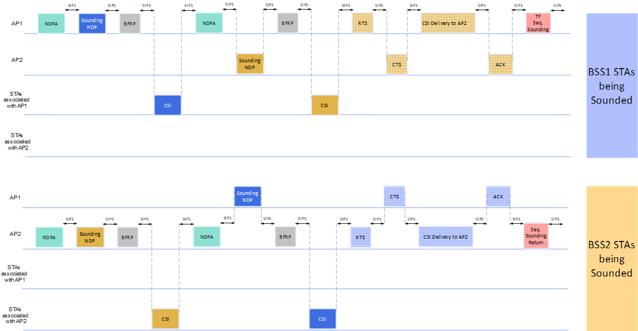
Complete current CoBF Sequential Sounding sequence - example
Time Consuming for each pair of APs
Considerable overhead due to basic concept
Assuming relay option implemented between AP1 and AP2

Slide 10
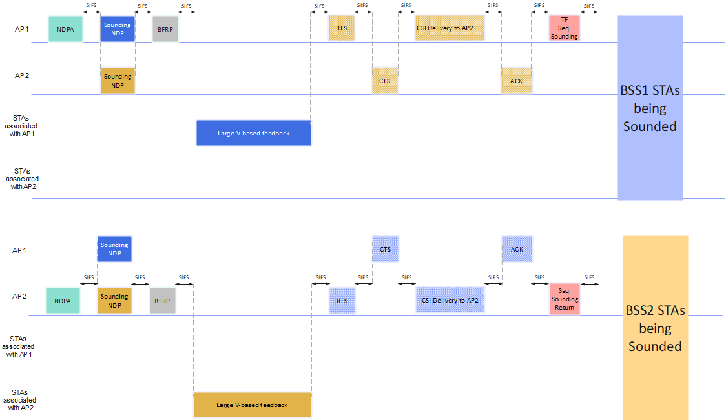
Complete current CoBF Joint Sounding sequence - example
Considerable overhead due to basic concept
Assuming relay option implemented between AP1 and AP2

Slide 11
Summary
This contribution discusses the challenges in the current proposed CoBF Sounding sequences
  “2-in-a-box” / “Ping- Pong” sequence
  CSI feedback corresponding to OBSS AP
  Initiation of Sequential sounding by OBSS AP
Need further discussions on the proposed resolutions for the detailed challenges.

Slide 12
References
[1] 11-24-0209-06-00bn-Specification Framework for TGbn
[2] 11-25-0006-02-00bn-sounding-procedure-follow-up

