Slide 1
Localization driven IMMW beam management
Date: 2024-11-30
Authors:

Slide 2
Introduction
Integrated mmWave (IMMW) is promising for the whole Wi-Fi industry.
In this contribution, we would like to consider beam management in IMMW.

Slide 3
Motivation
2.4/5/6 GHz Wi-Fi : Omni directional transmission
AP
STA
Slide 3

Slide 4
Motivation
Millimeter wave: High attenuation
AP
STA
Slide 4

Slide 5
Motivation
Millimeter wave: High attenuation
AP
STA
Slide 5

Slide 6
Motivation
Millimeter wave: High attenuation → Beamforming → Beam scanning
AP
STA
Slide 6

Slide 7
Motivation
Millimeter wave: High attenuation → Beamforming → Beam scanning → Beam alignment
AP
STA
Slide 7

Slide 8
Motivation
Millimeter wave: High attenuation → Beamforming → Beam scanning → Beam alignment
AP
STA
Slide 8

Slide 9
Motivation
Millimeter wave: High attenuation → Beamforming → Beam scanning → Beam alignment
Millimeter wave has the key problem of high beam-training overhead, which limits its large-scale commercial use.
Exhaustive scanning in a wide range of directions results in the high beam-training overhead or high latency.
Make full use of IMMW characteristics to help IMMW beam management.
AP
STA
Slide 9

Slide 10
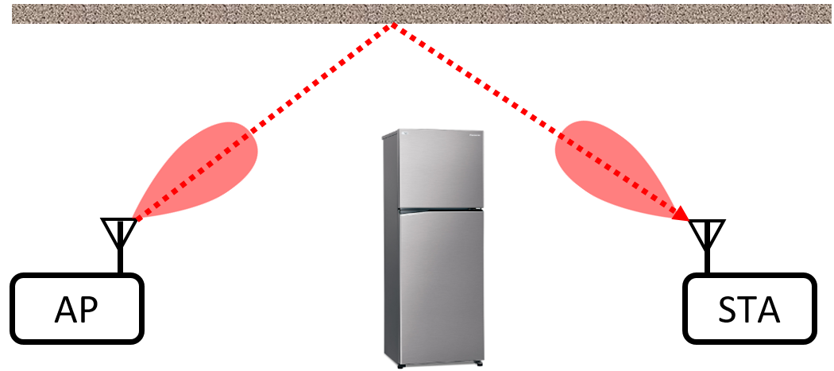
Proposal 1: Determining whether there is LOS
LOS (Line-of-Sight)
NLOS (Non-line-of-Sight)
Option1: Using Wi-Fi low-frequency to help determine whether there is LOS. For example, judging LOS or NLOS based on CSI (whether the signal component of the shortest path is the strongest).
Option2: Aligning beams based on relative spatial position, sending millimeter wave signals to measure RSSI, and comparing the measured RSSI with the link budget results to see if the difference exceeds an threshold value, thereby determining whether it is LOS or NLOS.

Slide 11
Proposal 2: Beam training with prior information
TX can determine relative direction based on location information or localization results in LOS scenarios.
TX scans the inner beam group first, then scans the outer beam group, and records some measurement results of each group.
RX uses Wi-Fi low-frequency link to feedback measurement results during the scanning process.
If the optimal beam quality in the current group is less than the optimal beam quality in the previous group, TX stops scanning and aligns the beam by the optimal beam from the previous group.

Slide 12
Proposal 2: Beam training with prior information
In NLOS/LOS scenarios, hierarchical beam scanning can be performed firstly. TX can determine the fine beam scanning range and relative direction (the central axis of the cone) based on the coarse beam scanning results.
TX scans the inner beam group first, then scans the outer beam group, and records some measurement results of each group.
RX uses Wi-Fi low-frequency link to feedback measurement results during the scanning process.
If the optimal beam quality in the current group is less than the optimal beam quality in the previous group, TX stops scanning and aligns the beam by the optimal beam from the previous group.

Slide 13
Summary
In this contribution, we propose to make use of prior information to help IMMW beam management. We can utilize prior information from localization, sensing, intermediate results of hierarchical scanning, historical location etc. to narrow the beam scanning range and perform group scanning to improve beam alignment efficiency.
Scanning the beam group with high probability first.
During the beam scanning process, the low-frequency link is used to feedback measurement results so that the beam scanning can be terminated when the alignment conditions are met.

Slide 14
References
[1] 11-24-0116-07-immw-immw-draft-proposed-par
[2] 11-23-1968-00-immw-discussion-on-general-direction-of-integrated-mmwave

