Slide 1
Considerations on SCS enhancement – Follow up
Date: 2025-02-XX
Authors:

Slide 2
Introduction
Our previous contribution (11-24/1355r1) proposed using the Application ID to group multiple SCSIDs, facilitating efficient traffic transmission for the same application and meeting requirements like video and audio synchronization (e.g., lip-sync) in VR applications [1].
The 11be defines R-TWT and SCS, where SCS streams are managed by SCSIDs and established between non-AP STAs and an AP. QoS requirements, including delay bound, are configured via the QoS Characteristics Element from the STA side.
Virtual meetings with avatars
11-24/1355r1
Example
At DL

Slide 3
Recap: Issue
The current SCS cannot fully address specific VR application requirements, such as video and audio synchronization (e.g., lip-sync).
QoS is configured using parametric settings (e.g., QoS Characteristics element) but managed through TID values (0–7), limiting differentiation and prioritization of traffic flows [2].
When multiple SCS streams are assigned the same TID, before the traffic from the VR application (e.g., SCSID#1 and SCSID#2) is fully transmitted, traffic from other applications (e.g., SCSID#N) may intervene, leading to issues such as out-of-sync video and audio.
VR App with
application requirements

Slide 4
Recap: Scheduling across Multiple SCS Streams by Application ID
The Application ID, included in the SCS Request frame, allows the AP to group and manage multiple SCSIDs (e.g., SCSID#1 and SCSID#2). It facilitates efficient traffic scheduling and supports requirements like video and audio synchronization (e.g., lip-sync) in VR applications.
with application requirements

Slide 5
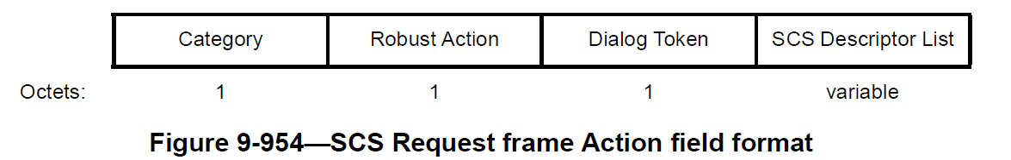
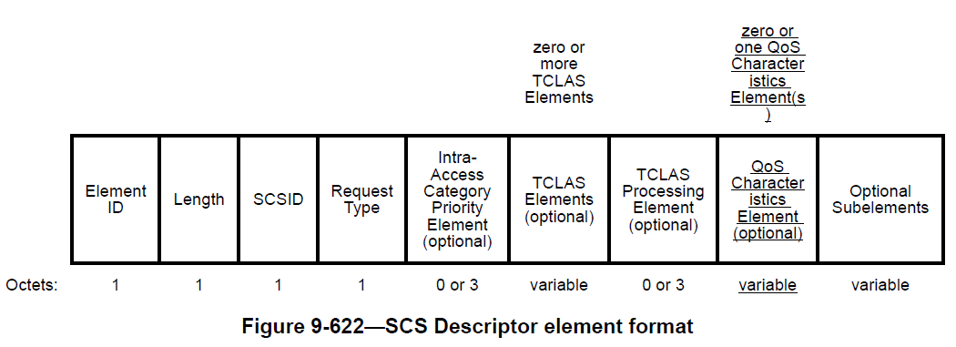
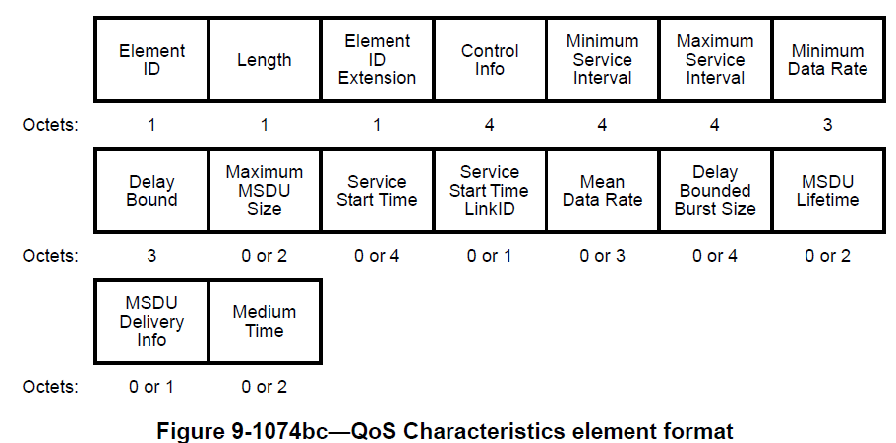
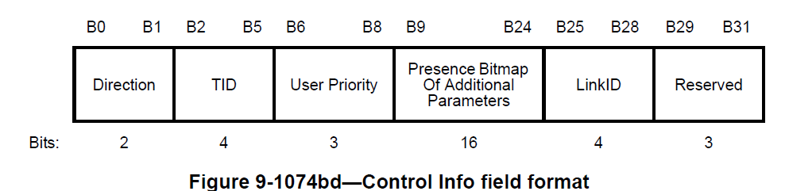
Signaling for Application ID
In 11be, each SCS Descriptor element can include a QoS Characteristics element to describe the traffic characteristics and QoS expectations of the traffic flows identified by the SCSID field value in the SCS Descriptor element.
Our proposal introduces signaling to associate multiple SCS streams (e.g., SCSID#1 and SCSID#2) to the same application.
Multiple SCS Descriptor elements
,
...
Audio traffic stream
Video traffic stream
SCSID#1
SCSID#2

Slide 6
Signaling for Application ID
Define Application Descriptor element includes an Application ID field in the Optional subelement IDs for SCS Descriptor element
Application ID associates multiple streams (SCSIDs) with a single application.
Optional subelement IDs for SCS Descriptor element
Subelement ID | Name | Extensible
0 | Application Descriptor | Yes
1-220 | Reserved
221 | Vendor Specific | Vendor defined
222-255 | Reserved
Subelement ID | Length | Application ID
Octets 1 1 1
Application Descriptor element format

Slide 7
Summary
This contribution proposes a signaling to associate multiple streams (SCSIDs) to a single application.

Slide 8
References
[1] IEEE 802.11-24/1355, Considerations on SCS enhancement
[2] IEEE 802.11-22/0041r0, Some Issues on SCS Operation

Slide 9





Appendix: Possible Use-case
In a scenario where a single AP manages an entire factory within a single BSS, the AP must control all devices handling multiple applications (Group #1, #2, etc.).
STA groups [2]
Group #1
(AGVs, etc.)
Group #2
(Robots, etc.)
Each group, working in the same location or performing the same task, requires low-latency transmission simultaneously.
AP
...
Factory, etc.
※The details of other applications are omitted from this slide.

Slide 10

Appendix: Possible Use-case
Some location information may become obsolete in terms of calculating the optimal route plan at a given moment.
At Server
(Path planning)
...
AP
AGV #1
AGV #2 ...
AGV #N
...
AP
In order to the route plan accurately calculated ...
AGVs report location information to the associated AP while moving
The Application ID facilitates the transmission of traffic associated with SCSIDs within a specified period
UL Data
...
AP
...
AGV #1
AGV #2 ...
AGV #N
※The details of other applications are omitted from this slide.

