Slide 1
IEEE 802.11ai and IEEE 802.11bc for Automotive Use
Date: 2025-03-10
Authors:

Slide 2
Abstract
This presentation provides information about IEEE 802.11ai and IEEE 802.11bc for automotive usage.

Slide 3
IEEE 802.11ai (Fast Initial Link Setup, FILS)
Non-AP
STA
AP
IEEE 802.11ai provides fast “initial” link setup.
  “Initial” means the first link setup in an ESS.
  It can be used not only for “initial” but also “non-initial” (inside ESS).
  “Link setup” is defined as
  The process of discovering an extended service set (ESS), (secure) association and authentication, and gaining the ability to send higher layer [e.g., Internet Protocol (IP)] traffic with a valid higher layer address through an access point (AP).
“Link setup” can be divided into three parts.
  AP discovery
  Authentication and key exchange
  Higher layer setup
IEEE 802.11ai provides optimized solutions to each part.
Probe (1 round trip)
Authentication (1 round trip)
Association (1 round trip)
EAPOL-Start
EAP-Identity (1 round trip)
Establishing TLS tunnel for PEAP
(3 round trips)
PEAP
EAP-MSCHAPv2
(4 round trips)
EAP-Success
EAPOL-Key
(2 round trips)
DHCP
(2 round trips)
ARP to the default gateway (1 round trip)

Slide 4
AP Discovery
Active scan
  Broadcast Probe Response
    Non-AP STA can use Prove Responses that are responses to other non-AP STA’s Probe Request.
Passive scan
  FILS Discovery frame
    It is less size and more frequent than Beacon frame.
Common
  Intermediate scan result
    MLME reports intermediate scan results before completing scan
  Neighbor Report optimization

Slide 5
Authentication and Key Exchange
IEEE 802.11ai defines shared key authentication and public key authentication.
Both authentication methods are performed by 1 round trip frame exchange between AP and non-AP STA.
Key exchange is also done by 2 round trip frame exchange, including key confirmation.
Non-AP
STA
AP
Authentication
Authentication and Key Generation
Association
Key Confirmation

Slide 6
Higher Layer Setup
IEEE 802.11ai provides piggy-backing higher layer packets in Association Request / Response frames.
  Higher layer packets are protected.
  It is intended to be used for DHCP and ARP / NDP.
  Although DHCP generally needs 2 round trips packet exchange between DHCP server and client, DHCP with Rapid Commit Option needs only 1 round trip.
IEEE 802.11ai can complete authentication, key exchange and higher layer setup by 2 round trips frame exchange, Authentication and Association.
Non-AP
STA
AP
Authentication
Association
Piggy-back
(e.g DHCP w/RCO, ARP)

Slide 7

IEEE 802.11ai for Automotive
Seamless handover can be realized by implementing multiple STAs in one device.
  Use STAs alternately.
  Link selection (handover) can be implemented without any modifications of standards.
    L2: Broadcast a frame (IEEE 802.1Q)
    L3: Mobile IP
    Higher Layer
For seamless handover, link setup has to be completed in the overlapping zone.
  Fast link setup makes seamless handover easier.
Overlapping zone
STA1
STA2
Vehicle Network
Gateway

Slide 8
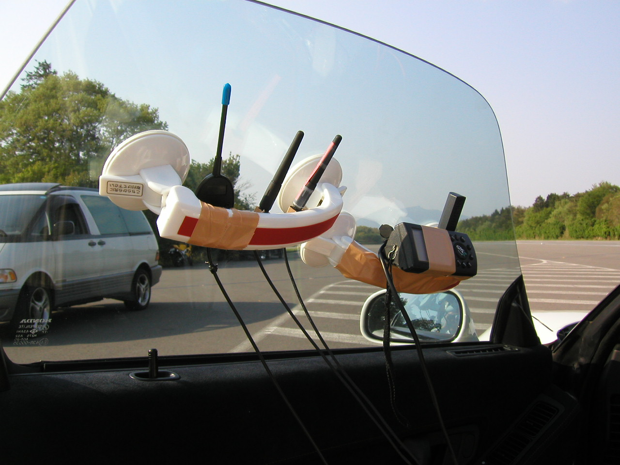
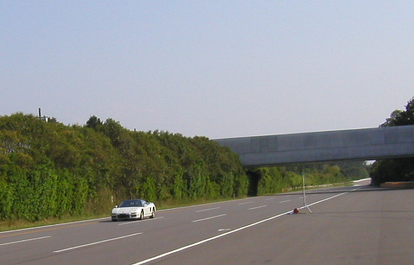
Our Trial in 2003
Antennas of the
non-AP STAs
We implemented IEEE 802.11ai like proprietary protocol.
  Base idea of IEEE 802.11ai
We tested seamless handover on a test course for automobile in 2003.
We installed 4 APs along the course. The distance of each AP was 300m.
The gateway had 2 non-AP STAs.
Realtime video transfer (DVTS) was tested.
Seamless video transfer was succeeded up to 260km/h (speed limit of the vehicle).
We got the results that indicated no packet losses for 1ms interval UDP TX/RX in laboratory tests.
Similar system was installed for commercial use of realtime train survey video transfer.
AP

Slide 9
IEEE 802.11bc (Enhanced Broadcast Service, EBCS)
IEEE 802.11bc provides broadcast-type services over IEEE 802.11 wireless LANs.
  Association does not require.
  Receiver does not need to send any frames.
  Per-frame authentication is provided to prevent rogue transmitters.
  Required bandwidth is constant regardless of the number of receivers.
Both downlink (AP -> non-AP STA) and uplink (non-AP STA -> AP) are defined.
  DL (downlink) use case: Local information distribution
  UL (uplink) use case: Sensor data upload

Slide 10
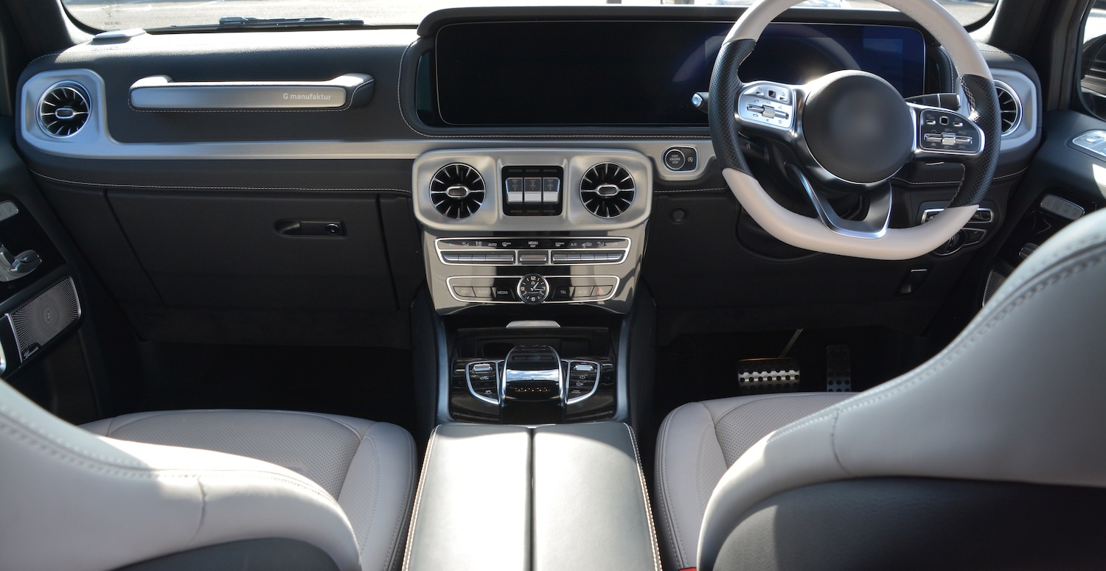

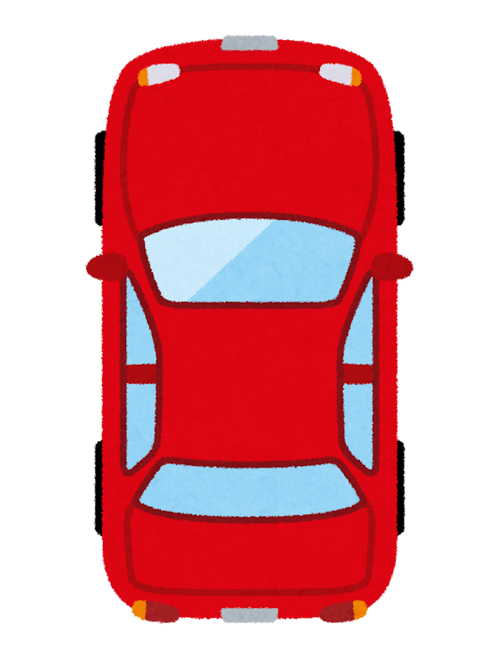
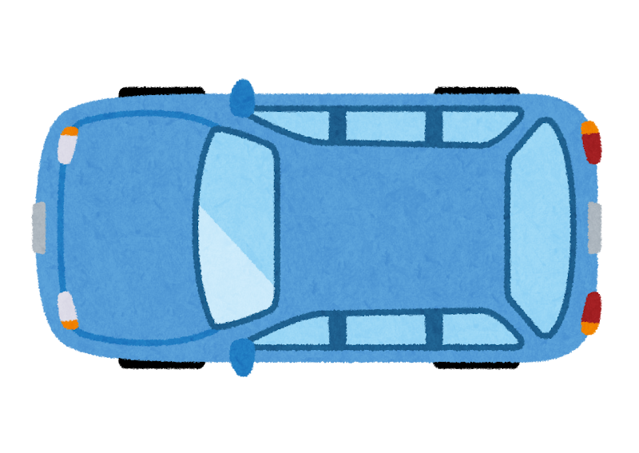

IEEE 802.11bc DL for Automotive
In-vehicle monitoring at blind intersection
Camera

Slide 11
IEEE 802.11bc UL for Automotive
Sensor data upload
Data Server
AP
Sensor Data

Slide 12
Combination of IEEE 802.11bc UL and DL for Automotive
Assisting autonomous driving by distributing location and intention
Relay by AP
EBCS UL
Please go first.
I will wait.
EBCS DL
Obstacle
Obstacle

Slide 13
References
H. Morioka, M. Ohmori, M. Ohta, H. Mano, “Development of a Seamless Handover Method Using Two Wireless LAN Devices on a Mobile Node”, The 10th IPSJ DPS Workshop, 2002 (Japanese)
H. Morioka, H. Mano, M. Ohmori, M. Ohta, M. Hirabaru, M. Hasegawa, M. Inoue, "Seamless Handover with Wireless LAN, Mobile IP, MISP and PDMA", The 9th International Symposium on Wireless Personal Multimedia Communications, 2006

