Slide 1
Task Group bf
Meeting agenda, March Plenary 2025
Date: 2025-03-05
Author:
Name | Affiliation | Address | Phone | Email
Tony Xiao Han | Huawei Technologies Co., Ltd. | F3, Huawei Base, Shenzhen, China |  | Tony.hanxiao@huawei.com

Slide 2
IEEE 802.11 Task Group bf
WLAN Sensing
Chair: Tony Xiao Han (Huawei)
Vice Chair: Sang Kim (LG Electronics)
Assaf Kasher (Self)
Secretary: Leif Wilhelmsson (Ericsson)
Technical Editor: Claudio Da Silva (Meta Platforms)

Slide 3
Abstract
This presentation contains the IEEE 802.11 Task Group bf agenda items for the meetings on
 | Monday | Tuesday | Wednesday | Thursday
AM 1
AM 2 | Opening | TGbf |  | TGbf
PM 1 |  |  | Mid week
PM 2
EVE

Slide 4
Meeting Protocol, Attendance, Voting & Document Status
Please announce your affiliation when you first address the group during a meeting slot
Cell Phones to be silent or Off
Attendance recording procedures
  https://imat.ieee.org/attendance
Documentation
  http://mentor.ieee.org
  Use “TGbf” for submission
  If you plan to make a submission, be sure it does not contain company logos or advertising
  Documents are prepared by individuals, not companies
Questions on Voting status, Ballot pool, Access to Reflector, Documentation, Member’s Area
  Contact Jon Rosdahl – jrosdahl@ieee.org

Slide 5
Registration for the March IEEE 802 plenary session
This meeting is part of the March IEEE 802 plenary session
You must pay the registration fee whether attending in-person or remotely
If you have not already done so, you can register here: https://cvent.me/q5le5L
If you do not intend to register for this session you must leave this meeting and, if you have logged attendance on IMAT, email the 802.11 chair or vice chairs to have your attendance cancelled

Slide 6
Patent Policy and logistics
Following 9 slides

Slide 7
Participants have a duty to inform the IEEE
Participants shall inform the IEEE (or cause the IEEE to be informed) of the identity of each holder of any potential Essential Patent Claims of which they are personally aware if the claims are owned or controlled by the participant or the entity the participant is from, employed by, or otherwise represents
Participants should inform the IEEE (or cause the IEEE to be informed) of the identity of any other holders of potential Essential Patent Claims
Early identification of holders of potential Essential Patent Claims is encouraged
Slide #1

Slide 8
Ways to inform IEEE
Cause an LOA to be submitted to the IEEE-SA (patcom@ieee.org); or
Provide the chair of this group with the identity of the holder(s) of any and all such claims as soon as possible; or
Speak up now and respond to this Call for Potentially Essential Patents
If anyone in this meeting is personally aware of the holder of any patent claims that are potentially essential to implementation of the proposed standard(s) under consideration by this group and that are not already the subject of an Accepted Letter of Assurance, please respond at this time by providing relevant information to the WG Chair
Slide #2

Slide 9
Other Guideline for IEEE WG meetings
All IEEE-SA standards meetings shall be conducted in compliance with all applicable laws, including antitrust and competition laws.
  Don’t discuss the interpretation, validity, or essentiality of patents/patent claims.
  Don’t discuss specific license rates, terms, or conditions.
  Relative costs of different technical approaches that include relative costs of patent licensing terms may be discussed in standards development meetings.
  Technical considerations remain the primary focus
  Don’t discuss or engage in the fixing of product prices, allocation of customers, or division of sales markets.
  Don’t discuss the status or substance of ongoing or threatened litigation.
  Don’t be silent if inappropriate topics are discussed … do formally object.
---------------------------------------------------------------
For more details, see IEEE-SA Standards Board Operations Manual, clause 5.3.10 and
Antitrust and Competition Policy: What You Need to Know at http://standards.ieee.org/develop/policies/antitrust.pdf
Slide #3

Slide 10
Patent related information
The patent policy and the procedures used to execute that policy are documented in the:
IEEE-SA Standards Board Bylaws (http://standards.ieee.org/develop/policies/bylaws/sect6-7.html#6)
IEEE-SA Standards Board Operations Manual (http://standards.ieee.org/develop/policies/opman/sect6.html#6.3)
Material about the patent policy is available at http://standards.ieee.org/about/sasb/patcom/materials.html
If you have questions, contact the IEEE-SA Standards Board Patent Committee Administrator at patcom@ieee.org
Slide #4

Slide 11
IEEE SA Copyright Policy
By participating in this activity, you agree to comply with the IEEE Code of Ethics, all applicable laws, and all IEEE policies and procedures including, but not limited to, the IEEE SA Copyright Policy.
  Previously Published material (copyright assertion indicated) shall not be presented/submitted to the Working Group nor incorporated into a Working Group draft unless permission is granted.
  Prior to presentation or submission, you shall notify the Working Group Chair of previously Published material and should assist the Chair in obtaining copyright permission acceptable to IEEE SA.
  For material that is not previously Published, IEEE is automatically granted a license to use any material that is presented or submitted.
Slide #5

Slide 12
IEEE SA Copyright Policy
    The IEEE SA Copyright Policy is described in the IEEE SA Standards Board Bylaws and IEEE SA Standards Board Operations Manual
      IEEE SA Copyright Policy, see
      Clause 7 of the IEEE SA Standards Board Bylaws
      https://standards.ieee.org/about/policies/bylaws/sect6-7.html#7
      Clause 6.1 of the IEEE SA Standards Board Operations Manual
      https://standards.ieee.org/about/policies/opman/sect6.html
    IEEE SA Copyright Permission
      https://standards.ieee.org/content/dam/ieee-standards/standards/web/documents/other/permissionltrs.zip
    IEEE SA Copyright FAQs
      http://standards.ieee.org/faqs/copyrights.html/
    IEEE SA Best Practices for IEEE Standards Development
      http://standards.ieee.org/develop/policies/best_practices_for_ieee_standards_development_051215.pdf
    Distribution of Draft Standards (see 6.1.3 of the SASB Operations Manual)
      https://standards.ieee.org/about/policies/opman/sect6.html
Slide #6

Slide 13
Participant behavior in IEEE-SA activities is guided by the IEEE Codes of Ethics & Conduct
All participants in IEEE-SA activities are expected to adhere to the core principles underlying the:
  IEEE Code of Ethics
  IEEE Code of Conduct
The core principles of the IEEE Codes of Ethics & Conduct are to:
  Uphold the highest standards of integrity, responsible behavior, and ethical and professional conduct
  Treat people fairly and with respect, to not engage in harassment, discrimination, or retaliation, and to protect people's privacy.
  Avoid injuring others, their property, reputation, or employment by false or malicious action
The most recent versions of these Codes are available at
  http://www.ieee.org/about/corporate/governance
Slide #7

Slide 14
Participants in the IEEE-SA “individual process” shall act independently of others, including employers
The IEEE-SA Standards Board Bylaws require that “participants in the IEEE standards development individual process shall act based on their qualifications and experience”
This means participants:
  Shall act & vote based on their personal & independent opinions derived from their expertise, knowledge, and qualifications
  Shall not act or vote based on any obligation to or any direction from any other person or organization, including an employer or client, regardless of any external commitments, agreements, contracts, or orders
  Shall not direct the actions or votes of other participants or retaliate against other participants for fulfilling their responsibility to act & vote based on their personal & independently developed opinions
By participating in standards activities using the “individual process”, you are deemed to accept these requirements; if you are unable to satisfy these requirements then you shall immediately cease any participation
Slide #8

Slide 15
IEEE-SA standards activities shall allow the fair &
equitable consideration of all viewpoints
The IEEE-SA Standards Board Bylaws (clause 5.2.1.3) specifies that “the standards development process shall not be dominated by any single interest category, individual, or organization”
  This means no participant may exercise “authority, leadership, or influence by reason of superior leverage, strength, or representation to the exclusion of fair and equitable consideration of other viewpoints” or “to hinder the progress of the standards development activity”
This rule applies equally to those participating in a standards development project and to that project’s leadership group
Any person who reasonably suspects that dominance is occurring in a standards development project is encouraged to bring the issue to the attention of the Standards Committee or the project’s IEEE-SA Program Manager
Slide #9

Slide 16
Required notices
Patent FAQ
http://standards.ieee.org/board/pat/faq.pdf
Disclosure of Affiliation
http://standards.ieee.org/faqs/affiliationFAQ.html
Anti-Trust Guidelines
http://standards.ieee.org/resources/antitrust-guidelines.pdf
Code of Ethics
http://www.ieee.org/web/membership/ethics/code_ethics.html
IEEE 802.11 Working Group Operations Manual
https://mentor.ieee.org/802.11/dcn/14/11-14-0629-22-0000-802-11-operations-manual.docx

Slide 17
Agenda items on March 11 (Tuesday AM 2)
Notes:
  Docs in green have been presented.
  Docs in red have been withdrawn.
  Docs in black have NOT been presented.
  Docs in blue were presented but need more discussion or deferred
Call the meeting to order
Patent policy and logistics
Approve TGbf meeting minutes
TGbf Timeline
Call for contribution
3rd SA Ballot Recirculation (D7.0) CR Status
Conditions for submission to REVCOM
Teleconference Times
Presentation of submissions
  Motion: P802.11bf fourth recirculation SA ballot
  Motion: TGbf CSD Re-affirmation
  Motion: P802.11bf Conditional Forward to REVcom
Any other business
  ?
  Adjourn
DCN | Author | Title (CR) | Time duration
25/0303 | Tony Xiao Han (Huawei) | P802.11bf report to 802 LMSC on Conditional approval to forward draft to RevCom | 15 mins

Slide 18
Approve TGbf meeting minutes
Move to approve TGbf minutes of meetings and teleconferences from January 2025 meeting to today:
  January Interim :
  https://mentor.ieee.org/802.11/dcn/25/11-25-0173-01-00bf-ieee-802-11bf-january-2025-interim-meeting-minutes.docx
  Teleconferences :
  None
Move: Leif Wilhelmsson Second: Sang Kim
Result: Approved by unanimous consent
Notes:
Approved by unanimous consent
Approved by unanimous consent

Slide 19
TGbf Timeline
  PAR approved Sep 2020
  First TG meeting Oct 2020
  Comment Collection (D0.1) Jan 2022→Mar 2022 → April 2022
  Initial Letter Ballot (D1.0) Jul 2022→ Sep 2022→ Nov 2022→ Jan 2023
  Recirculation LB (D2.0) Jan 2023 → Mar 2023 → July 2023
  Recirculation LB (D3.0) May 2023 → Nov 2023
  Conditional EC Approval–SA Ballot Mar 2024
  Recirculation LB (D4.0) July 2023 à Jan 2024à Apr 2024
  SA Ballot pool formation Apr 2024
  Initial SA Ballot (D4.0) Sep 2023 à Mar 2024à May 2024
  1st SA Ballot Recirculation (D5.0) Sep 2024
  2nd SA Ballot Recirculation (D6.0) Jan 2025
  3rd SA Ballot Recirculation (D7.0) Mar 2025
  Final 802.11 WG approval July 2024à Jan 2025à Mar 2025
  802 EC approval July 2024à Jan 2025à Mar 2025
  RevCom and SASB approval Sep 2024à Mar 2025à May 2025
PAR modification approved by the WG Nov 2023
802EC approval Mar 2024
NesCom/SASB approval Mar 2024

Slide 20
Call for contribution
Call for submissions for the following topics
  Technology and standardization gaps to support WLAN sensing
  Proposed Draft Text, comment resolution
  Other?

Slide 21
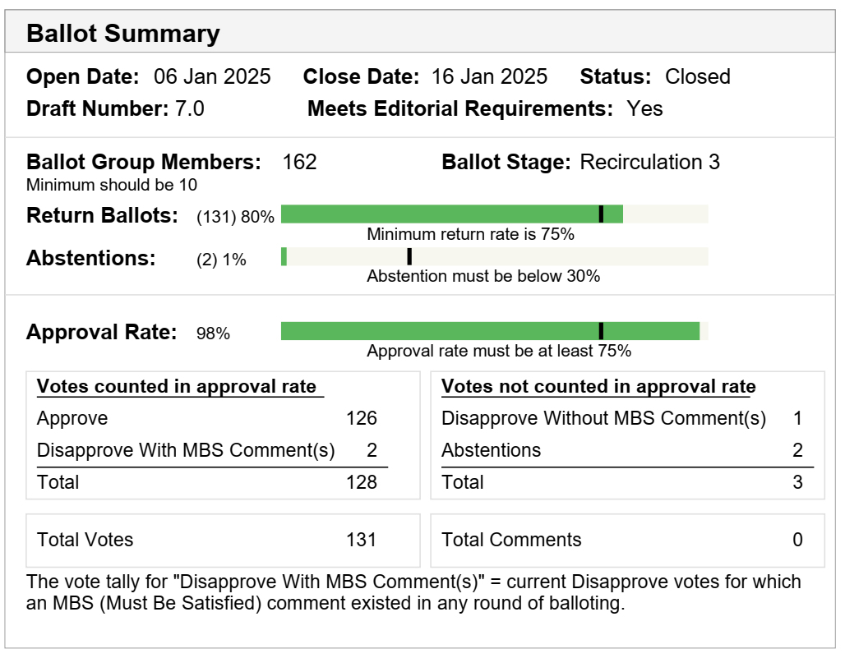
3rd SA Ballot Recirculation (D7.0)
Congratulations to all of us!!!

Slide 22
Conditions for submission to REVCOM
Conditions for submission to REVCOM (Checked)
  Recirculation ballot is completed.
  After resolution of the recirculation ballot is completed, the approval percentage is at least 75% and there are no new valid DISAPPROVE votes.
  No technical changes, as determined by the Working Group Chair, were made as a result of the recirculation ballot.
  No new valid DISAPPROVE comments on new issues that are not resolved to the satisfaction of the submitter from existing DISAPPROVE voters.

Slide 23
F2F meeting
  March Plenary 2025, Confirmed:
 | Monday | Tuesday | Wednesday | Thursday
AM 1
AM 2 | Opening | TGbf |  | TGbf
PM 1 |  |  | Mid week
PM 2
EVE
 | Atlanta | Beijing | Central Europe | Israel | Eastern | Pacific
AM1 | 08:00-10:00 | 21:00-23:00 | 14:00-16:00 | 15:00-17:00 | 09:00-11:00 | 06:00-08:00
AM2 | 10:30-12:30 | 23:30-01:30 | 16:30-18:30 | 17:30-19:30 | 11:30-13:30 | 08:30-10:30
PM1 | 13:30-15:30 | 02:30-04:30 | 19:30-21:30 | 20:30-22:30 | 14:30-16:30 | 11:30-13:30
PM2 | 16:00-18:00 | 05:00-07:00 | 22:00-24:00 | 23:00-01:00 | 17:00-19:00 | 14:00-16:00
EVE | 19:30-21:30 | 08:30-10:30 | 01:30-03:30 | 02:30-04:30 | 20:30-22:30 | 17:30-19:30

Slide 24
Teleconference Times (plan after March Plenary)
  To be Confirmed:
    No need
3 Nov 2024 - Daylight Saving Time Ends (US)
Sunday, 3 November 2024, 02:00:00 clocks are turned backward 1 hour to Sunday, 3 November 2024, 01:00:00 local standard time instead.
  ** Note:
  When conflict with CAC, the call may be changed.
  ()
  Thursday 23:00 - 01:00am ET (Thursday 20：00 – 22:00 PT, Friday 11am-13:00 in China, Friday 6am-8am in Israel, Friday 5am – 7am in Central Europe), and Sang Kim will help to take the minutes for these slots.

Slide 25
F2F meeting
  May Interim 2025, to be Confirmed:
    No need

Slide 26
Guidance for Mix mode meeting
  Host
  Chair (Tony) will host the meeting in-person
  One Vice chair will handle the audio/video, the other Vice chair will keep things in order, e.g., the queue
    Suggest to go to the meeting room to test all the things (e.g., audio, confirm the computer and connection to projector), before the first session, e.g., Sunday night.
  Secretary (Leif) could focus on the minutes
  Editor (Claudio) could focus on keeping track of CID
  Participant
  Join: All the “in person” member shall select “no audio” option on joining Webex, in order to avoid audio problems (feedback)
  Queue: All “Queue” should be requested online, in order to track the order easier
    “In person” member should request the “Queue” online, and then go to the microphone
  Vote: All Votes (SP/Motion) will be conducted on Webex
  Present: Presenter shall go to the platform, talk into microphone on the platform
    Option 1: Use his/her own computer, share the screen over Webex (but not directly connect to the projector)
    Option 2: Use the computer on the platform (Need to let Vice chairs know and download the slides before)
  Note: For more details, please refer to tutorial EC-22/118

Slide 27
Motions on
March 11 (Tuesday AM 2)

Slide 28
Motion: P802.11bf fourth recirculation SA ballot
Instruct the editor to prepare P802.11bf D8.0 incorporating any changes resulting from P802.11bk D5.0 and,
Approve a 10 day SA Recirculation Ballot asking the question “Should P802.11bf D8.0 be forwarded to RevCom?”
  Move: Claudio Da Silva Second: Sang Kim
  Preliminary Result: ( 10Y/ 0N/ 0A)
  Result*: Motion Passes (10Y, 0N, 0A)
  Note：
    * Amended result accounts for removal of 0 votes of non-voting members.
Notes:
Motion Passes (Y, N, A)
Could ask for Approved by unanimous consent ?

Slide 29
Motion: TGbf CSD Re-affirmation
  Re-affirm the P802.11bf CSD in
  https://mentor.ieee.org/802-ec/dcn/20/ec-20-0203-00-ACSD-p802-11bf.docx
  Move: Claudio Da Silva Second: Sang Kim
  Preliminary Result: ( 9 Y/ 0N/ 0A)
  Result*: Motion Passes (9Y, 0N, 0A)
  Note：
    * Amended result accounts for removal of 0 votes of non-voting members.
Notes:
Motion Passes (Y, N, A)
Could ask for Approved by unanimous consent ?

Slide 30
Motion: P802.11bf Conditional Forward to REVcom
Approve document 11-25-0303r0 as the report to the IEEE 802 LMSC on the requirements for conditional approval to forward P802.11bf D8.0 to RevCom, and
Request the IEEE 802 LMSC to conditionally approve forwarding P802.11bf D8.0 to RevCom.
  Move: Claudio Da Silva Second: Stephen McCann
  Preliminary Result: (10Y/ 0N/ 0 A)
  Result*: Motion Passes (10Y, 0N, 0A)
  Note：
    * Amended result accounts for removal of 0 votes of non-voting members.
Notes:
Motion Passes (Y, N, A)
Could ask for Approved by unanimous consent ?

Slide 31
Backup

Slide 32
Motion
  Move to approve resolutions to the following CIDs listed in the following document and incorporate the text changes into the latest TGbf draft:
  CIDs:
  as specified in doc.:
  Move: Second:
  Result:
  Note：
    Related document
    SP Result: Unanimous consent

Slide 33
SP Motion xx
  SP (PDT):
  Do you support including the text proposed in the following document into the IEEE 802.11bf draft amendment?
  DCN + title
  Motion (PDT):
  Move to include the text proposed in the following document into the IEEE 802.11bf draft amendment:
  DCN + title
  SP (CR):
  Do you agree to resolve the following CIDs listed in the following document and incorporate the text changes into the latest TGbf draft?
  CID, in DCN + title
  Motion (CR):
  Move to approve resolutions to the following CIDs listed in the following document and incorporate the text changes into the latest TGbf draft:
  CID, in DCN + title

