Slide 1
802.11 WG March 2025 Session Report
Date: 2025-03-15
Authors:

Slide 2
Abstract
This document is a digest of the closing reports of all 802.11 sub-groups for presentation at the March 2025 closing plenary meeting. Liaison reports (including liaison reports from the opening plenary) are also included.

Slide 4
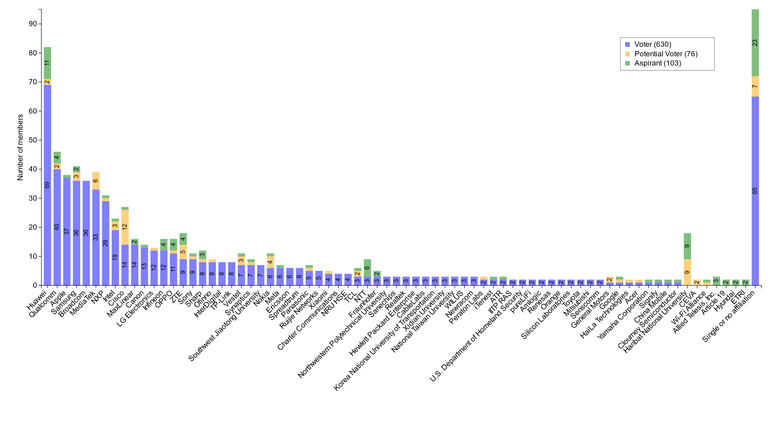
Members by affiliation

Slide 5
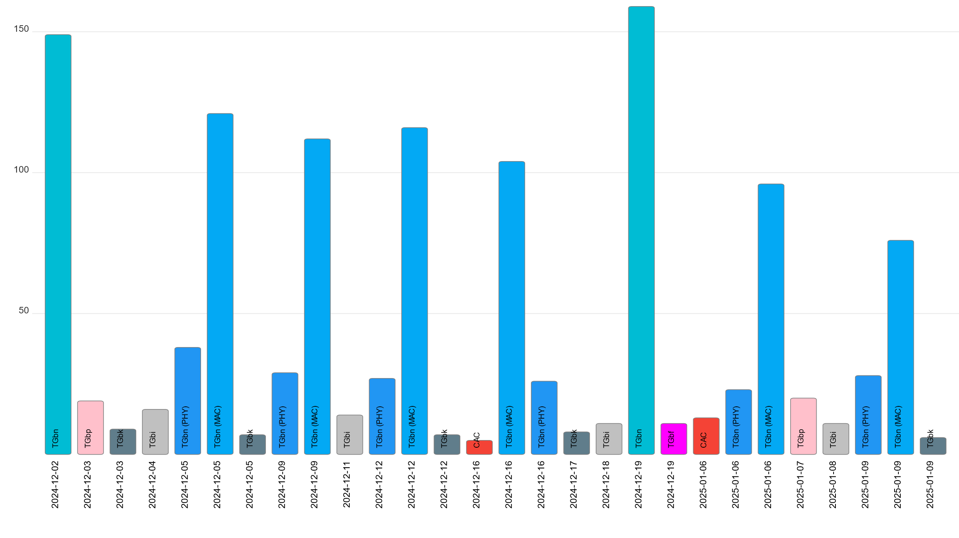
Telecon attendance (January to March)

Slide 6
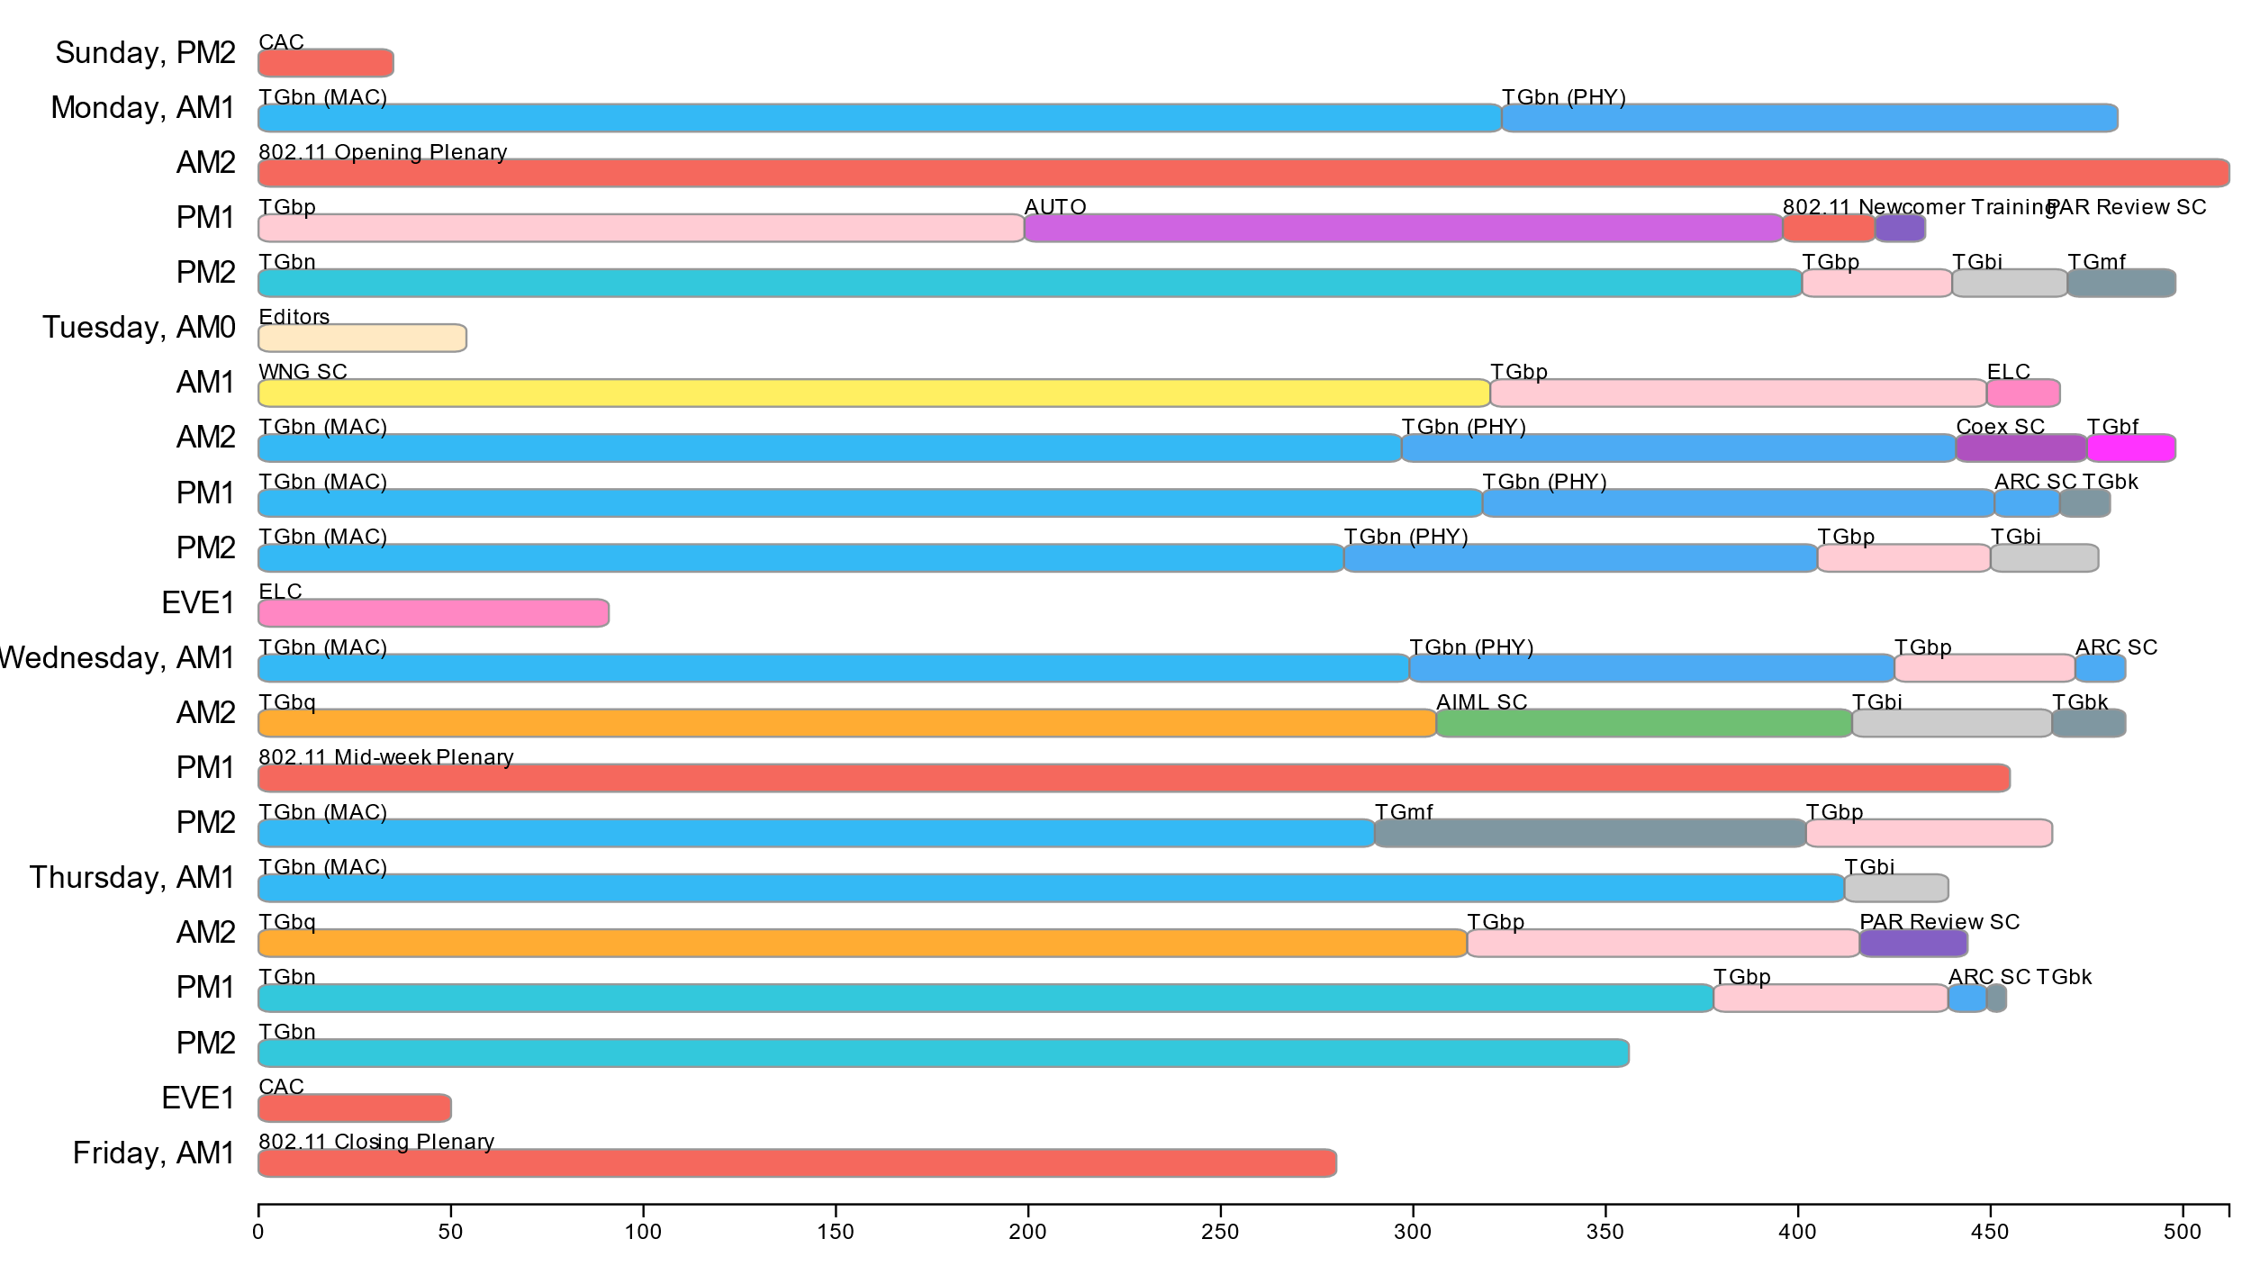
Attendance by breakout (March plenary session)

Slide 7
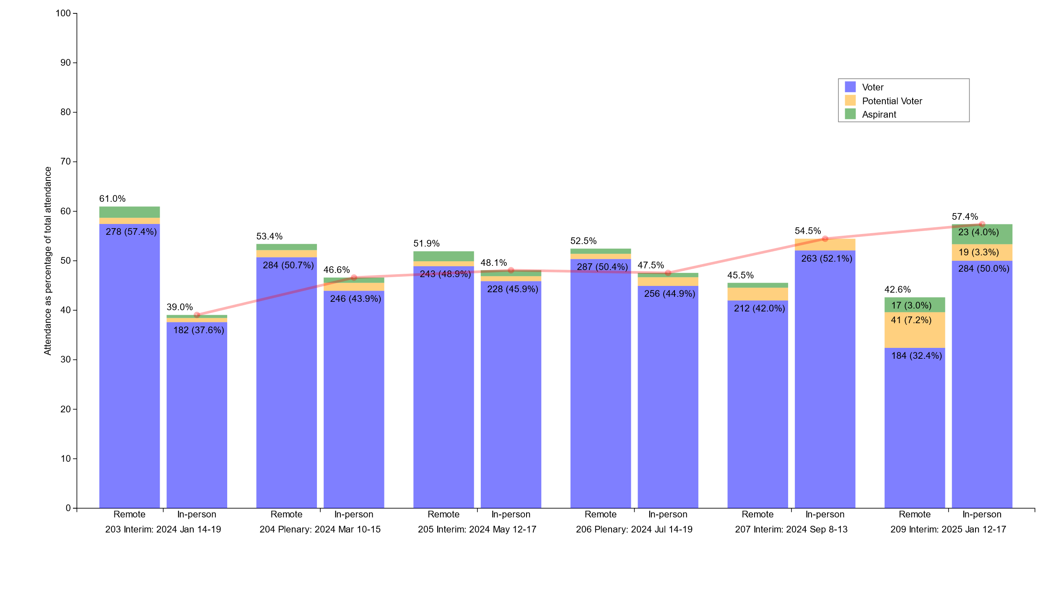
Percentage of attendees: In-person vs Remote

Slide 8
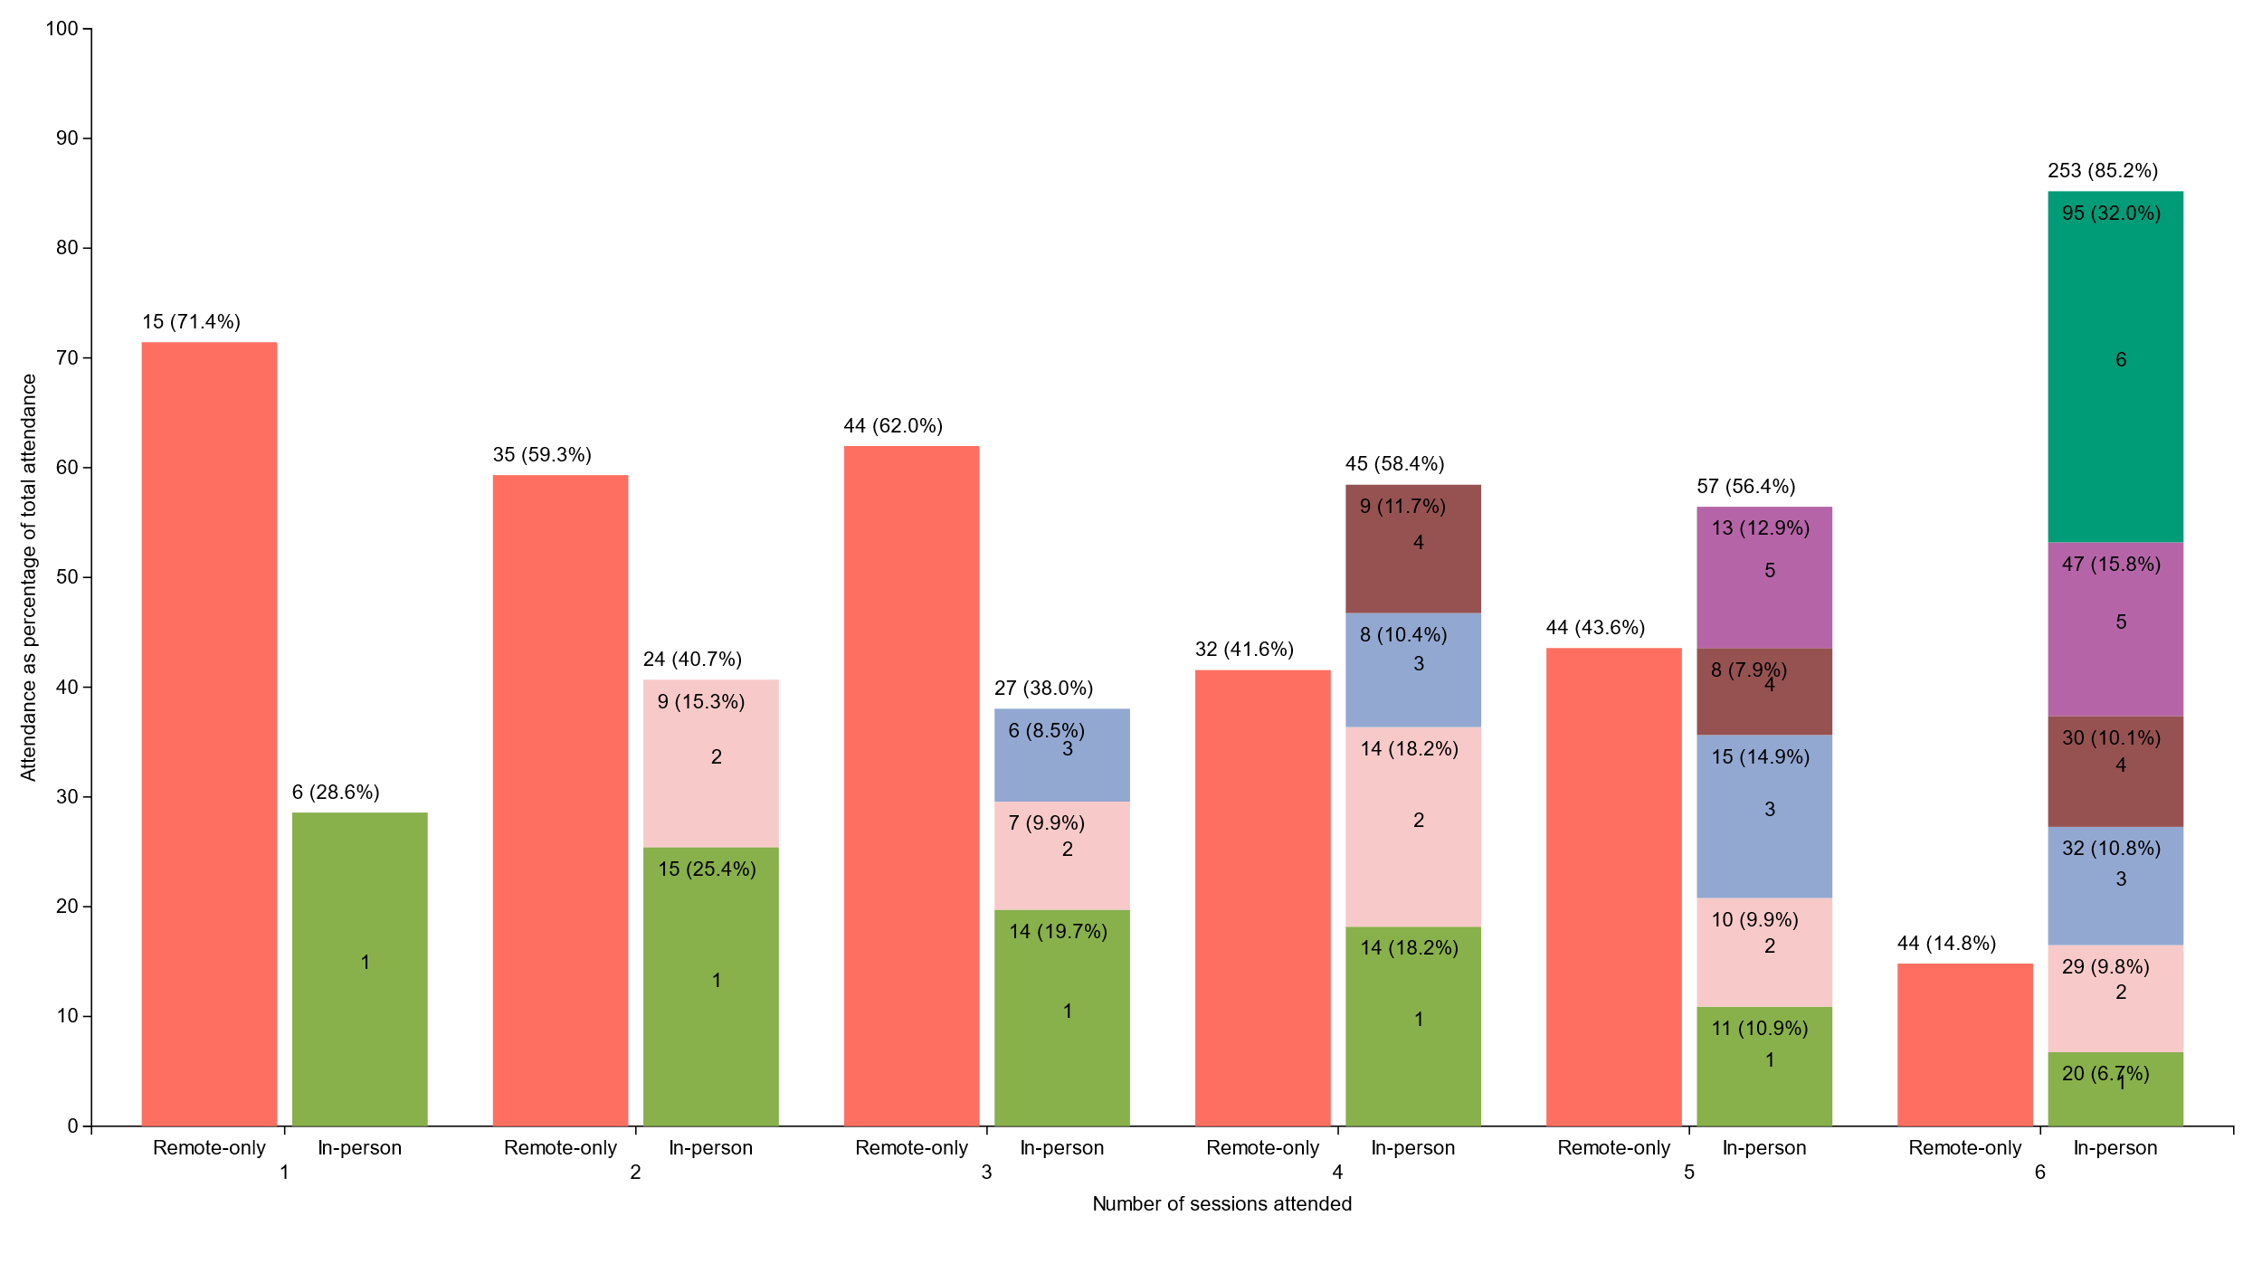
In-person vs Remote by number of sessions attended
(voting members only)

Slide 9
802.11 WG Editor’s Meeting (March 2025)
Date: 2025-03-13
Authors:

Slide 10
Volunteer Editor Contacts
  WG – Robert Stacey – robert.stacey@intel.com, Emily Qi – emily.h.qi@gmail.com
  TGbe – Edward Au – edward.ks.au@gmail.com
  TGbh – Carol Ansley – carol@ansley.com
  TGbk – Roy Want RoyWant@google.com
  TGbf – Claudio da Silva – claudiodasilva@meta.com
  TGbi – Po-kai Huang – po-kai.huang@intel.com
  TGbn- Ross Jian Yu ross.yujian@huawei.com
TGbq –
  REVme – Emily Qi – emily.h.qi@gmail.com, Edward Au – edward.ks.au@gmail.com
  REVmf - Po-kai Huang – po-kai.huang@intel.com, Edward Au – edward.ks.au@gmail.com

Slide 11
March meeting roundtable status report (to be updated)
REVme – D7.0, approved by IEEE SASB, will be published as IEEE Std 802.11™-2024
11bh – D6.0, approved by IEEE SASB, will be published as IEEE Std 802.11bh™-2024
11be – D7.0, approved by IEEE SASB, will be published as IEEE Std 802.11be™-2024
11bk 11bk completed the SA1 recirculation ballot based on D4.0, which resulted in 21 comments (8 Editorial, 13 Technical). The TGbk Task Group has been working to resolve these comments and expect to motion all resolutions during the Atlanta meeting, entering recirculation SA2 on D5.0 one week after the meeting.
11bf –SA recirc 2 closed; no comments received. Then waiting for 11bk to move forward. Expect recirc 3 with just baseline update to start at same time as 11bk.
11bi – D1.0 completed initial WG ballot. Approved. Received 1072 comments. Completed initial comment assignment and started resolving comments.
11bn – Completed CC on D0.1. Received 3970 comments. All assigned. Will release D0.2 out of March.
REVmf – Plan to have the initial draft 0.0 from published version. Then have D0.1 with 11bh and D0.2 with 11be. Implement approved changes to date in D1.0 coming out of May session (might be July).

Slide 12
Editor Amendment Ordering
See http://grouper.ieee.org/groups/802/11/Reports/802.11_Timelines.htm
Changes are usually based on MDR readiness.
As discussed in November 2024
Amendment Number | Task Group | Page Count | Projected RevCom Date (submission)
REVme | TGm | 6213 | September 2024 - Approved
802.11-2024 Amendment 1 | TGbh | 34 | September 2024 - Approved
802.11-2024 Amendment 2 | TGbe | 1089 | September 2024 – Approved
802.11-2024 Amendment 3 | TGbk | 111 | May 2025
802.11-2024 Amendment 4 | TGbf | 220 | May 2025
802.11-2024 Amendment 5 | TGbi | 144 | July 2026
802.11-2024 Amendment 6 | TGbn | 240 | May 2028
REVmf | TGm | 6000+ | Feb 2028

Slide 13
Draft Development Snapshot
Changes from last report shown in red.
March 2025
TG | Published or Draft Baseline Document |  |  |  |  |  |  |  | Source | MDR | Editor | Snapshot Date
 | Published | me | bh | be | bk | bf | bi | bn
me | Y | 7.0 |  |  |  |  |  |  | FrameMaker 2020 | Yes | Emily Qi, Edward Au | July 29, 2024
bh | Y | 7.0 | 6.0 |  |  |  |  |  | FrameMaker | Yes | Carol Ansley | July 16, 2024
be | Y | 7.0 | 6.0 | 7.0 |  |  |  |  | FrameMaker (old) | Yes | Edward Au | July 15, 2024
bk | Y | 7.0 | 6.0 | 7.0 | 5.0 |  |  |  | Word | No | Roy Want | March 10, 2025
bf | Y | 7.0 | 6.0 | 7.0 | 3.0 | 7.0 |  |  | FrameMaker 2020 | Yes | Claudio da Silva | January 14, 2025
bi | Y | 7.0 | 6.0 | 7.0 | 1.0 | 3.0 | 1.0 |  | FrameMaker 2020 |  | Po-kai Huang | March 10, 2025
bn | Y | 7.0 | 6.0 | 7.0 | 1.0 | 3.0 | 1.0 | 0.1 | FrameMaker 2020 |  | Ross Jian Yu | March 10, 2025
mf |  |  |  |  |  |  |  |  |  |  | Po-kai Huang, Edward Au

Slide 14
Publication Review Committees
REVme Review Committee
Emily Qi (lead): emily.h.qi@gmail.com
Edward Au: edward.ks.au@gmail.com
Mike Montemurro: montemurro.michael@gmail.com
Robert Stacey: robert.stacey@intel.com
Carol Ansley: carol@ansley.com
Po-kai Huang: po-kai.huang@intel.com
Mark Hamilton: mark.hamilton2152@gmail.com
Joseph Levy: joseph.levy@interdigital.com
11bh Review Committee
Carol Ansley (lead): carol@ansley.com
Mark Hamilton: mark.hamilton2152@gmail.com
Emily Qi: emily.h.qi@gmail.com
Robert Stacey: robert.stacey@intel.com
?
11be Review Committee
Edward Au (lead); edward.ks.au@gmail.com
Alfred Asterjadhi: aasterja@qti.qualcomm.com
Emily Qi: emily.h.qi@gmail.com
Robert Stacey: robert.stacey@intel.com
Carol Ansley: carol@ansley.com
?

Slide 15
802.11-2024 Revision Publication Review
3 Comments – addressed
Michelle will produce a redline pdf
Correct the searchable definitions (revert to draft)
Some of the tables in Clause 6 should not have titles – they are embedded in text with no title
Clause 28 has formatting issues

Slide 16
ANA managed number space
Protocol Version subfield: 9.2.4.1.2
Frame types and subtypes: 9.2.4.1.3, Tables 9-1 and 9-2
Element ID and Element ID extension: Table 9-128
Capability Information field: 9.4.1.4
Extended Capabilities: 9.4.2.25, Table 9-190
Reason codes: 9.4.1.7, Table 9-77
Status codes: 9.4.1.9, Table 9-78
Action frame categories: 9.4.1.11, Table 9-79
Authentication algorithm: 9.4.1.1
RSNE: 9.4.2.23
Cypher suites: Table 9-186
AKM suites: Table 9-188
RSN Capabilities: Figure 9-345
RSNXE Capabilities: 9.4.2.240, Table 9-365
ANQP-element (Info ID): 9.4.5.1, Table 9-412
Neighbor Report subelements: 9.4.2.35, Table 9-210
FTE subelements: 9.4.2.46, Table 9-219
Public Action frames: 9.6.7.1, Table 9-450
WMN-Notification Types: 9.6.13.29, Table 9-516
Mesh Configuration Active Path: 9.4.2.96.2, Table 9-277
TLV encodings: 9.4.4
KDE Selector Data Type: 12.7.2
Operating classes: Annex E
global, USA, Europe, Japan
MIB objects: Annex C
ieee802dot11, dot11smt, dot11phy, dot11mac, dot11StationConfigEntry, dot11OperationEntry, dot11Compliances, dot11Groups

Slide 17
March 2025 AIML SC Closing Report
Date: 2025-03-12
Authors:

Slide 18
Work Completed
  1 Meeting Slot
    Wednesday AM 2
    Agenda: 11-25/188r0
    SP and Motion Booklet: 11-24/765r4
  Achievements
    Two technical presentations
    Approved minutes of AIML SC for January 2025 Interim: 11-25/224r0

Slide 19
Plans for May 2025
No teleconference planned
Technical presentations
  Additional results, exploration and feasibility for existing use cases
  Additional AIML use cases
  Technical report drafts

Slide 20
ARC Closing Report
Date: 2025-03-13
Authors:

Slide 21
Annex G update/replacement
Continued discssion on the proposal for Annex G replacement: 11-23/0880r7, 11-25/0193r4, 11-25/0488r0
This is uncovering mis-alignment among experts on key concepts:
  “Frame exchange sequence” (and its relationship to/meaning for other behaviors like power save/doze, off-channel scanning, etc.)
  Relation of frame exchange sequence to medium protection (NAV, etc.)
  The definition and extent of an occurrence of Wireless Medium
  Relation of wireless medium to beamforming, sectorization, MU operation, etc.
Straw Polls didn’t help (much controversy on the questions)
Especially tricky as MLO, and now TGbn concepts are added/considered
Will continue discussion in May. Allocating 2 meeting slots worked well – will do that again, to try to sort out these terms and concepts.

Slide 22
Std 802 update impacts on 802.11
Reviewed 11-25/0150r4 discussion document
      Agreed direction, ready for specific text proposals:
        EPD and LPD terms are going away – we need to update 802.11 to align
        MAC address ordering discussion, and 802.11 assumptions
        https://mentor.ieee.org/802.1/dcn/24/1-24-0034-00-Mntg-proposal-to-revise-bit-ordering-material-in-p802revc-d2-0.docx
        Review 802.1AC mapping from ISS to 802.11 MAC SAP interface
        Any other changes to remove 802.2/LLC terms?
      Continue next session:
        802.11’s “Portal”, and mapping to/usage of IEEE Std 802 terminology
  Access Domains: “802 Access Domains”?
    Interconnection of Access Domains?
    In 802.11, Access Domain is BSS. Is that still the view, for 802.11be/MLD?
    Other 802s? 802.3 Multi-carrier fiber – 1 Access Domain, or many? We think it’s 1. But, there are multiple transmitters, in parallel.
  What if we make the DS a bridge (small ‘b’)?
Consider adding something about VLANs (just informational?) into 802.11? Relationship (if we talk about it) to security domains (e.g. Authenticator relationship)? VLAN-aware STAs? What about GLK/non-GLK STAs? (cf 11-08/0114r0)

Slide 23
Other topics
IEEE Std 802 revision (no change since Jan):
  Received a report on the P802REV activities
    Approvals are completed. Going through publication editing.
WBA L4S (no change since Jan):
  No discussion this session.
  Per request from proponents, ARC is deferring for discussion in TGbn and perhaps REVmf. ARC will step in with any support needed by those groups.
Still pending:
  MLME-RESET, versus MLME-JOIN, MLME-START, MLME-SCAN and MLME-END
Agenda is here: 11-25/0222r5

Slide 24
Plans
Next session/teleconference topics:
Continue EPD/LPD clean-up, other Std 802 alignment
Continue Annex G replacement
MLME clean-up
Teleconferences – None planned (may schedule with 10 days’ notice, depending on progress on reflector discussion on Annex G)
Three meeting slots requested for May

Slide 25
Coex SC Closing Report
Date: 2025-03-12
Authors:

Slide 26
Coex SC’s week at a glance
Coex SC met once this week
Technical discussion topics
Bluetooth SIG Update
ETSI BRAN Update
802.15.4ab NB Status Update
802.15.4ab CAD

Slide 27
Update from Bluetooth SIG Work
  Work on technical proposal for ETSI BRAN:
  Continued input to EN 303 687
    Proposed final parameters for LBT for clause 4
    Ongoing: work on testing procedures for clause 5
    Internal discussion on non-CBT-based channel access scheme
  Review of Canada ISED’s upper 6GHz consultation
  Further information on both work items to be reported in a subsequent status update

Slide 28
ETSI BRAN Update to 802.11 (1/3)
EN 303 687 (Wireless Access System/Radio Local Area Network (WAS/RLAN) in the license-exempt 6 GHz band)
EN 303 687 only active work item
Coexistence between Narrowband Frequency Hopping (NB FH) and wideband transmissions discussed focusing on Energy Detection Threshold levels, NB FH operation w/o Listen-before-Talk, and NB FH channelization
Discussion of Client-to-Client communication (C2C) at Low Power Indoor (LPI) levels

Slide 29
ETSI BRAN Update to 802.11 (2/3)
EN 303 687 (Wireless Access System/Radio Local Area Network (WAS/RLAN) in the license-exempt 6 GHz band)
Discussion of change in terminology:
  Version 1.1.1 defines: Load Based Equipment (LBE) and Frame Based Equipment (FBE).In addition, the HS defines a device category denoted as Narrowband Frequency Hopping Equipment (NBE)
  Potential new terminology: Channel access mechanisms to be called Frame Based channel Access (FBA), Load Based channel Access (LBA), and NarrowBand frequency hopping channel Access with Listen Before Talk (NBA-LBT). Term “equipment” to be limited to referring to physical instances that implement LBA, FBA, or NBA-LBT

Slide 30
ETST BRAN Update to 802.11 (3/3)
Official Journal of the EU (OJEU)
Update of OJEU related to Radio Equipment Directive (RED)
  Published 2025-01-30
  No updates relating to HS developed by TC BRAN
Next update might come as of March/April 2025
  It might be that version 1.1.1 of HS EN 303 687 will be listed in the OJEU, then

Slide 31
Technical Discussions
  802.15.4ab NB Status Update
  Review of 11-25/0349
    Recirculation of Draft 2.0 of 802.15.4ab ongoing
    All NB channel access comments rejected due to “lack of consensus”.
    Additional discussion in May anticipated to discuss main concern, i.e., lack of a mandatory mechanism.
  802.15.4ab CAD
    Discussion: some work discussed in .11 Coex and joint Coex/802.15.ab not referenced
    .19 ballot is open. Closes 2025-03-25

Slide 32
Plans for May
Two dot11 Coex slots
Tuesday PM1
Wednesday PM2
One joint session with 802.15.4ab Tuesday PM3/EVE
Topics:
Update on ETSI BRAN
Update on Bluetooth SIG
Technical submissions (tba)
Note: coexistence-related topics are welcome. Please contact the Chair

Slide 33
Telcos
No telco scheduled.
May be announced with 10-day notice. Member feeling the need for telco and have submissions ready for discussion are asked to approach the Chair.

Slide 34
References for this week
Agenda for this week: 11-24/0208
Snapshot Slide: 11-24/0209
Meeting / Chair’s Slide Deck: 11-24/0210
Closing report: 11-24/0211
Meeting minutes: 11-25/0473

Slide 35
PAR Review SC
Jon Rosdahl, Chair
3 PARs and CSDs were considered on 10 March 2025 13:30-15:30
See the list here: https://ieee802.org/PARs.shtml
  Comments were posted to the EC reflector doc:
Feedback from WGs was due Tuesday 11 March 2025
Feedback was reviewed on Thursday 13 March 2025 10:30-12:30 PDT
A Final report was sent out prior to the Closing 802 LMSC Plenary Meeting.
Notes:
Monday 13:30-15:30 a
Feedback to be reviewed on Thursday, 10:30-12:30

Slide 36
WNG SC Closing Report
Date: 2025-03-14
Authors:

Slide 37
Summary
Final Agenda
  https://mentor.ieee.org/802.11/dcn/25/11-25-0212-01-0wng-agenda-for-wng-sc-2025-march.pptx
Presentations at March 2025 meeting
  “Intrinsic vulnerabilities of the MIMO channel sounding procedure”, Francesca Meneghello (University of Padova)
    https://mentor.ieee.org/802.11/dcn/25/11-25-0460-01-0wng-intrinsic-vulnerabilities-of-the-mimo-channel-sounding-procedure.pptx
  “Post-Quantum 802.11”, Dan Harkins (HPE)
    https://mentor.ieee.org/802.11/dcn/24/11-24-1103-01-0wng-post-quantum-802-11.pptx
  “Post-Quantum Opportunistic Wireless Encryption (OWE)”, Alex Lungu (Samsung)
    https://mentor.ieee.org/802.11/dcn/25/11-25-0218-02-0wng-post-quantum-opportunistic-wireless-encryption-owe.pptx
  “802.11 Support of VLANs”, Donald Eastlake (Independent)
    https://mentor.ieee.org/802.11/dcn/25/11-25-0420-02-0wng-802-11-vlan-support.pptx
Minutes
  https://mentor.ieee.org/802.11/dcn/25/11-25-0463-00-0wng-wng-meeting-minutes-2025-march-atlanta-meeting.docx
Plans for May
  TBD: call for presentations will be sent out in April
No motions in the SG, two straw polls
  Support for ML-KEM for PQC: Y:66 / N:7 / A:8
  Support for VLAN TIG: Y:28 / N:10 / A:85

Slide 38
IEEE 802 JTC1 Standing Committee
March 2025 (mixed-mode) closing report
Date: 2025-03-14
Author:

Slide 39
The IEEE 802 JTC1 SC reviewed the PSDO process status, including IPR issues holding up 802.11
Agenda - ec-25/0017r01; Minutes – ec-25/0070
WG | Completed | In-process | Stalled
802.1 | 54 | 12 | 0
802.3 | 32 | 8 | 0
802.11 | 13 | 0 | 14
802.15 | 4 | 7 | 0
802.16 | 0 | 0 | 0
802.19 | 0 | 1 | 0
802.21 | 3 | 0 | 0
802.22 | 4 | 0 | 0
All | 110 | 28 | 14
802.11 IPR issue
Situation: IPR holding up adoption of some standards under the PSDO agreement
However, we will begin submitting standards with negative LoAs under IEEE policy to see if different LoAs are submitted under ISO’s policy
Next steps:
  Send a letter to IEEE SA President expressing the impacts of ISO/IEC IPR impasse
  Observe how IEEE 802.3 fares in the on-going ITU-T SG15 process

Slide 40
The IEEE 802 JTC1 SC will undertake its usual work at its mixed-mode meeting in Warsaw in May ’25
IEEE 802 JTC1 SC plans for May 2025 …
  Execute PSDO process, to the extent possible
    There are no current ballots open, but the following could go into ballot: IEEE 802.1DC (FDIS), IEEE 802.1ASdm (FDIS), IEEE 802.1ASdn (FDIS), IEEE 802.1Qdj (FDIS), IEEE 802.1Qdx (FDIS), IEEE 802.1Qdy (submitted for 60-day ballot), IEEE 802.3 (FDIS), IEEE 802.15.3 (FDIS), IEEE 802.15.7 (FDIS), and IEEE 802.15.4 (60-day ballot).
  Monitor ISO/IEC JTC 1/SC 6 activities
  Review response to IEEE 802 LMSC chair’s letter from IEEE SA President, if any

Slide 41
REVmf Closing Report – March 2025
Date: 2025-03-13
Authors:

Slide 42
Work Completed
Considered contributions on modifications REVme D7.0
  Accepted two documents with proposed changes
Discussed a contribution on PASN with MLO
Agenda doc: https://mentor.ieee.org/802.11/dcn/25/11-25-0219-03-000m-revmf-agenda-march-2025-session.pptx
Motion doc: https://mentor.ieee.org/802.11/dcn/25/11-25-0486-00-000m-revmf-closing-report-march-2025.pptx

Slide 43
Plans for May
Teleconferences scheduled
  Monday April 28 at 10am ET for 2h
May: 3 meetings
Objectives:
  Continue to discuss contributions on published REVme D7.0, P802.11bh D6.0, and P802.11be D7.0
  Approve the creation of REVmf D1.0 and the initial letter ballot.

Slide 44
TGmf Timeline
Nov 2024 – PAR Approval
Nov 2024 – Initial meeting, contributions on REVme D7.0
Jan - Mar 2025 – Contributions on REVme D7.0/IEEE 802.11-2024
Jan - Mar 2025 – Publication of 802.11-2024 and roll-in of TGbh and TGbe
May 2025 – Initial D1.0 WG Letter ballot
May-Nov 2025 – Roll-in TGbf and TGbk
Jan 2026 – D2.0 Recirculation LB
Jul 2026 – D3.0 Recirculation
Jan 2027 – D4.0 Initial SA Ballot – Roll-in TGbi
Jul 2027 – D5.0 Recirculation SA Ballot
Nov 2027 – D6.0 Recirculation SA Ballot
Jan 2028 – D6.0 Recirculation SA Ballot (clean recirculation)
Feb 2028 – RevCom/SASB Approval

Slide 45
Task Group BF
March 2025 Closing Report
Date: 2025-03-13
Authors:
Name | Affiliation | Address | Phone | Email
Tony Xiao Han | Huawei Technologies Co., Ltd. | F3, Huawei Base, Shenzhen, China |  | Tony.hanxiao@huawei.com

Slide 46
TGbf (WLAN Sensing)– March 2025
Progress during March 2025 session
  1 slots scheduled for TGbf
  P802.11bf report to 802 LMSC on Conditional approval to forward draft to RevCom
  Passed TG motions
    Motion: P802.11bf fourth recirculation SA ballot
    Motion: TGbf CSD Re-affirmation
    Motion: P802.11bf Conditional Forward to REVcom
  Passed WG motions
    Motion: TGbf CSD Re-affirmation
    Motion: P802.11bf Conditional Forward to REVcom
Goals for the next two months
  Release IEEE802.11bf D8.0
  Complete the 4th SA Ballot Recirculation (D8.0)

Slide 47
TGbf Timeline
  PAR approved Sep 2020
  First TG meeting Oct 2020
  Comment Collection (D0.1) Jan 2022→Mar 2022 → April 2022
  Initial Letter Ballot (D1.0) Jul 2022→ Sep 2022→ Nov 2022→ Jan 2023
  Recirculation LB (D2.0) Jan 2023 → Mar 2023 → July 2023
  Recirculation LB (D3.0) May 2023 → Nov 2023
  Conditional EC Approval–SA Ballot Mar 2024
  Recirculation LB (D4.0) July 2023 à Jan 2024à Apr 2024
  SA Ballot pool formation Apr 2024
  Initial SA Ballot (D4.0) Sep 2023 à Mar 2024à May 2024
  1st SA Ballot Recirculation (D5.0) Sep 2024
  2nd SA Ballot Recirculation (D6.0) Jan 2025
  3rd SA Ballot Recirculation (D7.0) Mar 2025
  Final 802.11 WG approval July 2024à Jan 2025à Mar 2025
  802 EC approval July 2024à Jan 2025à Mar 2025
  RevCom and SASB approval Sep 2024à Mar 2025à Jun 2025
PAR modification approved by the WG Nov 2023
802EC approval Mar 2024
NesCom/SASB approval Mar 2024

Slide 48
TGbi Closing Report
Date: 2025-03-13
Authors:
Name | Affiliation | Address | Phone | Email
Carol Ansley | Cox Communications |  | +1 404 229 1672 | carol@ansley.com

Slide 49
IEEE 802.11 TGbi
TGbi met 4 times during this plenary session.
We began working through comment resolutions, motioning 88 comment resolutions, with additional comment resolutions reviewed but not yet motioned.
We will weekly teleconferences between now and the May interim meeting.
    Wednesday 10:00-12:00 EDT
    Dates: March 26, April 2, 9, 23, 30

Slide 50
Timeline - Unchanged
TG use case start: March 2021
Use case completion: February 2022
Features identified: September 2022
Comment collection: May 2024
LB initial: January 2025
LB re-circ: July 2025
MDR: July 2025
Ballot Pool: September 2025
SA ballot: January 2026
SA re-circ: March 2026
802.11/LMSC approval: May 2026
RevCom/SASB approval: July 2026

Slide 51
TGbk 320MHz Positioning
March Meeting Closing Report
Date: 2025-03-13
Authors:

Slide 52
March Meeting Progress and Targets Till the May Meeting
Work completed during this meeting:
  Reviewed, and resolved 21 CIDs completing response to 1st SA recirculation.
  Approved 2nd recirculation SA ballot.
  Approved report to EC requesting to forward P802.11bk to RevCom.
  Reaffirm CSD.
Work expected towards May meeting:
  Publish draft P802.11bk D5.0
  Receive EC approval for conditional forwarding to RevCom
  Complete response to 2nd SA recirculation of P802.11bk D5.0.
  Conduct comment resolution if needed.

Slide 53
Scheduled TGbk telecons
March 18th 10:00 am PT/13:00 ET (2hrs) – previously announced
April 8th 10:00 am PT/13:00 ET (2hrs)
April 15 10:00 am PT/13:00 ET (2hrs)

Slide 54
TGbn March Closing Report
Date: 2025-03-13
Authors:

Slide 55
TGbn (Ultra High Reliability)
TGbn had scheduled 11 sessions during the March plenary
  Discussed technical submissions covering a variety of topics and proposed draft texts (PDTs)
  Approved over 80 motions that added additional concepts to the TGbn SFD, and spec text to the latest TGbn draft
  Instructed the TGbn Editor to create TGbn D0.2
  Approved a TGbn MAC/PHY ad-hoc (mixed mode) meeting in Europe (location TBD) between 23-25 July 2025
Agenda is available in 11-25/0221r10,
Motions are available in 11-24/0014r13.
Goals for May 2025:
  Resolve comments from CC50
  Complete inclusion of PDTs to TGbn draft
  Target approving delivery of TGbn D1.0

Slide 56
Teleconference Plan
March 17-21 (Monday-Friday) Holiday
March 24 (Monday) – MAC/PHY 19:00-21:00 ET
March 27 (Thursday) – MAC/PHY 10:00-12:00 ET
March 31 (Monday) – MAC/PHY 19:00-21:00 ET
April 03 (Thursday) – MAC/PHY 10:00-12:00 ET
April 07 (Monday) – MAC/PHY 19:00-21:00 ET
April 10 (Thursday) – MAC/PHY 10:00-12:00 ET
April 14 (Monday) – MAC/PHY 19:00-21:00 ET
April 17 (Thursday) – MAC/PHY 10:00-12:00 ET
April 21 (Monday) – MAC/PHY 19:00-21:00 ET
April 24 (Thursday) – MAC/PHY 10:00-12:00 ET
April 28 (Monday) – MAC/PHY 19:00-21:00 ET
May 01 (Thursday) – Joint* 10:00-12:00 ET
May 05-09 (Monday-Friday) Holiday
* TGbn joint session during which there can be motions, subject to WG chair approval and with 10-day advanced notice.

Slide 57
TGbn Timeline And Status
  PAR approved July 2023
  First TG meeting Nov 2023
  D0.1 Jan 2025
  D1.0 Letter Ballot May 2025
  D2.0 LB May 2026
  D3.0 LB Jan 2027
  Initial SA ballot (D4.0) May 2027
  Final 802.11 WG approval Mar 2028
  802 EC approval Mar 2028
  RevCom and SASB approval May 2028

Slide 58
IEEE 802.11 Mar 2025 Plenary
TGbp Closing Report
Chair: Bo Sun (Sanechips)
Elected Vice Chairs: Steve Shellhammer (Qualcomm)
Rakesh Taori (Infineon)
Secretary : Sebastian Max (Ericsson)
Tech Editor: Yinan Qi (OPPO)

Slide 59
TGbp’s Progress during this week
8 TGbp meetings were planned and held during the March plenary session, with the agenda included in the latest revision of 11-24/0228r7.
TGbp approved the updated SFD documents incorporating approved motions from Jan 2025.
Totally 35 tech contributions were presented and discussed, onPHY/MAC solutions, Wireless Power Transmission and security.
Lots of technical Motions for SFD were approved as captured in last revision of 11-24/0228r7.
  Consensus on waveform, coding/modulation, PPDU design, security, channel access, WPT design, etc.
The 11bp timeline was updated with the D0.1 milestone postponed to Jul 2025.
4 teleconferences are planned for after the March plenary session.
Goal of future TGbp work:
  Continue developing FRD and SFD based on consensus
  PDT development based on approved SFD
  Open technical discussion and prepare for PDT development

Slide 60
TGbp Timeline Plan (updated)
  PAR approved Mar 2024
  First TG meeting May 2024
  D0.1 (ready for CC) Mar → Jul, 2025
  D1.0 Letter Ballot Feb, 2026
  D2.0 LB recirculation Nov, 2026
  Form SA Ballot Pool Mar 1 to Mar 31, 2027
  Initial SA Ballot (D4.0) Aug, 2027
  Final 802.11 WG approval Jan 2028
  802 EC approval Mar 2028
  RevCom and SASB approval May 2028

Slide 61
TGbp Teleconference Plan
  Mar 25th (Tuesday), 10:00am, ET, 2 hours; Webex
  Apr 8th (Tuesday), 10:00am, ET, 2 hours; Webex
  Apr 22nd (Tuesday), 10:00am, ET, 2 hours; Webex
  May 6th (Tuesday), 10:00am, ET, 2 hours; Webex

Slide 62
Task Group BQ March 2025 Closing Report
Date: 2025-03-13
Author:

Slide 63
Work Completed
Completed the Editor appointment and Vice Chair elections
Discussed the proposed task group timeline
Discussed the proposed selection procedure for draft development
Reviewed technical contributions

Slide 64
Plans for May 2025 wireless interim
Teleconferences scheduled for technical contributions
  Tuesday, 1 April, 9:30am ET to 11:00am ET
  Tuesday, 8 April, 9:30am ET to 11:00am ET
  Tuesday, 15 April, 9:30am ET to 11:00am ET
  Tuesday, 22 April, 9:30am ET to 11:00am ET
Objectives in May interim
  Confirm the task group timeline
  Confirm the selection procedure for draft development
  Review and discuss technical contributions

Slide 65
Enhanced Light Communications Study Group (ELC)
March 2025 Closing Report
Date: 2025-3-12
Authors:

Slide 66
ELC activities at the March 2025 meeting
  Content
  ELC SG addressed comments on the ELC PAR and CSD received from 802.1, 802.3 and NesCom
  The modified PAR (doc. 11-25/0185r1) and CSD (doc. 11-24/1600r5) were also reapproved
  Meeting agenda and motions are available in doc. 11-25/0347r2.
  Minutes of the meeting are available in doc. 11-25/0461.

Slide 67
ELC SG moving forward
Mar. 2025
  802 LMSC approval of the PAR and acceptance of the CSD
  Submit to NesCom
May 2025
  TG start

Slide 68
Automotive TIG Closing Report
Date: 2025-03-14
Authors:

Slide 69
Summary
Final Agenda
  https://mentor.ieee.org/802.11/dcn/25/11-25-0213-00-auto-agenda-for-automotive-tig-2025-march.pptx
Presentation of submissions
  “IEEE 802.11ai and IEEE 802.11bc for Automotive Use”, Hitoshi Morioka (SRC Software)
    https://mentor.ieee.org/802.11/dcn/25/11-25-0226-00-auto-ieee-802-11ai-and-ieee-802-11bc-for-automotive-use.pptx
  “Hybrid MLD for Automotive”, Federico Lovison (Cisco)
    https://mentor.ieee.org/802.11/dcn/25/11-25-0308-00-auto-hybrid-mld-for-automotive.pptx
  “Automotive-TIG-Thoughts on PHY improvements”, Azin Neishaboori (General Motors)
    https://mentor.ieee.org/802.11/dcn/25/11-25-0293-00-auto-automotive-tig-thoughts-on-phy-improvements.potx
  “Proposed IEEE802.11 Automotive TIG Technical Report Text on Regional HD Map Updates use case,” Jing Ma (Toyota)
    https://mentor.ieee.org/802.11/dcn/25/11-25-0323-00-auto-proposed-ieee802-11-automotive-tig-technical-report-text-on-regional-hd-map-updates-use-case.doc
Minutes
  25/0489r0
Plans for May
  Presentations on use cases, requirements and KPIs
No motions or teleconferences

Slide 70
802.15 Liaison Report – March 2025
March 2025
Date: 2025-03-13
Authors:

Slide 71
Agenda & Opening Report
March 2025
Agenda:
https://mentor.ieee.org/802.15/dcn/25/15-25-0077-04-0000-march-2025-802-15-agenda.xlsx
WG opening report:
https://mentor.ieee.org/802.15/dcn/25/15-25-0078-04-0000-march-2025-802-15-opening-report.pptx

Slide 72
Subgroup Closing Reports
March 2025
Title | URL
TG15.6ma Closing Report for March 2025 | https://mentor.ieee.org/802.15/dcn/25/15-25-0151-01-006a-tg15-6ma-closing-report-for-march-2025.pptx
SCM Agenda, Opening and Closing Report March 2025 | https://mentor.ieee.org/802.15/dcn/25/15-25-0120-01-0mag-scm-agenda-opening-and-closing-report-march-2025.pptx
TG4ab Closing Report | https://mentor.ieee.org/802.15/dcn/25/15-25-0165-00-04ab-tg4ab-closing-report.pptx
TG4ac March Opening and Closing Report | https://mentor.ieee.org/802.15/dcn/25/15-25-0118-02-04ac-march-opening-and-closing.pptx
IEEE 802.15 IG NG-OWC Closing Report (March 2025) | https://mentor.ieee.org/802.15/dcn/25/15-25-0164-00-07ma-ieee-802-15-ig-ng-owc-closing-report-march-2025.pptx
TG15.6ma Closing Report for March 2025 | https://mentor.ieee.org/802.15/dcn/25/15-25-0151-00-006a-tg15-6ma-closing-report-for-march-2025.pptx
IG agenda opening and closing report and Minutes | https://mentor.ieee.org/802.15/dcn/25/15-25-0141-00-acss-ig-agenda-opening-and-closing-report-and-minutes.pptx
SCM Agenda, Opening and Closing Report March 2025 | https://mentor.ieee.org/802.15/dcn/25/15-25-0120-00-0mag-scm-agenda-opening-and-closing-report-march-2025.pptx
TG4ad Agenda, Opening and Closing Report March 2025 | https://mentor.ieee.org/802.15/dcn/25/15-25-0116-01-04ad-tg4ad-agenda-opening-and-closing-report-march-2025.pptx

Slide 73
802.15 Overview
March 2025
Wireless Specialty Networks Active standards:
802.15.3 - no active projects but a bunch of really cool stuff
802.15.4 - many current projects (see next slide)
802.15.6a Body Area Networks: WG ballot recirculations
802.15.7a Higher Rate, Longer Range Optical, in publication
802.15.9a KMP Transport, extensions to key management: Working group ballot
802.16t Extension to 802.16 for specific bands: Submitted to REVCOM (pending)
Interest Group Access: Several technical concepts to be developed into potential new projects
SC THz: discussing future THz communications with Terabit/second data rates

Slide 74
802.15.4 Projects
March 2025
802.15.4ab Next Generation UWB: First WG recirculation
802.15.4ac Enhanced Privacy: Initial WG ballot
802.15.4ad Next Generation SUN PHYs: Pre-draft, technical contributions and proposals
802.15.4ae ASCON light weight encryption extension for 802.15.4: draft in progress

Slide 75
802.15.4ab Next generation UWB: Amendment to IEEE Std 802.15.4-2024 (rev E)
March 2025
Recirculation ballot in progress
Closing report: https://mentor.ieee.org/802.15/dcn/25/15-25-0165-00-04ab-tg4ab-closing-report.pptx
 | Current Schedule
First recirculation | March 2025
Recirculation comment resolution | March-May 2025
Second recirculation | May 2025
Recirculation comment resolution | June-July 2025
First SA-Ballot | After July 2025…
SA-Ballot comment resolution | After that

Slide 76
802.15.4ac Enhanced Privacy
March 2025
This amendment specifies modifications to the IEEE Std 802.15.4 medium access control (MAC) specification to specify mechanisms that address and improve user privacy. These mechanisms include randomized addresses, and exchanges that support session continuity. This amendment maintains backward compatibility with the base standard.
State: WG Recirculation
Opening and closing report: https://mentor.ieee.org/802.15/dcn/25/15-25-0118-02-04ac-march-opening-and-closing.pptx

Slide 77
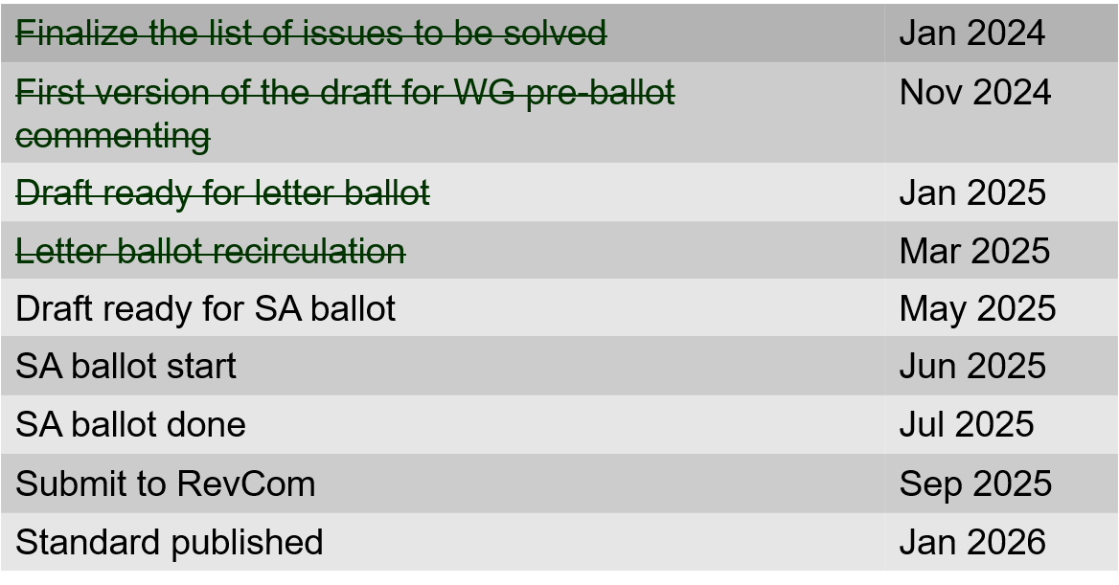
802.15.4ac Enhanced Privacy Timeline
March 2025

Slide 78
802.15.4ad Next Generation SUN PHYs
March 2025
Developing enhancements to the 802.15.4 SUN PHYs (FSK, OFDM)
State: pre-draft development
Meeting goals:
  Considering technical contributions
Objectives completed
Closing report: https://mentor.ieee.org/802.15/dcn/25/15-25-0116-01-04ad-tg4ad-agenda-opening-and-closing-report-march-2025.pptx

Slide 79
802.15.4ad Timeline
March 2025
2024
November: Approve Technical Guidance Document
Issue call for proposals (next week)
2025
January: Hear initial proposals
March: Hear updated proposals
March to May – 2 conference calls
  simulation results of remaining proposals not yet provided
  Prepare table of proposals for analysing against technical guidance document
May: Hear final proposals
July and beyond: Merging and start drafting the standard

Slide 80
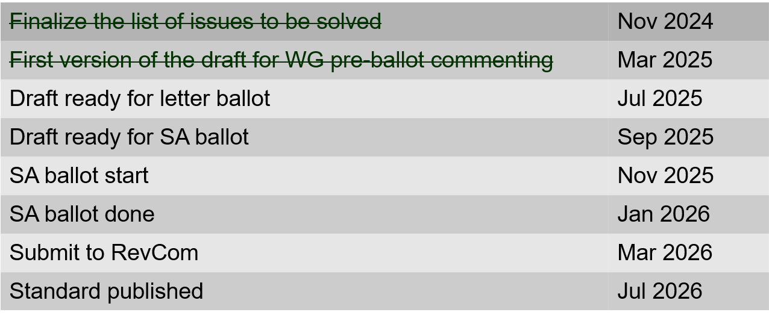
802.15.4ae (ASCON)
ASCON light weight encryption extension for 802.15.4
March 2025
Meeting achievements
Reviewed comments NIST received
Created draft ready for letter ballot
Created test vectors
Start pre-letter ballot comment collection after this session
Closing report: https://mentor.ieee.org/802.15/dcn/25/15-25-0119-01-04ae-march-opening-and-closing.pptx

Slide 81
802.15.6ma
March 2025
Draft in WG ballot
Session objectives: Preparation for 2nd Recirculation
Closing report: https://mentor.ieee.org/802.15/dcn/25/15-25-0151-01-006a-tg15-6ma-closing-report-for-march-2025.pptx

Slide 82
March 2025
TG 6ma Timeline(expected)
Tech Req Doc July 2022
Presentation of proposals
May 2023
Comment Resolutionfor LB
Nov. 2024
Comment Resolutionfor LB2
Jan. 2025
EC approval to SA, SA submission
March 2025
SA recirculation
May 2025
WG PreBallot submission for Draft2.5 August 2024
SA recirculation if required
July 2025
Revcom Approve
Sept 2025
^{Draft V1,18 Com}
May. 2024
Recirculation (LB2)
Dec. 2024
RevcomSubmission
August 2025
Comment Resolution fo Draft v2.3 on WG for PreBallot July 2024
1st Letter Ballot(LB)
Sept. 2024
Conditional approval for Standard Association Ballot (SA)
February 2025
TRD,CMD
Call Proposals Sept 2022
Std. Draf V1.9 Proposals
Nov. 2023
Notes: SASB/RevCom scheduled for 2024 a guess

Slide 83
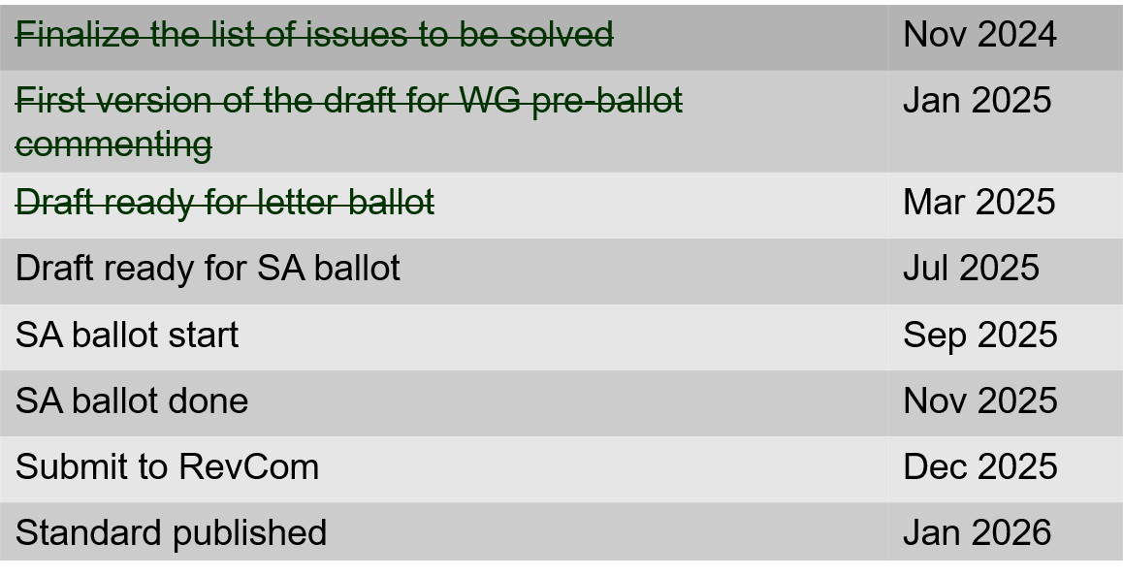
802.15.9a KMP Transport
March 2025
Extensions to key management: extending to support EDHOC
State: draft development
Session objectives
  Complete pre-ballot comment resolution
  Initiate WG ballot
Opening and closing report: https://mentor.ieee.org/802.15/dcn/25/15-25-0117-02-009a-march-opening-and-closing.pptx

Slide 84
IG Access
March 2025
Contributions on modified channel access building on suspendable CSMA-CA
Contribution on spectrum efficient group associate
Plan for May:
Move forward with possible MAC enhancement project (802.15.4)

Slide 85
Licensed Narrowband Amendment TG16t
March 2025
Pre-submitted for REVCOM
Pending LMSC approval (14-March)

Slide 86
802.18 Liaison Report – March 2025
Date: 10 March 2025
Author:
Name | Company | Address | Phone | Email
Edward Au | Huawei Technologies |  |  | edward.ks.au@gmail.com

Slide 87
RR-TAG at a glance
Membership as of 24 January 2025
  64 voters (including 10 on LMSC)
  3 nearly voters
  13 aspirants
Officers
  Chair: Edward Au (Huawei Technologies)
  Co-Vice Chair: Gaurav Patwardhan (Hewlett Packard Enterprise)
  Co-Vice Chair: Al Petrick (Jones-Petrick Associates)
  IEEE SA Program Manager: Jodi Haasz (IEEE SA)

Slide 88
Progress since the 2025 January wireless interim
Reviewed the latest ongoing consultations
Approved the following IEEE 802 LMSC submissions:
  France ARCEP: Draft decision repealing decision no. 2007-0683 of 24 July 2007 as amended and setting the conditions for use of radio frequencies for equipment operating using ultra-wideband technology
  UK Ofcom: Ofcom’s Plan of Work 2025/26
Approved the following liaison statements:
  Response to ITU-R Working Party 5C on technical and operational characteristics of their systems operating in the range 450 GHz to 1000 GHz
  Information to ITU-R Working Parties 5A and 5C on IEEE Std 802.15.3TM-2023
Discussed the latest topics related to spectrum and regulation in Europe, North America, and Asia Pacific.

Slide 89
Objectives this week (1)
Review and approve draft responses to the following consultations:
  UK Ofcom: Updating Wireless Telegraphy Licence Exemptions
  UAE TDRA: UAE Spectrum Outlook 2026 – 2031
  Australia ACMA: Draft Five-year spectrum outlook 2025-30
Discuss the latest topics related to spectrum and regulation in Europe, North America, and Asia Pacific, including

Slide 90
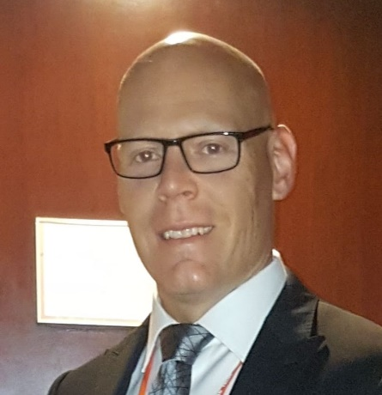
Objectives this week (2)
Invited presentation on Tuesday AM2
  Title: Canada Spectrum Outlook
  Author: Yan Losier (A/Director, Engineering, Planning and Standards Branch, Department of Innovation, Science and Economic Development Canada / Government of Canada)
  Document: 18-25/0007
Source: Yan Losier

Slide 91
802.19 WG January 2025 Liaison Report
Date: 2025-3-12
Authors:

Slide 92
IEEE 802.19 Overview
IEEE 802.19 group reviews coexistence assessment documents (CAD) produced by working groups developing new wireless standards for unlicensed devices.
IEEE 802.19 develops standards for coexistence between wireless standards of unlicensed devices.
Monday PM2 and Thursday PM3 (6:30 PM).
Position | Person
Working Group Chair | Tuncer Baykas (Self)
Working Group Vice Chair | Steve Shellhammer (Qualcomm)
Work Group Secretary | Yukimasa Nagai (Mitsubishi Electric)
Task Group 3a Chair | Ben Rolfe (Blind Creek Associates)
Liaison To/From 802.11 | Tuncer Baykas (Ofinno)

Slide 93
Coexistence Assessment Documents
Letterballot for IEEE P802.15.4ab Coexistence Assessment Document started.
If you are a voter of 802.19 WG, the link for the letterballot is
https://mentor.ieee.org/802.19/polls

Slide 94
FCC Consultation on Sub 1-GHZ Bands
On 6 August 2024, the US FCC Wireless Telecommunications Bureau and Office of Engineering and Technology begins a consultation that seeks public comments on NextNav's petition to reconfigure the 902-928 MHz band and adopt new rules to enable the deployment of a 5G terrestrial positioning, navigation, and timing (PNT) network that “complements and backs up” the U.S. Global Positioning System (GPS).
802.19 WG will provide information to 802.18 WG to be included in IEEE 802 LMSC’s response.

Slide 95
802.19.3a Task Group
Scope of the project: This amendment updates and expands coexistence recommendations to address new market requirements, increasing data traffic, greater device density of devices, and increased potential for congestion based on both IEEE Std 802.11-2020 and IEEE Std 802.15.4 sub-1 GHz standards.
This amendment includes recommendations with respect to new devices, as well as compatibility with deployed legacy devices
‘Follow up on measurement of radio noise over Sub-1 GHz band emitted from mini PC and laptop PC, and its impact on communication performance of IEEE 802.11ah’
Kazuto Yano (ATR) doc:IEEE 802.19-25-0012r0

Slide 96
802.24 Vertical Applications TAG
Liaison Report
March 2025 Plenary Session
Atlanta, GA, USA

Slide 97
802.24 Overview
802.24 Vertical Applications TAG
802.24.1 Smart Grid TG
802.24.2 IoT TG
Officers
  TAG Chair: Tim Godfrey
  Secretary & TAG Vice Chair: Ben Rolfe
Task Groups
  802.24.1 Smart Grid TG Tim Godfrey
  802.24.2 IoT TG Chris DiMinico
21 Voting Members
Meeting Plan. Tuesday and Wednesday, PM2 slot

Slide 98
AFV Communications - White Paper
Types of AFV sites: residential, commercial vehicle depot, public transport site, long haul freight transportation, and Public parking facilities
Communications requirements: data volume, resilience, reliability.
  Ancillary communication to vehicles (maps, firmware and software updates for vehicles, inventory tracking, logistics, media, etc)
Relate to the use of IEEE 802 technologies as the solution
Output document of combined outline:
  24-24-0027-01-0000-proposed-an-extended-outline-for-adding-use-cases-of-integrated-charging-infrastructure-with-distributed-energy-resources-building-and-grid-level-energy-management-systems-in-clause-3—1
AFV Teleconference - 23 April 2025 at 3pm PT 6pm ET, 7am Korea (April 24)

Slide 99
IoT White Paper Discussion
Discussions Notes
  Disambiguate the general poor state of available information on IoT, and highlight the IEEE 802 solutions that address them. (done)
  Need to distinguish “Internet” public vs private. OT network for highly secure, isolated networks. (Done)
  Embedded comments need text contributions
  How to incorporate wired IoT – specifically Single Pair Ethernet.
    Add section 5 for Connectivity Technologies (needs review from WG experts)
Actions from March 2025
  Smart City / Utility section – Ben will seek Wi-Sun text for this.
  New section moved to conclusion: “7.Looking back at the Hype, and what has actually been delivered.” (Ben will find a volunteer)
  Fill in section on IoT with high reliability (Tim)
  Closing statement (Ann)
Draft at end of March 2025: 24-22-0011-08-IoTg-internet-of-things-white-paper
Work on actions above, then we will create clean new version for 2025 after May meeting.

Slide 100
Smart Grid white paper revision
Update of first Smart Grid white paper to address latest amendments of 802.15.4 u, v, w, x, y, Rev-me, and new organization of documents to clarify UWB vs Narrowband
March 2025
  Action for Ben w.r.t. spectrum sharing
  Action – do we retain or remove OneM2M? Is there any relevance?
  Action – Tero to review security section
  Action Phil Beecher – update on energy constrained, low power devices
  Tim – review and update Companion document - 24-24-0029-00-sgtg-2025-update-package-of-802-smart-grid-standards.docx (looks like equal or greater effort than the white paper)
Output draft from March 2025: 24-24-0014-05-sgtg-802.24

Slide 101
Wi-Fi Alliance (WFA) Liaison March 2025 Update
Date: 2025-03-12
Authors:

Slide 102
Meetings
The Asia member meeting has been held on Feb. 18-20 in Tokyo.
It was a productive week with excellent guest speakers, networking opportunities, and task group sessions.
  Notable keynote speeches
  Showcase of the task groups
  Discussions on interoperability events’ ability to advance the Wi-Fi ecosystem
  Demo of Wi-Fi CERTIFIED HaLoW offerings
  Demonstration of EasyConnect interoperability
  Documents are available at https://groups.wi-fi.org/wg/Members/document/folder/3941 (available only for members)
The next WFA F2F (Americas) member meeting will take place on June 10th – 12th 2025, in Buenos Aires, Argentina.

Slide 103
Activities
Technical activity at WFA that has recently led to certification
  Wi-Fi 7
  QoS Management
  EasyMesh
  WPA3
  Wi-Fi proximity ranging
Technical activity at WFA that is expected to lead to certification
  Wi-Fi 7 R2
  6 GHz standard power
  Wi-Fi Direct
  XR (Augmented / Virtual / Mixed Reality)
  QoS Management
Increased use of interoperability events with commercial products after program launches

Slide 104
Additional Work Areas
Examples of additional WFA technical work
  Security
  Customer Experience
  EasyConnect
  Wi-Fi HaLow
  Wi-Fi Data Elements
  Wi-Fi Aware
  Passpoint
Examples of additional WFA activity that may lead to technical work
  Sensing
  Automotive
  Healthcare
  Internet of things
  Operators
Spectrum regulatory

Slide 105
Recent publications
Press Releases:
  Wi-Fi Alliance® applauds UK Ofcom’s proposal to expand 6 GHz Wi-Fi® access
  Wi-Fi Alliance® welcomes the nomination of Arielle Roth as NTIA Administrator
  Wi-Fi Alliance® statement on the nomination of Olivia Trusty to the FCC
The Beacon Blogs:
  Wi-Fi Alliance® pilot trial showcases the transformative power of 6 GHz Wi-Fi for healthcare
  Wi-Fi® and AI: Empowering the future of intelligence
Signal Podcasts:
  Episode 75: Wi-Fi® is a key ingredient to the AI evolution with Eric McLaughlin of Intel
  Episode 74: CEO Insights: Wi-Fi Alliance® and Mike Finley of Boingo
  Episode 73: Wi-Fi® enables a new level of security with Marian Kost of Texas Instruments

Slide 106
Further information
For more information on current areas of work, see http://www.wi-fi.org/who-we-are/current-work-areas
If these sound like interesting topics, please plan to sign up and participate
Further general information at http://www.wi-fi.org/

Slide 107
Wireless Broadband Alliance (WBA) Liaison Report – March 2025
Date: 2025-03-12
Authors:
Name | Company | Address | Phone | Email
Necati Canpolat | Intel |  |  | necati.canpolat@intel.com

Slide 108
Wireless Broadband Alliance (WBA)
Drives seamless & interoperable Wi-Fi services
Addresses business and technical issues, as well as opportunities in the industry
IEEE 802.11 (std dev) WFA (cert) WBA (enablement)

Slide 109
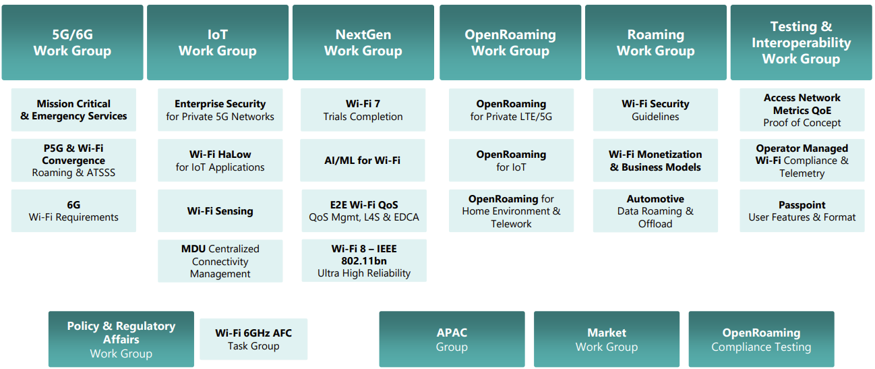
WBA Technical Activities & Roadmap for 2025
https://wballiance.com/wba-program-overview-2025/
https://wballiancec.com/proejcts-details

Slide 110
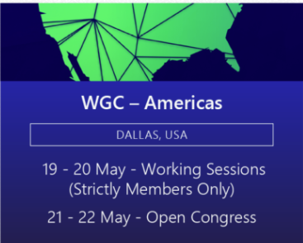

Wireless Global Congress & Members Meetings
https://www.wirelessglobalcongress.com/apac2025/
https://www.wirelessglobalcongress.com/
Presentations

Slide 111
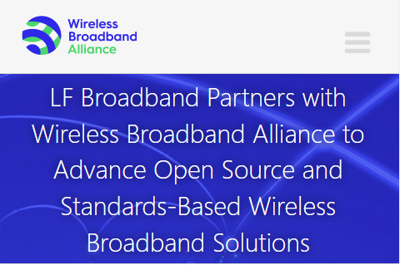
Linux Foundation Broadband & WBA Partners
The partnership aims to foster collaboration between the open source and wireless broadband communities to accelerate the development and adoption of carrier-grade broadband solutions.
WBA and LF Broadband

Slide 112
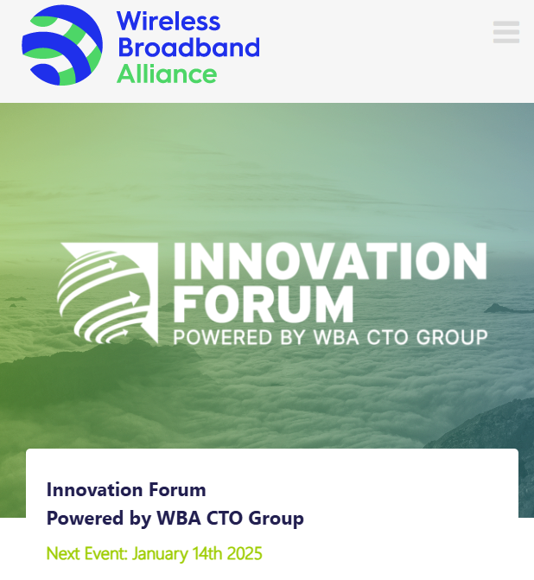
WBA Innovation Forum January
https://wballiance.com/innovation-forum/
Focus on key themes sharing perspectives that will shape the future of connectivity for the next decade and beyond

Slide 113

Enterprise Connectivity Forum
Launching Enterprise Connectivity Forum initiative focused on bringing enterprises together and fostering collaboration in the ecosystem
  Open (free) Community
  Networking and Collaboration
  Pilot Programs and Proof of Concepts
  Thought Leadership
https://wballiance.com/ecf/

Slide 114

WBA Wi-Fi 7 Field Trials - CableLabs
WBA is conducting Wi-Fi 7 field trials with its participating members to evaluate and validate the key capabilities of Wi-Fi in real-life various deployment scenarios.
As part of this initiative, CableLabs and Intel collaborated to test Wi-Fi 7 in residential settings – focusing on evaluating the performance and coverage of Wi-Fi 7, assessing its benefits over previous generations.
This report presents performance data from testing Wi-Fi 7 and Wi-Fi 6E in a typical home environment, quantifying the improvements. The findings show that Wi-Fi 7 delivered significant enhancements over Wi-Fi 6.
https://wballiance.com/wi-fi-7-cablelabs-intel/

Slide 115

Operator-Managed Smart Home Industry Framework
A reference framework providing a dynamic roadmap for the future of Smart Homes, extending from WBA’s Operator Managed Wi-Fi project.
Evolving Connectivity Hubs: Visualizes smart homes as evolving connectivity hubs that enhance interoperability between established and emerging technologies.
Managed Wi-Fi Reference Architecture: Support residential service providers with a Managed Wi-Fi reference architecture that integrates IoT and Matter components, setting a new standard in interoperability.
https://wballiance.com/smart-home-iot-framework/

Slide 116

L4S Implementation Guidelines
L4S technology, the guidelines cover:
  Reducing media access delays in Wi-Fi networks.
  Enhancing network configurations.
  Complementing QoS Management Stream Classification Services (SCS).
  Optimizing Enhanced Distributed Channel Access (EDCA) parameters.
In 2025, the WBA will continue advancing L4S in coordination with QoS Management initiatives, including additional trials, report generation, provider surveys, and evolving L4S testing scenarios.
Download

Slide 117
Further information
WBA information at https://wballiance.com/
Current work areas https://wballiance.com/wba-program-overview-2025/
WBA resource center https://wballiance.com/resource/
WBA events https://wballiance.com/events-awards/
WBA memberships: https://wballiance.com/membership/

Slide 118
Backup

Slide 119






WBA ORGANIZATION
WBA IS A NONPROFIT ASSOCIATION WITH THE VISION TO ACCELERATE THE DEVELOPMENT OF
“SEAMLESS AND INTEROPERABLE WI-FI SERVICES”
Seamless, Secure and Interoperable Wi-Fi
Convergence and Coexistence of Wireless Technologies
Accelerate Next Generation Wi-Fi Networks
Established
in 2003
+200 MEMBERSHIP
COMMUNITY
PROJECTS &
PROGRAMS
3 ANNUAL
EVENTS
PROMOTION AND
GO-TO-MARKET
THOUGHT LEADERSHIP &
MARKET RESEARCH

Slide 120


WBA Focus Areas
WBA MEMBERS SOLVE
REAL BUSINESS ISSUES
Fosters success for its members
WBA’s mission is to enable collaboration between service providers, technology companies and organizations to drive positive change and enable opportunities for growth.
Standards & Specifications - Setting the scene, requirements and creating specifications
Testing & Interoperability - Creating test plans to showcase the technology capabilities
End-to-End Trials - Running field trials/ proof of concept on real-world environment
Guidelines & Best Practices – Accelerate deployments of services and technologies
Certification & Plug Fests - Addressing gaps and helping the industry to maximizing biz opportunities
Think Thank & Advocacy – Industry leaders roundtables and targeted verticals analysis

Slide 121
IEEE 802.11-IETF Liaison Report
Date: 2025-03-12
Authors:

Slide 122
IETF Meetings
Upcoming Meetings:
  March 15-21, 2025 – Bangkok, TH
  July 19-25, 2025 – Madrid, ES
IETF meeting fee waivers
http://www.ietf.org
  Newcomer training: https://www.ietf.org/about/participate/get-started/
  April 2016: Wireless Tutorial (Donald Eastlake), 802.11 & 802.15 tutorials (Dorothy Stanley, Charlie Perkins), see 11-16/500, September 2016: Pat Thaler & Juan Carlos – 802.1E (Privacy Considerations) and 802c (Local MAC address usage) https://datatracker.ietf.org/group/edu/materials/

Slide 123
IETF- IEEE 802 Liaison Activity
Joint meetings, agenda and presentations
  http://www.iab.org/activities/joint-activities/iab-ieee-coordination/
  Proceedings: https://datatracker.ietf.org/iabasg/ietfieee/meetings/
  Coordination topics include: Layer 2/Layer 3 Interaction for Time-Sensitive Traffic, Development of YANG models in the IEEE 802, Capability Discovery, MADINAS
  IETF-IEEE 802 coordination teleconferences: February 19, 2025

Slide 124
IETF protocol use with 802.11 technology
RFC 9685 (Listener Subscription for IPv6 Neighbor Discovery Multicast and Anycast Addresses) has been published.

Slide 125
BOFs at IETF 122 March 15-21, 2025
See https://datatracker.ietf.org/wg/bofs/
nasr | Network Attestation for Secure Routing
skex | Symmetric Key Establishment and Exchange

Slide 126
IETF/IRTF groups being (re-)chartered
See https://datatracker.ietf.org/group/chartering/
hrpc | Human Rights Protocol Considerations
ccamp | Common Control and Measurement Plane
diem | Digital Emblems
opsawg | Operations and Management Area Working Group
spring | Source Packet Routing in Networking

Slide 127
YANG Model Catalog
YANG catalog development
  A YANG model catalog and registry that allows users to find models relevant to their use cases from the large and growing number of YANG modules being published.
  YANG Catalog was developed through a collaboration between the IETF and the Broadband Forum, and contains many data models, including from other Standards Development Organizations (SDOs) such as the IEEE, as well as some vendor-specific data models. Interest and participation from other SDOs, equipment vendors, open-source projects and network operators is encouraged.
See https://www.ietf.org/blog/yang-catalog-latest-developments-ietf-100-hackathon/
See https://yangcatalog.org/ and https://1.ieee802.org/yangsters/

Slide 128
IoT-related work
6LO
  Working Group website: https://datatracker.ietf.org/wg/6lo/
  Focus: IPv6 over Networks of Resource-constrained Nodes
Updates
  Revised: Path-Aware Semantic Addressing (PASA) for Low power and Lossy Networks: https://datatracker.ietf.org/doc/draft-ietf-6lo-path-aware-semantic-addressing/ (March 2025)
  Revised: Transmission of SCHC-compressed packets over IEEE 802.15.4 networks: https://datatracker.ietf.org/doc/draft-ietf-6lo-schc-15dot4/ (March 2025)
  Revised: Transmission of IPv6 Packets over Short-Range Optical Wireless Communications: https://datatracker.ietf.org/doc/draft-ietf-6lo-owc/ (February 2025) [mentions IEEE802.11bb]
  Revised: Generic Address Assignment Option for 6LowPAN Neighbor Discovery: https://datatracker.ietf.org/doc/draft-ietf-6lo-nd-gaao/ (February 2025)

Slide 129
IoT-related work (cont.)
ROLL: Working Group website: https://datatracker.ietf.org/wg/roll/
  Focus: Routing over Low Power and Lossy Networks
CORE: (Constrained RESTful Environments) Working Group website: http://datatracker.ietf.org/wg/core/
  Focus: framework for resource-oriented applications intended to run on constrained IP networks.
IoT Directorate:
  Reviews IETF drafts that are IoT related
  See: https://datatracker.ietf.org/group/iotdir/about/

Slide 130
MADINAS WG
See https://datatracker.ietf.org/wg/madinas/
MAC Address Device Identification for Network and Application Services
  This is the IETF’s equivalent of IEEE 802.11bh – how to deal with the implications of the deployment of random and changing MAC addresses.
Updates
  To be published as RFC 9724: Randomized and Changing MAC Address State of Affairs: https://datatracker.ietf.org/doc/draft-ietf-madinas-mac-address-randomization/ (March 2024)
  In RFC Editor’s queue: Randomized and Changing MAC Address Use Cases and Requirements: https://datatracker.ietf.org/doc/draft-ietf-madinas-use-cases/ (December 2024)

Slide 131
EAP Method Update (EMU)
See https://datatracker.ietf.org/wg/emu/
  This working group has been chartered to provide updates to some commonly used Extensible Authentication Protocol methods including of EAP-TLS, EAP-AKA, EAP-AKA’ (for 5G), EAP-SIM, etc.
  The group should document any recently gained new knowledge on vulnerabilities or the possible implications of pervasive surveillance or other new concerns.
Updates
  Revised: Using the Extensible Authentication Protocol (EAP) with Ephemeral Diffie-Hellman over COSE (EDHOC): https://datatracker.ietf.org/doc/draft-ietf-emu-eap-edhoc/ (March 2025)
  Revised, waiting for shepherd write-up: Bootstrapped TLS Authentication with Proof of Knowledge (TLS-POK): https://datatracker.ietf.org/doc/draft-ietf-emu-bootstrapped-tls/ (February 2025)
  Revised, still in RFC Editor’s queue awaiting other documents, but possibly coming back to the WG: Tunnel Extensible Authentication Protocol (TEAP) Version 1: https://datatracker.ietf.org/doc/draft-ietf-emu-rfc7170bis/ (February 2025)
  In AD evaluation: The eap.arpa domain and EAP provisioning: https://datatracker.ietf.org/doc/draft-ietf-emu-eap-arpa/ (January 2025)

Slide 132
Operations Area Working Group
https://datatracker.ietf.org/wg/opsawg/
Updates
  Revised: PCAP Capture File Format: https://datatracker.ietf.org/doc/draft-ietf-opsawg-pcap/ (March 2025)
  Revised: PCAP Next Generation (pcapng) Capture File Format: https://datatracker.ietf.org/doc/draft-ietf-opsawg-pcapng/ (March 2025)
Background
  Of interest: RFC 6632, An Overview of the IETF Network Management Protocols, see https://tools.ietf.org/html/rfc6632
  Automated network management, including YANG data models, see https://www.ietf.org/topics/netmgmt/

Slide 133
Internet Area Working Group
https://datatracker.ietf.org/wg/intarea/
Updates
  Revised: Communicating Proxy Configurations in Provisioning Domains: https://datatracker.ietf.org/doc/draft-ietf-intarea-proxy-config/ (March 2025)

Slide 134
Transport Layer Security (TLS)
See: https://datatracker.ietf.org/wg/tls/
Updates
  Held for formal analysis: TLS 1.3 Extension for Using Certificates with an External Pre-Shared Key: https://datatracker.ietf.org/doc/draft-ietf-tls-8773bis/ (March 2025)
  Revised: TLS Encrypted Client Hello: https://datatracker.ietf.org/doc/draft-ietf-tls-esni/ (March 2025)
  Revised: Extended Key Update for Transport Layer Security (TLS) 1.3: https://datatracker.ietf.org/doc/draft-ietf-tls-extended-key-update/ (March 2025)
  AD Evaluation: Revised I-D needed: The Transport Layer Security (TLS) Protocol Version 1.3: https://datatracker.ietf.org/doc/draft-ietf-tls-rfc8446bis/ (February 2025)
  In IESG Evaluation: TLS 1.2 is in Feature Freeze: https://datatracker.ietf.org/doc/draft-ietf-tls-tls12-frozen/ (February 2025)
  Adopted: The Datagram Transport Layer Security (DTLS) Protocol Version 1.3: https://datatracker.ietf.org/doc/draft-ietf-tls-rfc9147bis/ (December 2024)

Slide 135
Deterministic Networking (DETNET)
DETNET: https://datatracker.ietf.org/wg/detnet/
  The Deterministic Networking (DetNet) Working Group focuses on deterministic data paths that operate over Layer 2 bridged and Layer 3 routed segments, where such paths can provide bounds on latency, loss, and packet delay variation (jitter), and high reliability.
  The IEEE 802.11be activities seem like they may fit in with DetNet and there was a joint IEEE-IETF DetNet discussion in Bangkok (November 2018).
  Addresses Layer 3 aspects in support of applications requiring deterministic networking.
  The Working Group collaborates with IEEE 802.1 Time Sensitive Networking (TSN), which is responsible for Layer 2 operations, to define a common architecture for both Layer 2 and Layer 3.
  Example applications for deterministic networks include professional and home audio/video, multimedia in transportation, engine control systems, and other general industrial and vehicular applications being considered by the IEEE 802.1 TSN Task Group.
Updates:
  Revised and still in WGLC: Reliable and Available Wireless Architecture: https://datatracker.ietf.org/doc/draft-ietf-raw-architecture/ (February 2025)
  Revised and still in IESG evaluation: Reliable and Available Wireless Technologies: https://datatracker.ietf.org/doc/draft-ietf-raw-technologies/ (February 2025)

Slide 136
Autonomic Networking Integrated Model and Approach (ANIMA)
ANIMA: https://datatracker.ietf.org/group/anima/
  ANIMA designs protocols to allow network operations (e.g., on-boarding) to be carried out without requiring low-level management of individual devices
Updates:
  Waiting for AD go-ahead: BRSKI Cloud Registrar: https://datatracker.ietf.org/doc/draft-ietf-anima-brski-cloud/ (March 2025)
  Revised and still in WG Last Call: Constrained Bootstrapping Remote Secure Key Infrastructure (cBRSKI): https://datatracker.ietf.org/doc/draft-ietf-anima-constrained-voucher/ (March 2025)
  In IESG Evaluation: BRSKI with Pledge in Responder Mode (BRSKI-PRM): https://datatracker.ietf.org/doc/draft-ietf-anima-brski-prm/ (February 2025)
  In WGLC: Join Proxy for Bootstrapping of Constrained Network Elements: https://datatracker.ietf.org/doc/draft-ietf-anima-constrained-join-proxy/ (January 2025)

Slide 137
References
RFC 7241, “The IEEE 802/IETF Relationship” (RFC 4441 update)
  https://datatracker.ietf.org/doc/rfc7241/
IEEE 802 Liaisons list is available
  http://ieee-sa.centraldesktop.com/802liaisondb/FrontPage

