Slide 1
802.15 Liaison Report – January 2025
Date: 2024-01-16
Authors:

Slide 2
Abstract
Overview of current activities in WG15.

Slide 3
Working Group 15 November Agenda
https://mentor.ieee.org/802.15/dcn/24/15-24-0669-06-0000-jan-2025-802-15-agenda.xlsx

Slide 4
802.15 Overview
Wireless Specialty Networks Active standards:
802.15.3 - no active projects but a bunch of really cool stuff
802.15.4 - many current projects (see next slide)
802.15.6a Body Area Networks: Revision project, WG ballot comment resolutions
802.15.7a Higher Rate, Longer Range Optical, in publication
802.15.9a KMP Transport, extensions to key management: drafting
802.16t Extension to 802.16 for specific bands: In SA ballot
Interest Group Access: exploring potential new features to support more efficient spectrum usage via new and improved channel access and other purposes
SC THz: discussing future THz communications with Terabit/second data rates

Slide 5
WNG: Super-FUN with THz, mmWave, and sub-1GHz
In 802.15 Wireless Next Generation:
Multiple presentations on THz – it’s REAL (almost)
Live demonstrations
  THz communication (802.15.3d)
  60 GHz proximity communications (802.15.3e)
Presentation on Wi-SUN success using 802.15.4 SUN PHYs
  Large scale field area networks (FAN) deployed globally
  Very high density deployments demonstrated (Sub 1GHz bands)

Slide 6
802.15.4 Projects
802.15.4ab Next Generation UWB: First WG Ballot complete, in comment resolution
802.15.4ac Enhanced Privacy: pre-ballot comment collection and resolution
802.15.4ad Next Generation SUN PHYs: Pre-draft, technical contributions and proposals
802.15.4ae ASCON light weight encryption extension for 802.15.4: pre-draft.
802.15.4me Revision E of 802.15.4: Completed, IEEE Std 802.15.4-2024 published

Slide 7
802.15.4ab Next generation UWB: Amendment to IEEE Std 802.15.4-2024 (rev E)
Initial ballot complete
  1471 comments received on draft – 895 technical, 606 editorial
  47 comments received on CAD
Meeting objectives: Comment resolution
Closing report: https://mentor.ieee.org/802.15/dcn/25/15-25-0072-00-04ab-tg4ab-closing-january-2025.pptx
Comment resolution continues
 | Current Schedule
First letter ballot | June 2024
Initial LB comment resolution | Start: July 2024
First recirculation | Jan Feb or March 2025
Recirculation comment resolution | March 2025 and beyond
Second recirculation | April 2025
Recirculation comment resolution | May 2025
First SA-Ballot | After July 2025…
SA-Ballot comment resolution | After that

Slide 8
802.15.4ac Enhanced Privacy
This amendment specifies modifications to the IEEE Std 802.15.4 medium access control (MAC) specification to specify mechanisms that address and improve user privacy. These mechanisms include randomized addresses, and exchanges that support session continuity. This amendment maintains backward compatibility with the base standard.
State: reviewing initial draft
Opening and closing report: https://mentor.ieee.org/802.15/dcn/25/15-25-0029-03-04ac-january-opening-and-closing.pptx

Slide 9
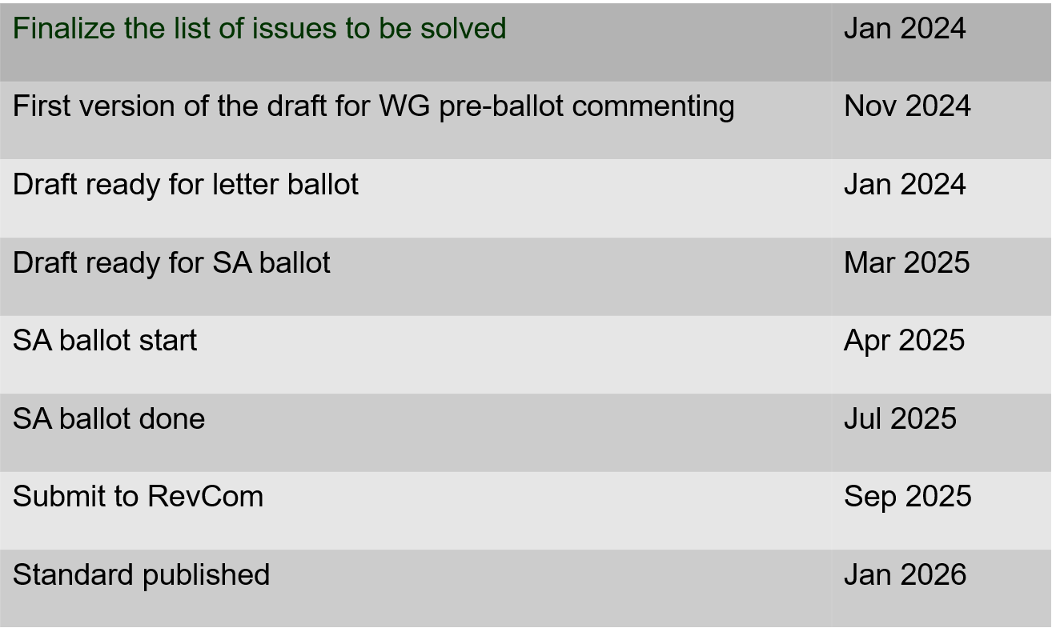
802.15.4ac Enhanced Privacy Timeline

Slide 10
802.15.4ad Next Generation SUN PHYs
Developing enhancements to the 802.15.4 SUN PHYs (FSK, OFDM)
State: pre-draft development
Meeting goals:
  Considering technical contributions
Objectives completed
Closing report: https://mentor.ieee.org/802.15/dcn/25/15-25-0022-01-04ad-tg4ad-agenda-opening-and-closing-report-january-2025.pptx

Slide 11
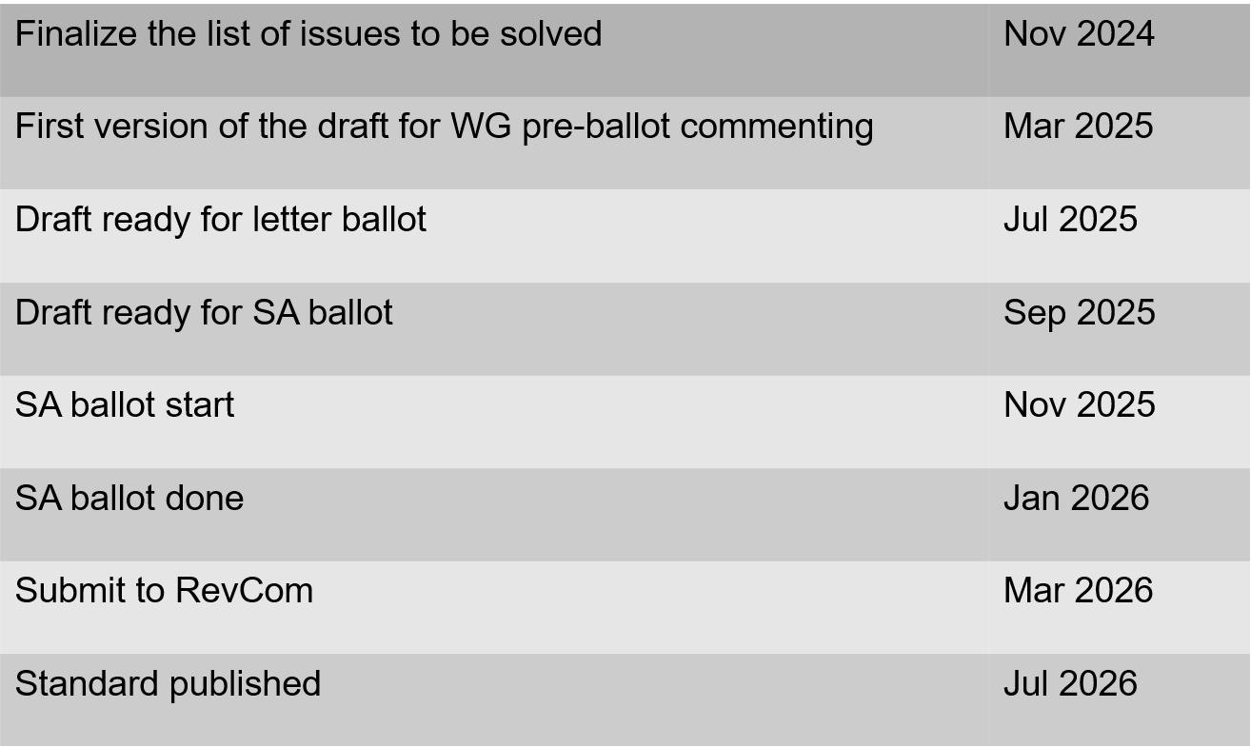
802.15.4ae (ASCON)
ASCON light weight encryption extension for 802.15.4
Pre-draft development
Reviewing required changes to 802.15.4 to support ASCON
Drafting
Closing report: https://mentor.ieee.org/802.15/dcn/25/15-25-0031-02-04ae-january-opening-and-closing.pptx

Slide 12
802.15.6a
Draft in WG ballot
Session objectives:
  Resolve comments
  Initiate recirculation
Closing report: https://mentor.ieee.org/802.15/dcn/25/15-25-0063-01-006a-tg15-6ma-closing-report-for-january-2025.pptx

Slide 13
TG 6ma Timeline(expected)
Tech Req Doc July 2022
Presentation of proposals
May 2023
Comment Resolutionfor LB
Nov. 2024
Comment Resolutionfor LB2
Jan. 2025
EC approval to SA, SA submission
March 2025
SA recirculation
May 2025
WG PreBallot submission for Draft2.5 August 2024
SA recirculation if required
July 2025
Revcom Approve
Sept 2025
^{Draft V1,18 Com}
May. 2024
Recirculation (LB2)
Dec. 2024
RevcomSubmission
August 2025
Comment Resolution fo Draft v2.3 on WG for PreBallot July 2024
1st Letter Ballot(LB)
Sept. 2024
Conditional approval for Standard Association Ballot (SA)
February 2025
TRD,CMD
Call Proposals Sept 2022
Std. Draf V1.9 Proposals
Nov. 2023
Notes: SASB/RevCom scheduled for 2024 a guess

Slide 14
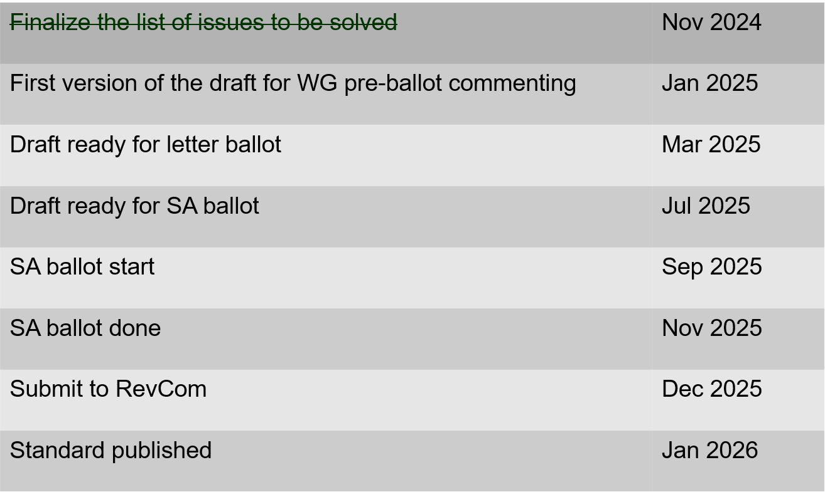
802.15.9a KMP Transport
Extensions to key management: extending to support EDHOC
State: draft development
Session objectives
  Update and send out call for participation and call for proposals.
  Update list of changes needed to the IEEE Std 802.15.9 for adding EDHOC KMP
Opening and closing report: https://mentor.ieee.org/802.15/dcn/25/15-25-0030-03-009a-january-opening-and-closing.pptx

Slide 15
IG Access
Did not meet in January (no contributions)
Contributions for March on multiple channel access schemes
  Results of simulation studies
  Results of field experience
Purpose: to explore potential enhancements to support better spectrum access
  Topics considered so far include sharing through coexistence, new channel access mechanisms, and reducing interference footprint.
Output: recommendations or information for the Working Group
Short term focus: Bands in which more than one wireless technology may operate
Support (Not preempt or disrupt) efforts in other projects
Some goals:
  Support for a diversity of uses
  Equal access and improved performance for all 802 wireless technologies
Participation encouraged!

Slide 16
Licensed Narrowband Amendment TG16t
State: In SA ballot
  Comments from last recirculation: https://mentor.ieee.org/802.15/dcn/25/15-25-0021-00-016t-comments-submitted-for-2nd-sa-recirculation-of-802-16t-d6-0.xlsx

