Slide 1
Enhanced Light Communications (ELC) Underwater Prototype Performance
Date: 2025-01-13
Authors:

Slide 2
Prototype Development
We have developed several underwater LiFi prototypes. A high-level look at the different systems we have tested can be summarized as:
PAM based prototype with maximum capability of 2 Gbps (UL + DL)
OFDM based prototype (g.hn) with maximum capability of 2 Gbps (UL+DL)
OFDM based prototype with maximum capability of 4 Gbps (UL+DL)

Slide 3
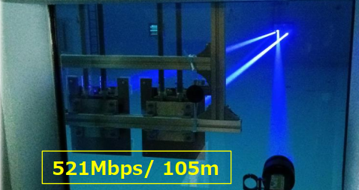
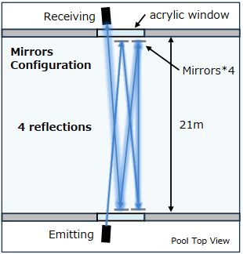
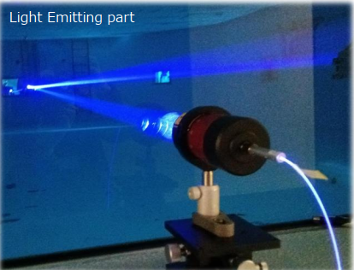
Prototype Performance
PAM LiFi system testing at 21m freshwater pool:
4 mirrors used to extend pool range to 105m
achieved 0.7 Gbps raw throughput over 105m
translates to 0.521 Gbps of user data rate using TCP/IP

Slide 4
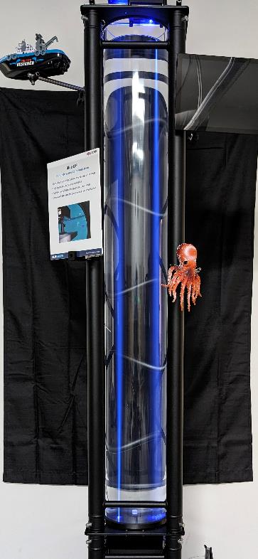
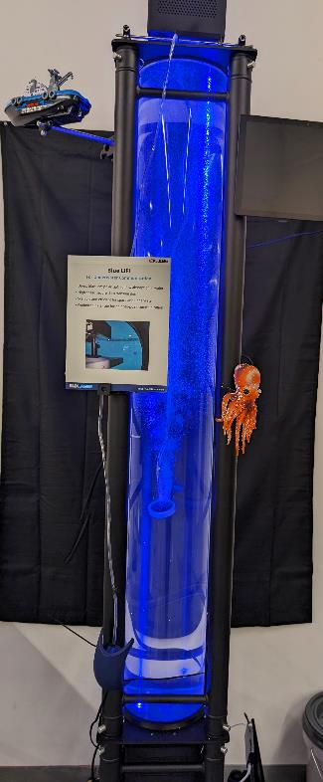
Prototype Performance
OFDM LiFi system testing at short range – 1.5 m distance in freshwater and saltwater:
Uplink: 1 Gbps
Downlink: 1 Gbps
Downlink
LiFi transceiver interface to air + through water surface
1 Gbps downlink
Photonics West demo fixture: 1.5m water column in acrylic tube
Uplink
LiFi transceiver interface to window through water surface
1 Gbps uplink

Slide 5
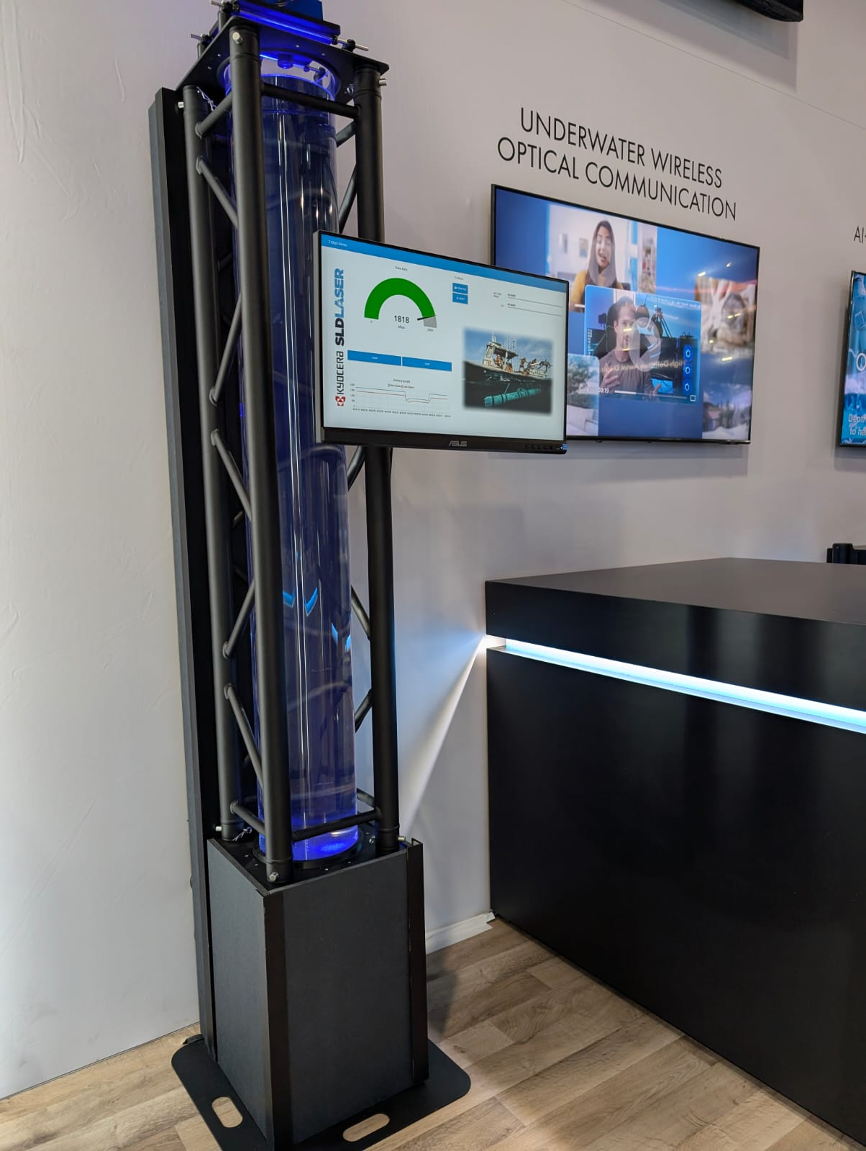
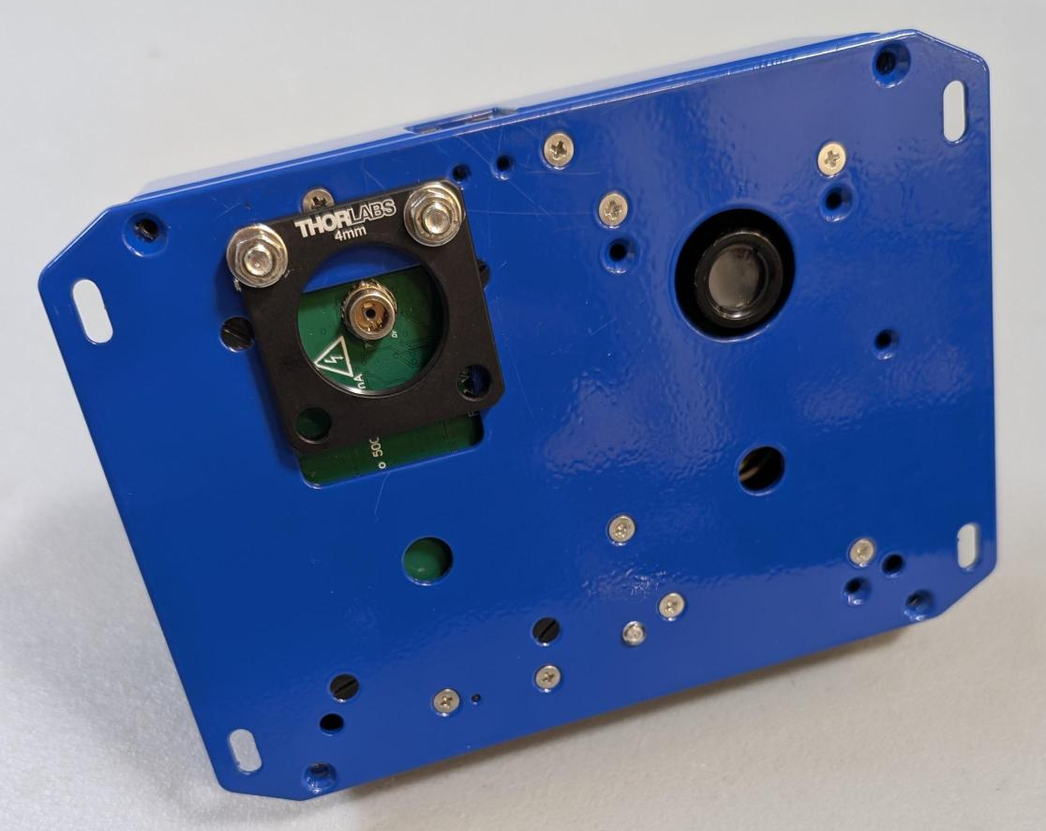
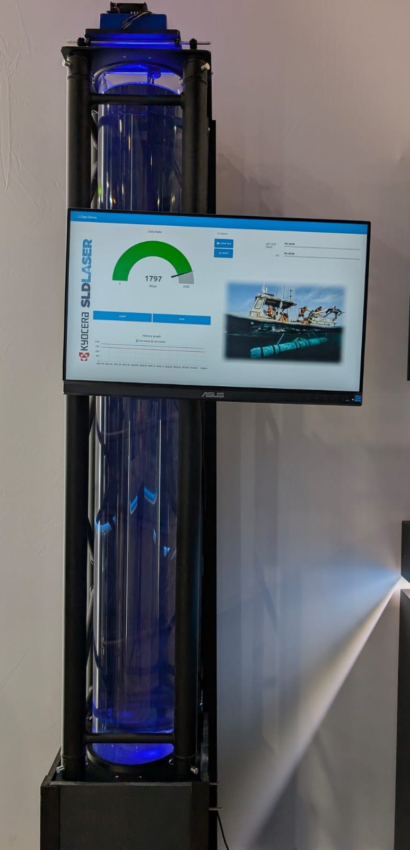
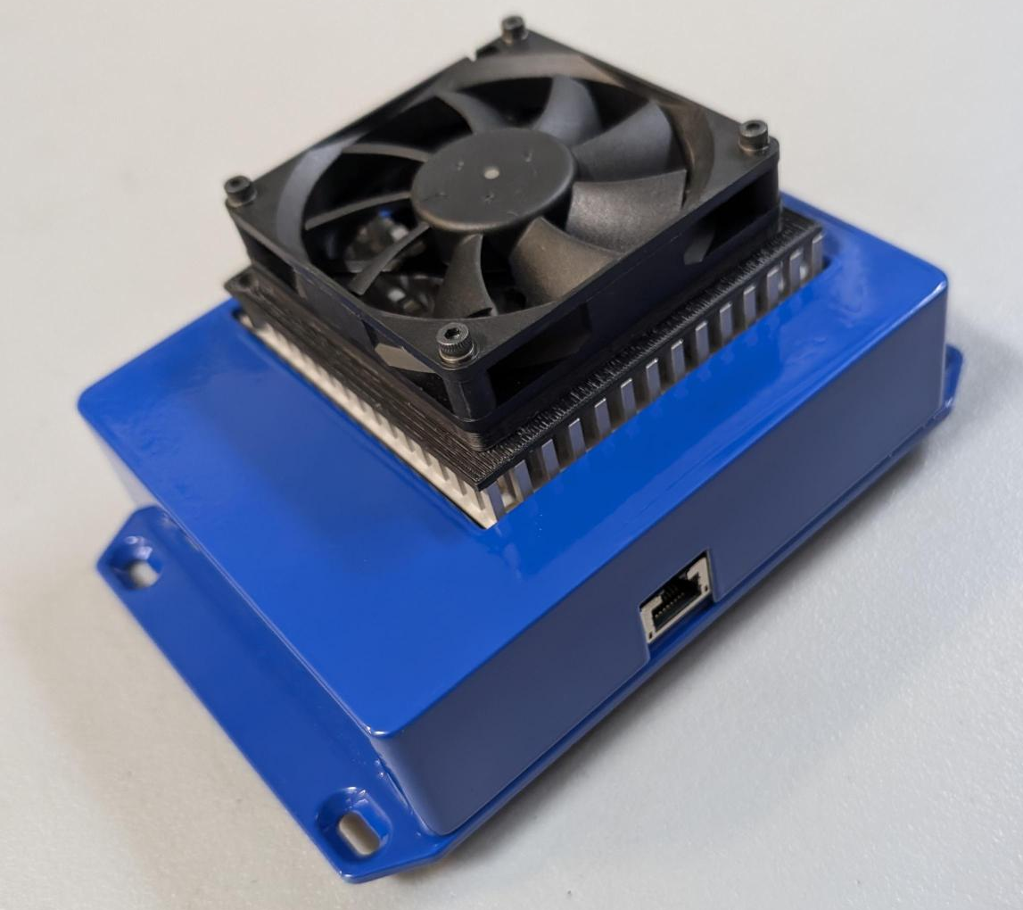
Prototype Performance

Slide 6
Prototype Performance
Demonstration of 4 Gbps capable (theoretically) OFDM LiFi system at CES 2025 – 1.5 m through freshwater.
Peak raw throughput achieved is 1968 Mbps.
Peak user throughput achieved is 1680 Mbps.

Slide 7
Summary
LiFi has been demonstrated as a feasible option for underwater communication.
It has been demonstrated that > 1 Gbps data rates are feasible.
It has been demonstrated that distances of >100m are also achievable.
System is flexible such that it can be reconfigured to best suit the environment – for example freshwater vs saltwater.
This combination of capability should be applicable to a wide variety of end-user applications.

