Slide 1
RU indication to reduce scheduling complexity
Date: Jan. 10, 2025
Authors:
Name | Affiliations | Address | Phone | Email
Jiyang Bai | TCL | Building G1, TCL International-E City, Shenzhen, Guangdong, China. |  | Jiyangbai@gmail.com
 | TCL
Zhanjin Bao

Slide 2
Introduction
  The existing contributions are trying to find the balance point by limiting some flexibility in standard level:
    A lot of contributions [1-7], passed motions [8] (e.g., Motion #39, #43, #52, #61-63, #65, #66, #87-90) and also the PDT of DRU [9] has related to the concern of scheduling complexity, which leads to increase the limitation the potential patterns of DRU.
  Even if we ignore the sacrificed performance and flexibility, the DRU mechanism is still not suitable for massive access in Wi-Fi:
    There differences of DRU between DBW 20/40/80, the potential size of DRU patterns is still significant.
  To solve this problem, we provide the other point of view：
    Within limited computational resource, we could utilize the feedback Preferred RU sets from STA to reduce the problem complexity.

Slide 3
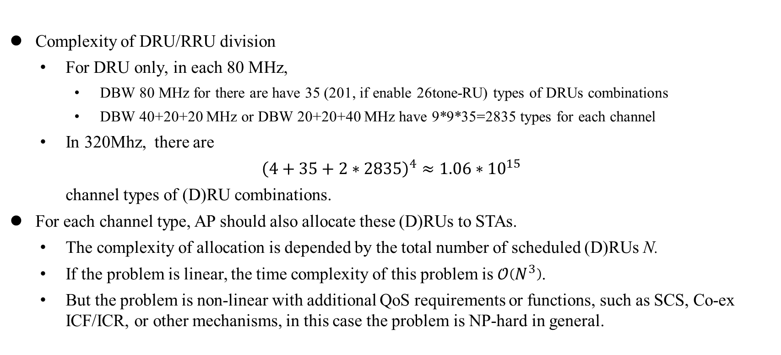
  Complexity analysis
Complexity of DRU/RRU division
    For DRU only, in each 80 MHz,
      DBW 80 MHz for there are have 35 (201, if enable 26tone-RU) types of DRUs combinations
      DBW 40+20+20 MHz or DBW 20+20+40 MHz have 9*9*35=2835 types for each channel
    In 320Mhz, there are
  ${\left(4+35+2∗2835\right)}^{4}≈1.06∗{10}^{15}$
  channel types of (D)RU combinations.
For each channel type, AP should also allocate these (D)RUs to STAs.
    The complexity of allocation is depended by the total number of scheduled (D)RUs N.
    If the problem is linear, the time complexity of this problem is $𝒪\left(N^{3}\right)$.
    But the problem is non-linear with additional QoS requirements or functions, such as SCS, Co-ex ICF/ICR, or other mechanisms, in this case the problem is NP-hard in general.

Slide 4
Proposed method
If we decompose the original optimization problem into the multiple sub-problem, i.e., the resource allocation problem of each STA.
STAs can optimize their own allocation locally using local computing capacity. The Preferred RU sets are the results.
AP can generate the allocation scheme by gathering the Preferred RU sets.
After resolves all Preferred RU Sets without conflict, AP only need to calculate the RU allocation with conflict, which is much lower than original calculation.
By enabling STA to feedback their preferred (D)RUs, we can utilize the computing resource as well as reduce the complexity of scheduling.

Slide 5
Summary
It is more difficult to schedule the Wi-Fi network after using DRU.
Enable STAs to report their Preferred RU sets could facilitate the scheduling on AP.
With higher management capacity, Wi-Fi network with Preferred RU sets could have better performance than Wi-Fi network without Preferred RU sets
Open Discussions: Detailed Signaling of STA Preferred RU indications

Slide 6
Straw Poll 1
Do you agree to add the following text to the TGbn SFD:
TGbn defines a mechanism that enables a non-AP STA to report its preferred RU sets for following transmission.
Y/N/A

Slide 7
References
[1] 11-23-2020-03-00bn-high-level-perspective-on-distributed-tone-ru-for-11bn
[2] 11-24-1189-01-00bn-dru-transmission-on-frequency-subblocks-of-wide-bandwidth-ppdu
[3] 11-24-1471-03-00bn-signaling-for-dru-in-trigger-frame
[4] 11-24-1472-03-00bn-consideration-on-dru-for-11bn
[5] 11-24-1489-01-00bn-signaling-for-dru-transmission
[6] 11-24-1510-02-00bn-open-issues-on-dru
[7] 11-24-1856-01-00bn-tone-distribution-in-dru-with-puncturing-follow-up
[8] 11-24-0171-26-00bn-tgbn-motions-list-part-1
[9] 11-24-2046-03-00bn-draft-text-on-dru
[10] J. Bai and X. Wang, "Distributed-Optimization With Centralized-Refining for Efficient Resource Allocation in Future Wireless Networks," in IEEE Transactions on Communications, vol. 72, no. 8, pp. 4829-4843, Aug. 2024.

Slide 8
Appendix: Existing methods and performance
AP can just reschedule the conflicted RRU set
  All conflicted RUs are rescheduled. This method only utilized the RU sets without conflict, all processed information in conflicted RUs are wasted.
AP can resolve the conflicted RRU sets, then just schedule the rest of RRU sets.
  This method utilizes the carried information in the conflicted RU sets, which is more efficient.
The simulations shows that indicating the Preferred RRU sets has better performance in either linear problem or non-linear problem
  Proposed mechanism uses 9.03% processing time but achieves 95.12 % utility performance.
By indicating the preferred RRU sets, network is able to support heavy duty and massive access network.
[10] J. Bai and X. Wang, "Distributed-Optimization With Centralized-Refining for Efficient Resource Allocation in Future Wireless Networks," in IEEE Transactions on Communications, vol. 72, no. 8, pp. 4829-4843, Aug. 2024.
Linear Problem [10]
Non-linear Problem [10]

