Slide 1
Alternative DRU Tone Plan 60MHz DBW
Date: 2025-02
Authors:
Name | Affiliation | Address | Phone | Email
Chenchen Liu | Huawei Technologies Co., Ltd | Huawei Base, Bantian, Shenzhen |  | liuchenchen1@huawei.com
Yan Xin
Jian Yu
Ming Gan

Slide 2
Introduction
DRU over 60MHz DBW passed the motion in Nov. IEEE meeting for the case where the highest 20MHz subchannel been punctured.
A DRU tone plan for DBW 60MHz was proposed in ref [1], which can be used for the cases where any 20MHz subchannel in an 80 MHz subblock is punctrued
In the restricted scenario where the highest 20MHz subchannel is punctured, an alternative DRU tone plan can be designed to optimize power boosting or reduce PAPR, such as the tone plan proposed by Eunsung Park in [2]

Slide 3
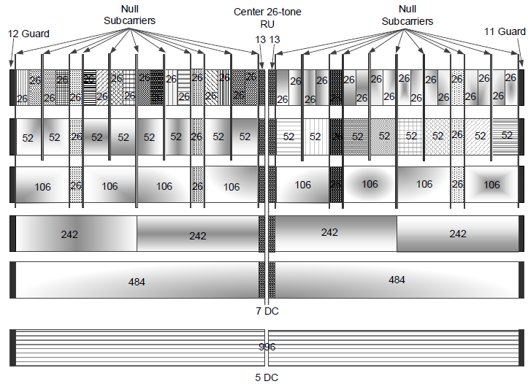
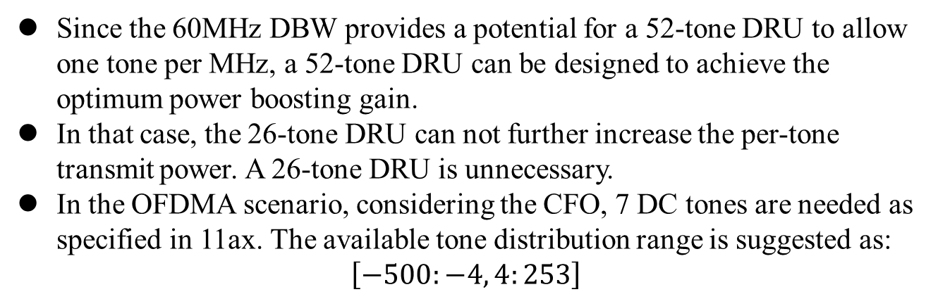
Optimum power boosting DRU Tone Plan
Since the 60MHz DBW provides a potential for a 52-tone DRU to allow one tone per MHz, a 52-tone DRU can be designed to achieve the optimum power boosting gain.
In that case, the 26-tone DRU can not further increase the per-tone transmit power. A 26-tone DRU is unnecessary.
In the OFDMA scenario, considering the CFO, 7 DC tones are needed as specified in 11ax. The available tone distribution range is suggested as:
$$\left[−500:−4, 4:253\right]$$

Slide 4
Tone Plan A - Optimum power boosting DRU
DRU data and pilot tone indices for 60MHz DBW
DRU type | DRU indices
52-tone DRU i=1:12 | DRU1 [-499:14:-23, 5:14:229] | DRU2 [-492:14:-16, 12:14:236] | DRU3 [-496:14:-20, 8:14:232] | DRU4 [-489:14:-13, 15:14:239]
 | DRU5 [-498:14:-22, 6:14:230] | DRU6 [-491:14:-15, 13:14:237] | DRU7 [-495:14:-19, 9:14:233] | DRU8 [-488:14:-12, 16:14:240]
 | DRU9 [-497:14:-21, 7:14:231] | DRU10 [-490:14:-14, 14:14:238] | DRU11 [-494:14:-18, 10:14:234] | DRU12 [-487:14:-11, 17:14:241]
106-tone DRU i=1:6 | DRU1 [-499:7:-9, 5:7:243] | DRU2 [-496:7:-6, 8:7:246] | DRU3 [-498:7:-8, 6:7:244] | DRU4 [-495:7:-5, 9:7:247]
 | DRU5 [-497:7:-7, 7:7:245] | DRU6 [-494:7:-4, 10:7:248]
242-tone DRU i=1:3 | DRU1 [-499:7:-9, 5:7:243, -496:7:-6, 8:7:246, -458:21:-38, 25:21:193] |  | DRU2 [-498:7:-8, 6:7:244, -495:7:-5, 9:7:247, -451:21:-31, 32:21:200]
 | DRU3 [-497:7:-7, 7:7:245, -494:7:-4,10:7:248, -444:21:-24, 39:21:207]

Slide 5
Advantages of the Optimum Power Boosting DRU Tone Plan
Optimal Power Boosting Gain for All DRU Sizes
  Ensures consistent power gain across all DRU sizes, improving overall system performance
Lower PAPR for Data Field
  52-tone and 106-tone DRUs are uniformly distributed, reducing PAPR and enhancing transmission efficiency
Simplified Implementation
  Tone indices can be shifted among the DRUs of the same sizes (52-tone and 106-tone), ensuring a uniform response and simplifying implementation
  Uniform distribution of 52-tone and 106-tone DRUs reduces smoothing implementation complexity

Slide 6
Pilot indices for the Optimum Power Boosting DRU Tone Plan A
DRU size | Pilot indices
DRU52, i = 1:12 | {-373 -219 -65 173}, {-450 -296 -142 96}, {-412 -258 -104 134}, {-335 -181 -27 211}, {-386 -232 -78 160}, {-463 -309 -155 83}, {-425 -271 -117 121}, {-348 -194 -40 198}, {-399 -245 -91 147}, {-476 -322 -168 70}, {-438 -284 -130 108}, {-361 -207 -53 185}
DRU106, i = 1:6 | {-450 -296 -142 96}, {-335 -181 -27 211}, {-463 -309 -155 83}, {-348 -194 -40 198}, {-476 -322 -168 70}, {-361 -207 -53 185}
DRU242, i = 1:3 | {-450 -335 -296 -181 -142 -27 96 211}, {-463 -348 -309 -194 -155 -40 83 198}, {-476 -361 -322 -207 -168 -53 70 185}
Near uniform distribution across a wide band, ensuring robustness against narrow band interference
Pilot indices can be shifted between DRUs of the same size, reducing implementation complexity
Sufficient separation within each DRU to provide enough diversity for reliable tracking and estimation

Slide 7
Tone Plan B - Uniform DRU
DRU data and pilot tone indices for 60MHz DBW
DRU type | DRU indices
26-tone DRU i=1:27 | DRU1 [-443:24:-35, 13:24:181] | DRU2 [-431:24:-23, 25:24:193] | DRU3 [-437:24:-29, 19:24:187] | DRU4 [-425:24:-17, 31:24:199]
 | DRU5 [not defined] | DRU6 [-440:24:-32, 16:24:184] | DRU7 [-428:24:-20, 28:24:196] | DRU8 [-434:24:-26, 22:24:190]
 | DRU9 [-422:24:-14, 34:24:202] | DRU10 [-442:24:-34, 14:24:182] | DRU11 [-430:24:-22, 26:24:194] | DRU12 [-436:24:-28, 20:24:188]
 | DRU13 [-424:24:-16, 32:24:200] | DRU14 [not defined] | DRU15 [-439:24:-31, 17:24:185] | DRU16 [-427:24:-19, 29:24:197]
 | DRU17 [-433:24:-25, 23:24:191] | DRU18 [-421:24:-13, 35:24:203] | DRU19 [-441:24:-33, 15:24:183] | DRU20 [-429:24:-21, 27:24:195]
 | DRU21 [-435:24:-27, 21:24:189] | DRU22 [-423:24:-15, 33:24:201] | DRU23 [not defined] | DRU24 [-438:24:-30, 18:24:186]
 | DRU25 [-426:24:-18, 30:24:198] | DRU26 [-432:24:-24, 24:24:192] | DRU27 [-420:24:-12, 36:24:204]

Slide 8
Tone Plan B1 - Uniform DRU
DRU data and pilot tone indices for 60MHz DBW
DRU type | DRU indices
26-tone DRU i=1:27 | DRU1 [-443:24:-35, 13:24:181] | DRU2 [-431:24:-23, 25:24:193] | DRU3 [-437:24:-29, 19:24:187] | DRU4 [-425:24:-17, 31:24:199]
 | DRU5 [not defined] | DRU6 [-440:24:-32, 16:24:184] | DRU7 [-428:24:-20, 28:24:196] | DRU8 [-434:24:-26, 22:24:190]
 | DRU9 [-422:24:-14, 34:24:202] | DRU10 [-442:24:-34, 14:24:182] | DRU11 [-430:24:-22, 26:24:194] | DRU12 [-436:24:-28, 20:24:188]
 | DRU13 [-424:24:-16, 32:24:200] | DRU14 [not defined] | DRU15 [-439:24:-31, 17:24:185] | DRU16 [-427:24:-19, 29:24:197]
 | DRU17 [-433:24:-25, 23:24:191] | DRU18 [-421:24:-13, 35:24:203] | DRU19 [not defined] | DRU20 [-441:24:-33, 15:24:183]
 | DRU21 [-429:24:-21, 27:24:195] | DRU22 [-435:24:-27, 21:24:189] | DRU23 [-423:24:-15, 33:24:201] | DRU24 [not defined]
 | DRU25 [-438:24:-30, 18:24:186] | DRU26 [-426:24:-18, 30:24:198] | DRU27 [-432:24:-24, 24:24:192] | DRU28 [-420:24:-12, 36:24:204]

Slide 9
Tone Plan B - Uniform DRU (Cont’d)
DRU data and pilot tone indices for 60MHz DBW
DRU type | DRU indices
52-tone DRU i=1:12 | DRU1 [-443:12:-23, 13:12:193] | DRU2 [-437:12:-17, 19:12:199] | DRU3 [-440:12:-20, 16:12:196] | DRU4 [-434:12:-14, 22:12:202]
 | DRU5 [-442:12:-22, 14:12:194] | DRU6 [-436:12:-16, 20:12:200] | DRU7 [-439:12:-19, 17:12:197] | DRU8 [-433:12:-13, 23:12:203]
 | DRU9 [-441:12:-21, 15:12:195] | DRU10 [-435:12:-15, 21:12:201] | DRU11 [-438:12:-18, 18:12:198] | DRU12 [-432:12:-12, 24:12:204]
106-tone DRU i=1:6 | DRU1 [-443:6:-17, 13:6:211] | DRU2 [-440:6:-14, 16:6:214] | DRU3 [-442:6:-16, 14:6:212] | DRU4 [-439:6:-13, 17:6:215]
 | DRU5 [-441:6:-15, 15:6:213] | DRU6 [-438:6:-12, 18:6:216]
242-tone DRU i=1:3 | DRU1 [-500:3:-14, 13:3:247] |  | DRU2 [-499:3:-13, 14:3:248]
 | DRU3 [-498:3:-12, 15:3:249]

Slide 10
Advantages of the Uniform DRU Tone Plan
Lower PAPR for Data Field
  All size DRUs are uniformly distributed, reducing PAPR and enhancing transmission efficiency
Simplified Implementation
  Tone indices can be shifted between DRUs of the same size, ensuring a uniform response and simplifying implementation
  Uniform distribution of all size DRUs reduces smoothing implementation complexity

Slide 11
Pilot indices for Uniform DRU Tone Plan B1
DRU size | Pilot indices
DRU26, i = 1:28 | {-203 133}, {-335 -71}, {-269 67}, {-401 -137}, {}, {-368 -104}, {-236 100}, {-170 166}, {-302 -38}, {-346 -82}, {-214 122}, {-412 -148}, {-280 56}, {},{-247 89}, {-379 -115}, {-313 -49}, {-181 155}, {}, {-225 111}, {-357 -93}, {-291 45}, {-159 177}, {}, {-390 -126}, {-258 78}, {-192 144}, {-324 -60}
DRU52, i = 1:12 | {-335 -203 -71 133}, {-401 -269 -137 67}, {-368 -236 -104 100}, {-302 -170 -38 166}, {-346 -214 -82 122}, {-412 -280 -148 56}, {-379 -247 -115 89}, {-313 -181 -49 155}, {-357 -225 -93 111}, {-291 -159 45 177}, {-390 -258 -126 78}, {-324 -192 -60 144},
DRU106, i = 1:6 | {-401 -269 -137 67}, {-368 -236 -104 100}, {-412 -280 -148 56}, {-379 -247 -115 89}, {-357 -225 -93 111}, {-390 -258 -126 78}
DRU242, i = 1:3 | {-401 -368 -269 -236 -137 -104 67 100}, {-412 -379 -280 -247 -148 -115 56 89}, {-390 -357 -258 -225 -126 -93 78 111}
Near uniform distribution across a wide band, ensuring robustness against narrow band interference
For 106-tone and 242-tone DRU, pilot indices can be shifted between DRUs of the same size, reducing implementation complexity
Sufficient separation within each DRU to provide enough diversity for reliable tracking and estimation

Slide 12
Power Boosting Gain
Power Boosting Gain for Different DRU Tone Plans
The DRU is designed to overcome the PSD limit for LPI. As a result, power boosting should be the primary consideration when designing the DRU tone plan
DRU Size | Option A |  | Option B |  | Ref [2]
 | Max. # of tones/MHz | Power Boost Gain (dB) | Max. # of tones/MHz | Power Boost Gain (dB) | Max. # of tones/MHz | Power Boost Gain (dB)
26 | NA | NA | 1 | 11.14 | 1 | 11.14
52 | 1 | 11.14 | 2 | 8.12 | 2 | 8.12
106 | 2 | 8.12 | 3 | 6.37 | 3 | 6.37
242 | 5 | 4.15 | 5 | 4.15 | 5 | 4.15

Slide 13
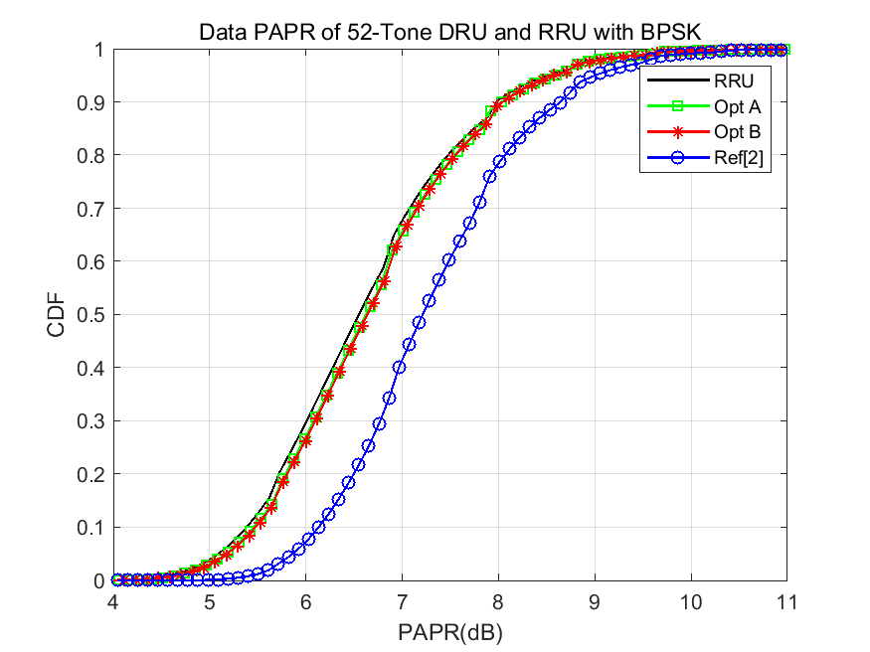
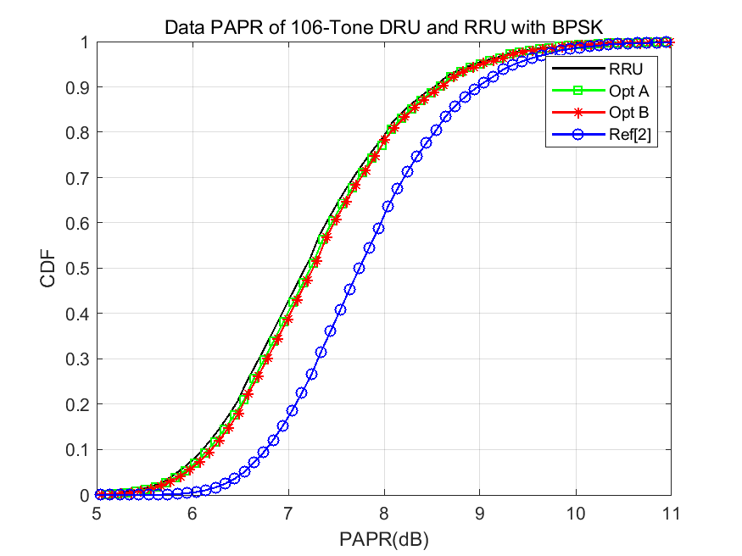
PAPR Evaluation
The PAPR comparation of the different DRU tone plans with BPSK modulation (4x oversampling, 1M random data)

Slide 14
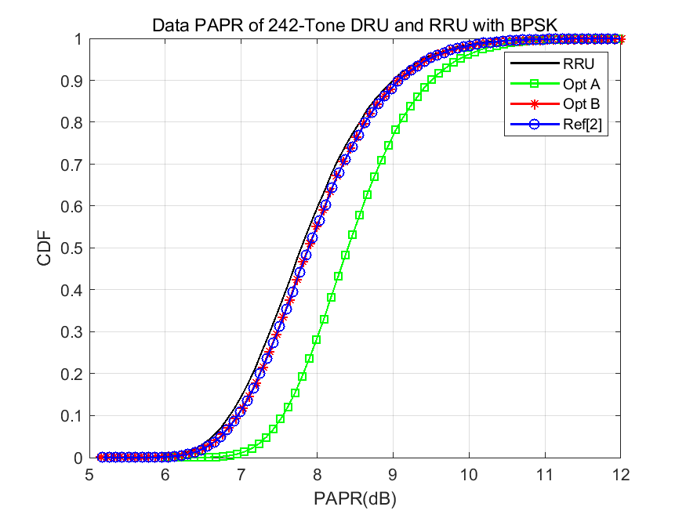
PAPR Evaluation
The PAPR comparation of the different DRU tone plans with BPSK modulation (4x oversampling, 1M random data)

Slide 15
Comparison of DRU Tone Plan Options
Criteria |  | Option A | Option B | Ref [2]
Power Boosting | 52 | O | X | X
 | 106 | O | X | X
 | 242 | O | O | O
PAPR | 52 | O | O | X
 | 106 | O | O | X
 | 242 | X | O | O
Implementation Complexity | 52 | O | O | X
 | 106 | O | O | X
 | 242 | X | O | O
O: Optimum
X: Not Optimum

Slide 16
Summary
Optimum Power Boosting DRU Tone Plan:
  Optimal power gain across all DRU sizes.
  52-tone and 106-tone DRUs with uniform distribution and shifting tone indices between DRUs , ensure low PAPR and simplifies implementation
Uniform DRU Tone Plan Design:
  Uniform distribution of DRU tones across all sizes reduces PAPR and reduces smoothing complexity
  Simplified implementation due to shifting indices within DRUs of the same size
Pilot Tone Index Design:
  Near-uniform distribution for robustness against NB interference
  Tone indices shifting reduce implementation complexity
  Adequate pilot spacing ensures diversity for reliable phase tracking and estimation.

Slide 17
References
[1] 11-24-1856-02-00bn-tone-distribution-in-dru-with-puncturing-follow-up
[2] 11-25-0064-00-00bn-60-mhz-dru-tone-plan

Slide 18
SP1
Do you agree to include the following text to the 11bn SFD?
  Data and pilot subcarrier indices for DRUs in an 60 MHz DBW are defined in following table:
DRU data and pilot tone indices for 60MHz DBW
DRU type | DRU indices
52-tone DRU i=1:12 | DRU1 [-499:14:-23, 5:14:229] | DRU2 [-492:14:-16, 12:14:236] | DRU3 [-496:14:-20, 8:14:232] | DRU4 [-489:14:-13, 15:14:239]
 | DRU5 [-498:14:-22, 6:14:230] | DRU6 [-491:14:-15, 13:14:237] | DRU7 [-495:14:-19, 9:14:233] | DRU8 [-488:14:-12, 16:14:240]
 | DRU9 [-497:14:-21, 7:14:231] | DRU10 [-490:14:-14, 14:14:238] | DRU11 [-494:14:-18, 10:14:234] | DRU12 [-487:14:-11, 17:14:241]
106-tone DRU i=1:6 | DRU1 [-499:7:-9, 5:7:243] | DRU2 [-496:7:-6, 8:7:246] | DRU3 [-498:7:-8, 6:7:244] | DRU4 [-495:7:-5, 9:7:247]
 | DRU5 [-497:7:-7, 7:7:245] | DRU6 [-494:7:-4, 10:7:248]
242-tone DRU i=1:3 | DRU1 [-499:7:-9, 5:7:243, -496:7:-6, 8:7:246, -458:21:-38, 25:21:193] |  | DRU2 [-498:7:-8, 6:7:244, -495:7:-5, 9:7:247, -451:21:-31, 32:21:200]
 | DRU3 [-497:7:-7, 7:7:245, -494:7:-4,10:7:248, -444:21:-24, 39:21:207]

Slide 19
SP2
Do you agree to include the following text to the 11bn SFD?
  Pilot subcarrier indices for DRUs in an 60 MHz DBW are defined in following table:
DRU size | Pilot indices
52-tone DRU i=1:12 | {-373 -219 -65 159}, {-450 -296 -142 82}, {-412 -258 -104 120}, {-335 -181 -27 197}, {-386 -232 -78 146}, {-463 -309 -155 69}, {-425 -271 -117 107}, {-348 -194 -40 184}, {-399 -245 -91 133}, {-476 -322 -168 56}, {-438 -284 -130 94}, {-361 -207 -53 171},
106-tone DRU i=1:6 | {-450 -296 -142 82}, {-335 -181 -27 197}, {-463 -309 -155 69}, {-348 -194 -40 184}, {-476 -322 -168 56}, {-361 -207 -53 171},
242-tone DRU i=1:3 | {-450 -335 -296 -181 -142 -27 82 197}, {-463 -348 -309 -194 -155 -40 69 184}, {-476 -361 -322 -207 -168 -53 56 171},

