Slide 1
Fairness Problem in PEDCA
Date: 2025-01-14
Authors:

Slide 2
Background
In TGbn, there were discussions for priority enhanced distributed channel access (PEDCA).
Detailed text and proposed draft text proposals on PEDCA were proposed [1], [2].
In these proposals, a handling method for time synchronization mismatch problems related to PEDCA were not suggested.
This submission explains the following:
The time synchronization mismatch problems related to PEDCA in detail.
The handling methods to address the time synchronization mismatch problems.

Slide 3
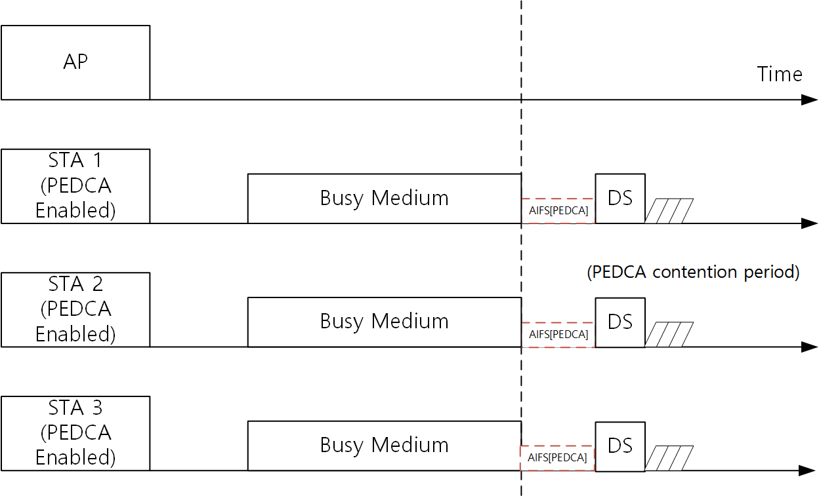
Background: PEDCA
A PEDCA control frames can be transmitted simultaneously from multiple STAs when after the medium is idle for TBD period.
After the PEDCA control frames are transmitted, PEDCA contention can be performed by the multiple STAs
When PEDCA contention is successfully performed, a low latency frame can be transmitted

Slide 4
NAV and frame exchange sequence end time mismatch problem
In an ideal case, a NAV end time and a real frame exchange sequence end time are same.
However, the discrepancy between the NAV end time and the real frame exchange sequence end time may occur.
In this case, unfairness may occur in PEDCA operation due to the discrepancy between the NAV end time and the real frame exchange sequence end time.

Slide 5
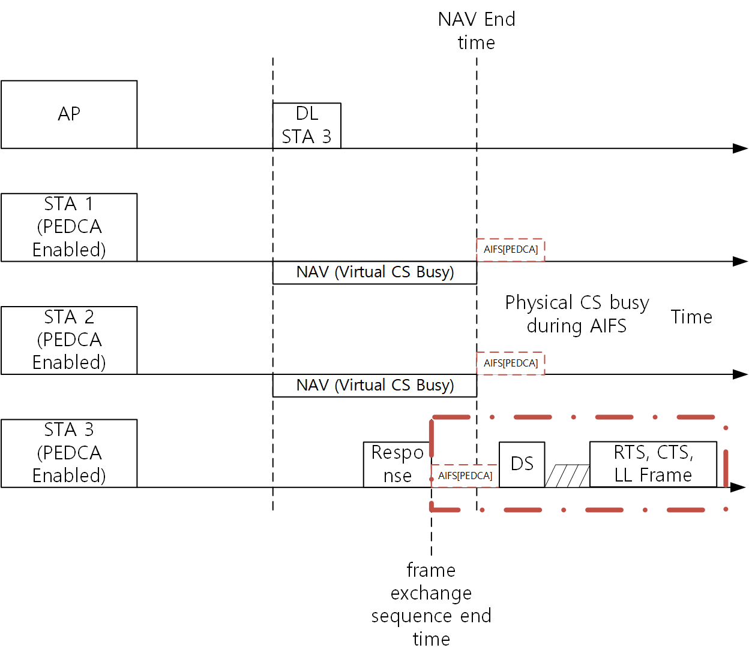
End time mismatch problem: NAV end time is longer than frame sequence end time
TXOP holder and responder does not set NAV (TXOP responder even does not set TXNAV)
STA 3: TXOP responder
If STA 3 detects medium as idle during AIFS time, it will transmit a PEDCA ctrl frame while another STAs are detecting medium as busy because of NAV.
STA 3 is the first STA to transmit the PEDCA ctrl frame, and it can start low latency frame exchange while another STAs cannot transmit the ctrl frame.
For fair operation, all STAs with low latency traffic should start the PEDCA ctrl frame transmission at the same time.

Slide 6
The mismatch problem
With the problem, PEDCA operation can be disrupted.
Specific STA can be prioritized by the mismatch.
In this case, another STAs which needs to transmit via PEDCA cannot contend for medium.
This leads to degraded fairness in PEDCA operation.

Slide 7
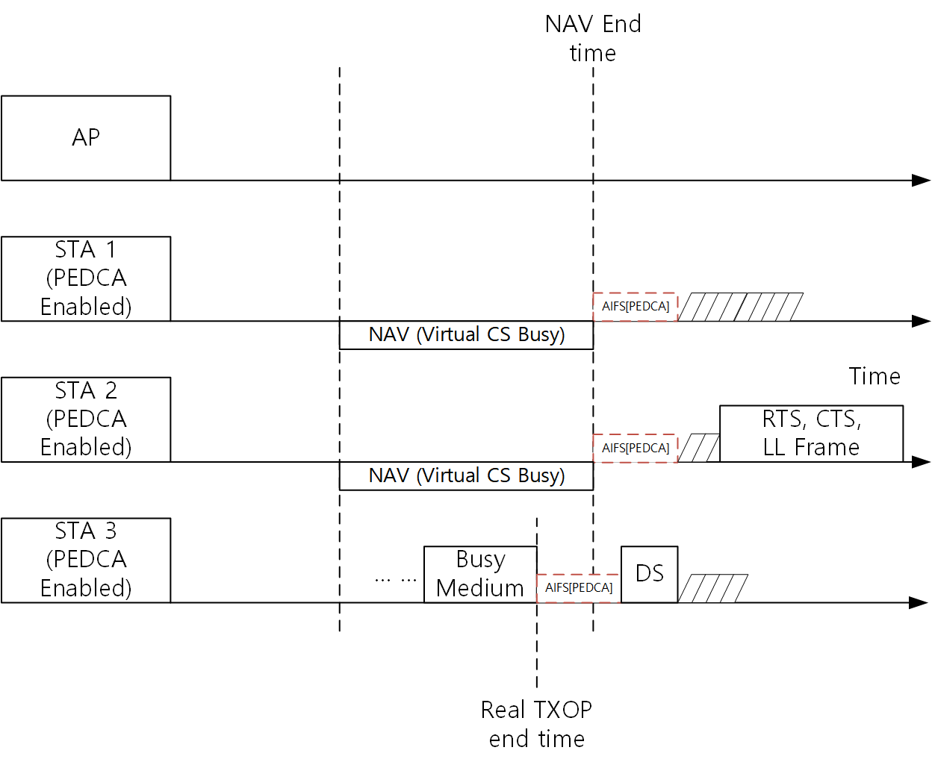
Possible approach for the mismatch problem
STAs using PEDCA can perform PEDCA contention based on other STA’s preceding PEDCA control frame
In this case, STAs using PEDCA can contend channel without giving priority to a specific STA (e.g., TXOP responder)

Slide 8
Conclusion
This submission proposed the NAV and frame exchange sequence end time mismatch problem in PEDCA
If the end time mismatch occurs, specific STA can perform PEDCA contention while another STAs cannot.
The unfairness will occur in PEDCA
This submission proposed the possible approach for the mismatch problem
STAs using PEDCA can perform PEDCA contention based on other STA’s preceding PEDCA control frame

Slide 9
Straw Poll #1
Do you agree that there is NAV and frame exchange sequence end time mismatch problem in PEDCA operation? (Related to submission 25/xxxxr0)
Y / N / A

Slide 10
References
[1] 24/1975r1, Detailed text proposal on HIP EDCA, Dmitry Akhmetov et al., https://mentor.ieee.org/802.11/dcn/24/11-24-1975-01-00bn-detailed-text-proposal-on-hip-edca.docx
[2] 24/2007r1, PDT-MAC-p-edca, Dmitry Akhmetov et al., https://mentor.ieee.org/802.11/dcn/24/11-24-2007-01-00bn-pdt-mac-p-edca.docx

