Slide 1
I-FCS inclusion in a Trigger frame
Date: 2025-01-04
Authors:
Name | Affiliations | Address | Phone | Email
Sindhu Verma | Broadcom |  |  | sindhu.verma@broadcom.com
Shubhodeep Adhikari |  |  |  | shubhodeep.adhikari@broadcom.com
Hang Su
Notes:
November 2012

Slide 2
Introduction
The following motions regarding intermediate FCS have been agreed in TGbn:
TGbn defines a way in 11bn to include in an initial control frame an intermediate FCS for UHR STA(s) that precedes padding and the FCS field.
If an initial control frame includes an intermediate FCS for UHR STA(s) that precedes padding and the FCS field, the intermediate FCS has the size of 32 bits.
The Intermediate FCS is used to provision various switching delays in UHR that are incurred for features like DPS, DSO, EMLSR, IDC processing, etc
Subsequently, there has been wide consensus that the intermediate FCS in a Trigger frame is inserted as a part of one or more the User Info fields

Slide 3
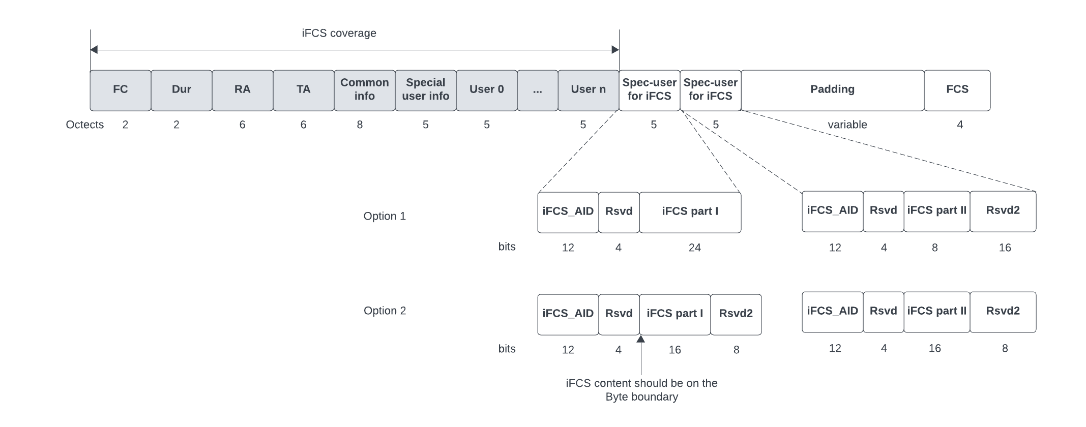
Method of I-FCS inclusion (1)
The diagram below shows our proposal on how I-FCS should be included in a Trigger frame as a part of its User Info fields
The I-FCS is included as a part of 2 contiguous User Info fields known as I-FCS User Info fields
The AID in these 2 I-FCS User Info fields should have the same special AID value (iFCS_AID)

Slide 4
Method of I-FCS inclusion (2)
The 32 bits of the actual I-FCS are distributed between the 2 I-FCS User Info fields as follows
Option 1: Keeping 24 bits in the 1st User Info and 8 bits in the second (Has more support per offline discussions)
Option 2: Keeping 16 bits in each User Info
The I-FCS bits in each I-FCS User Info field should start on the byte boundary i.e. they do not start immediately after the 12-bit AID in the I-FCS user info fields but after leaving a gap of 4 reserved bits.
The 4 reserved bits and other unused bits are set to “Do not care”
The I-FCS should cover all bytes from FC to the last valid user info before the I-FCS, but not including anything in the I-FCS user info fields or later. In other words, none of the bits including AID in the 2 I-FCS User Info fields or later should be included in the I-FCS calculation
The I-FCS User Info fields must occur after any User Infos that concern the candidate recipients of the Trigger frame which require inclusion of I-FCS. They can however be before User Info fields of for example, pre-UHR recipients.

Slide 5
Method of PN/MIC inclusion
Along the lines of the principle of inclusion of I-FCS in a Trigger frame, PN/MIC is also included by splitting the content into necessary number of consecutive User Info fields called SCF User Info fields
Each SCF User Infos has a 12-bit AID set to the same special AID value (SCF_AID) followed by 4 reserved bits (set to “Do not care”) followed by 3 bytes of PN/MIC content
8 consecutive SCF User Info fields are required: 2 for the 6-byte PN and 6 for the 16-byte MIC
The value of SCF_AID is unique and distinct from iFCS_AID
It can also be considered if the AIDs in the User Info fields that carry PN are different from the AIDs in the User Info fields that carry MIC

Slide 6
Straw Polls (1)
SP1: Do you agree that the I-FCS in a Trigger frame is included as part of 2 contiguous User Info fields known as I-FCS User Info fields?
SP2: Do you agree that the AID in these 2 I-FCS User Info fields have the same special AID12 value of 2009?
SP3: Do you agree that the 32 bits of the actual I-FCS are distributed between the 2 I-FCS User Info fields keeping 24 bits in first User Info and 8 bits in second User Info?
SP4: Do you agree that the I-FCS bits in each I-FCS User Info field start on the byte boundary after leaving a gap of 4 reserved bits after the AID12 field?

Slide 7
Straw Polls (2)
SP5: Do you agree that the input to the I-FCS computation covers all bytes from the Frame Control field up to and including the last User Info that precedes the I-FCS, but not including anything in the I-FCS User Info fields or later?
The input of the I-FCS does not cover any of the fields starting from the first IFCS User Info field
SP6: Do you agree that the I-FCS User Info fields appear after all User Info fields that are addressed to STAs that require the inclusion of I-FCS?

Slide 8
Straw Polls (3)
SP7: Do you agree that the PN and MIC in a Trigger frame are included in 8 contiguous dedicated User Info fields, and that the first 2 User Info fields carry the 6-bytes of the PN field in fragments of 3 bytes; and the following 6 User Info fields carry the 16-bytes of the MIC field in fragments of 3 bytes each, except for the last user info field that contains the last 1 byte of the MIC field
Within these dedicated User Info Fields, the 4 bits [B12-B15] after the AID12 field are reserved to align on the byte boundary followed by either 3 bytes of content [B16 to B39] or 1 byte of content [B16 B23]?

Slide 9
Reference
[1] IEEE P802.11be™/D7.0
[2] 11-24/0209r7 Specification Framework for TGbn
[3] 11-23/1873r0 Post-FCS MAC padding

