Slide 1
Indoor Enabled AP Signalling
Date: 2025-01-12
Authors:

Slide 2
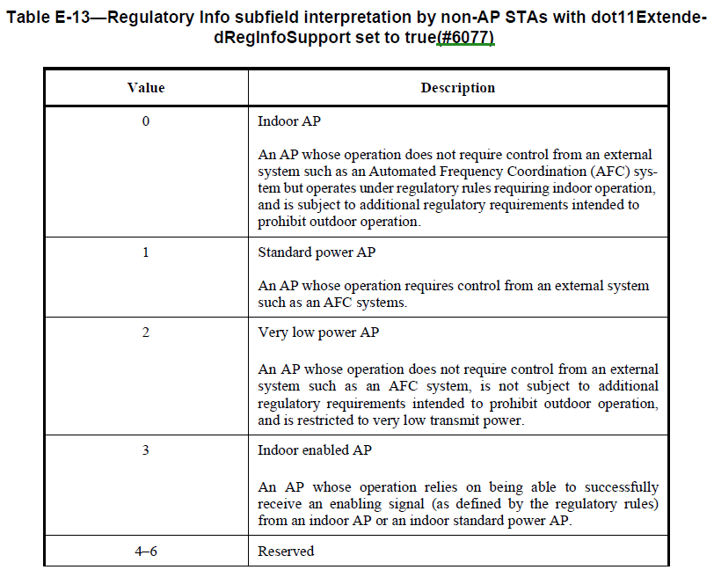
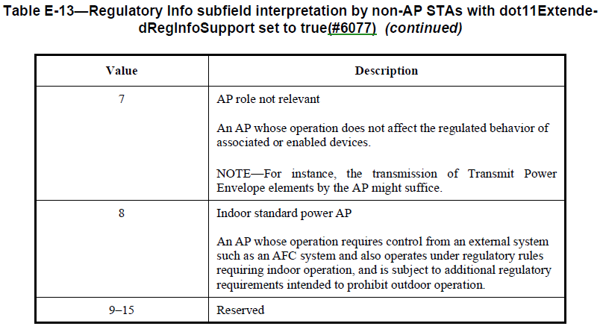
Background
In the 6 GHz band, Regulatory Info subfield (in the HE Operation element) is used to convey regulatory related information
E.g., used by non-AP STAs to determine information such as the allowed max. TX power
REVme D7.0 P5921

Slide 3
Background (2)
must Indoor AP (a.k.a. LPI AP) is permitted to operate in the 6 GHz band without having to check for incumbent systems using database lookup
E.g., Max. TX power
FCC : -1 dBm/MHz (non-AP STA)
Japan : 10 dBm/MHz
One of the requirements is that the AP must be an ‘indoor’ device
E.g., cannot have weather resistant enclosure, cannot operate on battery power, etc. in case of FCC
Client-to-Client (C2C) communication cannot benefit from the LPI rules as the client devices often do not meet the indoor requirement (e.g., battery operation)
Examples of C2C communication: Soft AP, P2P, etc.
Many regulatory bodies are enabling Very Lower Power (VLP) devices which is not subject to ‘indoor’ requirement, but at much lower max. TX power
FCC : -5 dBm/MHz
Japan : 1 dBm/MHz

Slide 4
Background (3)
Japan has enabled C2C communication in the 6GHz where if a device can hear an indoor AP, then the device may transmit using TX power level higher than that allowed by VLP regulations
E.g., a phone acting as a Soft AP may use 10 dBm/MHz TX power instead of 1 dBm/MHz (VLP) if the phone can hear another indoor AP (LPI AP or Indoor Standard Power AP)
C2C is under consideration in other regulatory bodies as well

Slide 5
Why Does an AP Need to Indicate C2C?
While Japan is the only country which currently allows C2C operation, US and other countries are also reviewing C2C
C2C regulations might differ between different regulatory regions, but there are largely three possibilities
Each end of the link can be enabled separately to use C2C power level
E.g., STA2 associated to AP1 could use C2C TX power if STA2 can hear another indoor AP3 independent of whether AP1 can also hear some indoor AP
Both ends of the link need to be enabled by indoor AP(s)
E.g., STA2 associated to AP1 may use C2C TX power only if both AP1 and STA2 can hear indoor AP(s), but not necessarily the same indoor AP(s)
Both end of the link need to be enabled by the same indoor AP
E.g., STA2 associated to AP1 may use C2C TX power only if both AP1 and STA2 can hear the same indoor AP3
#2 and #3 require APs to advertise that the AP is enabled by another indoor AP

Slide 6
Issue Observed in the Field: Devices using Linux Kernel Cannot Connect to C2C APs
IEEE 802.11 has designated Regulatory Info value “3” to allow an AP to announce that it is operating under the C2C regulations
Unfortunately, field tests show that APs w/ Regulatory Info = 3 are not included in the WLAN scan results in devices using Linux kernel
Not a vendor specific issue, but an issue in the Linux kernel
E.g., Android devices, laptops/PCs using Linux, IOT devices based on Linux

Slide 7
Devices using Linux Kernel Cannot Connect to C2C APs: Impact / Current Status
Because devices using Linux kernel cannot connect to C2C APs (huge interop issue), C2C APs have no other choice but to advertise themselves as a VLP AP
Even if the Linux kernel is ‘fixed’, C2C capable APs would not know when all Linux based devices in the field has received the kernel update
Hence, Regulatory Info = 3 (C2C) is unusable unfortunately
Suppose a non-AP STA2 is capable of C2C in regions where STA2 needs to know that the AP is also C2C enabled
But since C2C capable APs cannot advertise themselves as C2C APs due to the interop issue with Linux based devices, STA2 cannot use/benefit from C2C
Even if STA2 is not based on Linux kernel, STA2 would not be able to benefit from C2C

Slide 8
Proposed Solution – High Level
Spoof the AP regulatory type signaling such that
Legacy devices see the C2C AP as a VLP AP
Provide basic interoperability to legacy devices, albeit using lower TX power level
Updated STAs can understand that the AP is in fact a C2C AP
Hence, can make use of higher TX power level

Slide 9
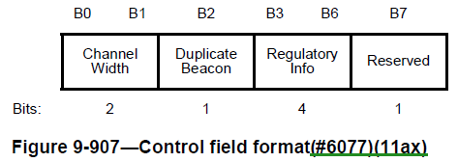
Proposed Solution – Option 1
Extend the Regulatory Info subfield in the HE Operation element to 5 bits
Use value “18” to designate an Indoor enabled AP
Regulatory Info subfield
Value | Description
0 | Indoor AP
1 | Standard power AP
2 | Very low power AP
3 | Indoor enabled AP (deprecated)
4 - 6 | Reserved
7 | AP role not relevant
8 | Indoor standard power AP
9 - 15 17 | Reserved
18 | Indoor enabled AP
19-31 | Reserved
Current
Proposed
B0
B1
B2
B3
B7
Channel width
Duplicate Beacon
Regulatory Info
Bits:
2
1
5

Slide 10
Proposed Solution – Option 1 (cont’d)
Legacy clients will see value 18 as value 2 (VLP)
Allows legacy devices to connect with C2C APs using VLP regulations
Updated clients will understand value 18 as C2C
Hence, benefit from the higher TX power allowed by C2C regulations
Deprecate value 3
Regulatory Info subfield
Value | Description
0 | Indoor AP
1 | Standard power AP
2 | Very low power AP
3 | Indoor enabled AP (deprecated)
4 - 6 | Reserved
7 | AP role not relevant
8 | Indoor standard power AP
9 - 15 17 | Reserved
18 | Indoor enabled AP
19-31 | Reserved

Slide 11
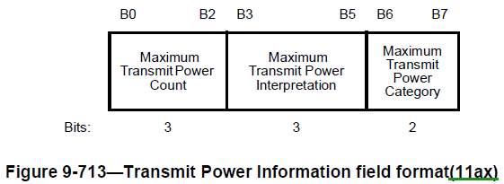
Proposed Solution – Option 2
No change to the Regulatory Info subfield
i.e., keep to the current 4 bits
Instead use the Transmit Power Envelope element to convey the C2C information
Transmit Power Envelope element currently has six Interpretation values

Slide 12
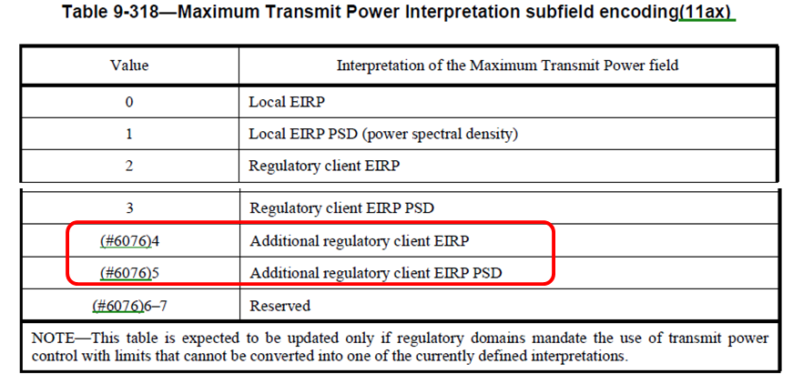
Proposed Solution – Option 2 (cont’d)
The “Additional regulatory client EIRP (PSD)” interpretation is currently used only when the Regulatory Info is Indoor standard power AP
Proposal is for Indoor enabled AP to
Use Regulatory Info value 2 (VLP)
Include TPE element with interpretation “Additional regulatory client EIRP (PSD)”
TX power level indicated corresponds to TX power allowed by C2C regulations
Non-AP STA would detect that the AP is using C2C regulations by the presence of the TPE elements with interpretation “Additional regulatory client EIRP (PSD)”
REVme D7.0 P5923

Slide 13
Summary
Current signaling for Indoor enabled (C2C) AP is unfortunately not compatible w/ significant number of legacy devices
Devices based in Linux do not include APs with Regulatory Info value equal to 3 in the WLAN scan results
We have proposed two options to enable Indoor enabled AP operation while keeping backwards compatibility to legacy devices

Slide 14
Straw poll
Which option do you prefer to fix the Indoor enabled AP signaling?
Option 1
Increase the Regulatory Info subfield to 5 bits, and use value 18 to indicate Indoor enabled AP
Option 2
Use Regulatory Info value 2 and include TPE element with interpretation “Additional regulatory…” to indicate Indoor enabled AP
NOTE – Regulatory Info value 3 to be deprecated

