Slide 1
BPE AP Discovery
Date: 2024-12-06
Authors:

Slide 2
Abstract
This submission is related to discovery of the BSS Privacy Enhanced APs.
Currently 802.11bi assumes that BPE AP parameters, required to authenticate and associate with the BPE AP, are preshared to the BPE non-AP STA. For instance, RSNE and RSNXE are such preshared parameters.
This submission introduces PASN TK protected AP capabilities and operations elements obtaining signaling that allows AP to securely provide its parameters to a BPE STA. The PASN signaling allows AP to check whether the requesting STA is allowed to receive the AP information.
Normative text for TK protected BPE AP scanning is provided in submission 11-25-135r0.

Slide 3
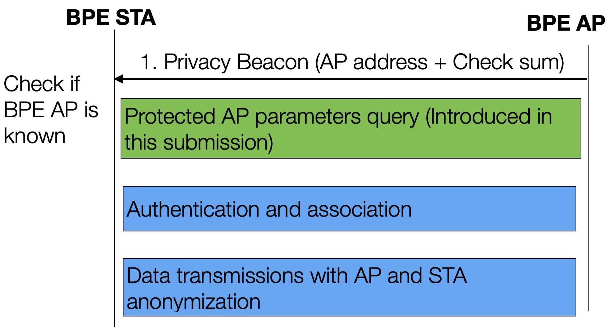
Background: BPE AP Discovery
BSS Privacy Enhancements protect AP and STA privacy
The legacy STAs are not able to associate with BPE AP
All transmitted data and management frames are encrypted in BPE
Currently:
BPE STAs are preconfigured with the AP parameters
Only preconfigured STAs may detect the AP from the Privacy Beacons
No AP parameters discovery defined
The BPE AP and associated STA anonymize their addresses periodically

Slide 4
Background: Minimum Set of Parameters for Authentication
STA needs to set the correct RSNE and RSNXE parameters:
RSNE: Individual cipher and AKM needs to be supported by AP
RSNE: Group cipher (GTK) and group integrity cipher (IGTK) of the AP
RSNXE: STA needs to support the same settings as the AP
Currently, RSNE and RSNXE parameters are preshared to the STA
Presharing works for mobile APs, because typically mobile AP uses the same RSNE settings
STA obtains the complete set of BPE AP parameters in association
Even if the STA uses poor parameters, the STA may associate again with the parameter values optimized for the mobile AP
STA may test of the RSNE and RSNXE configurations one-by-one to find a suitable setting (brute force approach)
This has high overhead and complexity
BPE AP may consider this as security attack and stop responding to the STA

Slide 5
High Level Proposal: PASN Protected AP Discovery
PASN allows a STA to create Temporary Key (TK) to protect management frames transmitted before association
TK could be used to protect active scanning
PASN creates a temporary key (TK) with or w/o authenticating the STA
PMKID (pointer to previous association) may be added to identify/authenticate the STA that requests key setup
If the PMKID is not added, the AP does not identify the STA, just a TK is created

Slide 6
Challenge 1: STA Identifier in PASN Protected AP Discovery
Challenge: The PMKID is created in the first authentication
STAs may have not authenticated, so no PMKID available
The PMKID identifies the STA / authentication. A scanning STA may not desire to be identified to protect its privacy

Slide 7
Proposal1: STA-ID to identify STA PASN
The STA-ID indicates whether the transmitter is allowed to obtain AP parameters
AP verifies the STA-ID with a single HASH calculation
PASN setup is continued only, if the STA-ID is verified
STA-ID value is for one-time use:
The AP OTA address changes per epoch
STA shall change its MAC address for each PASN protected active scanning

Slide 8
Challenge2: Overheads of PASN Protected AP Info Query
PASN Setup is not optimized for AP parameters query (5 messages)
A non-protected active scanning consumes only 2 messages
A non-AP STA is available during the complete protected active scanning
STA cannot scan multiple channels in parallel
STA power consumption is increased
The PASN protected scanning should be optimized to allow faster and more flexible scanning

Slide 9
Proposal 2: Optimized Protected Active Scanning
PASN1 frame signals:
Whether STA requests AP parameters
TK Adoption Delay of the STA
AP should send the PASN2 frame immediately:
AP may include its TK Adoption Delay
TK protected Management frames may be transmitted after the longest TK Adoption Delay
AP parameters are sent, if requested by PASN1 frame
Benefits:
Faster protected active scanning is faster
Less overhead, PASN3 frame may be skipped
STA may scan other APs or save power (radio off / doze state) during the TK Adoption Delay

Slide 10
Benefits of the TK Protected AP Information Query
Only the identification key and master key may be preshared to a BPE STA
STA memory consumption for preshared parameters is reduced
BPE AP may verify whether the scanning STA is authorized to get the BSS parameters
The BPE AP parameters do not leak to an attacker
The scanning STA privacy is improved
Scan request parameters do not leak to third devices
BPE STA may scan all AP parameters
RSNE and RSNXE mismatch does not prevent authentication
STA can optimize association: STA knows available links and AP parameters
The AP parameters are integrity protected
The requesting STA may verify the parameters integrity
The protected scanning optimizations reduce the number of transmitted frames and scanning delays

