Slide 1
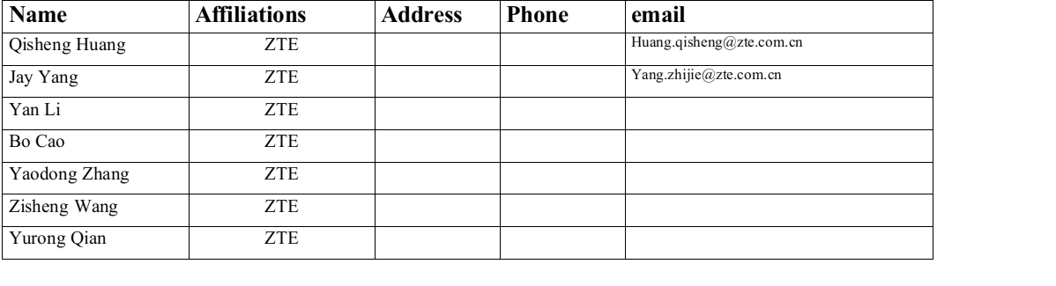
Defer Signal Design for High-Priority Channel Access

Slide 2
Background
Limited Protection for Low Latency (LL) Traffic in Current Standards: The channel access mechanism described in existing Wi-Fi standards struggles to ensure the quality of low-latency traffic, particularly when multiple devices within the same BSS compete for the medium simultaneously.
Need for Enhanced Mechanisms in 11bn: Members have expressed the desire to introduce new contention mechanisms in 11bn, building upon existing protocols, to better support low-latency traffic on 11bn devices.

Slide 3
Recap of 11bn SFD
3.13 Enhanced EDCA
• TGbn improves EDCA to reduce tail access delay of Low Latency traffic in multi-BSS dense scenarios in presence of best effort traffic
• The solution to improve EDCA is distributed
• The impact on legacy device has to be balanced
• Low Latency traffic is treated as AC_VO traffic. Other cases are TBD
[Motion #123, [1] and [188- 194]]
Reference documents:[11-24/0171r26,11-24/0209r7].
Notes:
To address the previous problems, enhanced EDCA is introduced. Relative descripstions have already been added to TGbn SFD

Slide 4
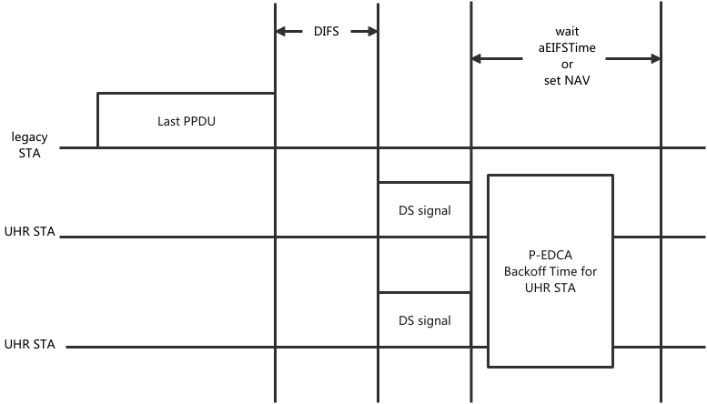
Recap of Previous Proposals
A STA with Low Latency traffic may be allowed, based on TBD conditions, to send a Defer Signal (e.g. CTS frame or RTS) to start a protected short contention for pending LL data.
The TBD frame has the Duration/ID field set to TBD value, Multiple HIP EDCA eligible STAs may transmit TBD frame at the same time.
Figure refered from documents: 11-24/1144r1,11-24/2126r3
Notes:
One possible design in prevoius work to reliaze enhance EDCA is allowing 11bn STAs with LL service to send defer signal a DIFS time after listening to defer the channel access of other STAs which will then ensure the high priority ot their channel access .

Slide 5
The problem of DS signal collision
Device-Specific Variations in L-SIG Fields and Collision Risk
  the L-SIG fields of DS frames differ between devices, particularly in the Rate and Length sections. These variations increase the likelihood of collisions during transmission, especially in environments with multiple devices.
EIFS Mode Entry Conditions and Potential Collisions
  The EIFS mode is triggered by FCS check failures, which depends on successful reception of the physical layer preamble. However, unrestricted DS signal-induced collisions may occur during the demodulation phase of the physical layer preamble
Impact on Priority EDCA
  the L-SIG fields of DS frames differ between devices, particularly in the Rate and Length sections. These variations increase the likelihood of collisions during transmission, especially in environments with multiple devices.

Slide 6
The problem of DS signal collision
Limitations of Using RTS or CTS Frames as DS Signals
  the general RTS and CTS frames in current protocols cannot avoid DS signal collisions. Variations in the TA field and Duration field across RTS frames, as well as the Duration field in CTS frames, lead to high probabilities of collisions and FCS check failures.
Impact of Collisions on NAV Setting:
  Differences in field values across RTS and CTS frames from different STAs increase the likelihood of collisions, which result in FCS check failures. This ultimately prevents NAV values from being successfully set, reducing the effectiveness of the protocol in managing high priority channel access.

Slide 7
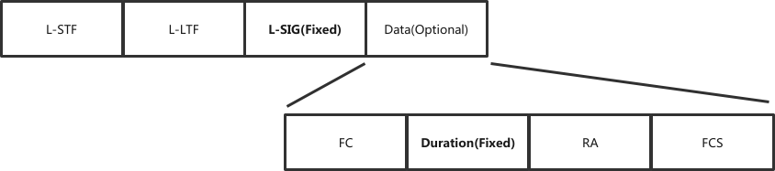
Motivation
Design a Unified DS Signal to Address Air Interface Collisions
  The PHY preamble of DS signal is identical to Non-HT frames.
  The data field of DS signal could be structured like a CTS frame

Slide 8
Considerations for Details
Main idea:
Preamble Structure of DS Frames: The preamble structure of any DS frame is identical to that of Non-HT frames, and the L-SIG fields in the preamble contain the same content.
Data Field Flexibility: DS frames may either exclude a data field or, if included, structure it identically to CTS (Clear to Send) frames.
Special Characteristics of DS Frames' Duration Field: Unlike regular CTS frames, the Duration field in DS frames is fixed and directly relates to the backoff window used for P-EDCA contention.The value of the backoff window is either set to a default or announced by the AP (Access Point).

Slide 9
Preamble design of DS signal
Consistency in L-SIG Fields of DS Frames:
  DS frames are transmitted at a fixed rate, either default or announced by the AP. Consequently, the Rate value in the L-SIG field of DS frames remains consistent.
  Since the frame length is fixed (DS frames do not include a data field), the Length value in the L-SIG field is also a fixed value when the transmission rate is determined.
Handling of DS Frames Without Data Fields:
  For DS frames that exclude a data field, the L-SIG Length value is still calculated based on a hypothetical data length of 14 bytes (Frame Control: 2 Bytes, Duration: 2 Bytes, Receiver Address: 6 Bytes, FCS: 4 Bytes). This ensures uniformity in the physical preamble of all DS frames, allowing legacy devices to demodulate and parse the preamble successfully. However, they cannot decode the data portion, requiring them to wait for at least aEIFSTime before attempting to access the channel again, as per protocol rules.

Slide 10
Frame body design of DS signal
Structure and Function of the DS Frame Data Section:
  When DS frames include a data section, the Frame Control (FC) value is identical to that of a standard CTS frame. The Duration field is either generated based on the Contention Window (CW) value of P-EDCA using a default method or announced by the AP. Unlike standard CTS frames, the Duration field in DS frames does not indicate the duration of subsequent data frames. Instead, it reserves time for P-EDCA backoff contention, during which legacy devices are prevented from accessing the channel.
NAV Setting for Legacy Devices:
  The design ensures that upon receiving a DS frame, legacy devices successfully set their NAV (Network Allocation Vector), blocking their access to the channel for the reserved time.
RA Field Configuration:
  The Receiver Address (RA) field in the DS frame can take a specific default value, the MAC address of the AP associated with the transmitting STA, or a value announced by the AP. This flexibility allows for better compatibility and adaptability in different network scenarios.
$$Duration = aSlotTime * (P_EDCA CW + 1)$$

Slide 11
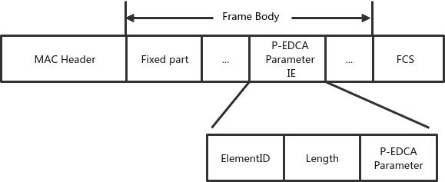
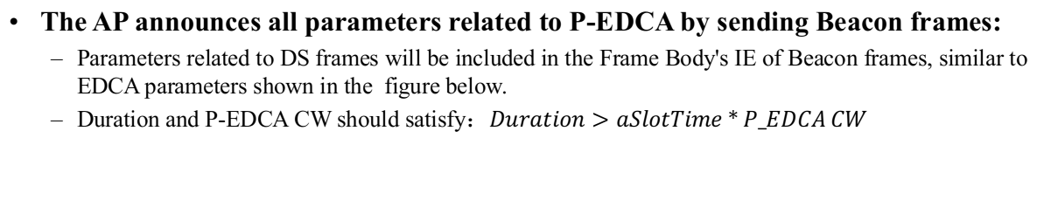
Announcement of Relevant Paramters (Opt)
The AP announces all parameters related to P-EDCA by sending Beacon frames:
  Parameters related to DS frames will be included in the Frame Body's IE of Beacon frames, similar to EDCA parameters shown in the figure below.
  Duration and P-EDCA CW should satisfy：$Duration>aSlotTime*P_EDCA CW$
P-EDCA parameter content | Description
DS Type | Specify whether the allowed DS frame includes a data field.
Rate | Specify Rate of DS frame
Duration | Specify duration value in data field of DS.
About RA：
In the default mode, the RA field is set to the MAC address of the associated AP.
In the multi-AP collaboration mode, the RA field is set to the broadcast address.

Slide 12
Summary
Device-Specific Variations in sending DS signals cause Collision Risk and impact on high priority EDCA mechanism。
Therefore a novel 802.11 frame has been designed for 11bn new EDCA mechanism (P-EDCA) ：
  Featuring a fixed L-SIG field and either no data field or a specially designed data field with a fixed Duration value, ensuring legacy devices silence for the required time (EIFS or NAV) and enabling the effective operation of the new EDCA mechanism, with DS frame parameters announced in Beacon frames.
Design of DS signal:

Slide 13
Staw Poll
Do you agree to standardize a unified Defer Signal to address potential air interface collisions?
  The preamble of Defer Signal is identical to Non-HT frames.
  The data field could be structured like a CTS frame.
  The Defer Signal is sent with same rate and designed to ensure the proper functioning of the P-EDCA mechanism.

Slide 14
THANK YOU ☺

Slide 15
Reference
[1]802.11bn PAR

