Slide 1
Robust Beamforming Nulling for CBF – follow up
January 2025
Date: 2025-01-12
Authors:
Name | Affiliations | Address | Phone | email
Ken Tanaka | Sony Corporation |  |  | Ken.Tanaka2@sony.com
Daniel Verenzuela
Dana Ciochina
Thomas Handte |  |  |  | Thomas.Handte@sony.com
Yudai Morikawa
Ryuichi Hirata
Kosuke Aio
Shigeru Sugaya
Yusuke Tanaka |  |  |  | Yusuke.YT.Tanaka@sony.com
Qing Xia
Notes:
September 2012
Hello everyone.
This is Ken Tanaka from Sony, document number is 1463, and I’ll talk about robust beamforming nulling for CBF

Slide 2
Introduction
Concurrent Transmission from multiple APs (CBF) has been discussed
  It is envisioned to enhance reliability by suppressing interference
  Coordinated beamforming nulling is beneficial for high throughput & reliability applications such as VR
  Nulling to OBSS STAs is also one of key features for CBF
In 24/1463r1, robust beamforming nulling is introduced, and its performance has been investigated under time-varying channel.
  Robust beamforming nulling is essentially nulling to several channel vectors of different time with sacrificing Bfer’s spatial DoFs
  Interference can be mitigated by approx. 10dB by leveraging CSIs of different time, which are correlated with current channel vector.
In this contribution, we suggest potential issues with the robust beamforming nulling and candidate solution addressing the issue.
Notes:
Concurrent transmission from multiple APs has been discussed.
In concurrent transmission, essentially beamforming nulling is the key feature.
Beamforming nulling can have two variants, and let me call Tx nulling and Rx nulling in this time.
Tx nulling is essentially design of a precoder such that mutual interference is reduced. In other words, AP stees null to unintended receiving STAs.
On the other hand, Rx Nulling is a design of MIMO equalizer to reduce interference. In other words, receivers steer null to interferer AP.

Slide 3
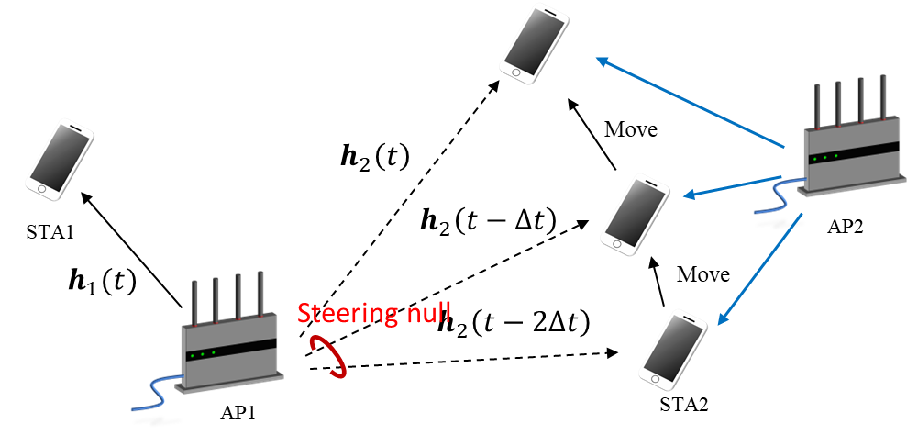





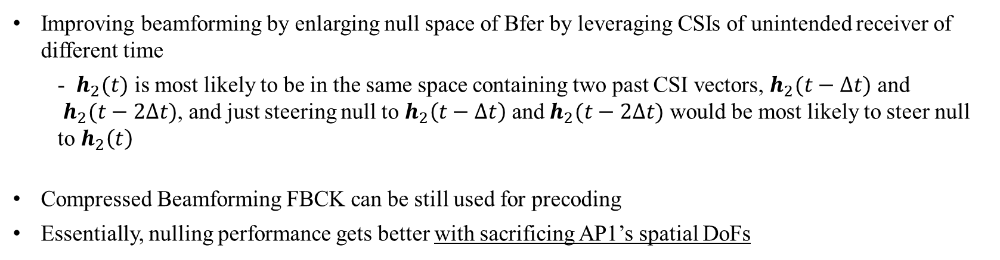

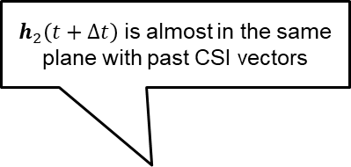
Recap: Robust beamforming nulling^{[15]} (1/2)
$h_{2}\left(t+Δt\right)$is almost in the same plane with past CSI vectors
$$h_{1}(t)w_{1}$$
$$h_{2}\left(t\right)$$
$$h_{2}\left(t−Δt\right)$$
$$≅k\vec{u}$$
$$h_{2}\left(t−2Δt\right)$$
$$\vec{u}$$
Improving beamforming by enlarging null space of Bfer by leveraging CSIs of unintended receiver of different time
  - $h_{2}(t)$ is most likely to be in the same space containing two past CSI vectors, $h_{2}(t−Δt)$ and
  $h_{2}(t−2Δt)$, and just steering null to $h_{2}\left(t−Δt\right)$ and $h_{2}(t−2Δt)$ would be most likely to steer null to $h_{2}\left(t\right)$
Compressed Beamforming FBCK can be still used for precoding
Essentially, nulling performance gets better with sacrificing AP1’s spatial DoFs
Notes:
Concurrent transmission from multiple APs has been discussed.
In concurrent transmission, essentially beamforming nulling is the key feature.
Beamforming nulling can have two variants, and let me call Tx nulling and Rx nulling in this time.
Tx nulling is essentially design of a precoder such that mutual interference is reduced. In other words, AP stees null to unintended receiving STAs.
On the other hand, Rx Nulling is a design of MIMO equalizer to reduce interference. In other words, receivers steer null to interferer AP.

Slide 4
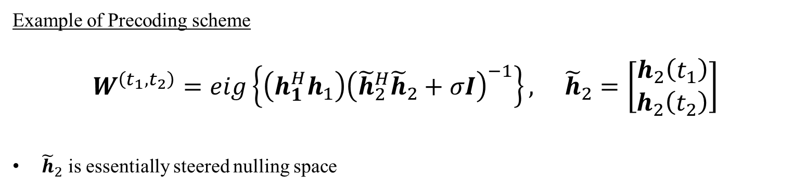
Recap: Robust beamforming nulling ^{[15]} (2/2)
$h_{2}\left(t+Δt\right)$is almost in the same plane with past CSI vectors
$$h_{1}(t)w_{1}$$
$$h_{2}\left(t\right)$$
$$h_{2}\left(t−Δt\right)$$
$$≅k\vec{u}$$
$$h_{2}\left(t−2Δt\right)$$
$$\vec{u}$$
Example of Precoding scheme
$$W^{\left(t_{1},t_{2}\right)}=eig\left\{\left(h_{1}^{H}h_{1}\right){\left({\tilde{h}}_{2}^{H}{\tilde{h}}_{2}+σI\right)}^{−1}\right\}, {\tilde{h}}_{2}=\left[\begin{aligned}h_{2}\left(t_{1}\right) \\ h_{2}\left(t_{2}\right)\end{aligned}\right]$$
${\tilde{h}}_{2}$ is essentially steered nulling space
$t_{1}:$latest time of sounding feedback, $t_{2}:$ second latest time of sounding feedback
Notes:
Concurrent transmission from multiple APs has been discussed.
In concurrent transmission, essentially beamforming nulling is the key feature.
Beamforming nulling can have two variants, and let me call Tx nulling and Rx nulling in this time.
Tx nulling is essentially design of a precoder such that mutual interference is reduced. In other words, AP stees null to unintended receiving STAs.
On the other hand, Rx Nulling is a design of MIMO equalizer to reduce interference. In other words, receivers steer null to interferer AP.

Slide 5
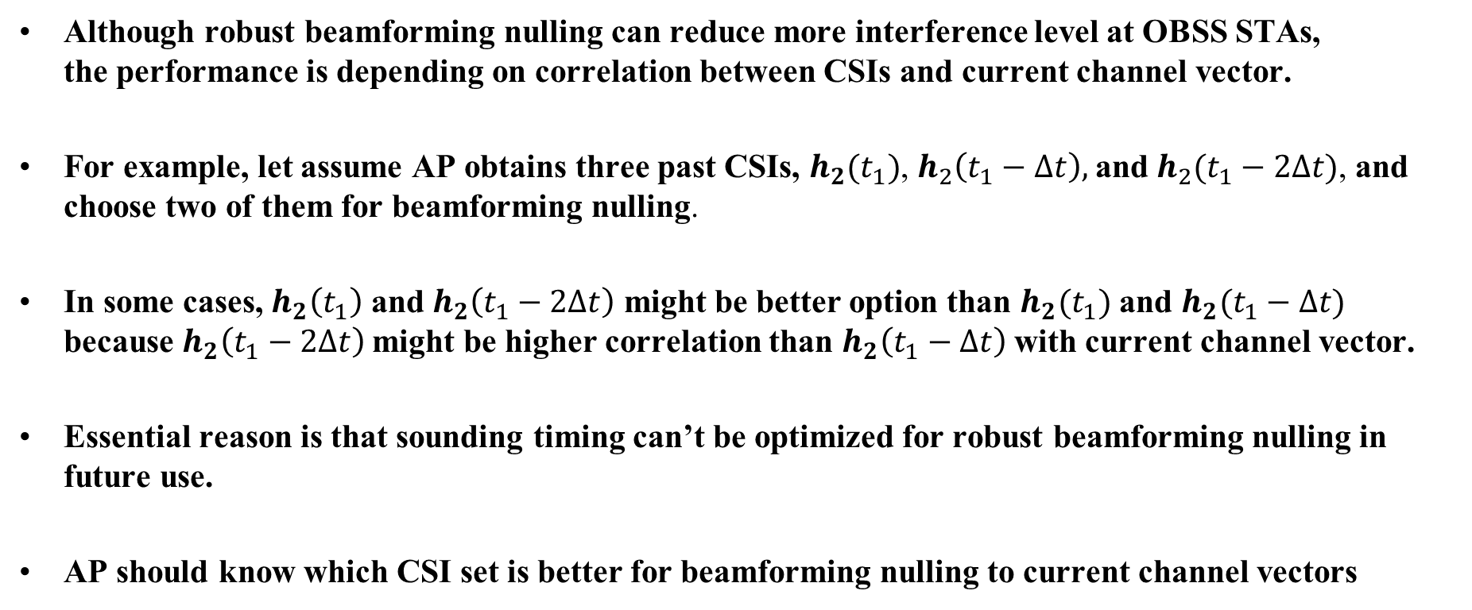
Issue with the robust beamforming nulling
Although robust beamforming nulling can reduce more interference level at OBSS STAs,
the performance is depending on correlation between CSIs and current channel vector.
For example, let assume AP obtains three past CSIs, $h_{2}(t_{1})$, $h_{2}\left(t_{1}−Δt\right),$and $h_{2}(t_{1}−2Δt)$, and choose two of them for beamforming nulling.
In some cases, $h_{2}\left(t_{1}\right)$ and $h_{2}\left(t_{1}−2Δt\right)$ might be better option than $h_{2}(t_{1})$ and $h_{2}(t_{1}−Δt)$ because $h_{2}\left(t_{1}−2Δt\right)$might be higher correlation than $h_{2}\left(t_{1}−Δt\right)$ with current channel vector.
Essential reason is that sounding timing can’t be optimized for robust beamforming nulling in future use.
AP should know which CSI set is better for beamforming nulling to current channel vectors

Slide 6
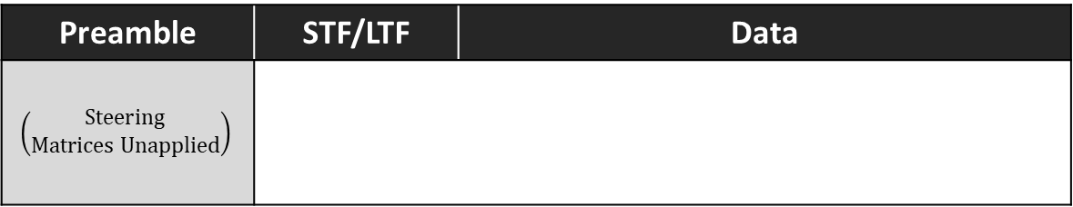



Subcarrier Allocation to Steering Matrices from different CSI set
To obtain better CSI set, frequent sounding is a straight-forward approach, but suffering from additional overhead.
To minimize the overhead, it would be better that AP sends PPDU where different subcarrier groups are allocated to steering matrices derived from different CSI set.
  More subcarriers can be allocated to more promising steering matrices from CSI set
This enables STA to estimate interference level from OBSS AP’s steering matrices derived from different CSI set, while receiving data in CBF.
Example of using three different CSI sets
PPDU
Preamble | STF/LTF | Data
$$\left(\begin{aligned}Steering \\ Matrices Unapplied\end{aligned}\right)$$
$$W^{(t_{1},t_{2})}$$
subcarrier
$$W^{(t_{1},t_{3})}$$
$$⋮$$
$$W^{(t_{2},t_{3})}$$

Slide 7

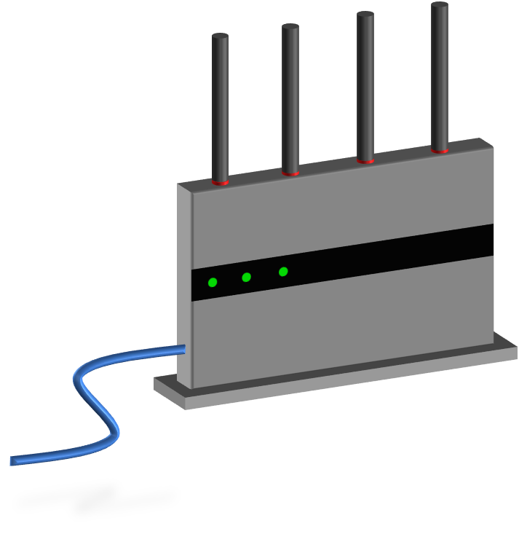
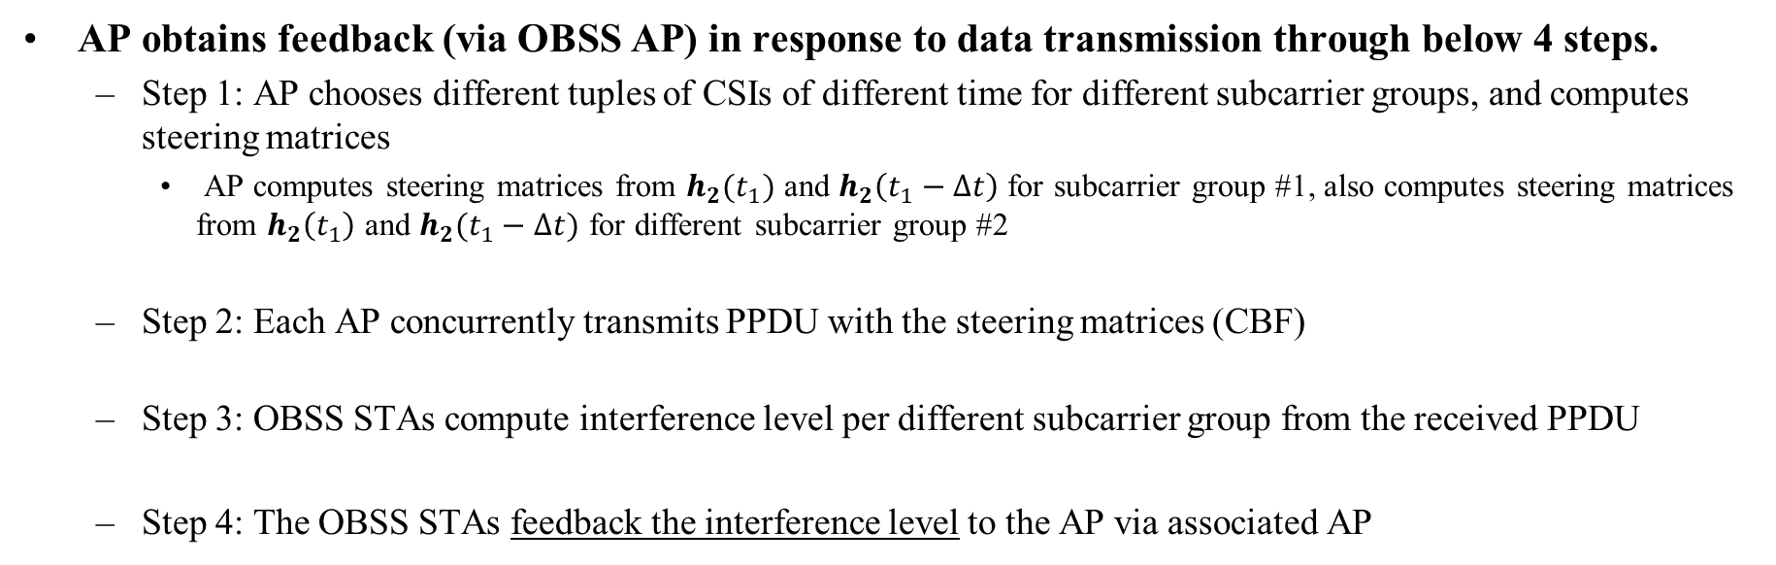
Candidate Solution (1/2)
AP obtains feedback (via OBSS AP) in response to data transmission through below 4 steps.
  Step 1: AP chooses different tuples of CSIs of different time for different subcarrier groups, and computes steering matrices
    AP computes steering matrices from $h_{2}(t_{1})$ and $h_{2}\left(t_{1}−Δt\right)$ for subcarrier group #1, also computes steering matrices from $h_{2}\left(t_{1}\right)$ and $h_{2}(t_{1}−Δt)$ for different subcarrier group #2
  Step 2: Each AP concurrently transmits PPDU with the steering matrices (CBF)
  Step 3: OBSS STAs compute interference level per different subcarrier group from the received PPDU
  Step 4: The OBSS STAs feedback the interference level to the AP via associated AP
Example of using two different CSI sets
S2 (null)
STA2
(Steered null)
AP1
Using the latest and 1st past CSI
S2
Using the latest and 2nd past CSI
STA1
(Intended Receiver)
freq

Slide 8
Candidate Solution (2/2)
During concurrent transmission, STAs compute interference level
  Additional frame might be needed to indicate which subcarrier groups are allocated to steering matrices using the same past CSIs.
  In PSDU, different subcarrier groups are allocated steering matrices from different CSIs.
  FBCK informs interference level per different subcarrier group like ‘CQI report field,’ which is smaller information than CSI FBCK
Additional frame and/or procedure may be needed
Interference FBCK
to AP1
Concurrent Transmission (CBF)
TXOP Sharing
Robust Beamforming
Nulling at AP1
Trigger
Data
TXS-MU-RTS
AP1
Data
REQ
FBCK
AP2
Ack
(+FBCK)
STA1
assoc’d AP1
Delayed Ack
+ FBCK
STA2
assoc’d AP2

Slide 9
Summary
In this contribution, we suggest potential issues with robust beamforming nulling.
  Essentially null space derived from latest past CSIs is not always optimized to current channel vector
Suggest subcarrier and steering matrices allocation to address the issue.
  Different subcarrier groups are allocated to steering matrices derived from CSIs of different time
  Determination way of which STAs to be nulled with robust beamforming nulling is TBD
It might be beneficial for beamforming nulling in CBF that non-AP STA can feedback OBSS AP interference level per different subcarrier groups.
  The feedback way is TBD. It might be sent directly or via associated AP.

Slide 10
References
[1] 22/1821r1, ‘System Level Simulation of Co-BF and Joint Tx’
[2] 19/1212r2, ‘Performance of Coordinated Null Steering in 802.11be’
[3] 24/0012r0, ‘Coordinated Spatial Nulling (C-SN) Simulations’
[4] 23/1868r2, ‘Coordinated Spatial Reuse Design’
[5] 22/1895r0, ‘Thoughts on M-AP Coordination Principles’
[6] 22/1899r0, ‘Multi-AP Operation for Low Latency Traffic Delivery – Follow up’
[7] 23/1871r2, ‘M-AP Coordinated Transmission frame work’
[8] 24/0072r0, ‘MAP channel access procedure’
[9] 24/0011r0, ‘Coordinated Spatial Nulling (C-SN) Concept’
[10] 19/0445, ‘Nulling and coordinated beamforming’
[11] 23/1193, ‘Nulling Performance of Coordinated Beamforming’
[12] 22/1649, ‘MIMO Interference Suppression for enhanced reliability’
[13] 24/0156r0, ‘Minutes 802.11bn PHY ad hoc – Jan Interim meetings’
[14] Mirette Sadek, et al., ‘A Leakage-Based Precoding Scheme for Downlink Multi-User MIMO Channels,’ IEEE Trans. on Wireless Commun., May 2007
[15] Tatsuhiko Iwakuni, et al., ‘Inter-user interference suppression in time varying channel with null-space expansion for multiuser massive MIMO,’ 2015 IEEE PIMRC, Aug. 2015
[16] 23/1998r0, ‘Zero-MUI Coordinated Beamforming’
[17] 24/1542r5, ‘Sounding Schemes for Coordinated Beamforming’

Slide 11
Straw Poll #1
Do you agree to support the following feature for CBF?
  At least one AP may allocate two or more different subcarrier groups to steering matrices by using CSIs of different time
- Y/N/A

Slide 12
Straw Poll #2
Do you agree to support the following feature for CBF?
  At least one non-AP STA may send feedback of interference levels for two or more different subcarrier groups, in response to OBSS AP’s transmission
  Note:
  Procedure of the feedback is TBD.
  Determination way of the subcarrier groups is TBD.
- Y/N/A

